Slide 1
Introduction to Statistics Part 2
January 18, 2018

Slide 2
Course Outline
Intro to Stats part 1 review
Significance
Correlation
Regression
Cluster analysis http://www.listendata.com/2016/01/cluster-analysis-with-r.html

Slide 3
Intro to Statistics Part 1 Review
What is statistics
Major definitions
Exploratory analysis
Descriptive statistics
Inferential statistics
Probability and statistics

Slide 4
Statistical Significance
Be careful about results of your statistic analysis
Statistics isn’t an exact science, think of it as finely tuned guesswork
The statistical significance let’s you assess how good your “guess” is
Usually is denoted as α (“alpha”)
Alpha level is largely arbitrary
Depends on an industry
If analysis satisfies industry-accepted alpha level, your “guess” is good

Slide 5
Probability in Statistics
Statistical analysis makes certain claims about the data
Statistics uses probability math to determine significance of the results
Significance is level of probability considered to be “good enough”
In probability speak the claim about the data is Hypothesis
P-Value (short for probability):
A measure of the strength of evidence against the hypothesis
The smaller the p-value, the greater is the evidence against the hypothesis

Slide 6
What is Probability
A branch of math calculating likelihood of a given event
Expressed as a number between 1 and 0
1 for certainty
0 for impossibility
In a simple case of two discrete events (e.g. coin toss) the probability is
P(a) = N(a) / [N(a) + N(b)
N is number of events
Important: events (a) and (b) are independent, either (a) or (b)
For large number of events we use mass probability function
In cases with continuous events/variables we use probability density function

Slide 7
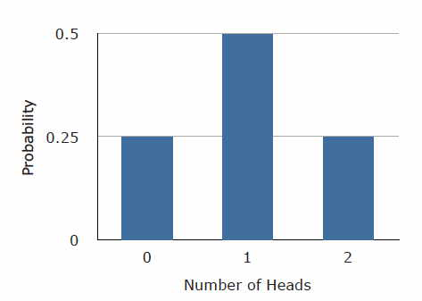
Two-coin Toss Example Binomial Distribution
Outcome | First Flip | Second Flip
1 | Heads | Heads
2 | Heads | Tails
3 | Tails | Heads
4 | Tails | Tails
Number of Heads | Probability
0 | 1/4
1 | 1/2
2 | 1/4
Note: if you replace Probability with Frequency, you will get histogram of a two-coin test

Slide 8
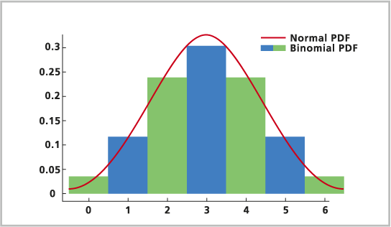
Binomial and Normal Distributions
For large number of events (i.e. from discrete to continuous) binomial becomes normal
Binomial Distribution is Mass Probability Function
Normal Distribution is Probability Density Function

Slide 9
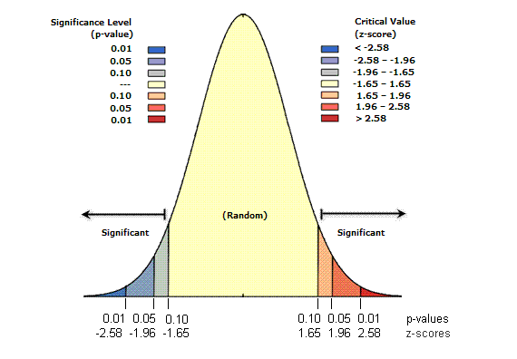
What is P-value

Slide 10
Hypothesis Testing
The claim on trial is called Null Hypothesis
Null (“non existing”) Hypothesis H₀, e.g.:
no significant difference between two data samples
To determine the significance the P-value is compared to an α level
Rough guideline:
P-value < 0.01 - very strong evidence against H₀
0.01 < P-value < 0.05 – strong evidence against H₀
0.05 < P-value < 0.1 – weak evidence against H₀
P-value > 0.1 – little or no evidence against H₀

Slide 11
Hypothesis Testing Example
Null Hypothesis: leaves of plants grown in a shadow are different from leaves of same plants in the sun
Leaves in a shadow, length
c(0,1,3,4,6,11,11,6,5,2,1)
Leaves in the sun, length
c(3,3,7,11,9,7,5,3,1,0,0)
Evaluate with descriptive statistics
> sun = c(0,1,3,4,6,11,11,6,5,2,1)
> shadow = c(3,3,7,11,9,7,5,3,1,0,0)
> mean(sun)
[1] 4.545455
> mean(shadow)
[1] 4.454545
> sd(sun)
[1] 3.777926
> sd(shadow)
[1] 3.670521

Slide 12
Hypothesis Testing w/ T-test
P-value >> 0.1, the null hypothesis is rejected
T.test
> sun = c(0,1,3,4,6,11,11,6,5,2,1)
> shadow = c(3,3,7,11,9,7,5,3,1,0,0)
> t.test(sun,shadow)
Welch Two Sample t-test
data: sun and shadow
t = 0.057241, df = 19.983, p-value = 0.9549
alternative hypothesis: true difference in means is not equal to 0
95 percent confidence interval:
-3.222152 3.403970
sample estimates:
mean of x mean of y
4.545455 4.454545

Slide 13
Hypothesis Testing Based on Descriptive Statistics
T.test
One sample t.test: t = (m−μ)/S/√n
where m is mean, μ is theoretical mean, S is sum of squares, and n is number of samples
Independent two-sample t.test: t = (m_{A}−m_{B})/√(S²/n_{A}+S²/n_{B})
Paired t.test: similar to one sample where one of the samples serves as theoretical
Z.test
One sample z.test: z = (x – μ) / σ, where σ is standard deviation
T Vs. Z: use Z if you know standard deviation
T- and Z- tests compare means (“normalized” by variances)
Use ANOVA to compare variances

Slide 14
Hypothesis Testing Based on Inferential Statistics
Prime inferential method is Correlation
T/Z tests Vs. Correlation
Descriptive: can compare measurements in same units
Inferential: can compare measurements in same and in different units
Cannot use correlation when the data is not “ordered”, the samples are not “tied” to each other, e.g. you can correlate width and length of leaves of the same plant sample

Slide 15
Correlation Analysis Example StatesDataForR.xlxs

Slide 16
Regression Analysis Example Scatter Plot / StatesDataForR.xlxs
Nevada /
Las Vegas
Mississippi

Slide 17
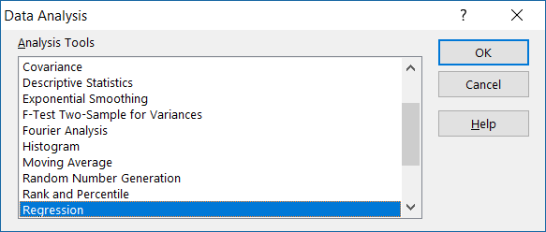
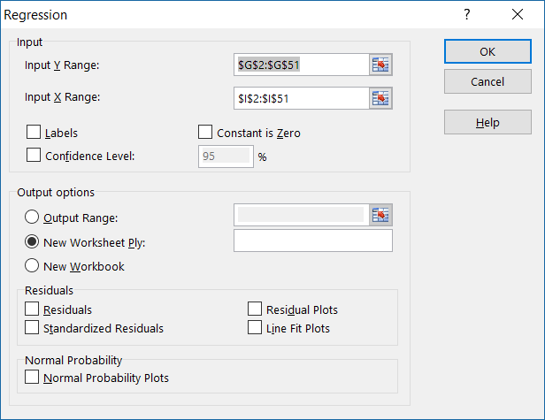
Regression Analysis Example Data Analysis / Regression / StatesDataForR.xlxs

Slide 18
Regression Analysis Example (Cont.) Data Analysis / Regression / StatesDataForR.xlxs
SUMMARY OUTPUT
Regression Statistics
Multiple R | 0.702975
R Square | 0.494174
Adjusted R Square | 0.483636
Standard Error | 0.438001
Observations | 50
ANOVA
 | df | SS | MS | F | Significance F
Regression | 1 | 8.99644 | 8.99644 | 46.89432 | 1.2579E-08
Residual | 48 | 9.20856 | 0.191845
Total | 49 | 18.205
 | Coefficients | Standard Error | t Stat | P-value | Lower 95% | Upper 95% | Lower 95.0% | Upper 95.0%
Intercept | 0.313616 | 0.139557 | 2.247226 | 0.029259 | 0.03301797 | 0.59421455 | 0.03301797 | 0.59421455
X Variable 1 | 0.116073 | 0.01695 | 6.847942 | 1.26E-08 | 0.08199236 | 0.15015287 | 0.08199236 | 0.15015287
R² = 1 – SS_{reg.line} – SS_{total(mean)}

Slide 19
Useful Links
http://www.statisticshowto.com/statistics-basics/
https://www.socialresearchmethods.net/kb/index.php
A semester-long course
http://online.stanford.edu/course/probability-and-statistics-self-paced
R tutorials
http://www.statmethods.net/index.html
http://www.cengage.com/resource_uploads/downloads/1305115341_450336.pdf

Slide 20
Q & A

