Slide 1
Introduction to Statistics
December 5, 2017

Slide 2
Course Outline
What is statistics
Major definitions
Exploratory analysis
Descriptive statistics
Inferential statistics
Probability and statistics
Additional training

Slide 3
What is Statistics
Webster definition:
“A branch of mathematics dealing with the collection, analysis, interpretation, and presentation of masses of numerical data."
The purpose of statistics is converting the data into useful information
“Statistics is a science for decisions”
Unknown statistician
Etymology
From Italian statista – politician
Originally “analysis of data about the state”
Modern day applications
Census
Economics
Market analysis
Manufacturing (quality control)
Scientific research

Slide 4
Key Definitions (Statistics and visualization tools often have different names for same things)
Data
Pieces of information about individuals/samples/records organized into variables
Variable
An element, feature, or factor that vary
Categorical (qualitative) variables
Place an individual/object into one of several groups
Can be organized into hierarchies, e.g. vertebrae-mammals-bears-grizlies
Also called dimensions or attributes
Quantitative variables
Represent some kind of measurement
Take numerical values
Also called measures
Dataset
a set of data identified with particular circumstances

Slide 5
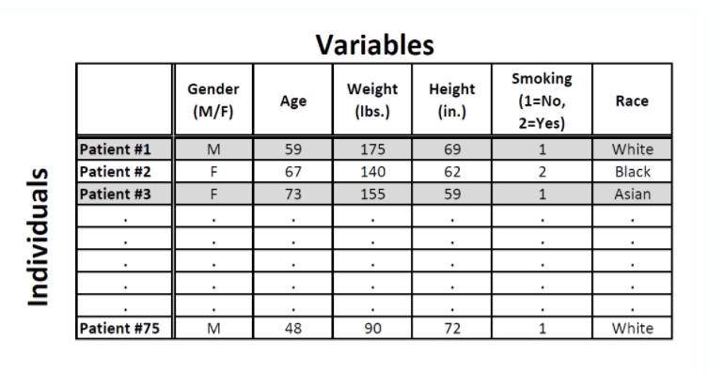
Exercise
Please name:
categorical variables
quantitative variables

Slide 6
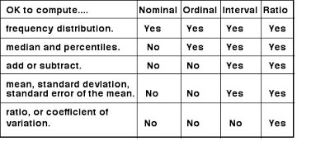
Data Levels of Measurements
A variable can have one of four levels of measurement:
Nominal: categories or names only, can be used to classify the data
Ordinal: can be ordered, e.g. small-medium-big, never-sometimes-always, etc.
Interval: meaningful differences within the measurement, e.g. temperature, dress sizes
Ratio: can do math across different ratio measurements, e.g. weight, length, currency

Slide 7
Exploratory Data Analysis
Examine distribution of variables
What values variables can take
How often they take those values
Establish hierarchies for categorical variables (dimensions)
Compute descriptive statistics (for numeric variables)
Visualize with Plots
Scatter – general picture
Histogram – frequency

Slide 8
Descriptive Statistics
Descriptive statistics quantitatively describe or summarize features of data
Simple summaries of a variable
Main descriptive statistics:
Distribution
Frequency (of occurrences)
Central Tendency
Mean (Average)
Median
Mode
Dispersion
Range
Variance
Standard Deviation

Slide 9
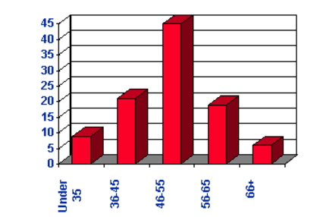
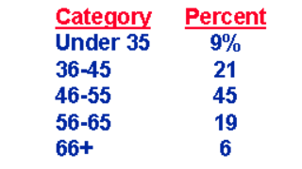
Descriptive Statistics: Distribution
A frequency of individual values or ranges of values for a variable
Can be a table or a graph (histogram)
Example: Percent of income
of five age groups

Slide 10
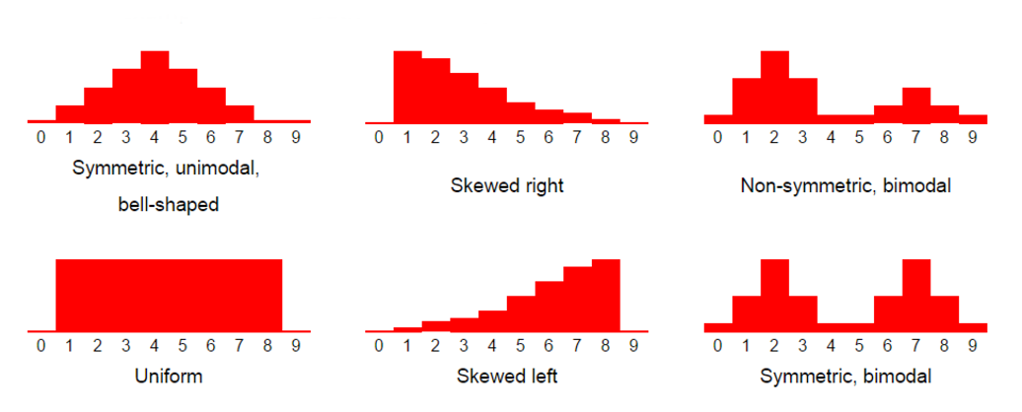
Table Vs. Histogram
Table
Compact
Easy to see the values
Machine readable
Histogram
Shows patterns
Better for human perception

Slide 11
Descriptive Statistics: Central Tendency
Central Tendency - one number to describe the variable
Three ways to estimate
Mean (bias, average)
A = [15, 20, 21, 20, 36, 15, 25, 15]
Mean(A) = sum(A)/count(A) = 167/8 = 20.875
Median
A = [15,15,15,20,20,21,25,36]
Median(A) = 20 (the mid point of A)
Mode
The most frequently occurring number
Mode(A) = 15
Can be applied to both quantitative and categorical data
Note: for normal distribution Mean = Median = Mode

Slide 12
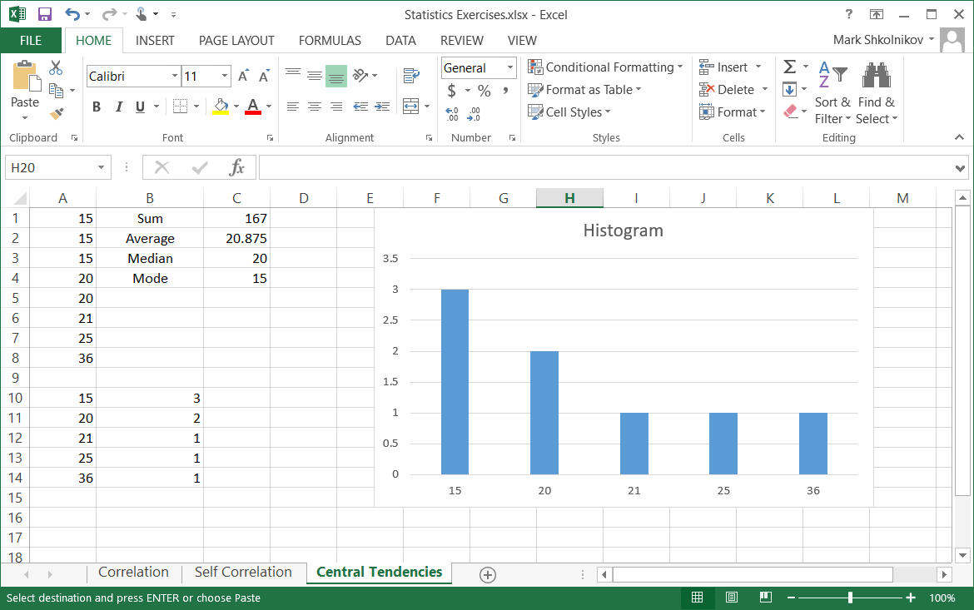
Exercise
Compute Mean, Median, and Mode in Excel
Use built-in functions
Average
Mode
Median
How to create histogram in Excel
https://www.ablebits.com/office-addins-blog/2016/05/11/make-histogram-excel/

Slide 13
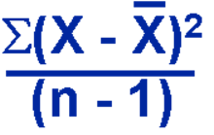
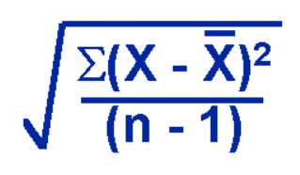
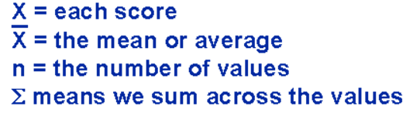
Descriptive Statistics: Dispersion
Three common ways to estimate
Range - simply max - min
A = [15, 20, 21, 20, 36, 15, 25, 15]
Range(A) = 36 – 15 = 21
Note: a big outlier can greatly influence a result!
Variance
Show the relation of each value to the mean
(variance around average)
Standard Deviation
A square root of variance

Slide 14

Why Do We Square Differences in Variance and Standard Deviation?
Imaging a data set
A = [4, 4, 0, -4, -4] Average(A) = 0
If we would not square differences, the negatives will compensate the positives and we would not get a true perception of the dispersion, i.e.:
(4 – 0) + (4 – 0) + 0 + (-4 – 0) + (-4 – 0) = 0
Can we take absolutes? Yes, this will be called Mean Deviation
However, Standard Deviation has proven to work better on most of datasets and is used way more often
Exercise: compute Mean and Standard Deviations for
A = [7, 1, -6, -2]

Slide 15
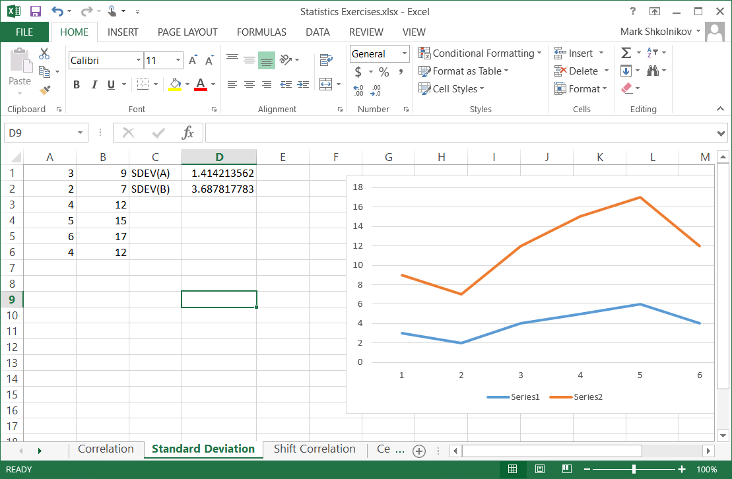
Exercise
Compute Standard Deviation
For A
For B

Slide 16
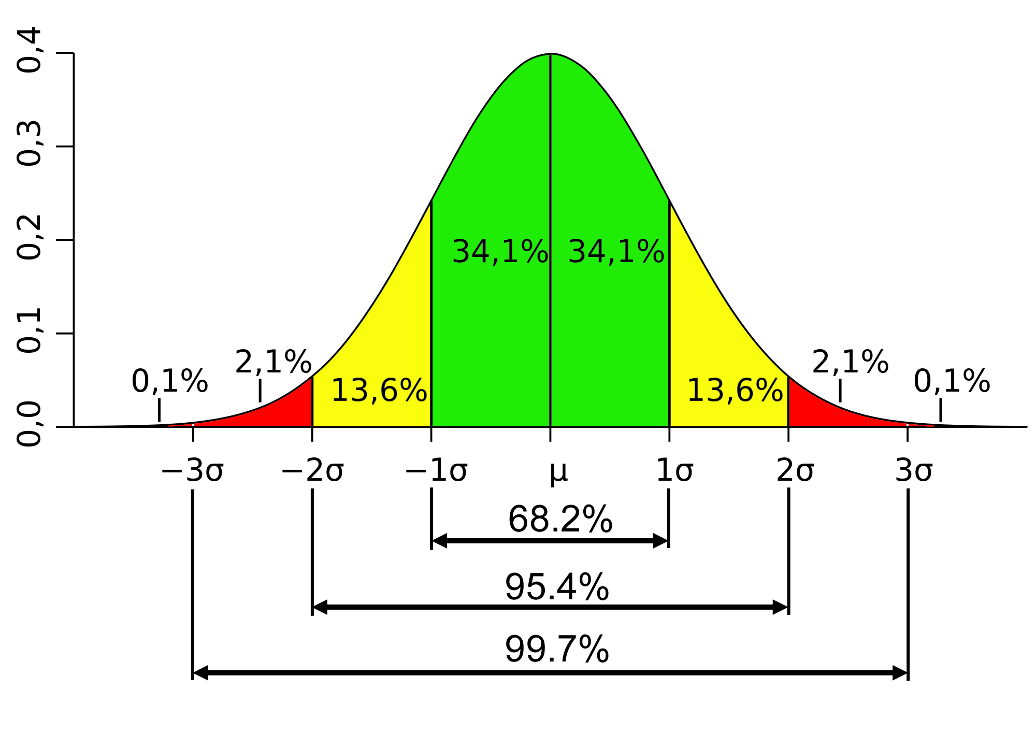
Normal Distribution and Standard Deviation
Normal Distribution
Mean / Average
One Standard Deviation
Two Standard Deviations

Slide 17
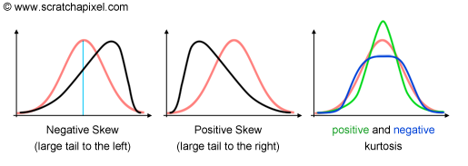
Skew(ness) and Kurtosis
Skew is a measure of “lack of symmetry” – the bigger is the skew the more asymmetric is the distribution
Kurtosis is a measure of
“Peakedness” (Wolfram MathWorld)
Combined weight of the “tails” relative to the rest of the distribution (Dr. Donald Wheeler)
Normal distribution Skew = 0, Kurtosis = 3

Slide 18
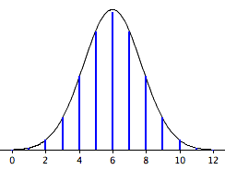
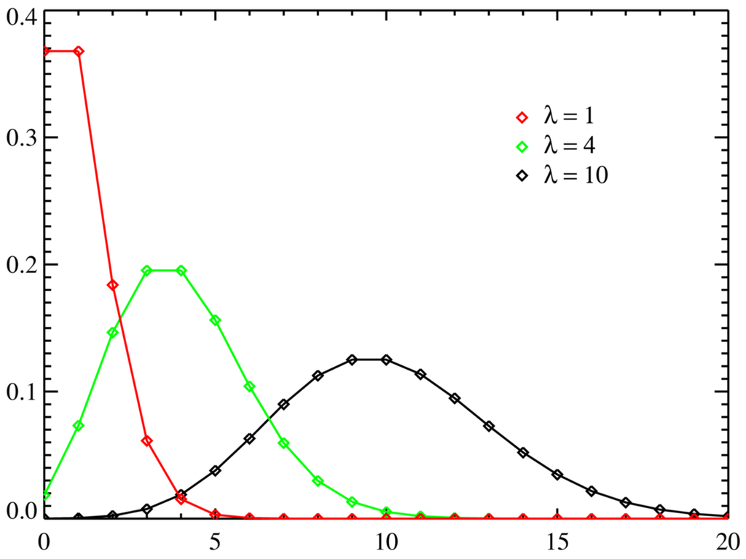
Normal, Binomial and Poisson Distributions
Normal distribution (Gaussian) is a probability distribution of a (truly) random continuous variable
Binomial distribution is a probability distribution of a discrete random variable (have mutually exclusive outcomes), e.g. coin flipping
For a large number of evens approaches normal distribution curve
Poisson distribution describes probability of a certain number of events within a certain period of time, e.g. cars passing traffic light, radioactive decay
For large number of events approaches normal
Normal
Binomial
Poisson

Slide 19
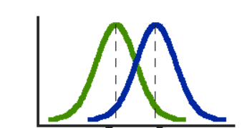
Inferential Statistics
Reaching conclusions that extend beyond the immediate data
Identify trends
Establish relations between independent and dependent variables
Often involves comparison of
Variables
A variable to a model or pattern
Can be qualitatively accessed by plotting
Can be quantitatively accessed by
Covariance and Correlation (compare patterns)
T-test (compare means)
ANOVA (compare variances)

Slide 20
Covariance and Correlation
Both describe how two variables deviate from expected values (means/averages)
Covariance is average of the products of deviations of each variable from its mean
Correlation (coefficient) is “normalized” dimensionless covariance, i.e.
Correlation(A,B) = Covariance(A,B) / ((Standard Deviation(A))(Standard Deviation(B)))
Example
A = [3, 2, 4, 5, 6] Average(A) = 4
B = [9, 7, 12, 15, 17] Average(B) = 12
Covariance(A,B) =
= ((3 – 4)(9 – 12) + (2 – 4)(7 – 12) + (4 – 4)(12 – 12) + (5 – 4)(15 – 12) + (6 – 4)(17 – 12))/5 =
= 5.2
Exercise: use Excel to compute covariance and correlation

Slide 21
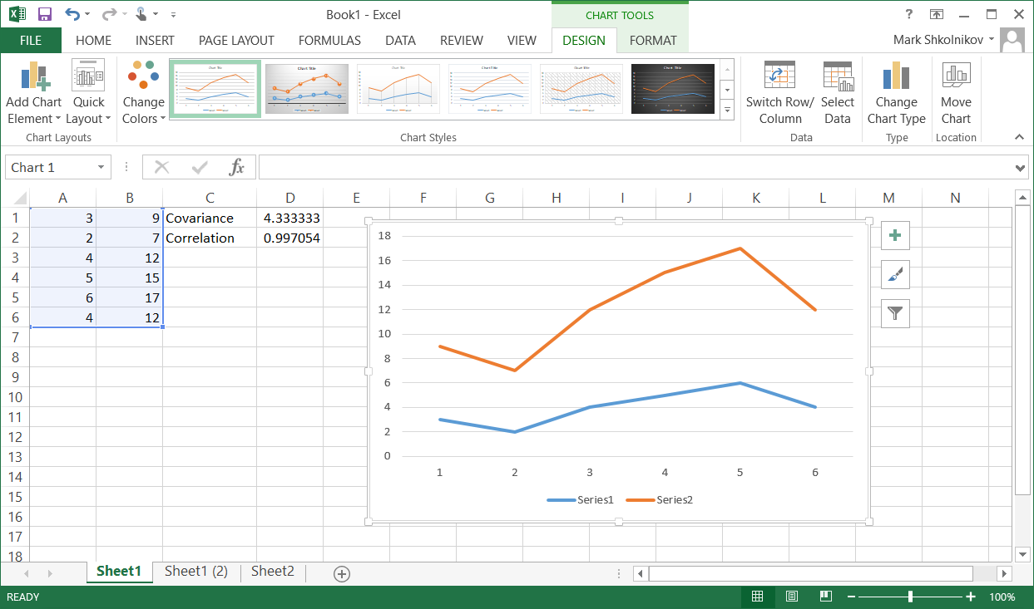
Exercise
Compute Covariance and Correlation Coefficient
For A and B
For A and A

Slide 22
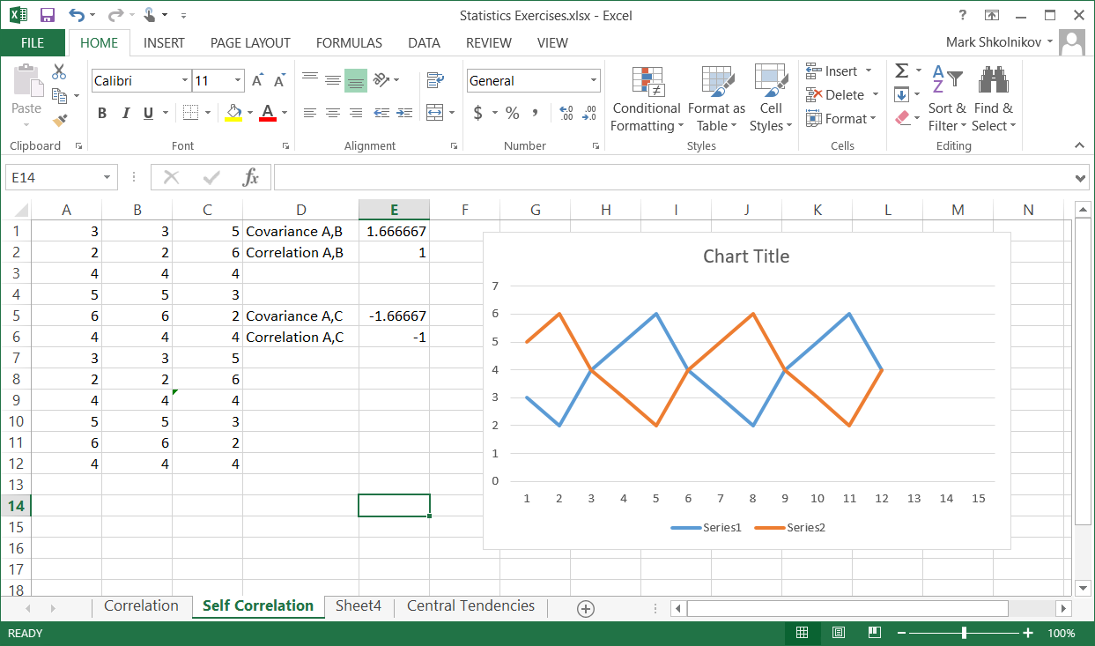
Exercise (cont.)
Compute Covariance and Correlation Coefficient
For A and C, where C is shifted A

Slide 23
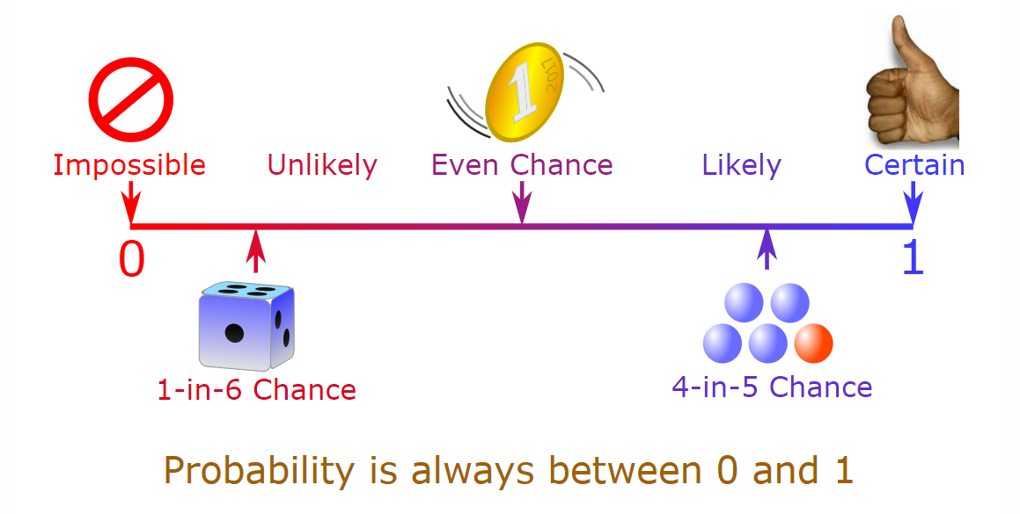
What is Probability?
The extent to which an event is likely to occur, measured by the ratio of the favorable cases to the whole number of cases possible
P(A or B) = P(A) + P(B) P(A & B) = P(A) * P(B)
Example:
Fair coin: two equal possibilities P(Head) = P(Tail) = 1/2 Probability of Head or Tail = 1/2 + 1/2 = 1
Probability of Head after Tail = 1/2 * 1/2 = 1/4

Slide 24
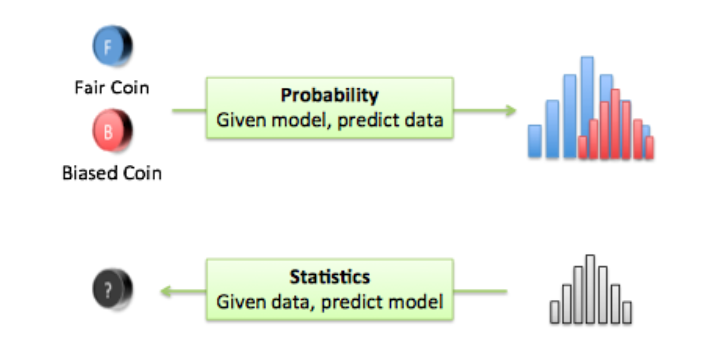
Probability and Statistics Where is the connection?
A (very) facilitated explanation:
Probability: from model to data distribution (create/analyze a model and predict an outcome)
Statistics: from data distribution to model (what effects the outcome)
Connection – math behind models and data distribution

Slide 25
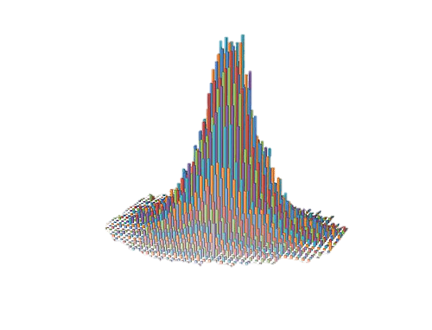
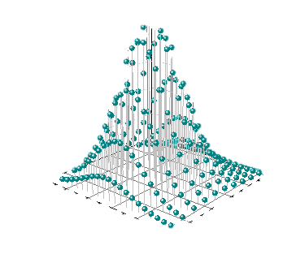

Probability and Statistics Together Predictive Analytics
Statistics
Probability
Analyze
Data
Create
Model
Predict behavior under
various conditions

Slide 26
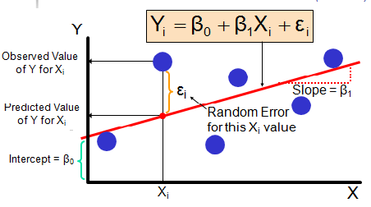
Regression Analysis
Regression is a method for fitting a curve through a set of points using some goodness-of-fit criterion
Linear regression is the most common type of regression
Least Squares Fitting is the simplest mathematical procedure for finding the best-fitting curve to a given set of points by minimizing the sum of the squares of the offsets ("the residuals") of the points from the curve
Regression analysis is a set of statistical processes for estimating the relationships among variables
Regression analysis is used to understand which among the independent variables are related to the dependent variable, and to explore the forms of these relationships

Slide 27
T-test
T-test (A.K.A. Student’s t test) is a statistical test which is widely used to compare the mean of two groups of samples, i.e.: to evaluate whether the means of the two sets of data are statistically significantly different from each other.
T-tests are handy hypothesis tests in statistics when you want to compare means. You can compare a sample mean to a hypothesized or target value using a one-sample t-test. You can compare the means of two groups with a two-sample t-test. If you have two groups with paired observations (e.g., before and after measurements), use the paired t-test.
The one-sample t-test, used to compare the mean of a population with a theoretical value.
Let x represent a set of values with size n, with mean m and with standard deviation s. The comparison of the observed mean m of the population to a theoretical value μ is performed with the formula below:
t = (m−μ)/(s/√(n))

Slide 28
ANOVA - Analysis of Variance A.K.A Fisher Analysis of Variance
ANOVA is a statistical hypothesis test: how a dataset is different from another one (or a model)
One / Two way ANOVA (for single/two factor analysis)
MANOVA / N-way ANOVA – Multivariate ANOVA (for multifactor analysis)
Rather involved computation
Results are typically displayed as an ANOVA Table
Source SS DF MS F
Treatments SST k−1 SST/(k−1) MST/MSE
Error SSE N−k SSE/(N−k)
SS – sum of squares
DF – degrees of freedom, DF = k – 1, where k is number of groups of samples (“treatments”)
MS – mean squares, MS = SS/DF
T – treatment, A.K.A “between”
E – error, A.K.A “within”
N – number of samples in the groups

Slide 29
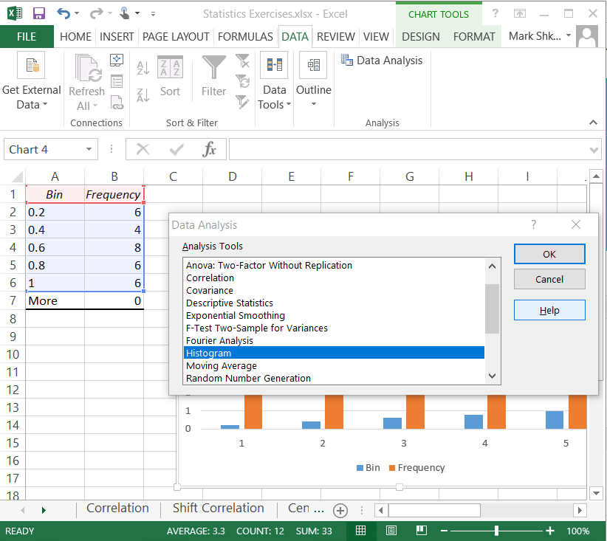
Data Analysis in Excel
Enable Data Analysis ToolPak
File => Options => Add-Ins => Analysis ToolPak => Go
Check box “Analysis ToolPak”
OK

Slide 30
Useful Links
http://www.statisticshowto.com/statistics-basics/
https://www.socialresearchmethods.net/kb/index.php
A semester-long course
http://online.stanford.edu/course/probability-and-statistics-self-paced
R tutorials
http://www.statmethods.net/index.html
http://www.cengage.com/resource_uploads/downloads/1305115341_450336.pdf

Slide 31
Q & A

