Slide 1
Introduction to manual testing
TTS Accessibility Guild
GSA | Technology Transformation Services
Notes:
Robert

Slide 2
1. Introductions
2. Syllabus
3. Introduction to manual testing

Slide 3
Introductions
What’s your name, pronouns, and city?
What do you work on?
What is one thing you want to get out of this class?

Slide 4
What you’ll get out of this course
An overview of common accessibility issues and how they affect real people.
Several tools and techniques for finding accessibility problems in the products that you work on.
A lightweight process that you can use to review every pull request for accessibility problems.

Slide 5
Syllabus, by week
Introduction to manual testing
Well-structured HTML
Assistive technology
Media
Inputting information
Scenario-based testing
Design choices
Recap and final

Slide 6
Why does accessibility matter?
Notes:
Nikki

Slide 7
Accessibility matters because…
Our products are for everyone! The government has a responsibility to serve the entire public.

Slide 8
Accessibility matters because…
An estimated 12.7% of the population (more than 40M people!) reported a disability of some kind in 2017. That’s a lot of people.

Slide 9
Accessibility matters because…
It’s the law!

Slide 10
How manual testing fits in
Manual testing isn’t the entire solution. But it’s a really good way to make sure that our products aren’t shipping with basic bugs that make them difficult, or impossible, for some people to use.

Slide 11
How usability testing fits in
It’s a good idea to combine manual testing with usability tests with participants who have disabilities. They can give you realistic feedback based on their personal experiences.

Slide 12
Common vocabulary
Notes:
Robert

Slide 13
What is inclusive design?
Notes:
Robert

Slide 14
“Inclusive Design is a methodology, born out of digital environments, that enables and draws on the full range of human diversity. Most importantly, this means including and learning from people with a range of perspectives.”
— Microsoft Design

Slide 15
Recognize exclusion
Designing for inclusivity not only opens up our products and services to more people, it also reflects how people really are. All humans grow and adapt to the world around them and we want our designs to reflect that.

Slide 16
Solve for one, extend to many
Everyone has abilities, and limits to those abilities. Designing for people with permanent disabilities actually results in designs that benefit people universally. Constraints are a beautiful thing.

Slide 17
Learn from diversity
Human beings are the real experts in adapting to diversity. Inclusive design puts people in the center from the very start of the process, and those fresh, diverse perspectives are the key to true insight.

Slide 18
What is Section 508?
Notes:
Nikki

Slide 19
Section 508 is the most important law in U.S. government covering technology accessibility. It is the One Big Rule that everyone follows when it comes to accessibility.

Slide 20
Section 508 of the Rehabilitation Act
In 1998, Congress amended the Rehabilitation Act of 1973 to require Federal agencies to make their electronic and information technology (EIT) accessible to people with disabilities. The law (29 U.S.C § 794 (d)) applies to all Federal agencies when they develop, procure, maintain, or use electronic and information technology. Under Section 508, agencies must give disabled employees and members of the public access to information comparable to the access available to others.

Slide 21
Section 508 requirements
The U.S. Access Board is responsible for developing Information and Communication Technology (ICT) accessibility standards to incorporate into regulations that govern Federal procurement practices. On January 18, 2017, the Access Board issued a final rule that updated accessibility requirements covered by Section 508, and refreshed guidelines for telecommunications equipment subject to Section 255 of the Communications Act. The final rule went into effect on January 18, 2018.

Slide 22
Section 508 requirements
The rule updated and reorganized the Section 508 Standards and Section 255 Guidelines in response to market trends and innovations in technology. The refresh also harmonized these requirements with other guidelines and standards both in the U.S. and abroad, including standards issued by the European Commission, and with the World Wide Web Consortium (W3C) Web Content Accessibility Guidelines (WCAG 2.0), a globally recognized voluntary consensus standard for web content and ICT.

Slide 23
Specific requirements
Information and Communication Technology (ICT) Final Standards and Guidelines - Read the Revised 508 Standards (final rule)
Text of the Standards and Guidelines
About the Update of the Section 508 Standards and Section 255 Guidelines for Information and Communication Technology - High-level overview
Revised 508 Standards Transition Guide - An overview of changes your agency needs to make to transition to the Revised 508 Standards.

Slide 24
What this means for you:
Make sure everything you build (or buy) meets or exceeds the WCAG 2.0 AA standard.

Slide 25
What is WCAG?
Notes:
Robert

Slide 26
The Web Content Accessibility Guidelines (WCAG) are a set of testable criteria defining what it means for a web product to be accessible.

Slide 27
WCAG is the accepted international standard for technology accessibility. It’s developed and maintained by W3C member organizations around the world.

Slide 28
WCAG conformance levels explained
Level A
Level AA
Level AAA
Level A guidelines cover essential accessibility needs of people with disabilities. When you meet this level, the most impactful barriers to access have been removed.
Level AA is meant to cover the majority of needs that a general audience would have, which is why it’s the standard specified in Section 508. Conforming to Level AA also means that all Level A guidelines have been met.
Level AAA is the most aspirational and includes criteria that cannot be applied everywhere. Therefore, AAA guidelines are not required for compliance with Section 508.

Slide 29
Right now, Section 508 says that government IT products must meet the WCAG 2.0 AA standard. That’s your minimum bar.

Slide 30
There is also a published WCAG 2.1 standard! Nothing in 2.1 contradicts 2.0, and WCAG 2.1 AA is an even better target to aim for if you want your products to be as accessible as possible.

Slide 31
What is a11y?
Notes:
Nikki

Slide 32
Accessibility is often abbreviated as the numeronym a11y, where the number 11 refers to the number of letters omitted. This parallels the abbreviations of internationalization and localization as i18n and l10n respectively.

Slide 33
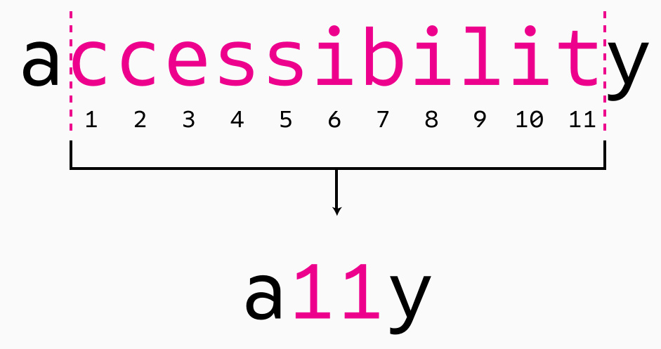

Slide 34
Questions?
Notes:
Robert

Slide 35
Homework
Notes:
Nikki

Slide 36
Assignment #1: videos and reflection
The Power of Exclusion | Tiffany Yu
Why Accessibility Matters
Introduction to Web Accessibility and W3C Standards
What is Accessibility?
Write 2-3 paragraphs: What did you learn? What information was new? What did you already know?

Slide 37
Thanks!
Slack #g-accessibility

