Slide 1
Well-structured HTML
TTS Accessibility Guild
GSA | Technology Transformation Services
Notes:
Robert

Slide 2
Homework
What is the most interesting thing you learned from the homework?

Slide 3
Why does HTML matter?
Notes:
robert

Slide 4
HTML is the bedrock of all web products.
How you structure your HTML sets the foundation for how all of the content on your website is experienced.

Slide 5
JS
Functionality & Interactivity
CSS
Styling & Layout
HTML
Structure & Meaning
Notes:
All roads lead back to HTML

Slide 6
Well-structured HTML is easier to maintain, and it’s also more accessible.

Slide 7
Specifically, it makes it easier for computers to parse. This is important because many people rely on assistive technology — tools that help people with disabilities interact with the world.

Slide 8
Screen readers are a great example. Well-structured HTML makes it easy for a screen reader to read the page to a user.

Slide 9
HTML
Screen readers read the underlying HTML
<h2>Inclusive design has many benefits.</h2>
<p>Inclusive design helps us make sure that what we build can be used by everyone. It also helps us identify opportunities to make our products work better for everyone.</p>
<p>For example, designing a website to work well for people who are blind also helps people who can’t look at the screen right now.</p>

Slide 10
HTML
Display
Screen readers read the underlying HTML
<h2>Inclusive design has many benefits.</h2>
<p>Inclusive design helps us make sure that what we build can be used by everyone. It also helps us identify opportunities to make our products work better for everyone.</p>
<p>For example, designing a website to work well for people who are blind also helps people who can’t look at the screen right now.</p>
Inclusive design has many benefits.
Inclusive design helps us make sure that what we build can be used by everyone. It also helps us identify opportunities to make our products work better for everyone.
For example, designing a website to work well for people who are blind also helps people who can’t look at the screen right now.

Slide 11
HTML
Screen reader
Screen readers read the underlying HTML
<h2>Inclusive design has many benefits.</h2>
<p>Inclusive design helps us make sure that what we build can be used by everyone. It also helps us identify opportunities to make our products work better for everyone.</p>
<p>For example, designing a website to work well for people who are blind also helps people who can’t look at the screen right now.</p>
Heading level 2, Inclusive design has many benefits.
Inclusive design helps us make sure that what we build can be used by everyone. It also helps us identify opportunities to make our products work better for everyone.
For example, designing a website to work well for people who are blind also helps people who can’t look at the screen right now.

Slide 12
Testing HTML
Notes:
nikki

Slide 13
1 / Look for a descriptive title on every page.

Slide 14
Every page should have a descriptive title. This is how people using a screen reader know where they are.

Slide 15

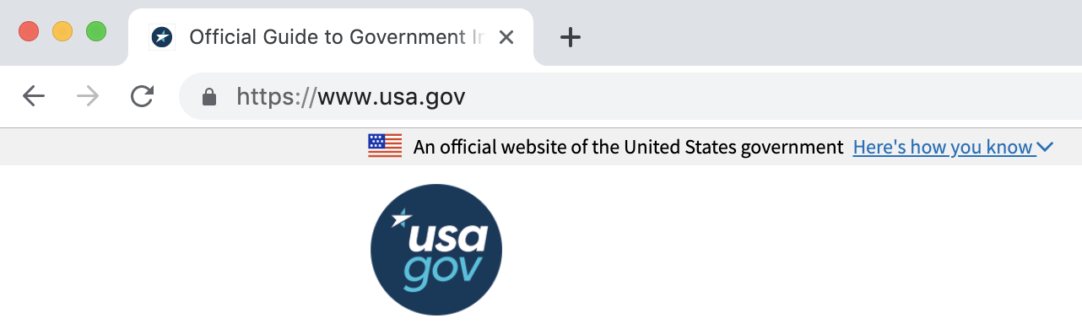
HTML
Display
Screen reader
A descriptive, accessible page title
<head>
...
<title>Official Guide to Government Information and Services &#124; USAGov</title>
...
</head>
Now in, Official Guide to Government Information and Services | USAGov

Slide 16

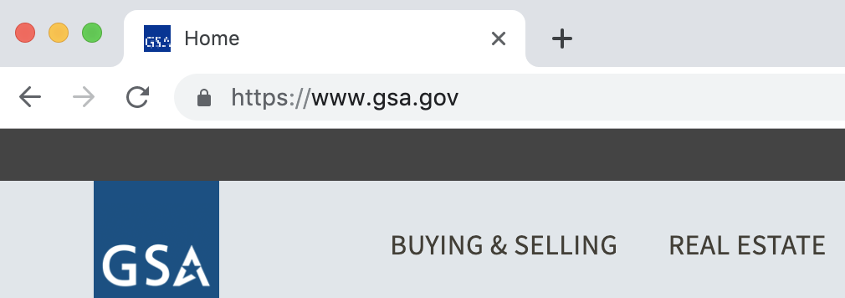
HTML
Display
Screen reader
An uninformative page title
<head>
...
<title>Home</title>
...
</head>
Now in, Home

Slide 17
How to test
Open up a page, and look at the title in the tab. Hover over the title in the tab.
A good title will be descriptive and unique. You’ll be able to guess the contents or purpose of the page just by reading the title. You should also know where on the website you are — different pages must have different titles.
If any of that is missing, you can reference WCAG 2.4.2: Page Titled in your bug report.

Slide 18
2 / Check for appropriate headings and HTML elements to structure content.
Notes:
robert

Slide 19
Screen readers use different HTML tags, like <h2> and <p>, to reveal the page’s structure and content hierarchy. This is equivalent to a sighted person visually scanning the page.

Slide 20
If those tags aren’t used, it’s difficult for a person using a screen reader to understand the overall structure of the content – which makes it harder for them to read. It can even alter the meaning of the page.

Slide 21
HTML
Display
Screen reader
Page structure set using appropriate HTML elements
<h2>Headers help everyone</h2>
<p>Sighted users can tell that something that’s large, or bold, is a heading. But screen readers don’t know that! They have to rely on the underlying HTML.</p>
Headers help everyone
Sighted users can tell that something that’s large, or bold, is a heading. But screen readers don’t know that! They have to rely on the underlying HTML.
Heading level 2, Headers help everyone
Sighted users can tell that something that’s large, or bold, is a heading. But screen readers don’t know that! They have to rely on the underlying HTML.

Slide 22
HTML
Display
Screen reader
Page structure set only using visual properties
<span style=”font-weight: bold; font-size: 14pt”>Headers help everyone</span>
<p>Sighted users can tell that something that’s large, or bold, is a heading. But screen readers don’t know that! They have to rely on the underlying HTML.</p>
Headers help everyone
Sighted users can tell that something that’s large, or bold, is a heading. But screen readers don’t know that! They have to rely on the underlying HTML.
Headers help everyone
Sighted users can tell that something that’s large, or bold, is a heading. But screen readers don’t know that! They have to rely on the underlying HTML.

Slide 23
We’re not going to talk about every single HTML element, but these are some of the most important ones...

Slide 24
Headings
HTML has a hierarchy of headings: <h1> is the highest level of heading, <h2> is the next highest, and so on.
Headings should reflect the content hierarchy of the page.
If text is styled to look like a heading (bolded, larger), then it should be coded as a heading.

Slide 25
Paragraphs
Text should live inside of paragraph (<p>) tags, instead of free floating inside of a <div> or <span> element.

Slide 26
Lists
Lists allow us to group information in logical ways for our audiences.
Unordered (bulleted) lists: for items where their order isn’t relevant.
<ul>
Ordered (numbered) lists: for items in a sequence.
<ol>
Description lists: for terms and their descriptions.
<dl>

Slide 27
Links and buttons
Anything that you click on to go to another web page should live inside of an <a> (anchor) element!
Similarly, anything you click on to do something should use the <button> tag. In the past it was common to use a <div> with javascript attached to it, but we can (and should) use <button> now that HTML5 is widely supported.

Slide 28
Images
Images belong inside of <img> tags.
<img> supports alt, or alternative, text. Alt text is a written description of the image, for those who are unable to see it, and should be included for every image.

Slide 29
How to test
A well-structured page will make sense when you look at only the HTML.
A browser extension tool like WAVE will catch many structural problems. Navigate to the structure section of WAVE and look at all of the headers or use WAVE to turn off styles, exposing the structure and order of the HTML. If what you see doesn’t make sense, that’s a problem!
If any of that is missing, you can reference WCAG 1.3.1: Info and Relationships in your bug report.

Slide 30
3 / Use HTML to present content in a logical order.
Notes:
nikki

Slide 31
Screen readers read pages in the order that the code is in. If the code order and the visual order don’t match, it can cause real usability problems for people.

Slide 32
Content is usually in a particular order for a reason, and that ordering should be the same for all users.

Slide 33
HTML
Display
The page sequence is consistent no matter how you interact with it
<div id=”mainbar”>...</div>
...
<div id=”sidebar”>...</div>

Slide 34
HTML
Display
The visual order is different from the underlying structure
<div class=”discussion-sidebar”>...</div>
...
<div class=”discussion-timeline”>...</div>

Slide 35
How to test
Load the web page and use your tab key to see whether or not you can navigate the content and reach any controls.
You should be able to navigate to and use any controls (links, buttons, forms, and any other interactive elements) without taking your hands off your keyboard. Most commonly, you should be able to use the whole web page with tab, arrow keys, enter, space, and esc.
If you find problems, reference WCAG 1.3.1: Info and Relationships and/or WCAG 1.3.2 Meaningful Sequence in your bug report.

Slide 36
Keyboard navigation cheat sheet
arrows: pan the web page, or, if you’re inside a control, interact with the control
tab: move to the next control
shift + tab: move to the previous control
enter: “click” on all controls
space: “click” on most controls (but not links!)
esc: escape your current context

Slide 37
4/ Make sure tables work with a screen reader.
Notes:
robert

Slide 38
Tables should be used for tabular data, and not for layout. Tables aren’t just a visual style – they have meaning that is interpreted by assistive technology like screen readers. Tables should be navigable and understandable with a screen reader.

Slide 39
Tables can be marked up so that column and row headers are identified to assistive technology. This makes it easier for users to skim the table without having to examine every single cell in the table.

Slide 40
Marking table row and column headers allows screen reader users to skim the table.

Slide 41
Captions and summaries also help with understanding the information contained in a table.

Slide 42
For more information about building accessible tables, the W3C has an excellent guide.

Slide 43
How to test
Every data table should have headers that tell you what the data is.
If you’re comfortable using a screen reader, turn on your screen reader and have it read through the table. If you’re not comfortable using a screen reader, you can use WAVE to scan the page.
If the table doesn’t have headers, you can reference WCAG 1.3.1 Info and Relationships in your bug report.

Slide 44
4 / Double check your navigation options.
Notes:
nikki

Slide 45
Not all users move through a web page in the same way, and websites should respect that. Provide multiple ways to navigate a site, such as a navigation menu, sitemap, or search function.

Slide 46
There is one exception to this: steps in a linear process (like a registration or checkout flow) don’t need to support multiple types of navigation.

Slide 47
How to test
There should be more than one way to locate a page within a site
Check for the presence of one or more of the following:
a working site search
a sitemap or table of contents
links to pages from other pages
If there is only one way to reach a page—and it’s not a step in a sequential process—you can reference WCAG 2.4.5 Multiple Ways in your bug report.

Slide 48
For users who navigate primarily with a keyboard, allow them to bypass repetitive blocks of content. Don’t make them tab through navigation links and side bars on every page.

Slide 49
Users can immediately skip to the main content

Slide 50
Users have to tab many times to get to the main content

Slide 51
How to test
Load up a web page and hit tab. The page should offer you a way to quickly skip to the most relevant content. This should be the first focusable element on the page.
If there’s not a lot of repetitive content (like navigation), the page doesn’t need to have a skip link. There are no hard rules for what is “a lot” of repetitive content; use your usability common sense. One shared element doesn’t need a skip link, and a 50 item menu obviously does.
You can reference WCAG 2.4.1 Bypass Blocks in your bug report.

Slide 52
5/ Give links descriptive names.
Notes:
robert

Slide 53
Links should have descriptive text that gives users a sense of what they will find after clicking the link. This is better for everybody; all users are more likely to follow links that have clear descriptions.

Slide 54
Screen reader users have the ability to display a list of links on a page. Writing descriptive text ensures that links are understandable on their own.

Slide 55
In short, avoid link text like “click here” and “read more” and instead use text that actually describes the link.

Slide 56
HTML
Display
Screen reader
The link clearly communicates where the user will end up
<p>Spotted owls live in Western North America. <a href=”https://en.wikipedia.org/wiki/Spotted_owl”>You can read more about the spotted owl on Wikipedia.</a></p>
Spotted owls live in Western North America. You can read more about the spotted owl on Wikipedia.
Spotted owls live in Western North America.
Link, You can read more about the spotted owl on Wikipedia.

Slide 57
HTML
Display
Screen reader
The link doesn’t tell the user where they will end up
<p>Spotted owls live in Western North America. You can read more about the spotted owl: <a href=”https://en.wikipedia.org/wiki/Spotted_owl”>click here</a></p>
Spotted owls live in Western North America. You can read more about the spotted owl: click here
Spotted owls live in Western North America.
You can read more about the spotted owl:
Link, click here

Slide 58
How to test
Examine all of the links on the page. See if they have descriptive titles that would still make sense if the link was taken out of context.
If you find an undescriptive link name, like “read more”, you can cite WCAG 2.4.4 Link Purpose.

Slide 59
6 / Tell automated tools what language to use.
Notes:
robert

Slide 60
Ensure that every page has the language set, so that assistive technologies appropriately interpret the page contents.
<html lang="en">

Slide 61

How to test
You can either look at the source code or run WAVE, which will tell you if the language is not set. WAVE will also show you which language the page is set to at the very top of the marked up web page.
If the language is not set, you can reference WCAG 3.1.1 Language of Page.

Slide 62
Questions?

Slide 63
Homework
Notes:
nikki

Slide 64
Assignment #2:
We have two websites for you to look at — spend 20 minutes on each website and write up your findings.
Look at this GitHub page. What accessibility issues do you see?
Now take a look at this college website. What layout choices have they made? How about their design choices? How do those affect accessibility?

Slide 65
Thanks!
Slack #g-accessibility

