Slide 1

Welcome to Python 2 Session #3
Michael Purcaro & The GSBS Bootstrappers
February 2014
michael.purcaro@umassmed.edu

Slide 2
Building Blocks: Classes
Strings, dictionary, defaultdict, set are all examples of classes
In an ideal world, a class contains
data (numbers, strings, lists, other classes, etc.)
the functions allowed to manipulate the data
Provides further mechanisms to give code structure
Allows data and concepts to be encapsulated (i.e. hidden or only occur in one place)

Slide 3
Classes and Objects
In object-oriented programming, a “class” is the code that defines
the class variables
the functions allowed to operate on those class variables
No memory taken up
Like the abstract concept of a book
An “object” is an instance of a class
Memory will be allocated for the variables in the object
Like an actual book

Slide 4
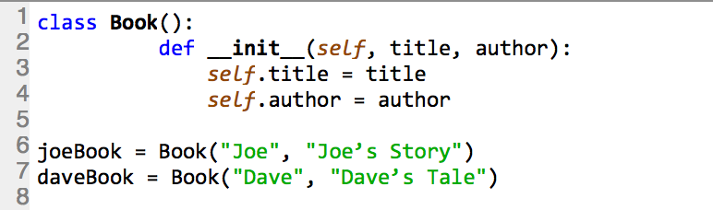
Simple Book Class
By Nick

Slide 5


Class Book
Definition
self.author
self.title
Class Book
joeBook
self.author = “Joe”
Usage 1
self.title = “Joe’s Story”
Class Book
daveBook
self.author = “Dave”
Usage 2
self.title = “Dave’s Tale”
By Nick

Slide 6
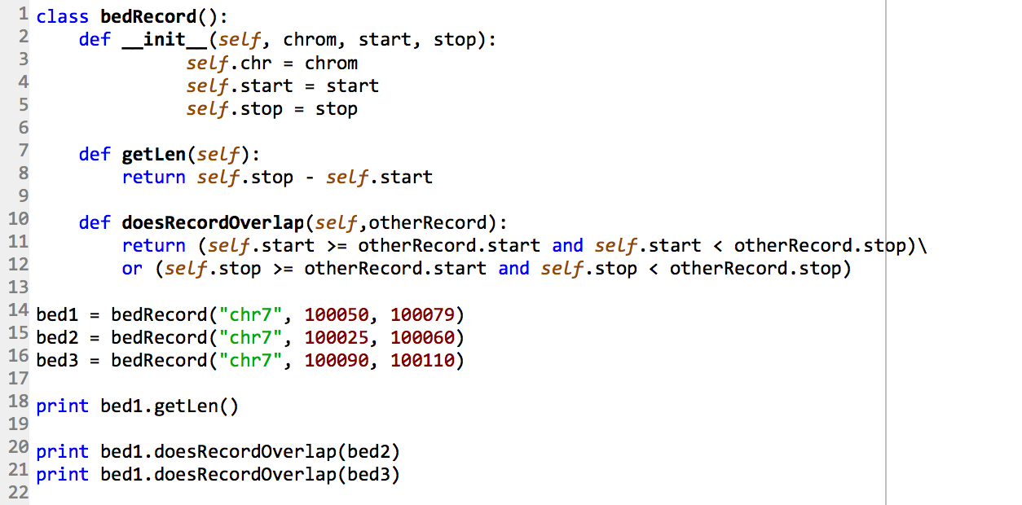
Bed Record Class
“Instantiate the objects”
By Nick

Slide 7
Bed Record Class
“Instantiate the objects”
By Nick

Slide 8

Instance Methods
class bedRecord
bed1
self.chr = “chr7”
self.start = 100050
self.stop = 100079
Definition
usage
By Nick

Slide 9
Instance Methods
class bedRecord
bed1
self.chr = “chr7”
self.start = 100050
self.stop = 100079
Definition
usage
Don’t need to use self when
using the member function
By Nick

Slide 10

class bedRecord
bed1
class bedRecord
bed2
self.chr = “chr7”
self.chr = “chr7”
self.start = 100050
self.start = 100025
self.stop = 100079
self.stop = 100060
By Nick

Slide 11
class bedRecord
bed1
class bedRecord
bed2
self.chr = “chr7”
self.chr = “chr7”
self.start = 100050
self.start = 100025
self.stop = 100079
self.stop = 100060
By Nick

Slide 12




class bedRecord
bed1
class bedRecord
bed2
self.chr = “chr7”
self.chr = “chr7”
self.start = 100050
self.start = 100025
self.stop = 100079
self.stop = 100060
By Nick

Slide 13
Extended Exercise 4
Rework your code from the previous Extended Exercises into a ChipseqData class, similar to
class ChipseqData:
def __init__(self, paths, url):
The class initializer should only download the chipseq data if needed
What are the pros/cons of downloading the data during class initialization?
The class should have a function to return the number of peaks found in a given chromosome
The class should also have a function to compute the percentage of a given chromosome covered by peaks
Would a Peak class (that understood how to parse each line of the narrow peak) be useful? Try it!

Slide 14
class Paths():
def __init__(self, lectureNumber):
self.homeFolder = os.path.abspath(os.path.expanduser("~"))
self.desktopFolder = os.path.join(self.homeFolder, "Desktop")
self.python2folder = os.path.join(self.desktopFolder, "python_2")
lecture = "lecture_" + str(lectureNumber)
self.lectureFolder = os.path.join(self.python2folder, lecture)
print "today's lecture folder location will be:", self.lectureFolder
Utils.mkdir_p(self.lectureFolder)
def makeFilePath(self, fn):
return os.path.join(self.lectureFolder, fn)

Slide 15
class Paths():
def __init__(self, lectureNumber):
self.homeFolder = os.path.abspath(os.path.expanduser("~"))
self.desktopFolder = os.path.join(self.homeFolder, "Desktop")
self.python2folder = os.path.join(self.desktopFolder, "python_2")
lecture = "lecture_" + str(lectureNumber)
self.lectureFolder = os.path.join(self.python2folder, lecture)
print "today's lecture folder location will be:", self.lectureFolder
Utils.mkdir_p(self.lectureFolder)
def makeFilePath(self, fn):
return os.path.join(self.lectureFolder, fn)
def makeRawDataPath(self, fn):...
def makePreprocessDataPath(self, fn):...
def makeOutputPath(self, fn):...

Slide 16
class ChipseqData:
def __init__(self, paths, url):
self.paths = paths
self.url = url
self.fnp = Utils.get_file_if_size_diff(self.url, paths.lectureFolder)
def getPeaks(self, chr):
peaks = []
with open(self.fnp) as f:
for line in f:
toks = line.split()
if chr != toks[0]:
continue
peaks.append(toks)
return peaks
def numPeaks(self, chr):
return len(self.getPeaks(chr))
def computePercentageChromosomeCovered(self, chr, chromosomeLength):
peaks = self.getPeaks(chr)
numBases = 0
for toks in peaks:
numBases += int(toks[2]) - int(toks[1])
return "{0:.2f}%".format(float(numBases) / chromosomeLength * 100)
http://bioinfo.umassmed.edu/bootstrappers/bootstrappers-courses/python2/lecture2/lecture2.txt

Slide 17
paths = Paths(3)
chipData = ChipseqData(paths, "http://bib3.umassmed.edu/~purcarom/Python2/Lecture1/ENCFF002COQ.narrowPeak")
print "number of peaks on chromosome 7:", chipData.numPeaks("chr7")
print "% of chromosome 7 covered by peaks:", chipData.computePercentageChromosomeCovered("chr7",
159138663)

Slide 18
Extended Exercise 5
Build a class “HG19chrSize” that holds chromosome lengths
Have its constructor download and parse the file
Store chromosome lengths in a dictionary
Key of “chromosome name” (i.e. “chr6” or “chrX”)
Value of integer
Have a class method “length(chrmosomeNum)” that returns the length of the chromosome requested
Chromosome length file url:
http://bioinfo.umassmed.edu/bootstrappers/bootstrappers-courses/python2/lecture1/hg19.chrom.sizes

Slide 19
class HG19chrSize():
def __init__(self, paths):
self.paths = paths
self.url = "http://bioinfo.umassmed.edu/bootstrappers/bootstrappers-courses/python2/lecture1/hg19.chrom.sizes"
fnp = Utils.get_file_if_size_diff(self.url, paths.lectureFolder)
self.chrsToLen = {}
with open(fnp) as f:
for line in f:
toks = line.split()
self.chrsToLen[toks[0]] = int(toks[1])
def length(self, chr):
if not chr in self.chrsToLen:
raise Exception("unknown chromosome: " + chr)
return self.chrsToLen[chr]

Slide 20
Extended Exercise 6
Goal: Run numPeak() and computePercentageChromosomeCovered() for chromosomes 1 to 22
Store the numPeak() output into a dictionary:
numPeaks = {}
numPeaks[“chr1”] = …
Store the computePercentageChromosomeCovered() output in another dictionary:
percChromCovered = {}

Slide 21
chrLengths = HG19chrSize(paths)
numPeaks = {}
percChromCovered = {}
for chrNum in range(1,23):
chr = "chr" + str(chrNum)
numPeaks[chr] = chipData.numPeaks(chr)
percChromCovered[chr] = chipData.computePercentageChromosomeCovered(chr, chrLenths.length(chr))
print chr, numPeaks[chr], percChromCovered[chr]

Slide 22
Homework #1
Work through these problems from http://rosalind.info/problems/list-view/
DNA Counting DNA Nucleotides
RNA Transcribing DNA into RNA
REVC Complementing a Strand of DNA
GC Computing GC Content
HAMM Counting Point Mutations
SPLC RNA Splicing
PROT Translating RNA into Protein
SUBS Finding a Motif in DNA
PRTM Calculating Protein Mass
REVP Locating Restriction Sites
Review on February 12, 2015

