Slide 1

Welcome to Python 2 Session #1
Michael Purcaro & The GSBS Bootstrappers
February 2014
michael.purcaro@umassmed.edu

Slide 2
Welcome and Structure
6 sessions
Review of Python 1
Object orientation
Modules
Data structures
Regular Expressions
I/O
Working on cluster
Work w/ real data
bioinfo.umassmed.edu/bootstrappers/bootstrappers-courses/python2/lecture1/

Slide 3
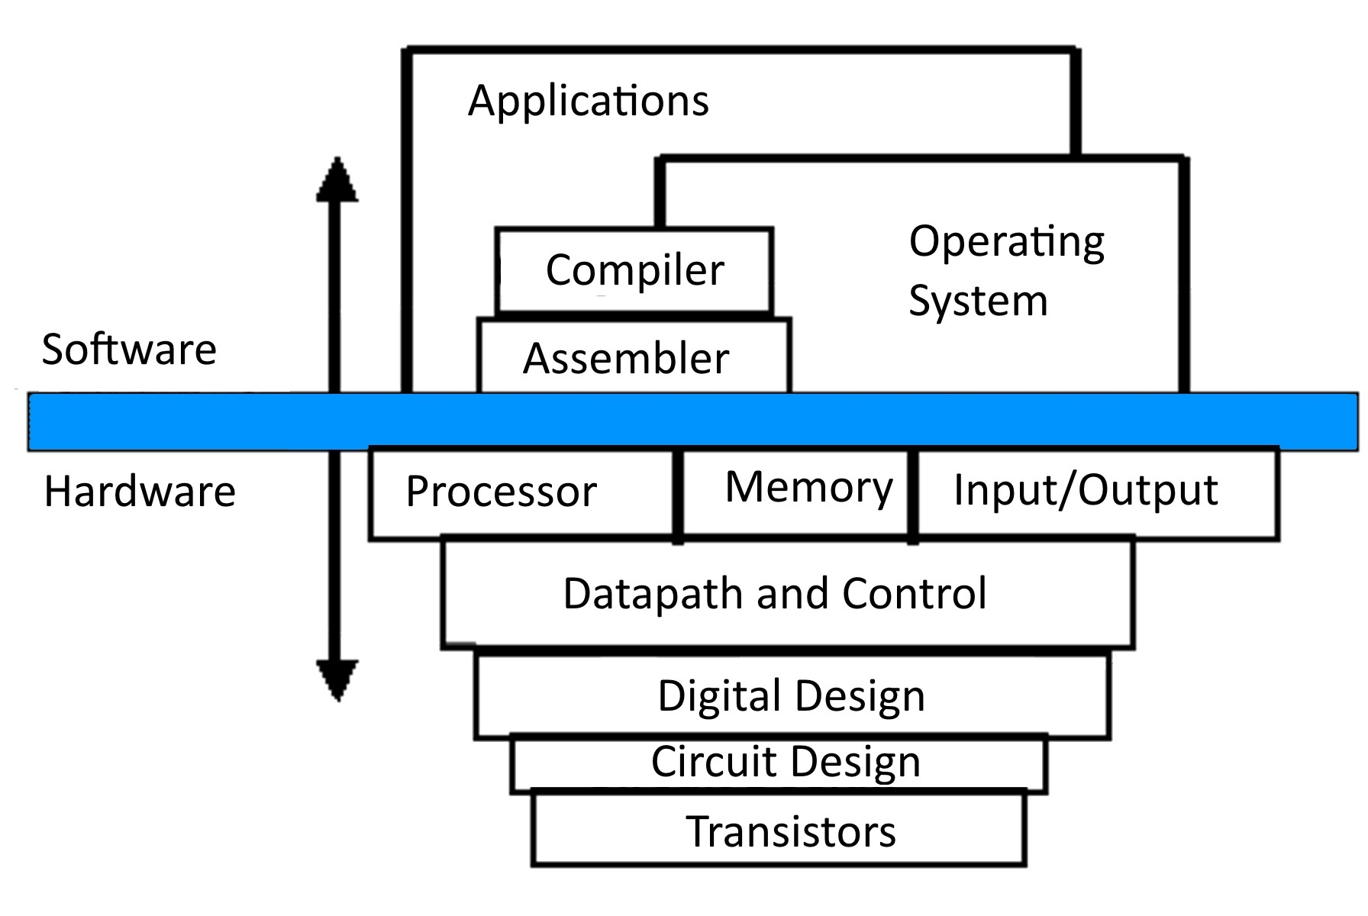
Layers of Abstraction
Based on http://www.cise.ufl.edu/~mssz/CompOrg/Figure1.1-LevelsOfAbstractn.gif

Slide 4
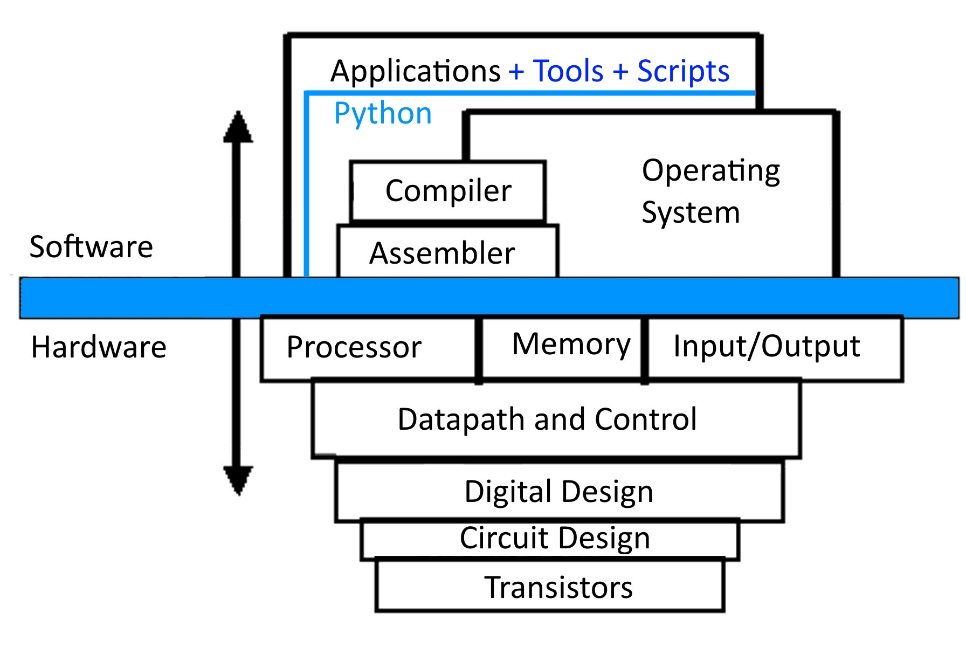
Layers of Abstraction

Slide 5
Computer Memory

Slide 6
Computer Memory: Addressing
0 | 1 | 2 | 3 | 4 | 5 | 6 | 7 | 8 | 9
10 | 11 | 12 | 13 | 14 | 15 | 16 | 17 | 18 | 19
20 | 21 | 22 | 23 | 24 | 25 | 26 | 27 | 28 | 29
30 | 31 | 32 | 33 | 34 | 35 | 36 | 37 | 38 | 39
40 | 41 | 42 | 43 | 44 | 45 | 46 | 47 | 48 | 49
50 | 51 | 52 | 53 | 54 | 55 | 56 | 57 | 58 | 59
60 | 61 | 62 | 63 | 64 | 65 | 66 | 67 | 68 | 69
…

Slide 7
Computer Memory: Addressing
0 | 32 | 64 | 96 | 128 | 160 | 192 | 224 | 256 | 288
320 | 352 | 384 | ….
units = bits
“data structure alignment”

Slide 8
Computer Memory: Addressing
0 | 32 | 64 | 96 | 128 | 160 | 192 | 224 | 256 | 288
320 | 352 | 384 | ….
Memory size limited by system, number of programs
running, etc.

Slide 9
Processors prefer to operate in terms of these blocks of memory
Example: adding two 3 digit intgers
 |  | 6
 |  | 7
 | 1 | 3
+

Slide 10
Processors prefer to operate in terms of these blocks of memory
Base 10
0 | 0 | 6
0 | 0 | 7
0 | 1 | 3
+

Slide 11
Processors prefer to operate in terms of these blocks of memory
Base 10
Base 2 → 8 bit integers
0 | 0 | 6
0 | 0 | 7
0 | 1 | 3
0 | 0 | 0 | 0 | 0 | 1 | 1 | 0
0 | 0 | 0 | 0 | 0 | 1 | 1 | 1
0 | 0 | 0 | 0 | 1 | 1 | 0 | 1
+

Slide 12
Overflow
1 | 1 | 1 | 1 | 1 | 1 | 1 | 1
1 | 1 | 1 | 1 | 1 | 1 | 1 | 1
0 | 0 | 0 | 0 | 0 | 0 | 0 | 0
+
1
Result is too large to fit in memory given!

Slide 13
Building Blocks: Numbers
Numbers take up a certain amount of space in memory
Two fundamental types in python
Integers (ints)
Decimal (float)
print type(1)
print type(1.2)

Slide 14
Building Blocks: Numbers
Numbers take up a certain amount of space in memory
Two fundamental types in python
Integers (ints)
Decimal (float)
print type(1)
<type 'int'>
print type(1.2)
<type 'float'>

Slide 15
Size in memory limits precision of number types
print "1+2 = ", 1+2
print "1e100 + 2e100 = ", 1e100 + 2e100
print "1e400 + 2e400 = ", 1e400 + 2e400
print "1e-100 + 2e-100 = ", 1e-100 + 2e-100
print "1e-400 + 2e-400 = ", 1e-400 + 2e-400

Slide 16
Size in memory limits precision of number types
print "1+2 = ", 1+2
1+2 = 3
print "1e100 + 2e100 = ", 1e100 + 2e100
1e100 + 2e100 = 3e+100
print "1e400 + 2e400 = ", 1e400 + 2e400
1e400 + 2e400 = inf
print "1e-100 + 2e-100 = ", 1e-100 + 2e-100
1e-100 + 2e-100 = 3e-100
print "1e-400 + 2e-400 = ", 1e-400 + 2e-400
1e-400 + 2e-400 = 0.0
wrong!
wrong!

Slide 17
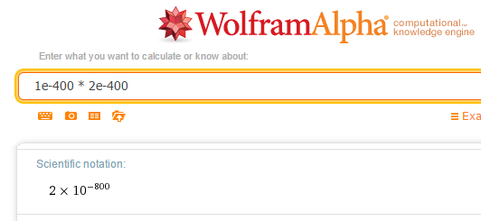
Arbitrary precision numbers possible!

Slide 18
Arbitrary precision numbers in Python
import gmpy
from gmpy import mpf
print "mpf('1e100') + mpf('2e100') = ", mpf('1e100') + mpf('2e100')
print "mpf('1e400') + mpf('2e400') = ", mpf('1e400') + mpf('2e400')
print "mpf('1e-100') + mpf('2e-100') = ", mpf('1e-100') + mpf('2e-100')
print "mpf('1e-400') + mpf('2e-400') = ", mpf('1e-400') + mpf('2e-400')

Slide 19
Arbitrary precision numbers in Python
import gmpy
from gmpy import mpf
print "mpf('1e100') + mpf('2e100') = ", mpf('1e100') + mpf('2e100')
mpf('1e100') + mpf('2e100') = 3.e100
print "mpf('1e400') + mpf('2e400') = ", mpf('1e400') + mpf('2e400')
mpf('1e400') + mpf('2e400') = 3.e400
print "mpf('1e-100') + mpf('2e-100') = ", mpf('1e-100') + mpf('2e-100')
mpf('1e-100') + mpf('2e-100') = 3.e-100
print "mpf('1e-400') + mpf('2e-400') = ", mpf('1e-400') + mpf('2e-400')
mpf('1e-400') + mpf('2e-400') = 3.e-400
More examples in Lecture1/nums.py

Slide 20
Why aren’t all numbers arbitrary precision?
Performance
Size in memory
Many complex and subtle floating point issues

Slide 21
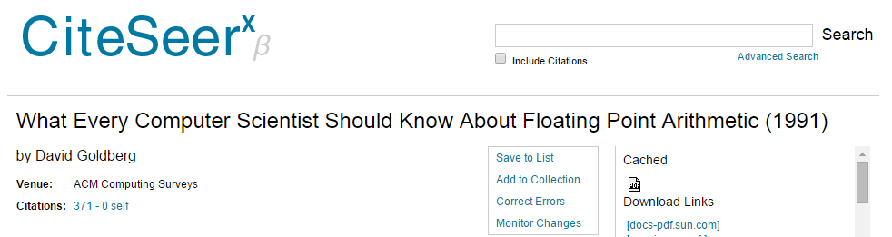
Why aren’t all numbers arbitrary precision?
Performance
Size in memory
Many complex and subtle floating point issues

Slide 22
Why aren’t all numbers arbitrary precision?
Performance
Size in memory
Many complex and subtle floating point issues
94 pages long!

Slide 23
Building Blocks: Lists
Contiguous set of blocks in memory
v = []
for i in range(10):
v.append(i)
print v

Slide 24
Building Blocks: Lists
Contiguous set of blocks in memory
v = []
for i in range(10):
v.append(i)
print v
[0, 1, 2, 3, 4, 5, 6, 7, 8, 9]

Slide 25
Building Blocks: Lists
Contiguous set of blocks in memory
v = []
for i in range(10):
v.insert(0, i)
print v

Slide 26
Building Blocks: Lists
Contiguous set of blocks in memory
v = []
for i in range(10):
v.insert(0, i)
print v
[9, 8, 7, 6, 5, 4, 3, 2, 1, 0]

Slide 27
Building Blocks: Lists
0-based indexing (list of length 10)
Python, C, C++, Java, Javascript
1-based indexing (list of length 10)
R, MATLAB
Starts at index of 0
Ends at index of 9
Starts at index of 1
Ends at index of 10

Slide 28
Building Blocks: Lists
v = [1, 1, 2, 3, 5, 8, 13, 21]
print v.count(1)
print v[0]
print v[-1]
print v[-2]
print v[1:2]
print v[::-1]
print v.index(21)
See https://docs.python.org/2/tutorial/datastructures.html for document on lists

Slide 29
Building Blocks: Lists
v = [1, 1, 2, 3, 5, 8, 13, 21]
print v.count(1)
2
print v[0]
1
print v[-1]
21
print v[-2]
13

Slide 30
Building Blocks: Lists
v = [1, 1, 2, 3, 5, 8, 13, 21]
print v[1:2]
[1]
print v[::-1]
[21, 13, 8, 5, 3, 2, 1, 1]
print v.index(21)
7
[inclusive, exclusive)
or v.reverse()

Slide 31
Building Blocks: Lists
v = [1, 1, 2, 3, 5, 8, 13, 21]
v = v[3:5]
print v
v[0] = 100
print v
v[1] = [1,1,2]
print v

Slide 32
Building Blocks: Lists
v = [1, 1, 2, 3, 5, 8, 13, 21]
v = v[3:5]
print v
[3, 5]
v[0] = 100
print v
[100, 5]
v[1] = [1,1,2]
print v
[100, [1, 1, 2]]

Slide 33
Building Blocks: Strings
Essentially (if not exactly) a list of characters
s = "Hello World!"
print s
s = "Hello World!\n"
print s
print s[0:5]
s[0:5] = "HELLO!"
print s

Slide 34
Building Blocks: Strings
Essentially (if not exactly) a list of characters
s = "Hello World!"
print s
Hello World!
s = "Hello World!\n"
print s
Hello World!
print s[0:5]
Hello

Slide 35
Building Blocks: Strings
Essentially (if not exactly) a list of characters
s = "Hello World!\n"
s[0:5] = "HELLO!"
print s
Traceback (most recent call last):
File "./strings.py", line 9, in <module>
s[0:4] = "HELLO!"
TypeError: 'str' object does not support item assignment

Slide 36
Building Blocks: Strings
Essentially (if not exactly) a list of characters
s = "Hello World!\n"
s = "HELLO!" + s[5:-1]
print s

Slide 37
Building Blocks: Strings
Essentially (if not exactly) a list of characters
s = "Hello World!\n"
s = "HELLO!" + s[5:-1]
print s
HELLO! World!

Slide 38
Building Blocks: Strings
s = "Hello World!"
print s.startswith("He")
print s.split()
print s.split("o")

Slide 39
Building Blocks: Strings
s = "Hello World!"
print s.startswith("He")
True
print s.split()
['Hello', 'World!']
print s.split("o")
['Hell', ' W', 'rld!']

Slide 40
Building Blocks: Strings
s = "2015"
print s == 2015
print int(s) == 2015
print s == str(2015)

Slide 41
Building Blocks: Strings
s = "2015"
print s == 2015
False
print int(s) == 2015
True
print s == str(2015)
True

Slide 42
Dealing with files and folders
docs.python.org/2/library/os.path.html
import os
(os is a Python module: code that can be imported and used w/ your own programs)
Get home folder:
homeFolder = os.path.expanduser("~")
Get absolute path
homeFolder = os.path.abspath(homeFolder)
Append a folder (or file) name to path
python2folder = os.path.join(homeFolder, "python_2")

Slide 43
Dealing with files and folders
Make directories if needed:
import os, errno
def mkdir_p(path):
# from http://stackoverflow.com/a/600612
try:
os.makedirs(path)
except OSError as exc: # Python >2.5
if exc.errno == errno.EEXIST and os.path.isdir(path):
pass
else: raise

Slide 44
Example: make a folder for today’s lecture
import os, errno
def mkdir_p(path):
# from http://stackoverflow.com/a/600612
try:
os.makedirs(path)
except OSError as exc: # Python >2.5
if exc.errno == errno.EEXIST and os.path.isdir(path):
pass
else: raise
homeFolder = os.path.abspath(os.path.expanduser("~"))
desktopFolder = os.path.join(homeFolder, "Desktop")
python2folder = os.path.join(desktopFolder, "python_2")
lecture1folder = os.path.join(python2folder, "lecture_1")
print "today's lecture folder location will be:", lecture1folder
mkdir_p(lecture1folder)

Slide 45
Downloading a file
url = “http://someaddress.com/fileName.txt”
fileName = os.path.basename(url)
fnp = os.path.join(lecture1folder, fileName)
print "going to download", fileName, "from", url
import urllib
urllib.URLopener().retrieve(url, fnp)

Slide 46
Reading a large file line-by-line
with open(fileNameAndPath) as f:
for line in f:
print line

Slide 47
Extended Exercise 1
Goal: count how many signal peaks are present in processed ENCODE ChIP-seq data on chromosome 7
url: http://bib3.umassmed.edu/~purcarom/Python2/Lecture1/ENCFF002COQ.narrowPeak
File format:
genome.ucsc.edu/FAQ/FAQformat.html#format12
Answer hint: between 2000 and 3000

Slide 48
Extended Exercise 2
Modify code from Extended Exercise 1 to count what percentage of chromosome 7 (assume hg19) is covered by peaks.
Length of chr7 in hg19: 159138663
(Length of HG19 chromosomes in hg19.chrom.sizes in bioinfo.umassmed.edu/bootstrappers/bootstrappers-courses/python2/lecture1/)
Answer hint: <5%

