Slide 1
Introduction to single-cell methylation analysis
G&E Data Science Working Group
Ryan Mulqueen
Navin Lab, Systems Biology, MDACC
11/13/2025

Slide 2
Lecture overview
Unique samples for DNA methylation
Foundations of methylation
How we can measure it in single-cell scale
Analysis of most-omics data sets
How methylation analysis is different
What else can we do with it?
Where is the field headed?
My main take-aways:
Most single cell omics analyses are essentially the same.
DNA methylation has unique attributes that allow for unique analyses.
I’m excited about DNA methylation and I think you should be too.
INTRO
ANALYSIS
EXAMPLES

Slide 3
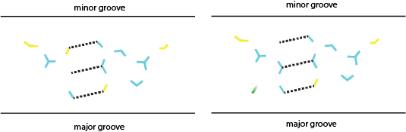
Methylation is stable in FFPE and specific across cancer staging
Notes:
The data were from 749 controls and 878 participants with newly diagnosed untreated cancer across 20 tumor types and all stages. For eight tumor types, the reported sensitivity across stage I-III cancers was 66% colorectal (n = 28), 63% esophageal (n = 19), 56% head and neck (n = 5), 80% hepatobiliary (n = 5), 59% lung (n = 73), 77% lymphoma (n = 17), 73% multiple myeloma (n = 11), 90% ovarian (n = 10), and 80% for pancreatic (n = 10) tumors. In each instance, specificity was held at 95%.

Slide 4
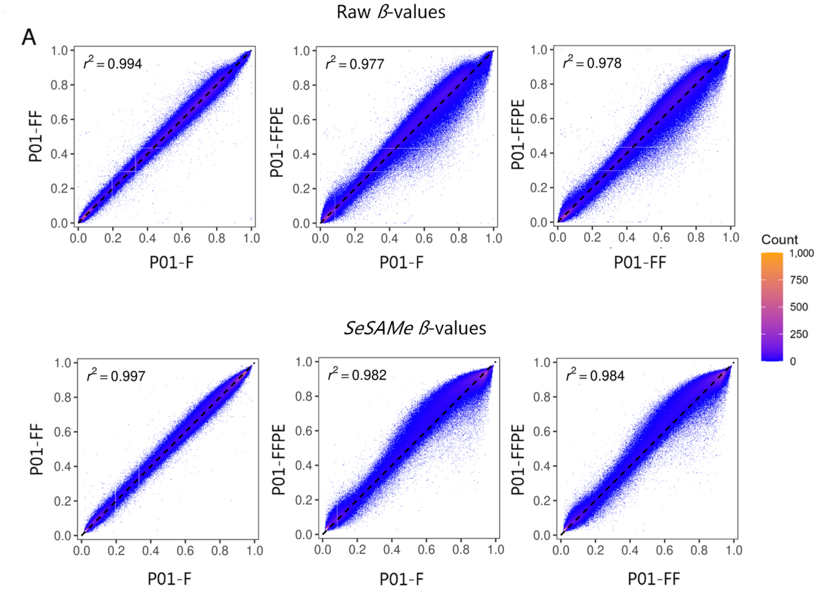
Methylation is stable in FFPE and specific across cancer staging
Liu, M. C., et al Annals of Oncology 31.6 (2020): 745-759.
Fenaux, Pierre, et al. Journal of clinical oncology 28.4 (2010): 562-569.
DuPont, et al. Scientific Reports 13 (2023): 16381
Notes:
The data were from 749 controls and 878 participants with newly diagnosed untreated cancer across 20 tumor types and all stages. For eight tumor types, the reported sensitivity across stage I-III cancers was 66% colorectal (n = 28), 63% esophageal (n = 19), 56% head and neck (n = 5), 80% hepatobiliary (n = 5), 59% lung (n = 73), 77% lymphoma (n = 17), 73% multiple myeloma (n = 11), 90% ovarian (n = 10), and 80% for pancreatic (n = 10) tumors. In each instance, specificity was held at 95%.

Slide 5
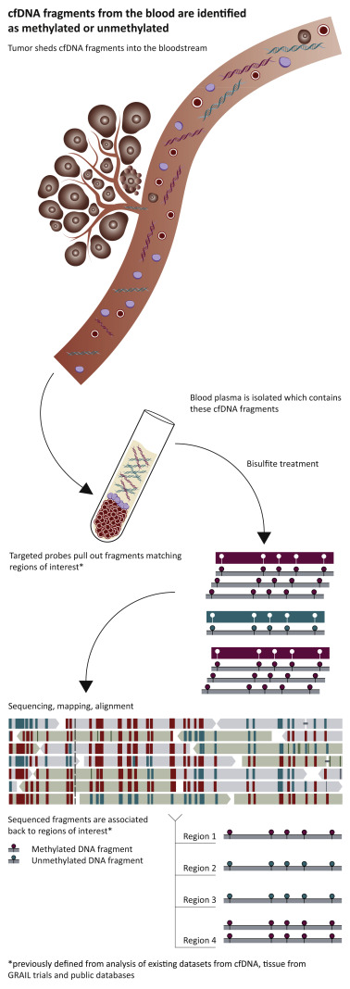
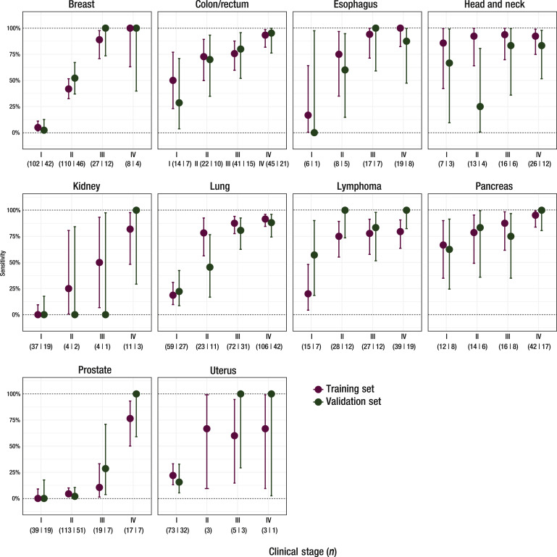
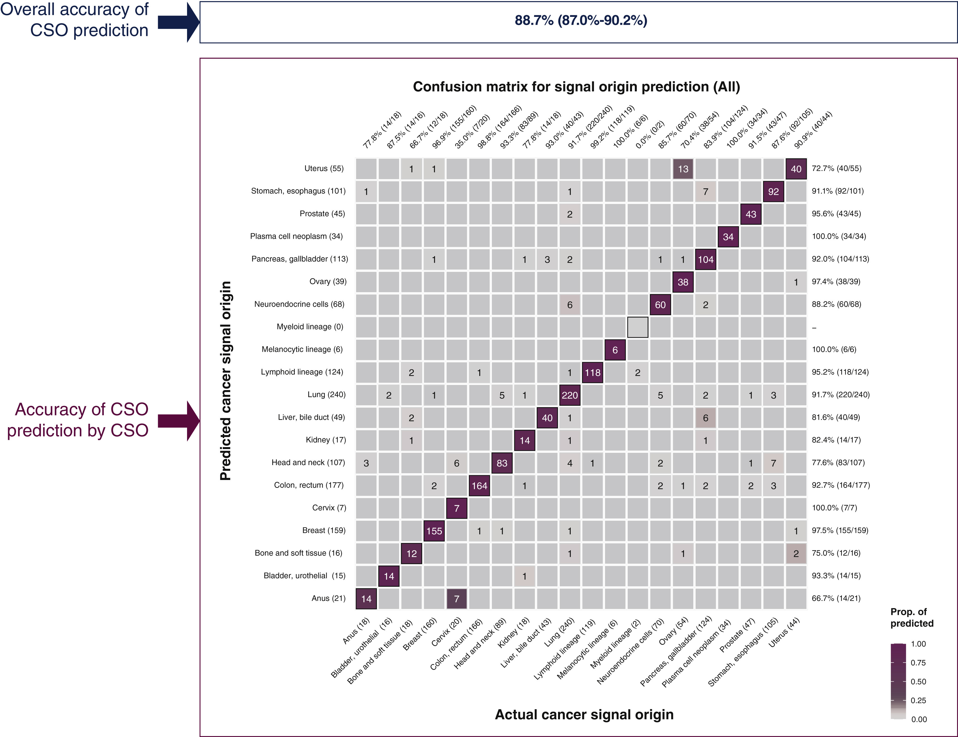
Methylation is stable in FFPE and specific across cancer staging
Pathfinder 2 Galleri Test
methylation is cancer and stage specific
Liu, M. C., et al Annals of Oncology 31.6 (2020): 745-759.
Fenaux, Pierre, et al. Journal of clinical oncology 28.4 (2010): 562-569.
DuPont, et al. Scientific Reports 13 (2023): 16381
Notes:
The data were from 749 controls and 878 participants with newly diagnosed untreated cancer across 20 tumor types and all stages. For eight tumor types, the reported sensitivity across stage I-III cancers was 66% colorectal (n = 28), 63% esophageal (n = 19), 56% head and neck (n = 5), 80% hepatobiliary (n = 5), 59% lung (n = 73), 77% lymphoma (n = 17), 73% multiple myeloma (n = 11), 90% ovarian (n = 10), and 80% for pancreatic (n = 10) tumors. In each instance, specificity was held at 95%.

Slide 6
FOUNDATIONS OF DNA METHYLATION
WRITER (2)
ERASER (1)
READER (4)

Slide 7
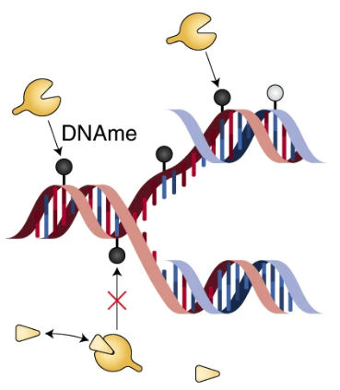
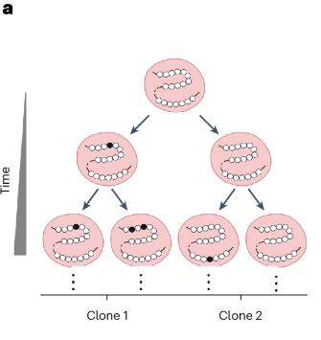
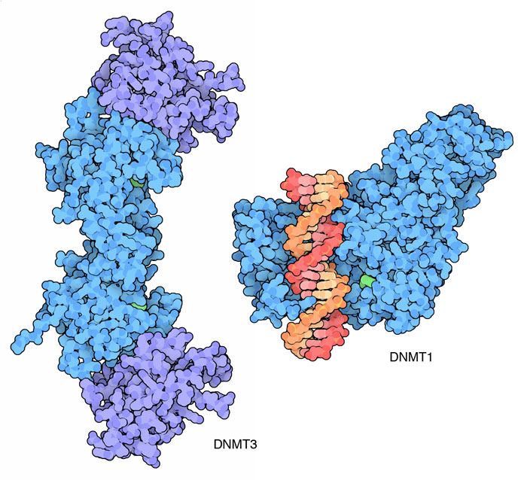
WRITER: DNMT1 (DNA MethylTransferase 1)
maintains methylation by strand symmetry
at CG dinucleotides
Wang, Shou-Wen. "MethylTree: exploring epimutations for accurate and.”
pdb.org

Slide 8
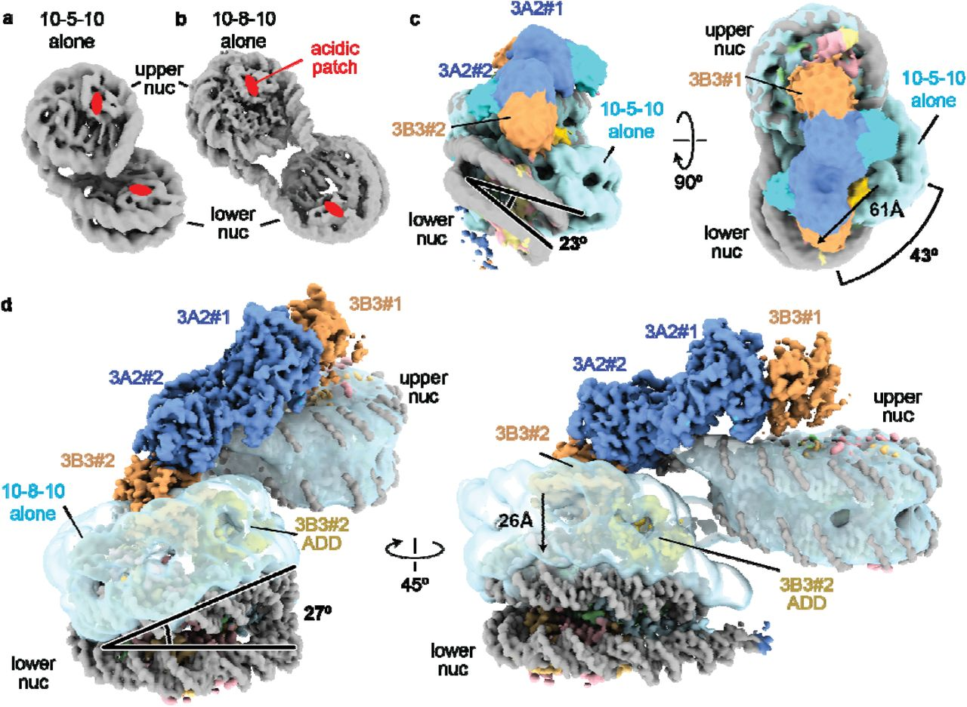
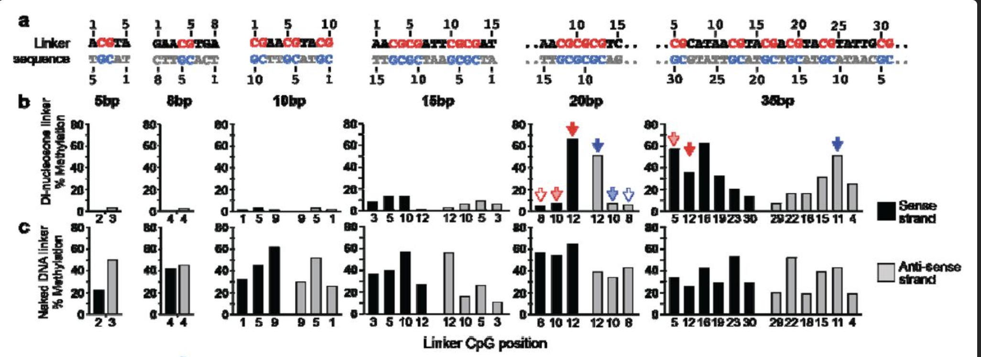
WRITER: DNMT3 (DNA MethylTransferase 3):
de novo methylation on closed chromatin
DNMT3
binds dinucleosomes marked with H3K36me3
methylates within the linker region > 15bp
lack of MBD means DNMT3 can methylate non-CG dinucleotides
and can induce hemi-methylation
Xie, Xiaoyan, et al. bioRxiv (2024): 2024-12.

Slide 9
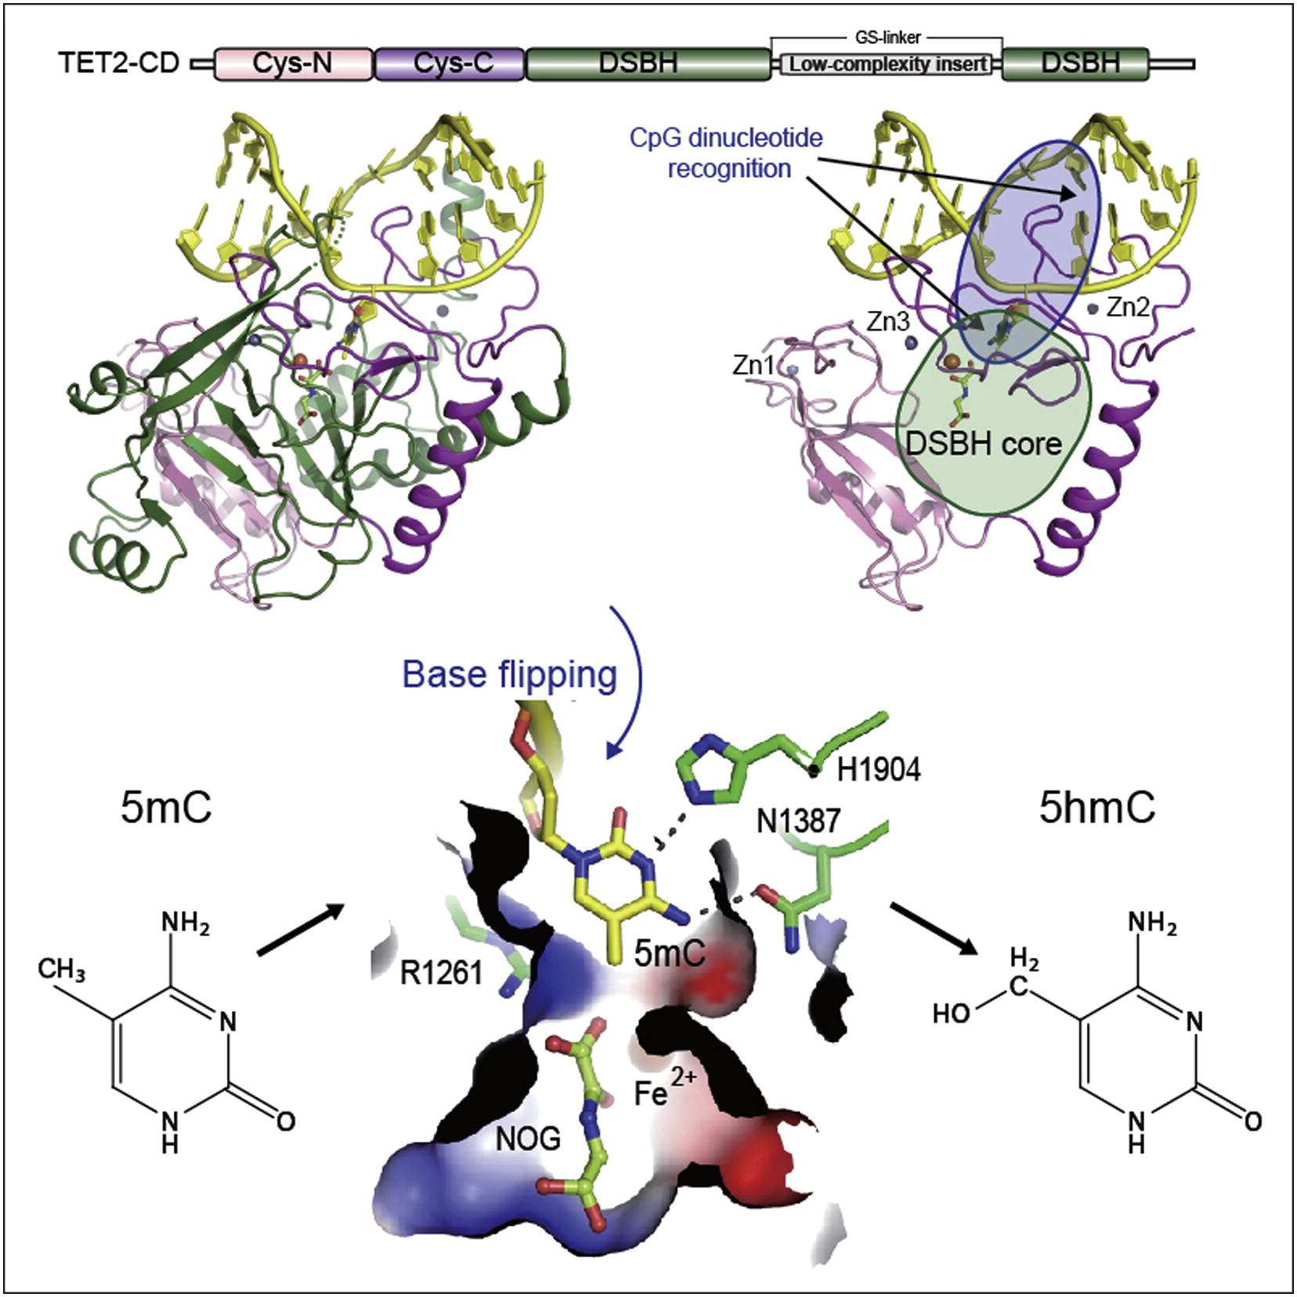
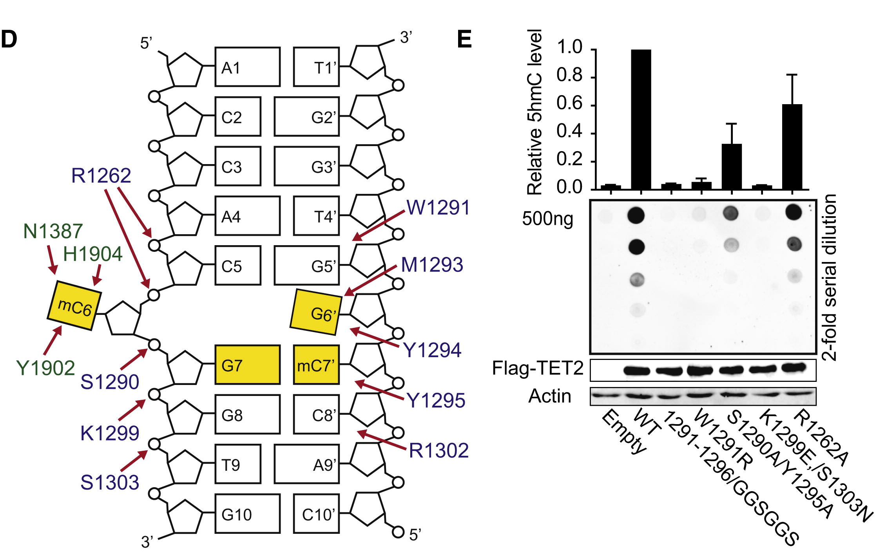
ERASER: TET2 (Ten Eleven Translocase 2)
oxidizes 5mC marking it for base excision repair
Hu, Lulu, et al. Cell 155.7 (2013): 1545-1555.

Slide 10
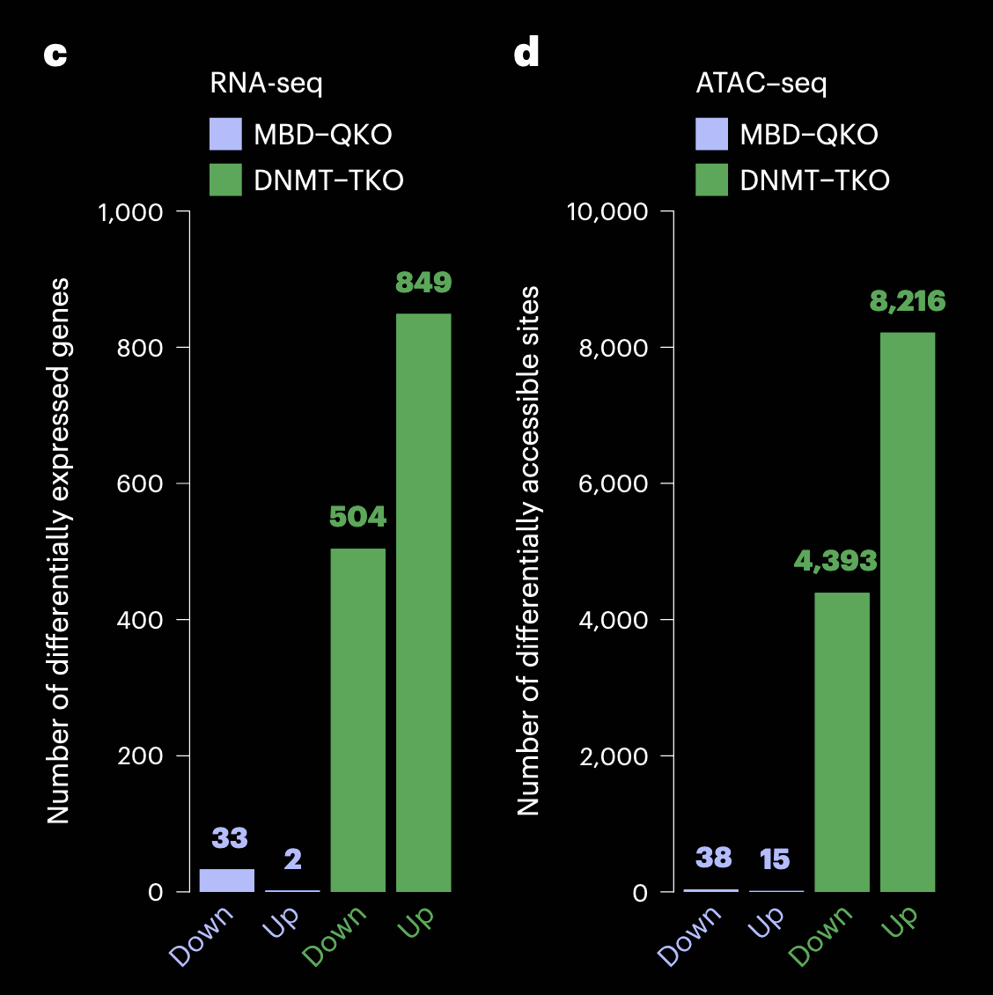
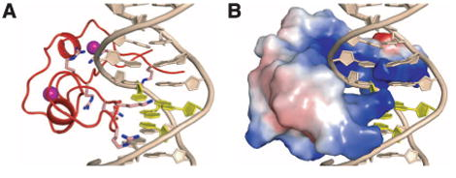
READERS: Only 4 transcription factors have MethylBinding Domains (MBD)
Kaluscha, Sebastian, et al Nature genetics 54.12 (2022): 1895-1906.

Slide 11
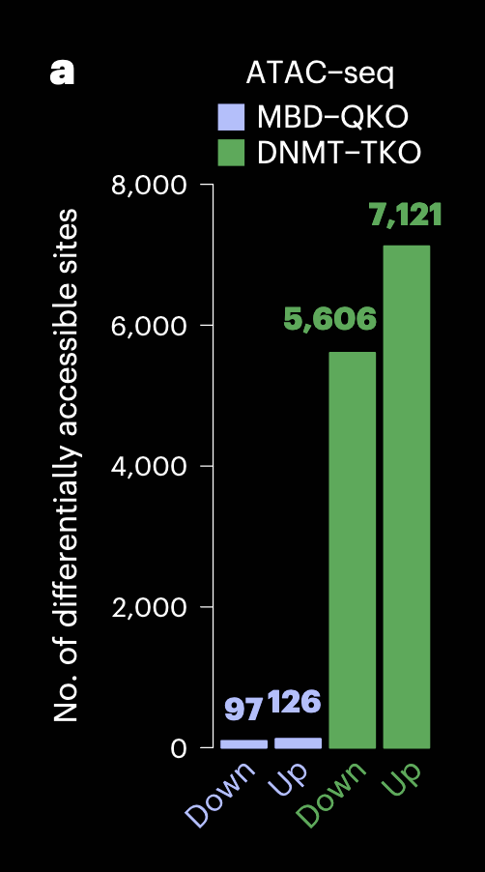
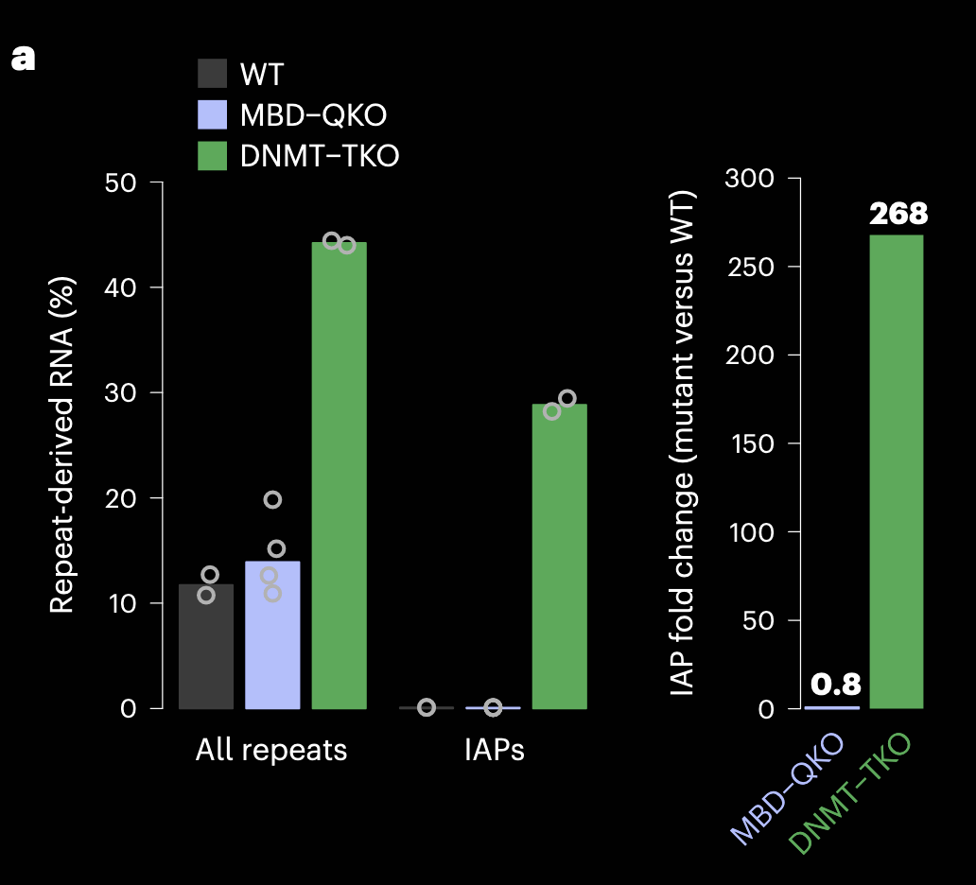
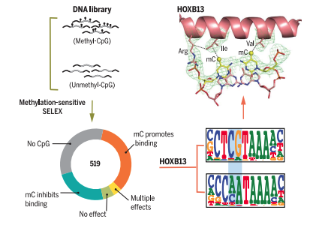
READERS: >50% of transcription factors show CG-methylation preference
Yin, Yimeng, et al. Science 356.6337 (2017): eaaj2239.
Kaluscha, Sebastian, et al Nature genetics 54.12 (2022): 1895-1906.

Slide 12
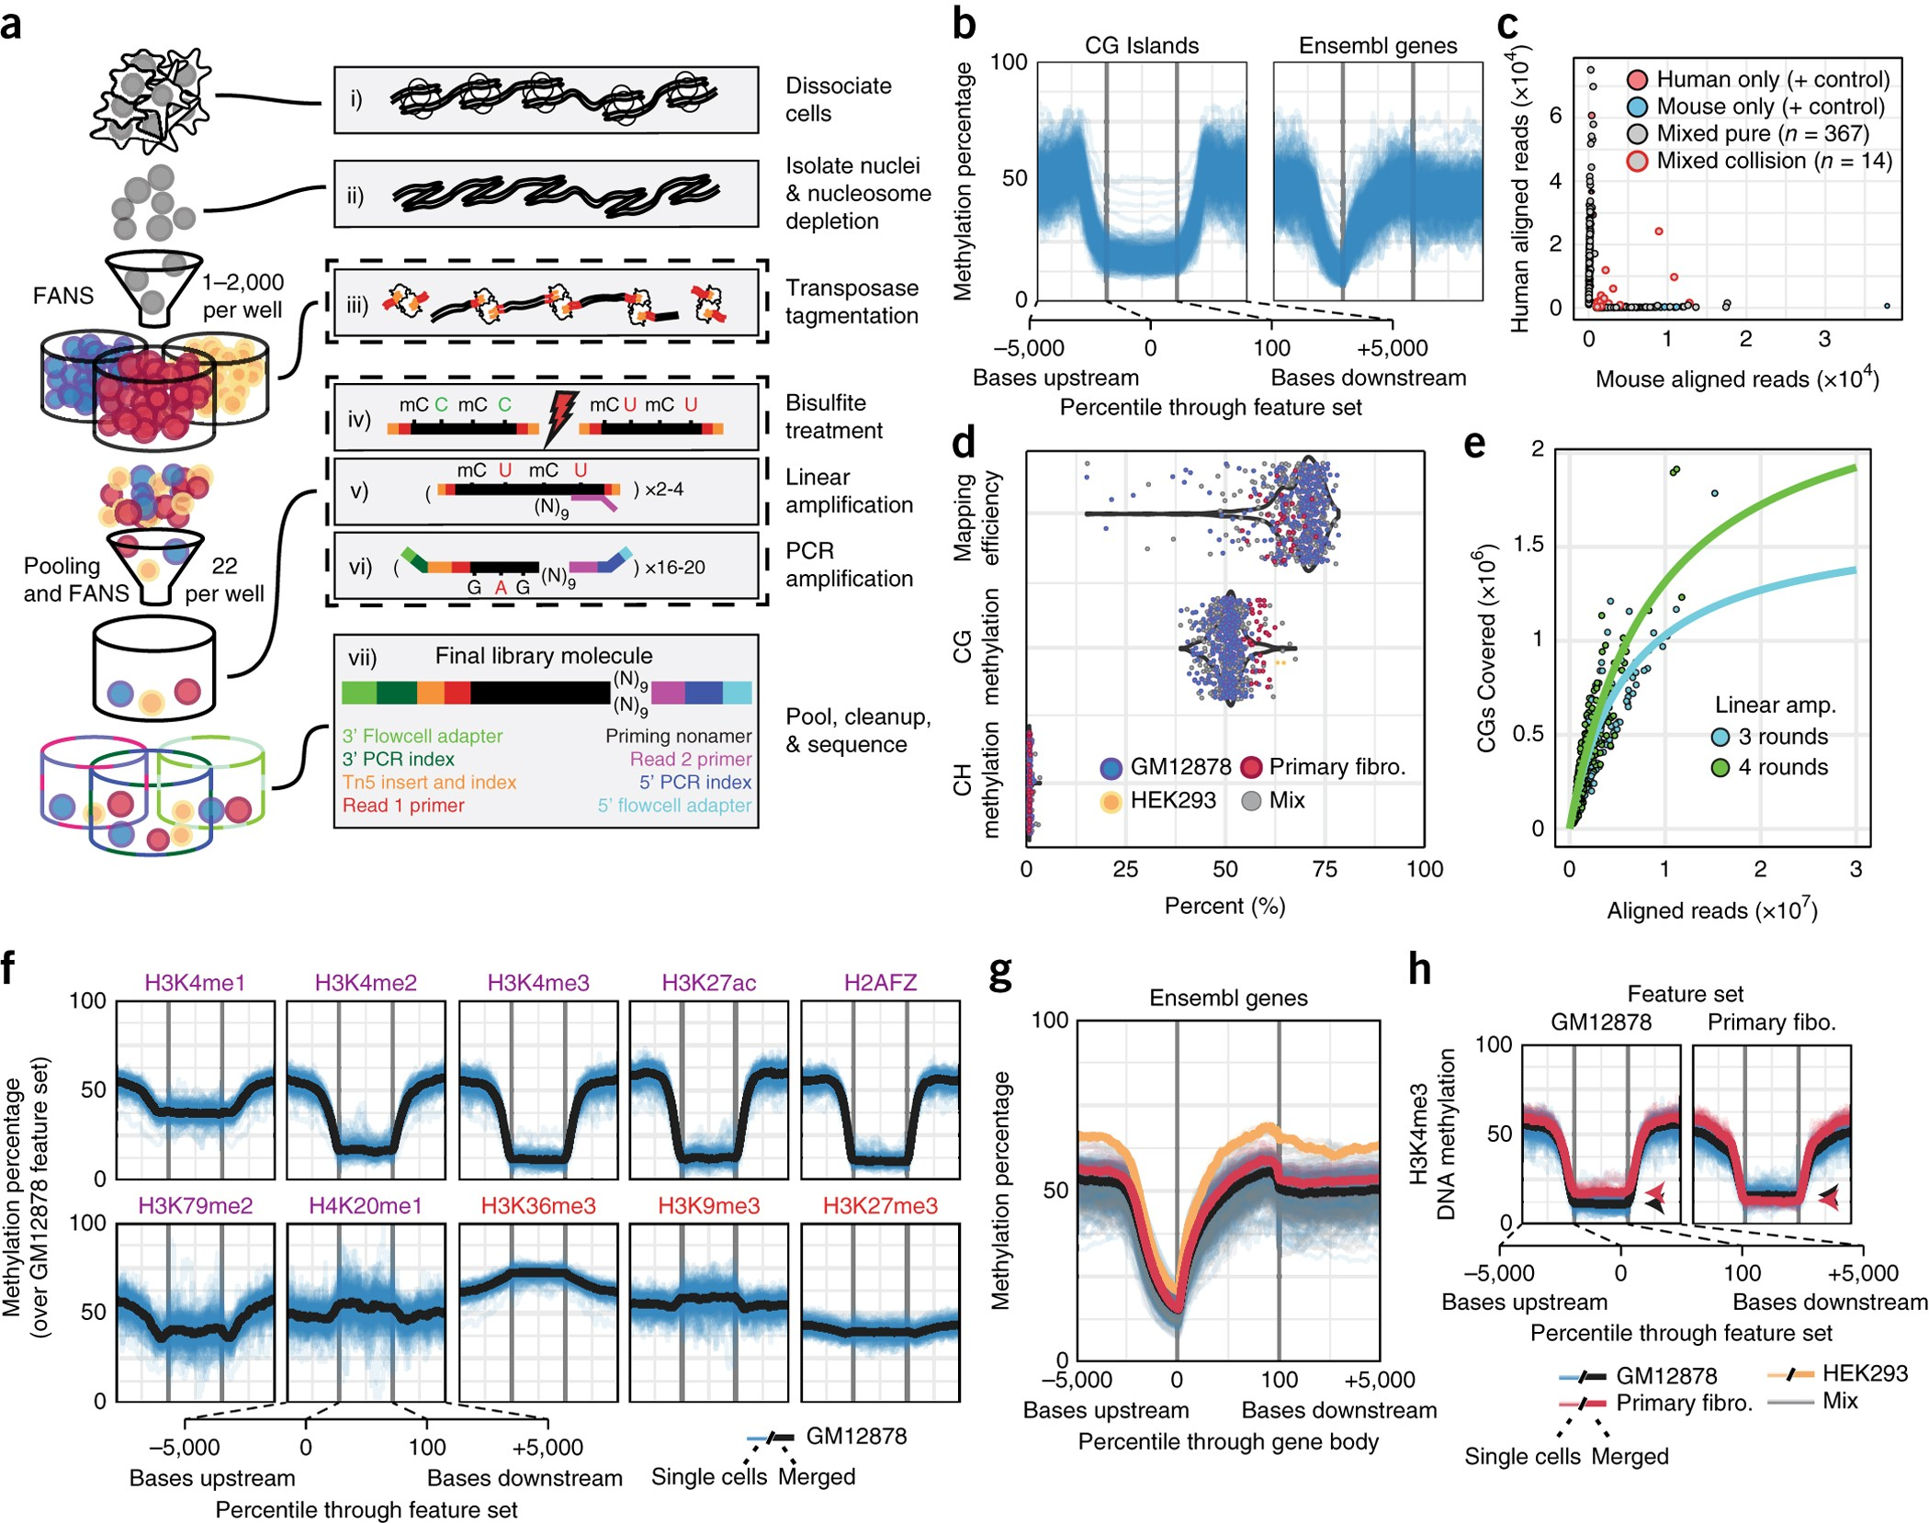
METHYLATION ALONG THE GENOME:
CG sites are 60-80% methylated depending on cell type
▼active sites ▲silenced sites
Clusters of CG sites are known as CG islands, these overlap promoters and enhancers and are ~80-90% hypomethylated
Mulqueen et al. Nature biotechnology 36.5 (2018): 428-431.

Slide 13
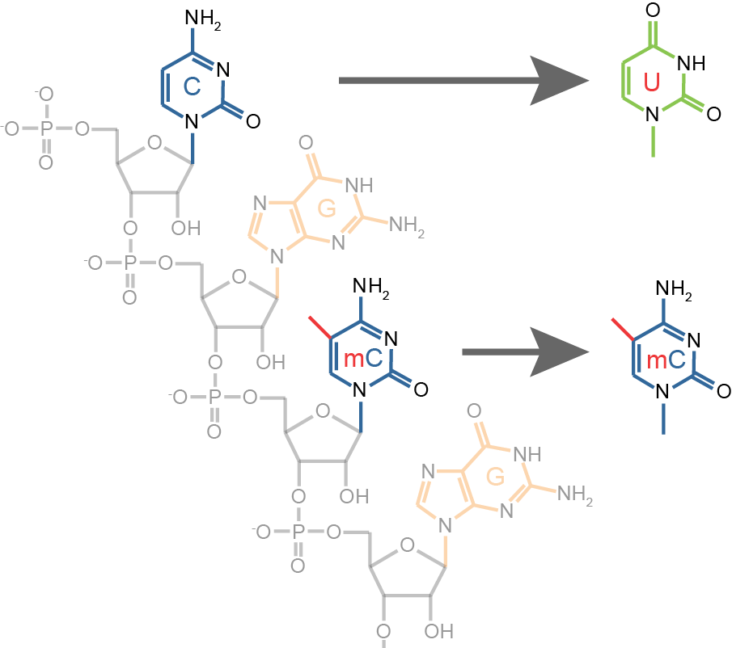
MEASURING METHYLATION THROUGH INDUCED POINT MUTATIONS
me
me
Methylated
Genomics DNA
CCAGTCGCTATAGCCGCGATATCGTA
Bisulfite
Converted DNA
UUAGTCGUTATAGUUGCGATATUGTA
TTAGTCGTTATAGTTGCGATATTGTA
PCR Product
|
|
|
|
|
|
|
|
CCAGTCGCTATAGCCGCGATATCGTA
Reference

Slide 14
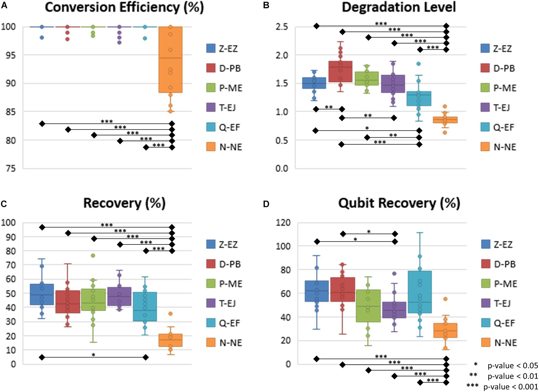
BISULFITE CONVERSION DEGRADES LIBRARIES
Hong, Sae Rom, and Kyoung-Jin Shin. Frontiers in genetics 12 (2021): 618955.

Slide 15
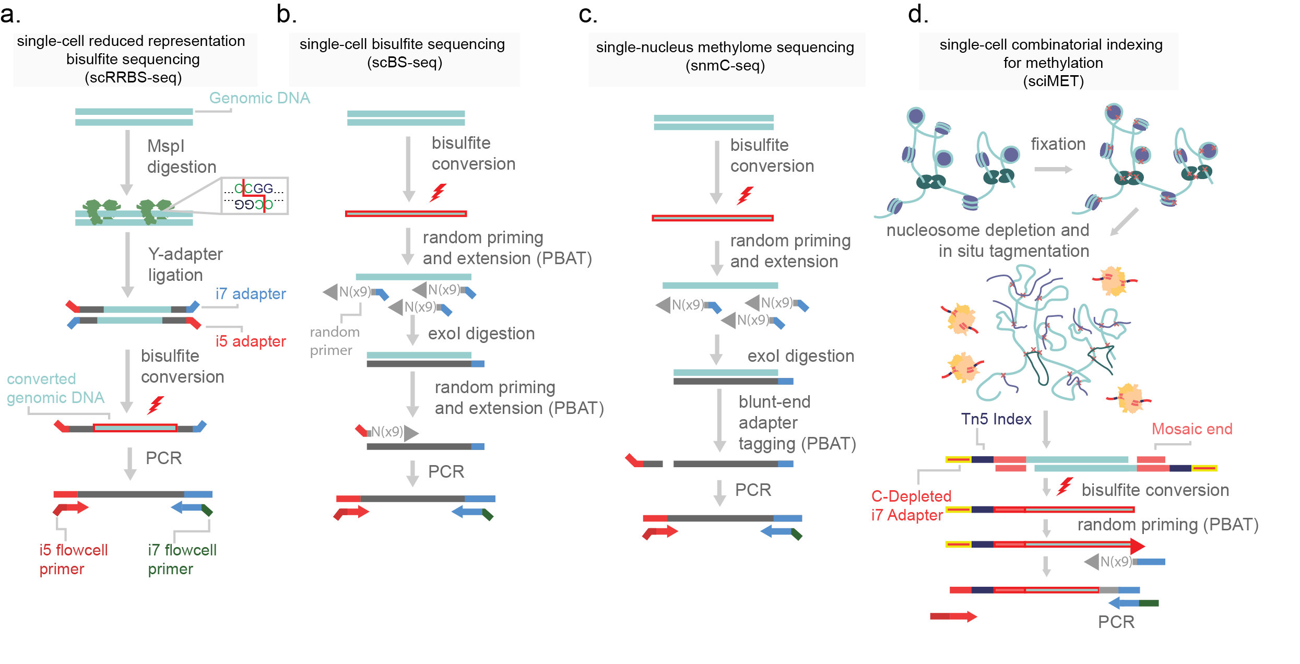
METHODS

Slide 16

STUDIES TO DATE
PMID | Sample | Year | Journal | Strategy | Cell Count
25042786 | Mouse Oocytes | 2014 | Nat Methods. | scBS-seq | 53
26549683 | Mouse Oocytes | 2015 | Mol Cell | scBS-seq | 27
27696608 | Mouse Oocytes | 2016 | Science | scPBAT | 10
26752769 | Human Embryonic cells | 2016 | Genes Cells. | scM&T-seq | 96
29255258 | Human Embryonic cells | 2017 | - | scPBAT | 506
28798132 | Human and Mouse Cortex | 2017 | Science | snmC-seq | 4,552
30078558 | Human Hematopoetic Cells | 2018 | Stem Cell Reports. | scPBAL | 219
30031774 | Human Embryonic cells | 2018 | Cell Syst | scBS-seq | 334
29915357 | Human Embryonic cells | 2018 | Nat Cell Biol. | scCOOL-seq | 285
30498128 | Human Colorectal Cancer | 2018 | Nat Genet | scTrioSeq2 | 581
29644997 | Cell Lines, Human and Mouse Cortex | 2018 | Nat. Biotechnology | sciMET | 3,282
30560925 | Mouse Oocytes | 2019 | Cell Res. | iscCOOL-seq | 766
31554804 | Mouse Muscle Stem Cells | 2019 | Nat Commun. | scBS-seq | 260
- | Mouse Oocytes | 2019 | - | scM&T-seq | 24
31847873 | Mouse Oocytes | 2019 | Genome Med | scBS-seq | 5
34616061 | Mouse cortex | 2021 | Nature | snmC-seq | 103,982
36494343 | Human Cortex | 2022 | Nature Commun. | sciMETv2 | 2,546
39719707 | Human Cortex | 2025 | Cell Genomics | sciMETv3 | >140,000
scMethBank: a database for single-cell whole genome DNA methylation maps.Nucleic Acids Res. 2021.

Slide 17
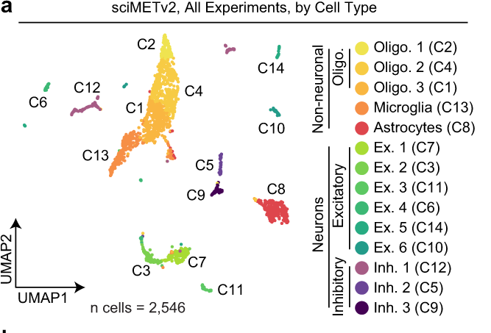
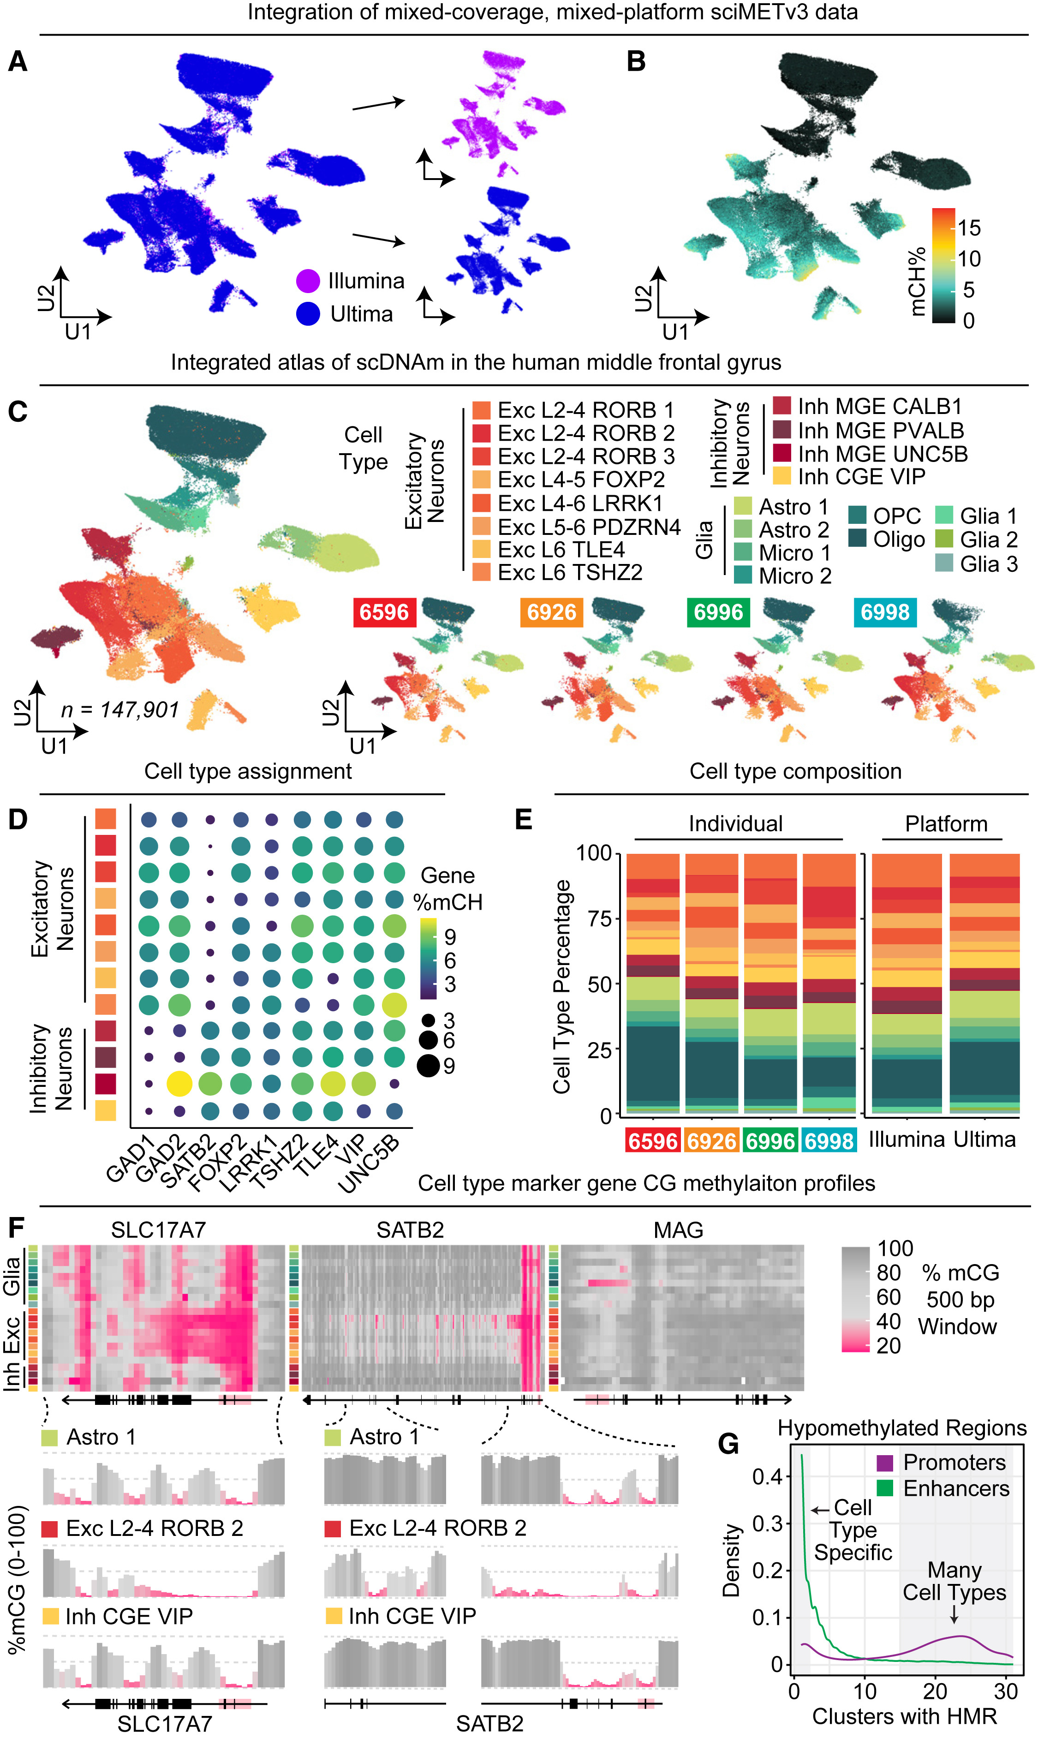
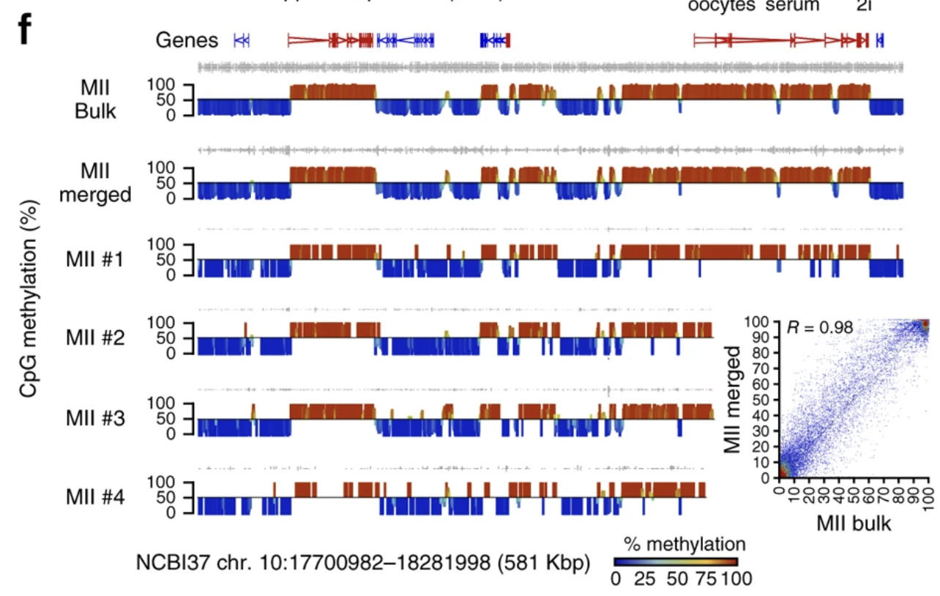
HISTORY OF THROUGHPUT
2022 sciMETv2
2,546 cells
2025 sciMETv3
147,901 cells
11 years ago
12 scMET libraries
Smallwood et al. 2014
Nichols et al. 2022
Nichols et al. 2024

Slide 18
COUNTS BASED ASSAYS

Slide 19
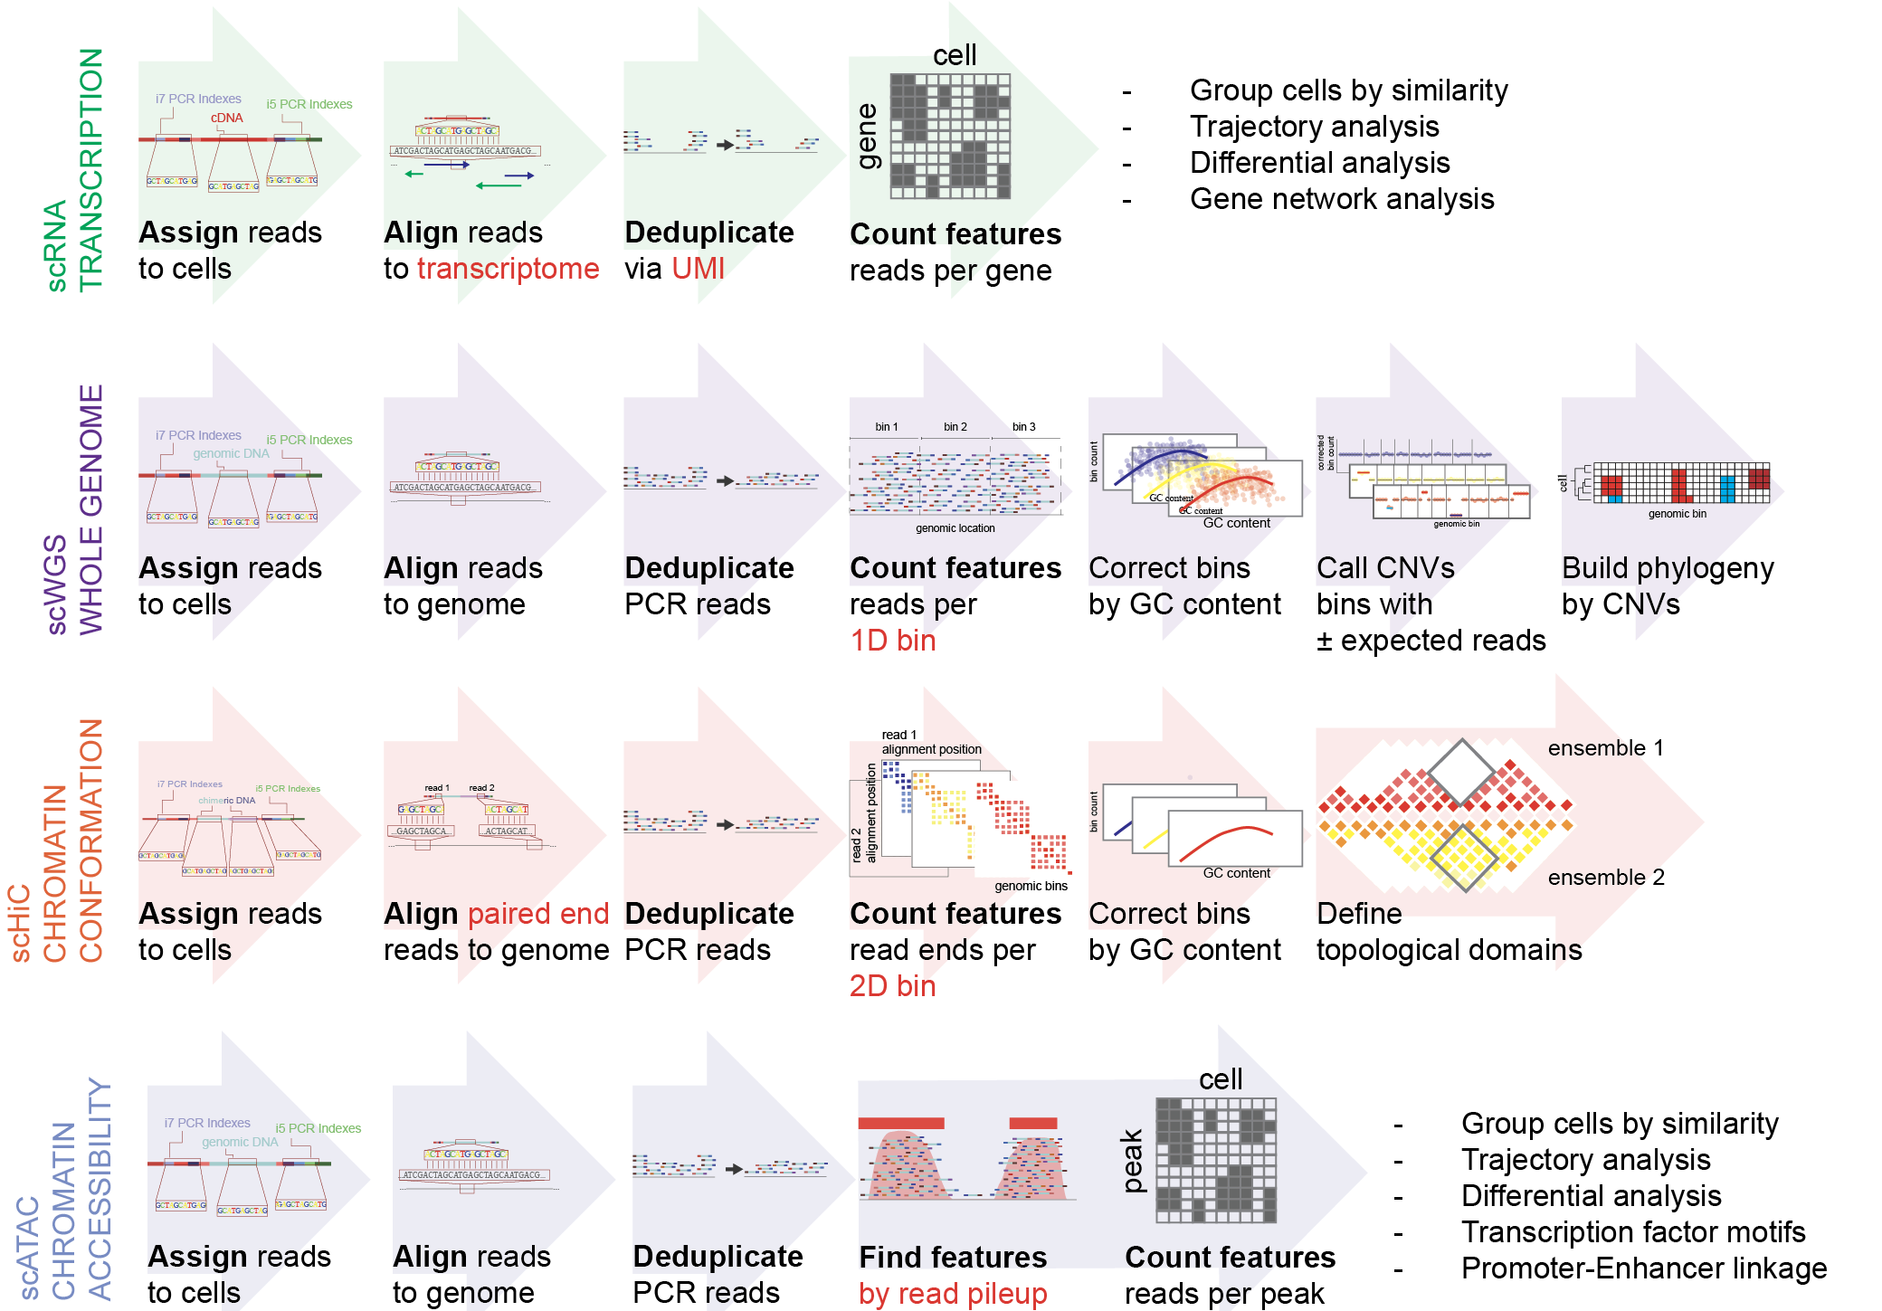
COUNTS BASED ASSAYS

Slide 20
COUNTS BASED ASSAYS
Features are genome bins instead of genes

Slide 21
COUNTS BASED ASSAYS
Read 1 and Read 2 of Paired end are aligned separately giving a 2D genome bin

Slide 22
COUNTS BASED ASSAYS
Features of read pileups (Open regions)

Slide 23
COUNTS BASED ASSAYS

Slide 24
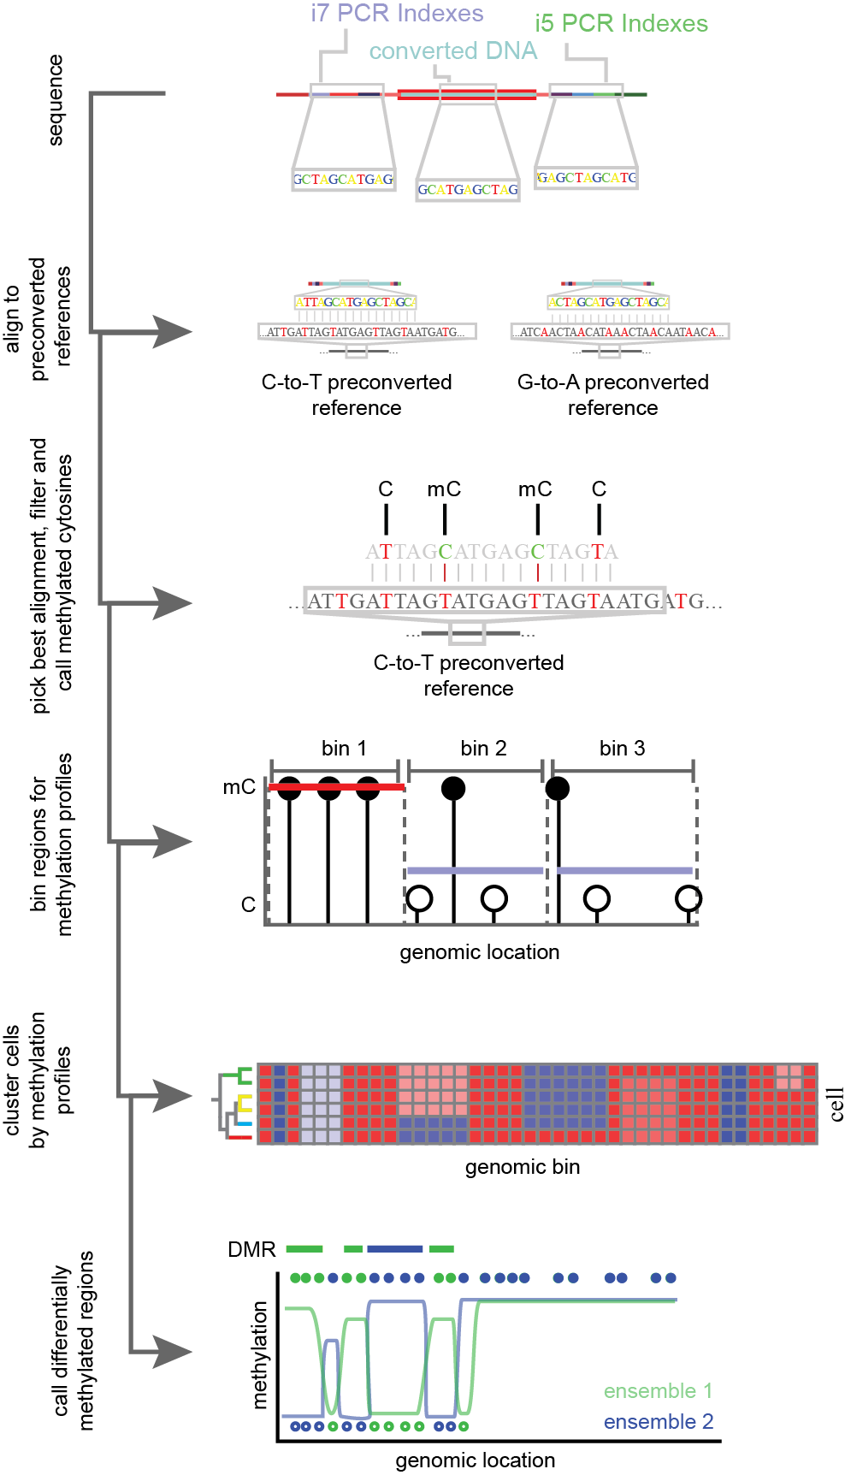
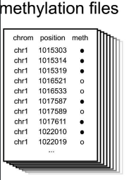
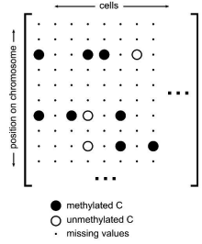
METHYLATION
ALIGNMENT ▶︎ FEATURE SUMMARY ▶︎ CELL X FEATURE MATRIX
assign bisulfite converted reads to cells
identify methylated cytosines per cell
Convert cell data into a cell by feature matrix
Aligners like bismark preconvert the reference genome and your data to increase alignment rate
Krueger, Felix, and Simon R. Andrews. Bioinformatics 27.11 (2011): 1571-1572.
Kremer, Lukas PM, et al. BioRxiv (2022).

Slide 25
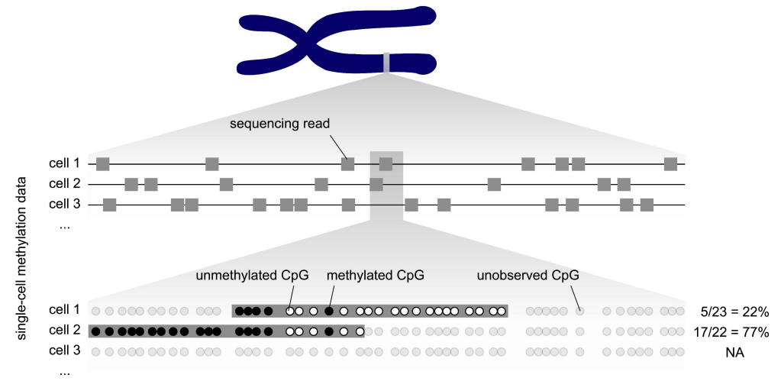
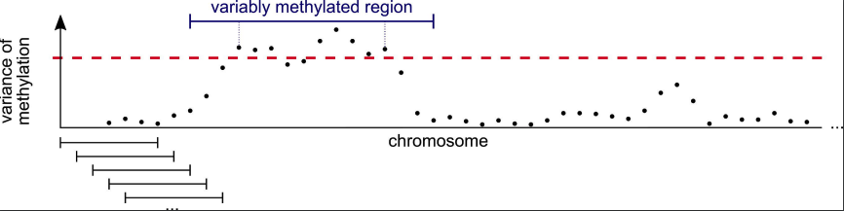
Unobserved regions are fundamentally different than counts based assays
Kapourani et al. 2021

Slide 26
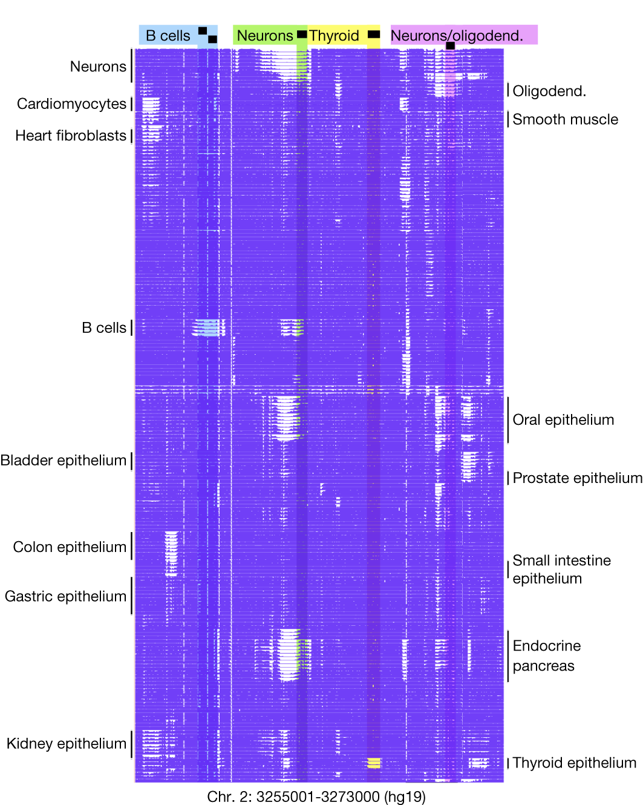
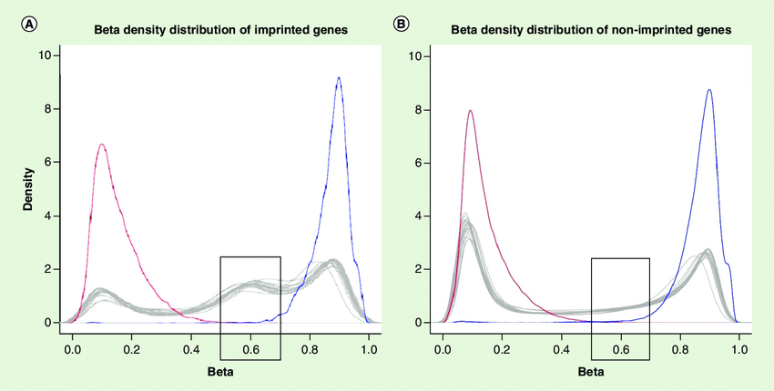
Unobserved regions are fundamentally different than counts based assays
Methylation is binary in small genomic windows
15kbp locus
Loyfer et al. 2023
Pervjakova et al. 2016

Slide 27
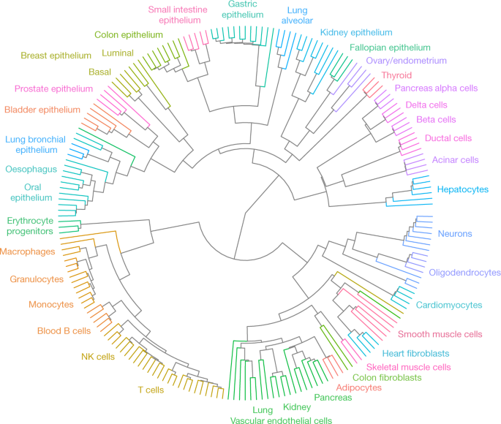
Cell typing!
Bulk methylomes from purified cell types
Loyfer et al. 2023

Slide 28
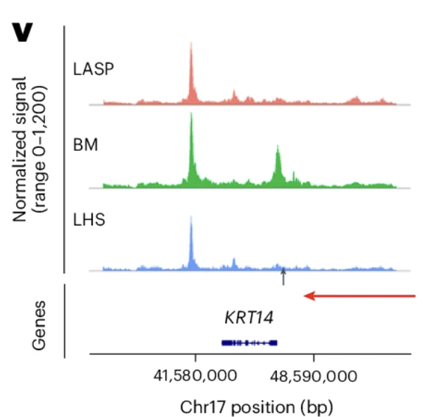
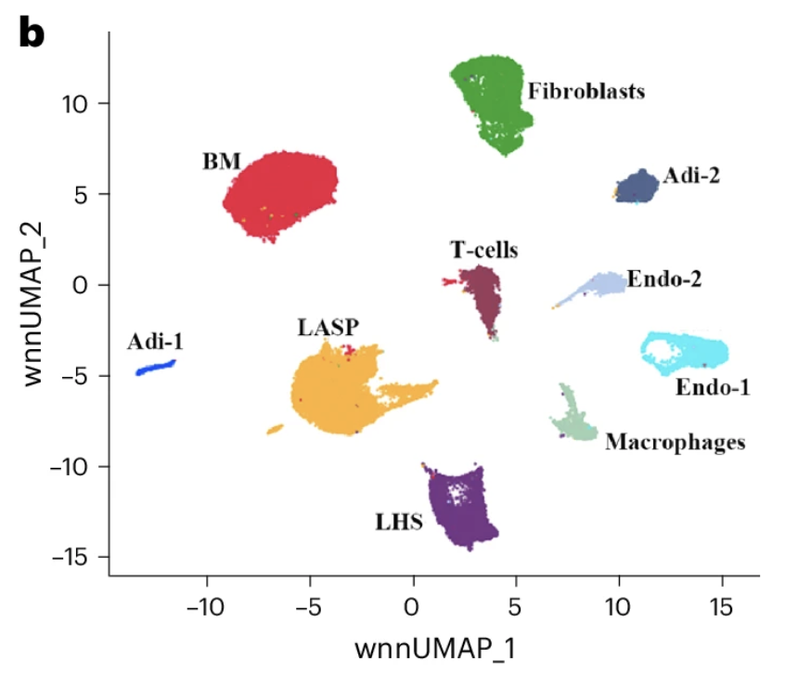
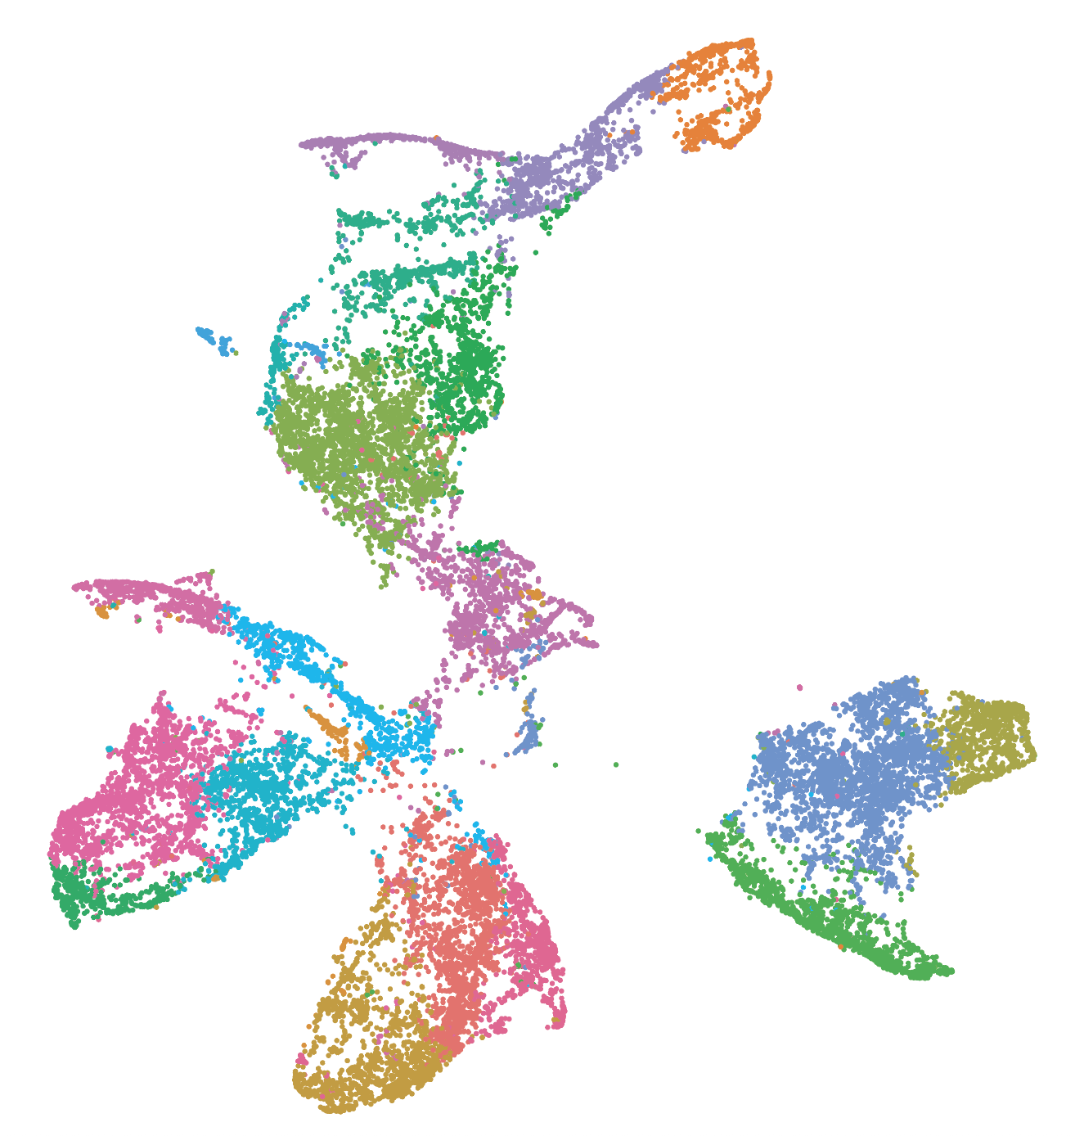
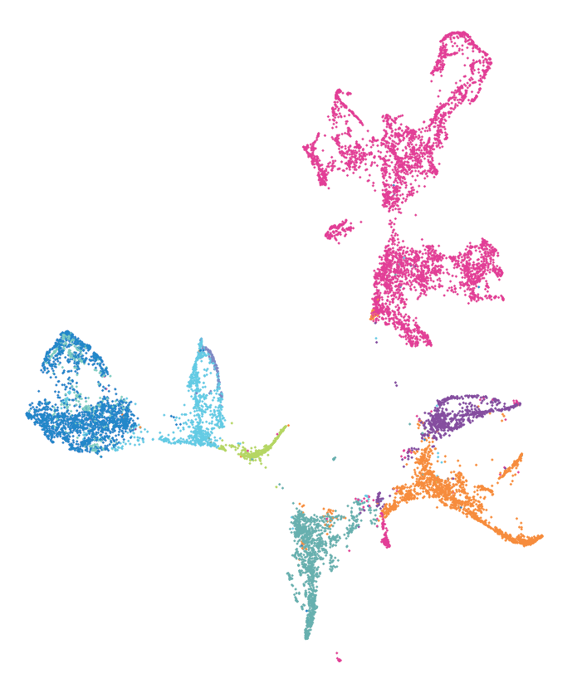
METHYLATION
CLUSTER CELLS ON WINDOWS ▶︎ IDENTIFY DMRS ▶︎ RECLUSTER CELLS ON DMRS
Select starting features:
5kb bins
ATAC peaks
RNA promoters
CUT&TAG markers
Weighted methylation across features
Cluster on DMRs and assign cell types
cell
feature
cluster cells on these features
use cell groupings to define DMRs
Bhat- Nakshatri et al. 2024

Slide 29
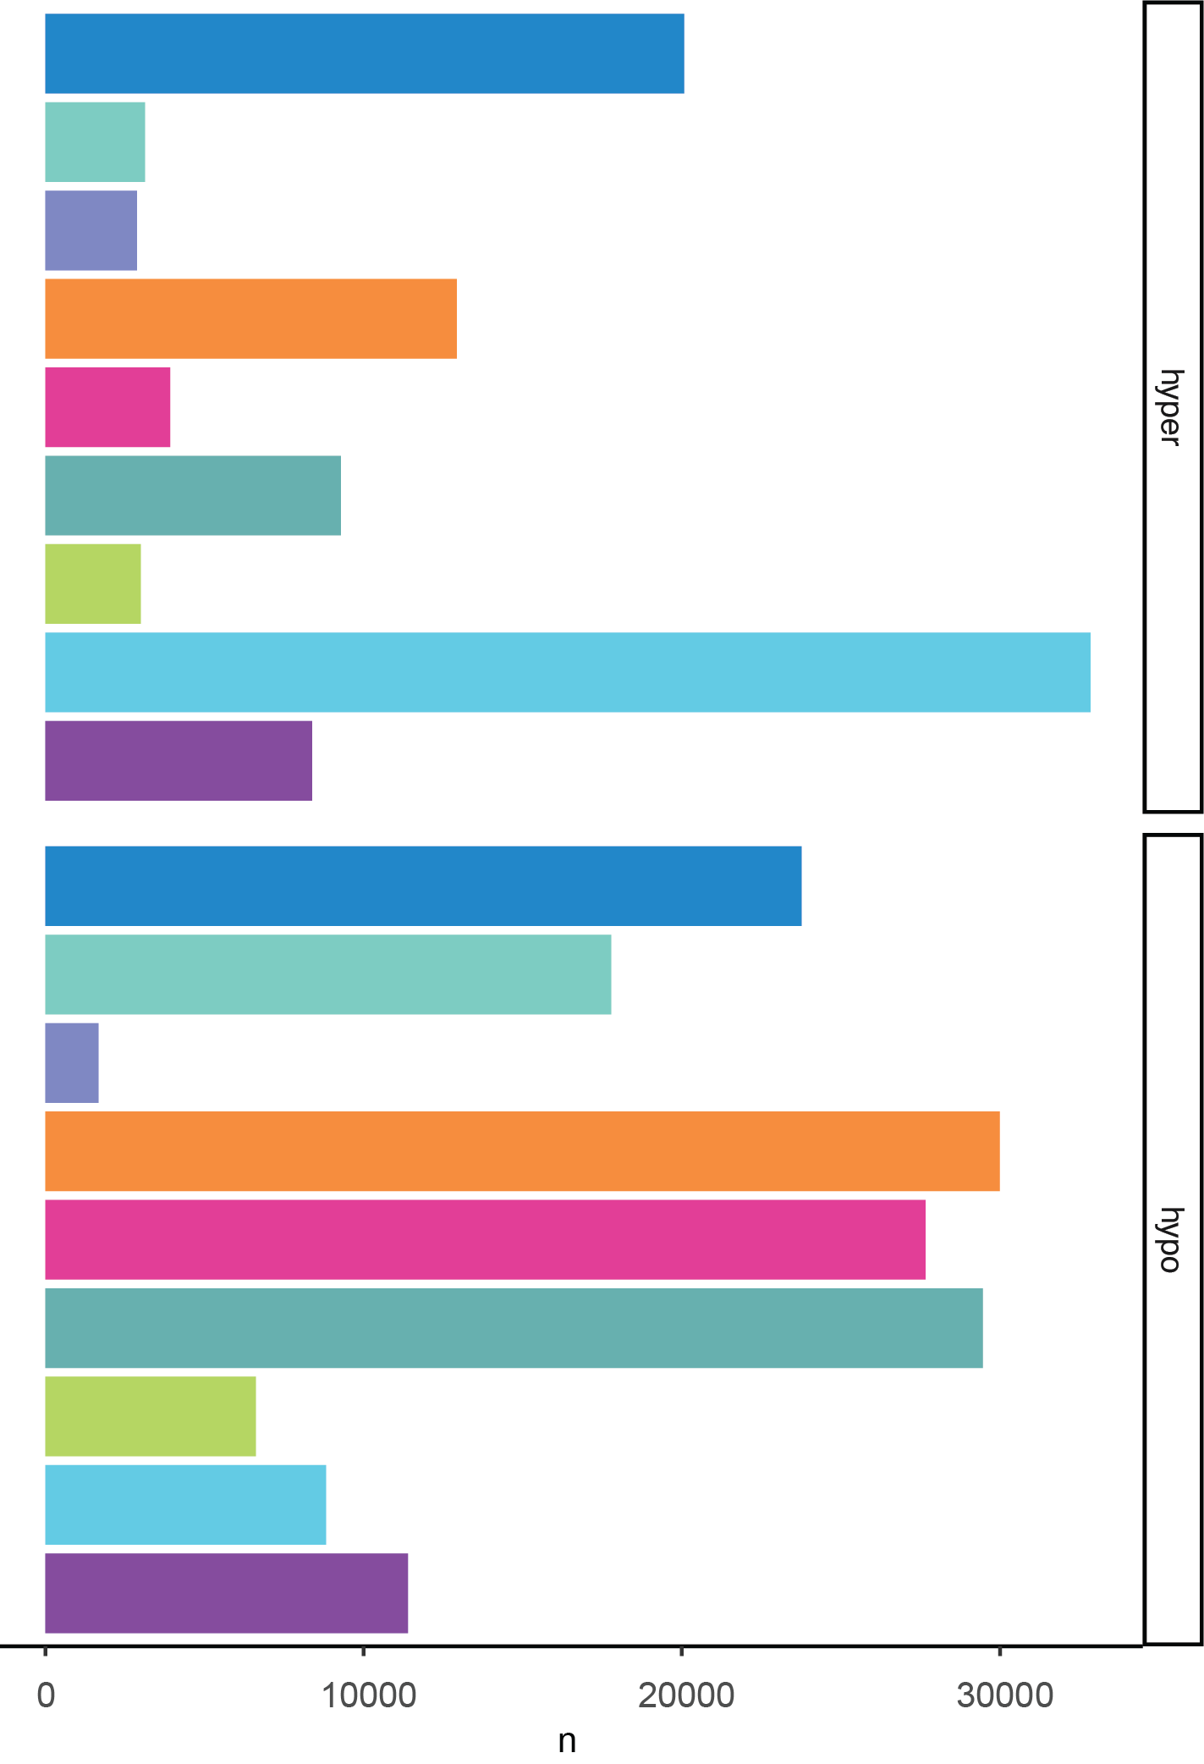
From cluster to cell types: a priori
96,436 DMRs
mean 3.6kbp
157,143 DMRs
mean 3.9kbp

Slide 30
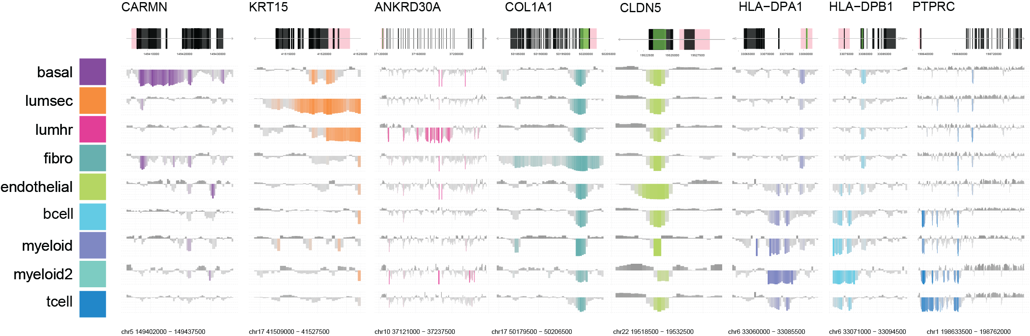
Cell typing in methylation: a posteriori
hyper
mean %mCG
hypo
500bp windows

Slide 31
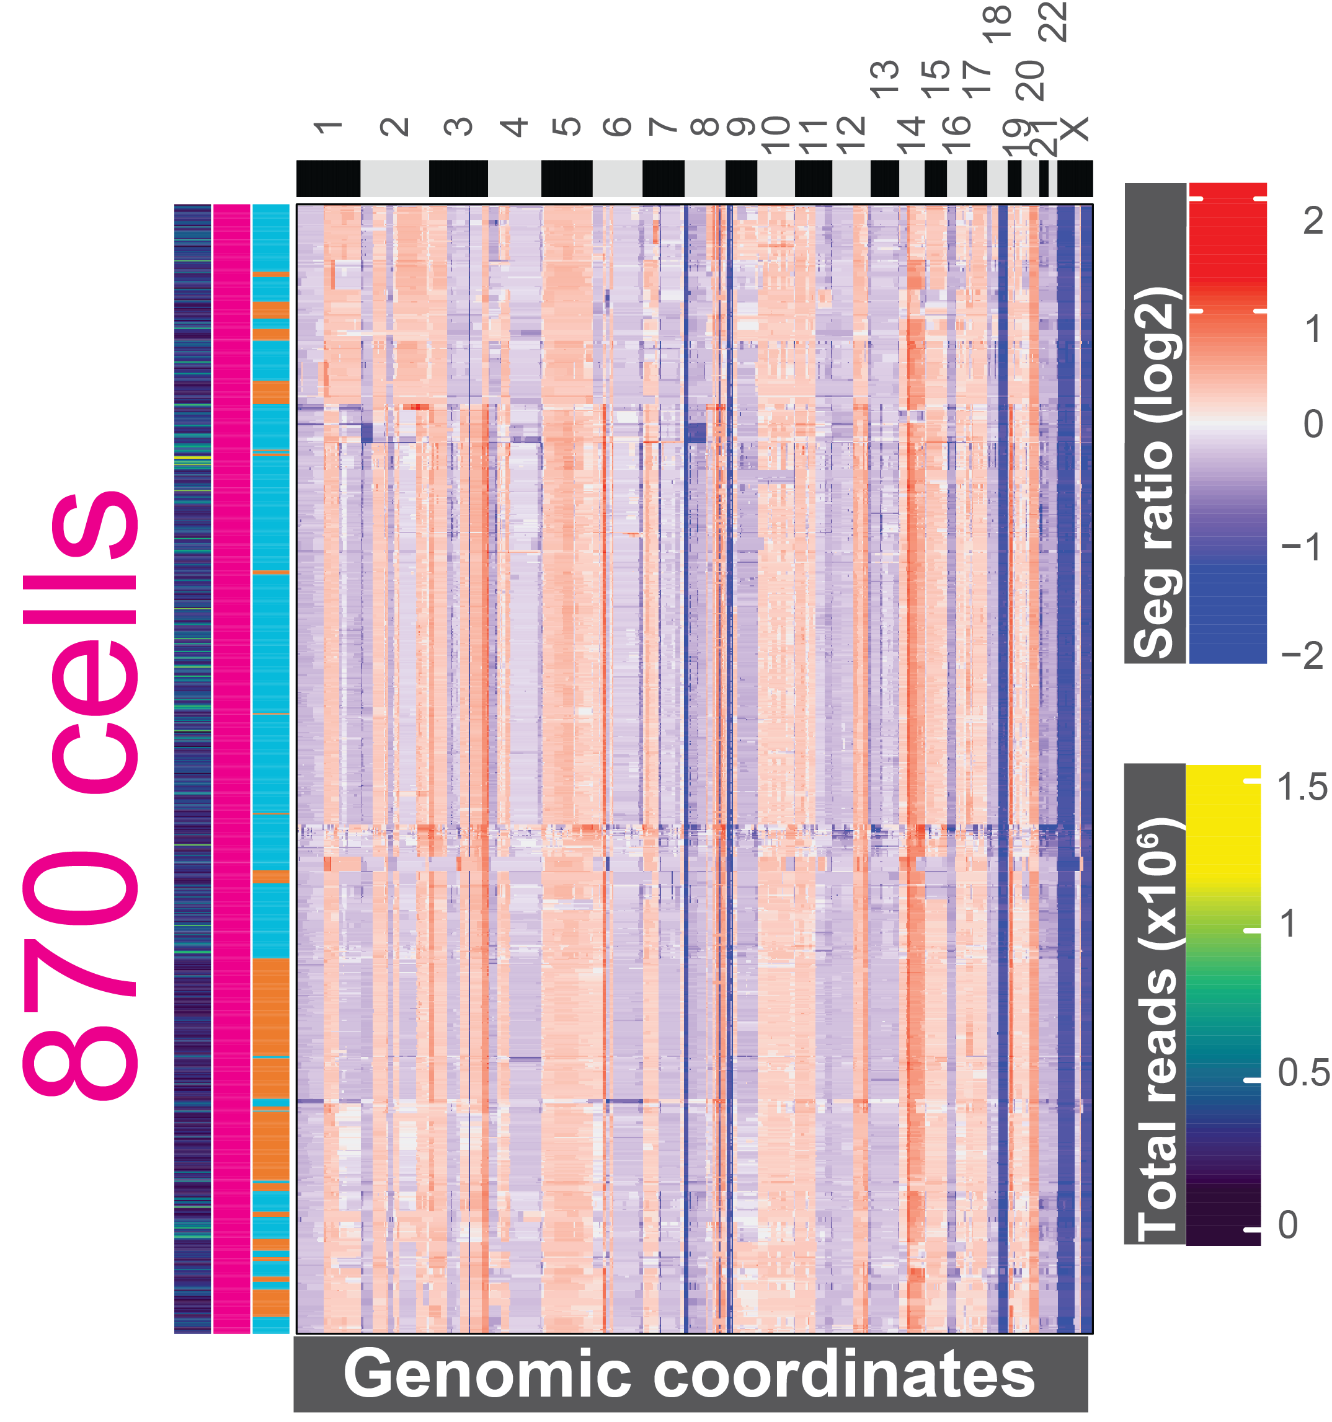
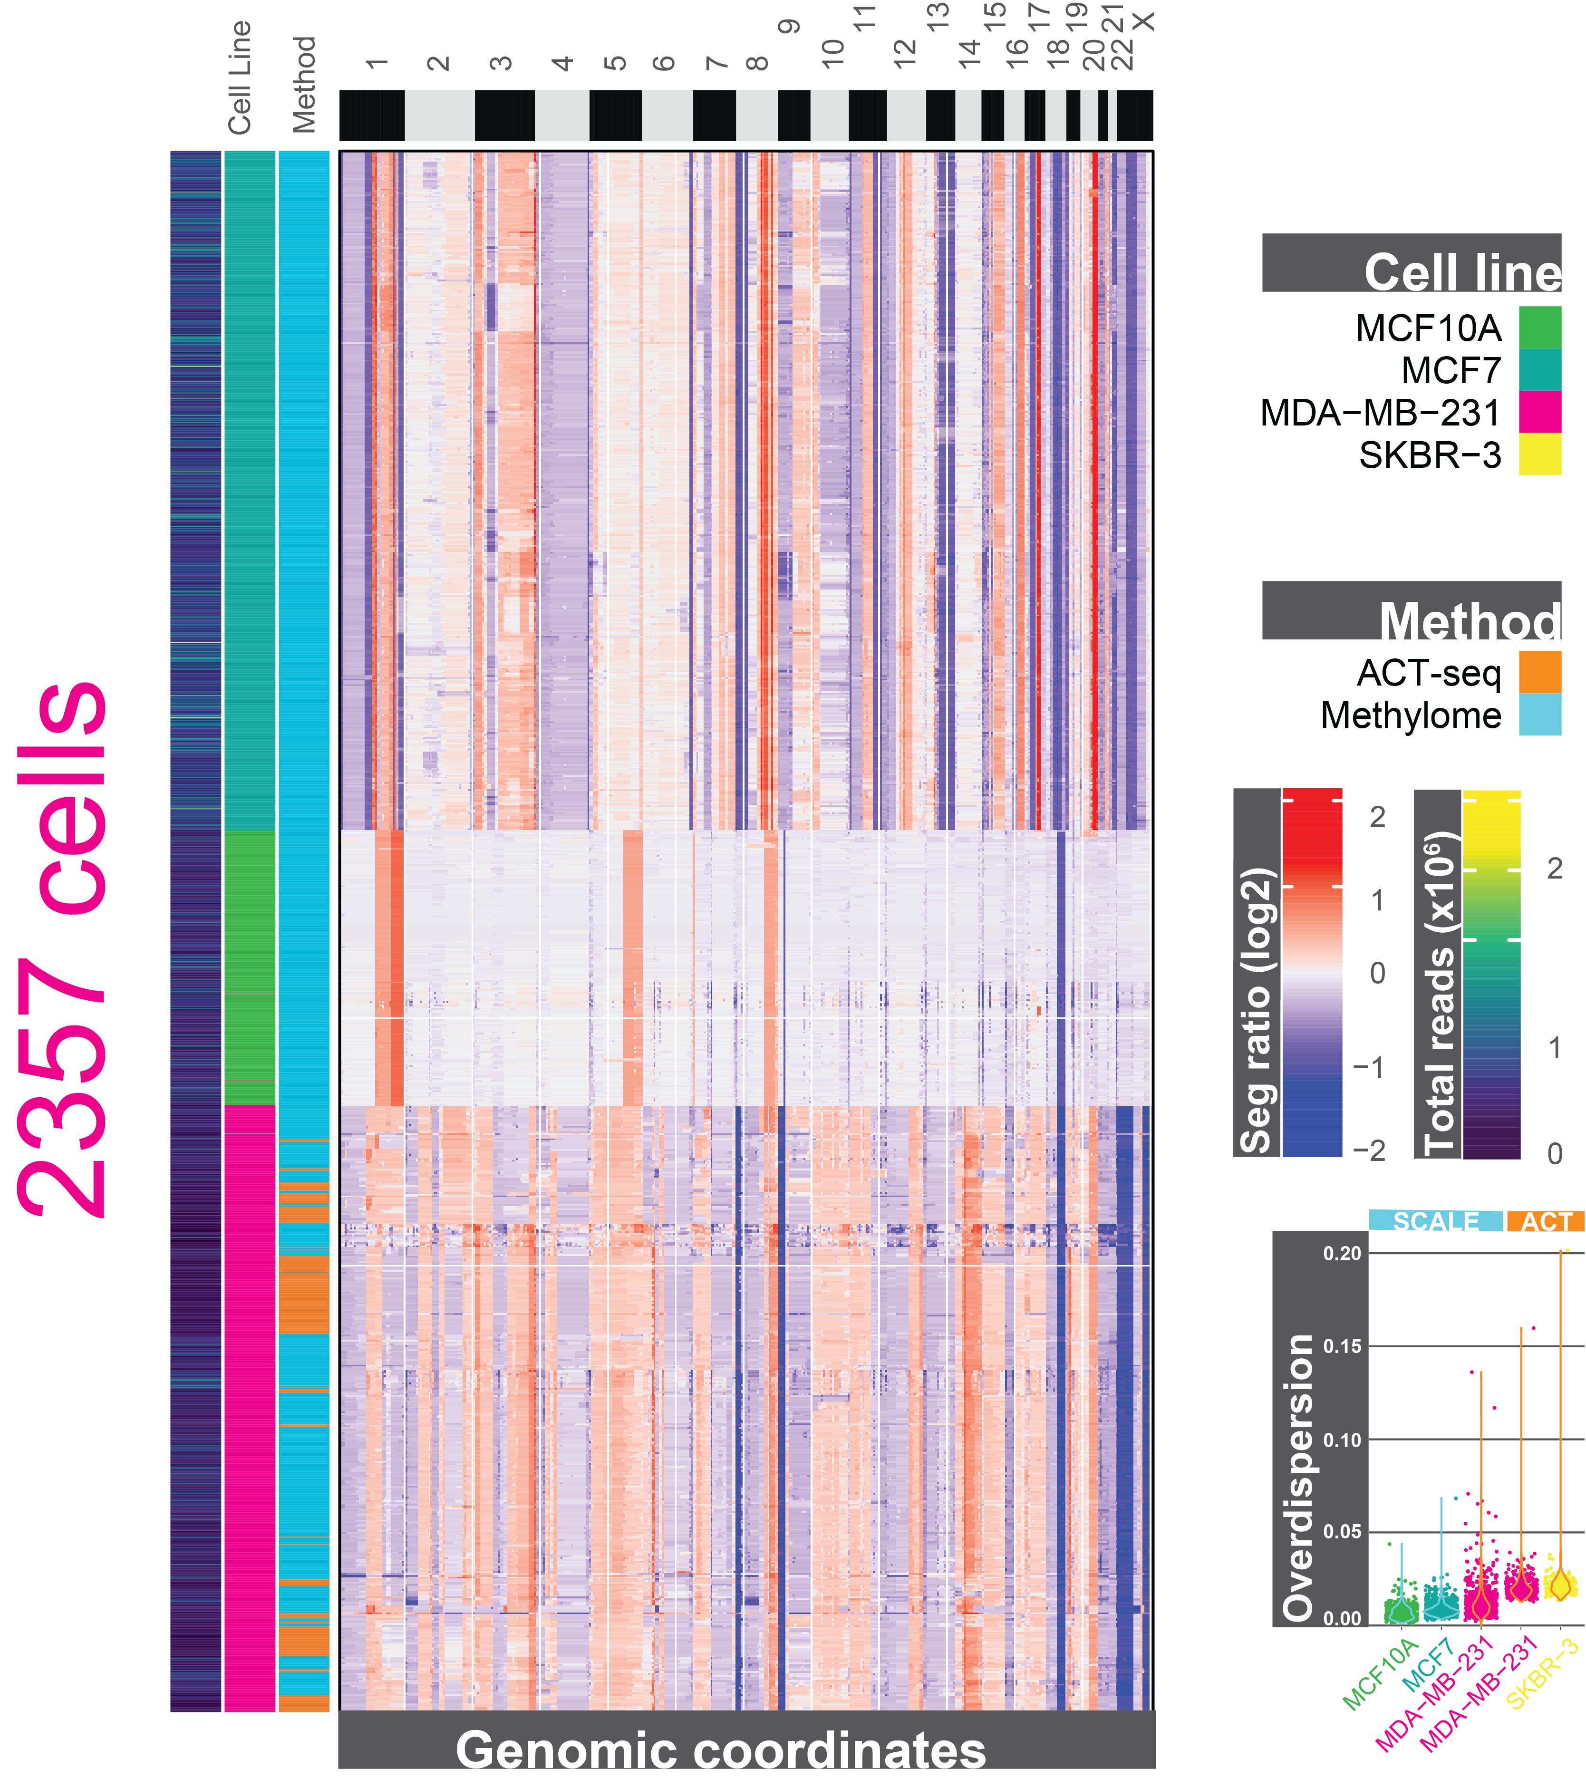
Validating CNV calling on heterogenous cell lines
MET

Slide 32
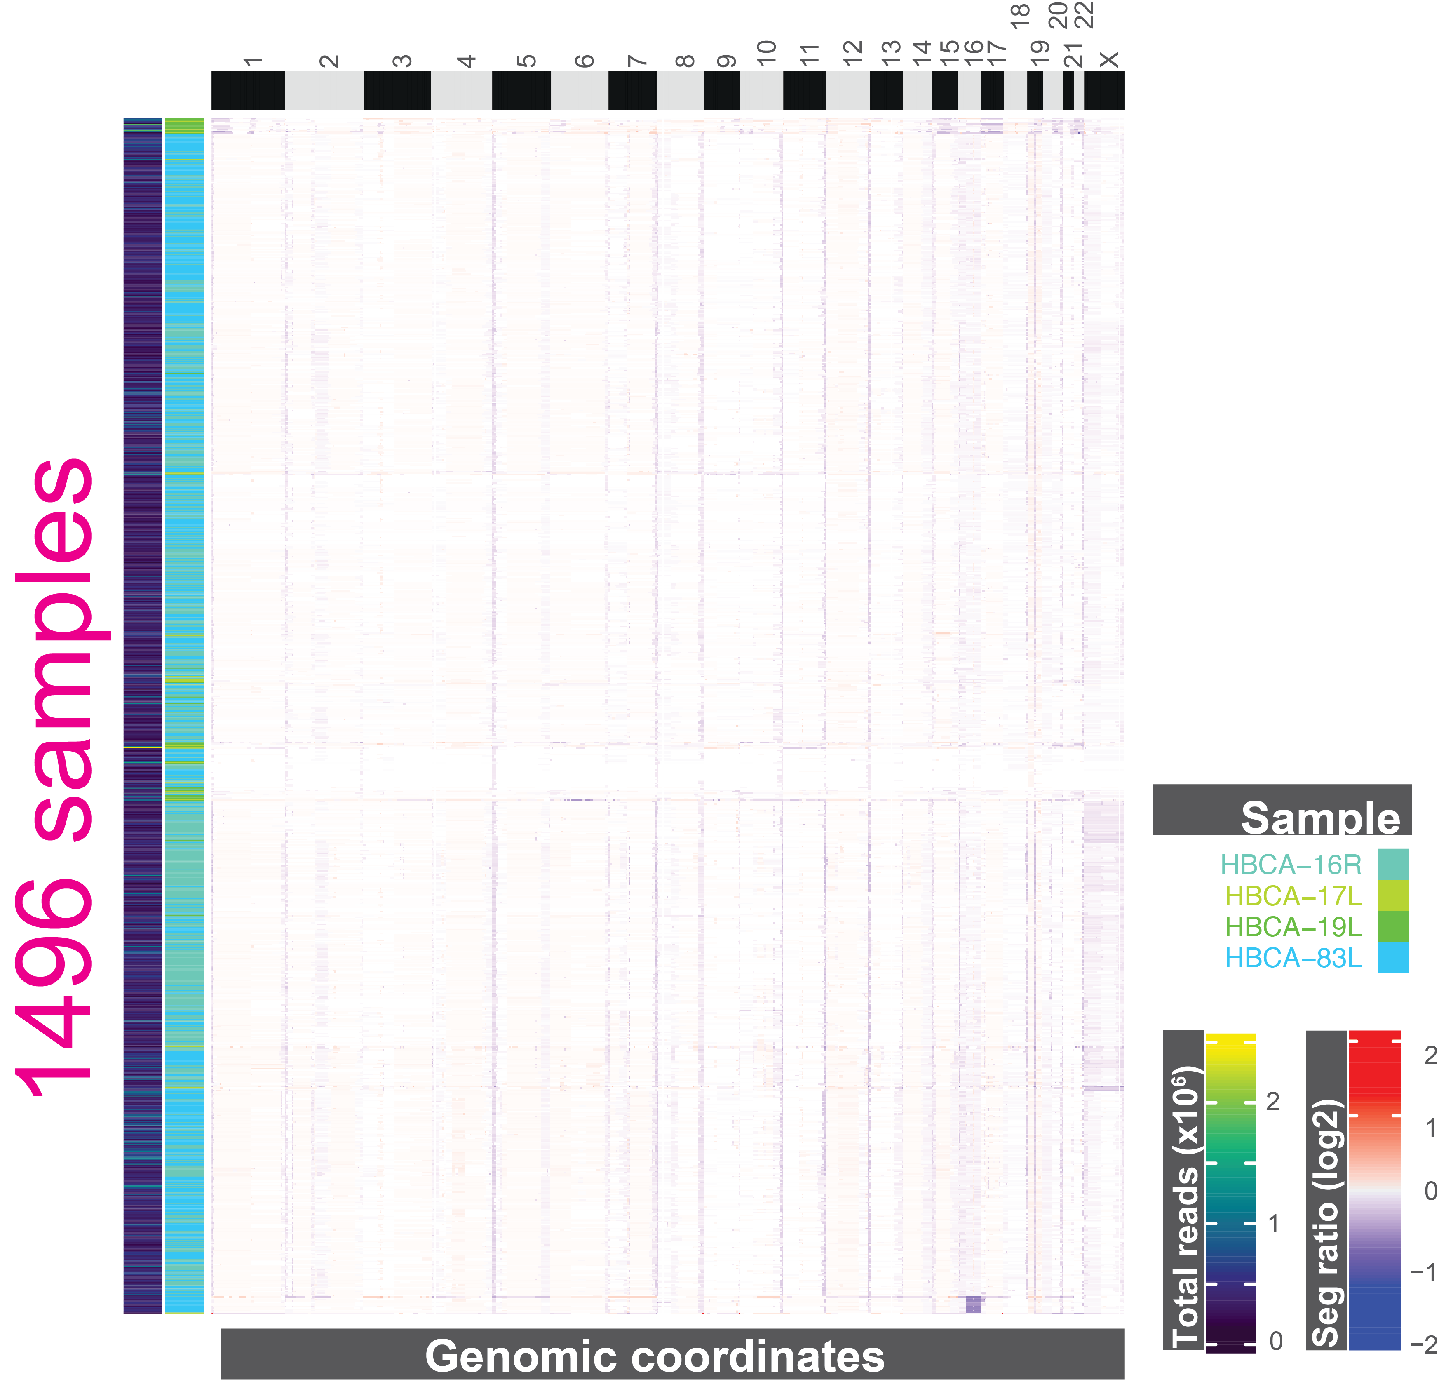
Lineage tracing through CNVs
In normal breast tissue we found 1 CNV across 4 samples
16q loss
icell8: Epithelial enriched
►
►
Lin, Yiyun, et al. "Normal breast tissues harbor rare populations of aneuploid epithelial cells." Cancer Research 84.6_Supplement (2024): 780-780.

Slide 33
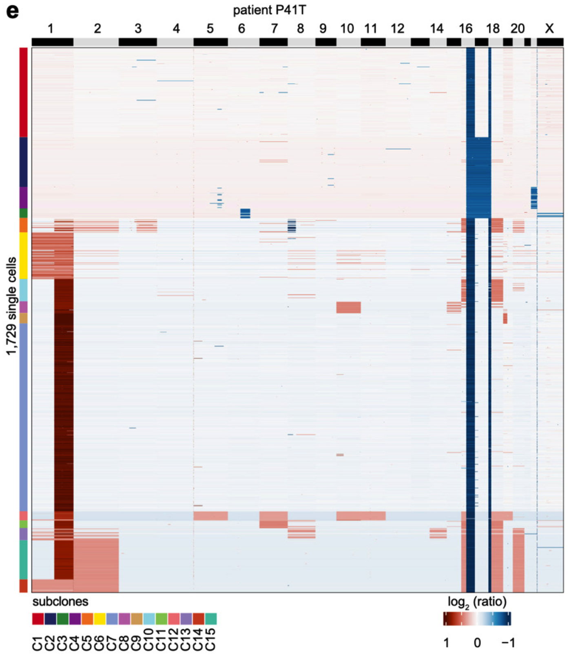
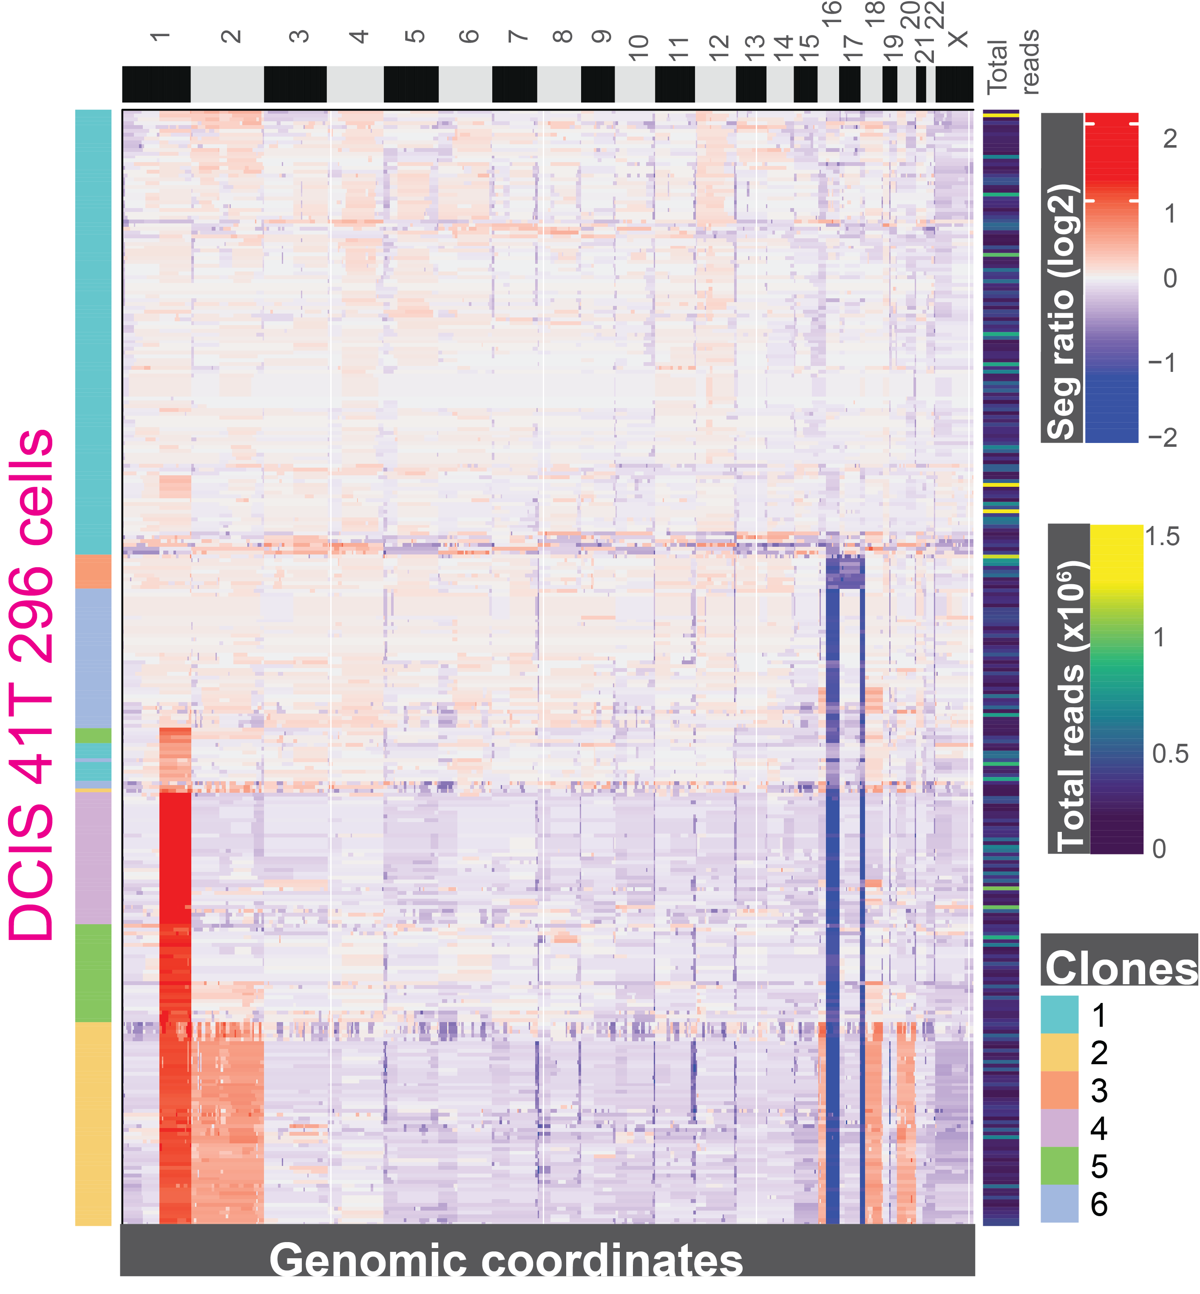
Lineage tracing through CNVs
scWGS
scMET

Slide 34

Lineage tracing through epimutations
Chen et al. 2025

Slide 35
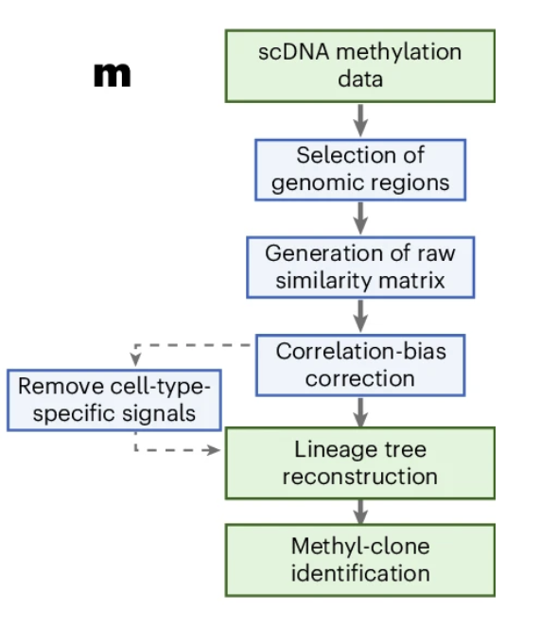
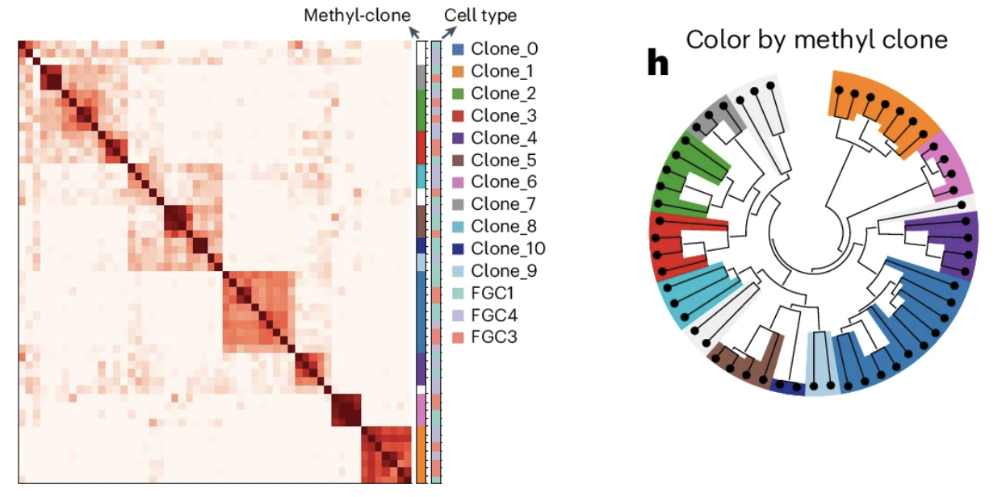
Lineage tracing through epimutations
Chen et al. 2025

Slide 36
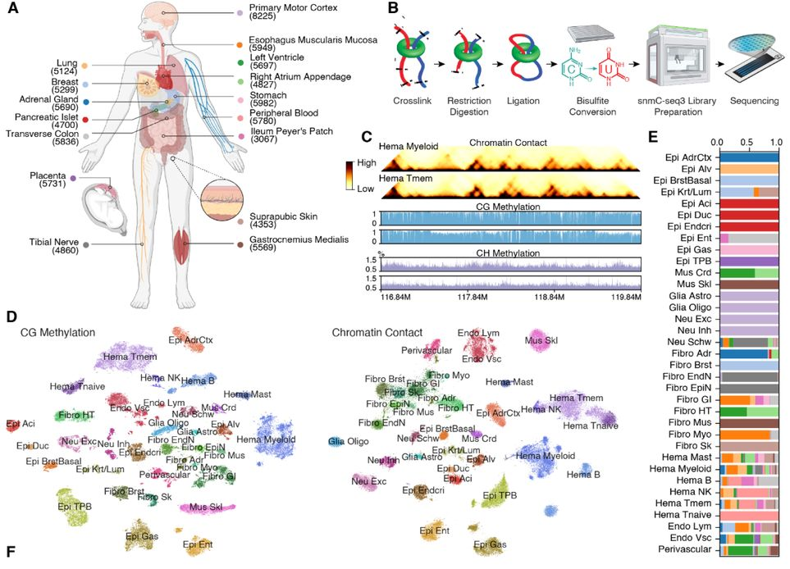

Exciting advancements in single cell methylation
Subject of our new GCC Single Cell and Spatial Consortium Journal Club next week!
Zhou et al. bioRxiv 2025

Slide 37
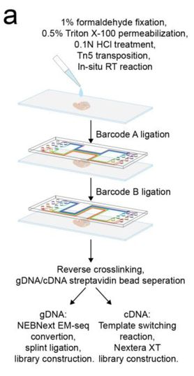
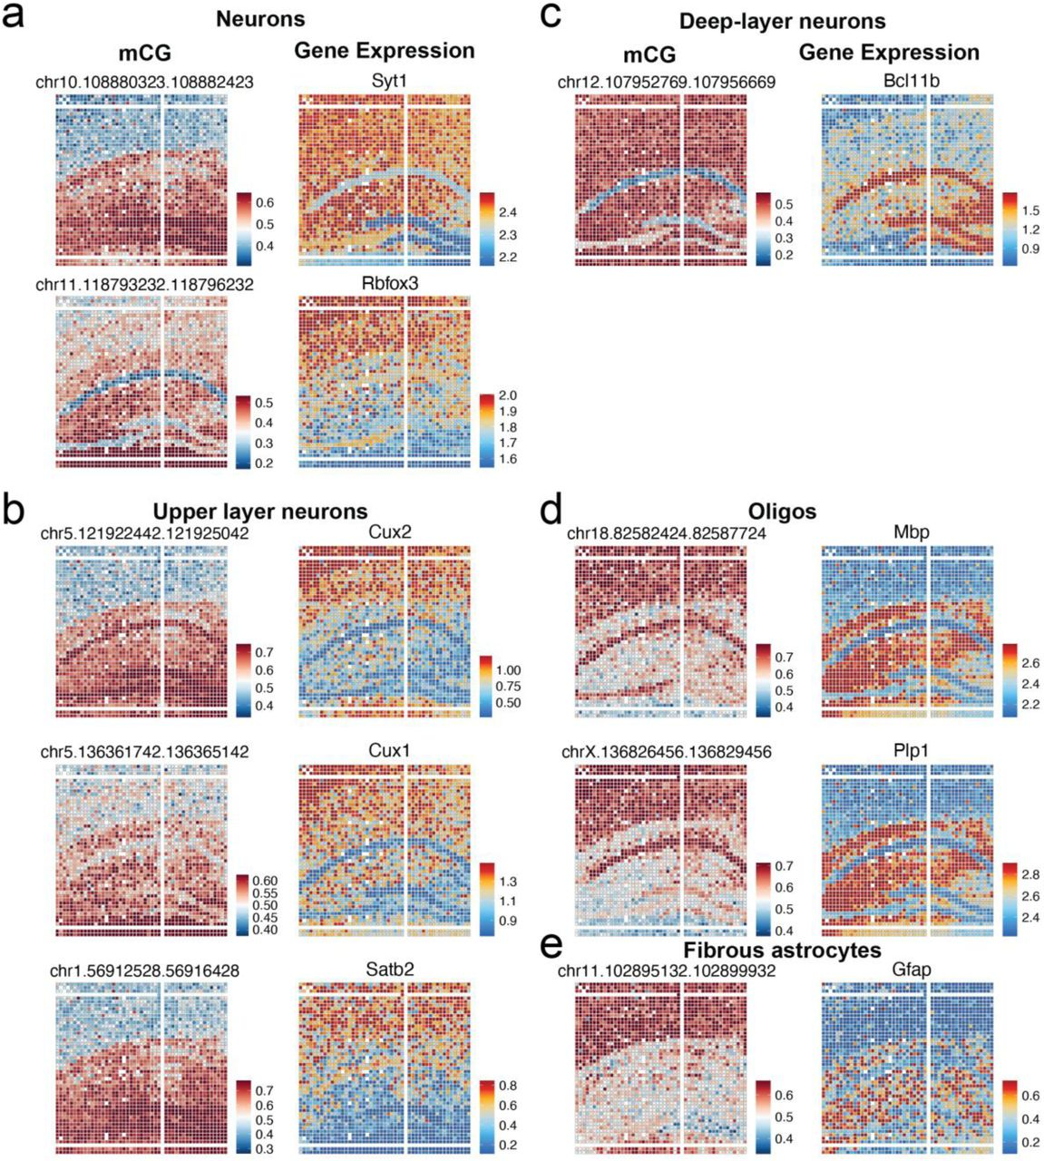
Exciting advancements in single cell methylation
Yanxiang Deng is giving a talk at BCM on November 25th!
Nien Lee et al. bioRxiv 2025

Slide 38
Conclusions
My goals:
Show the commonalities of most single-cell analyses and their use of counts data.
Show off relatively new assay and its unique challenges and analyses.
Get you excited about methylation and thinking about how it can be useful for you.
The workshop next month:
Clustering single cell methylation data from three cell lines and identifying them through marker genes.
You’ll need a google account: we’ll run it through google colab

