Slide 1

Transformers for Summarization
Gurpreet Singh

Slide 2
Background
Summarization model = time-saver for real world applications
e.g. researchers, students, industry professionals, businesses
Summarize research papers, google reviews, book passages
Challenge: Summarize while maintaining original meaning and coherence
Dataset used: HuggingFace’s CNN/Dailymail

Slide 3
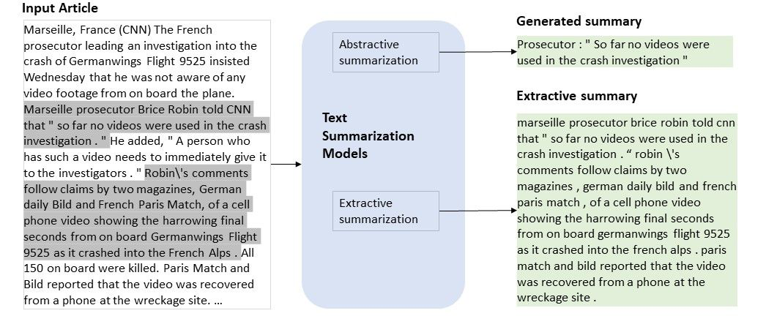
Extractive vs Abstractive
Extraction selects existing key words of the text document
Word-Frequency models, TF-IDF
Abstraction generates words that summarizes the original document
Transformers
Notes:
https://techcommunity.microsoft.com/t5/ai-customer-engineering-team/bootstrap-your-text-summarization-solution-with-the-latest/ba-p/1268809

Slide 4
Extractive Method – Word Frequency
Data Preprocessing
Removed punctuation, numbers, and special characters
Replaced contractions, lowercased strings, removed stopwords
Tokenized sentences using nltk
Calculated weighted frequencies by dividing word frequencies by the max frequency
Using these frequencies, we iterate through the input sentences. Each input had multiple sentences
If sentence is greater than 2 and less than 40 words, we add the scores into a dict. The top 5 scores of each input is used to make the new sentences.
ROUGE1: 0.246, ROUGE2: 0.085, ROUGEL: 0.148

Slide 5
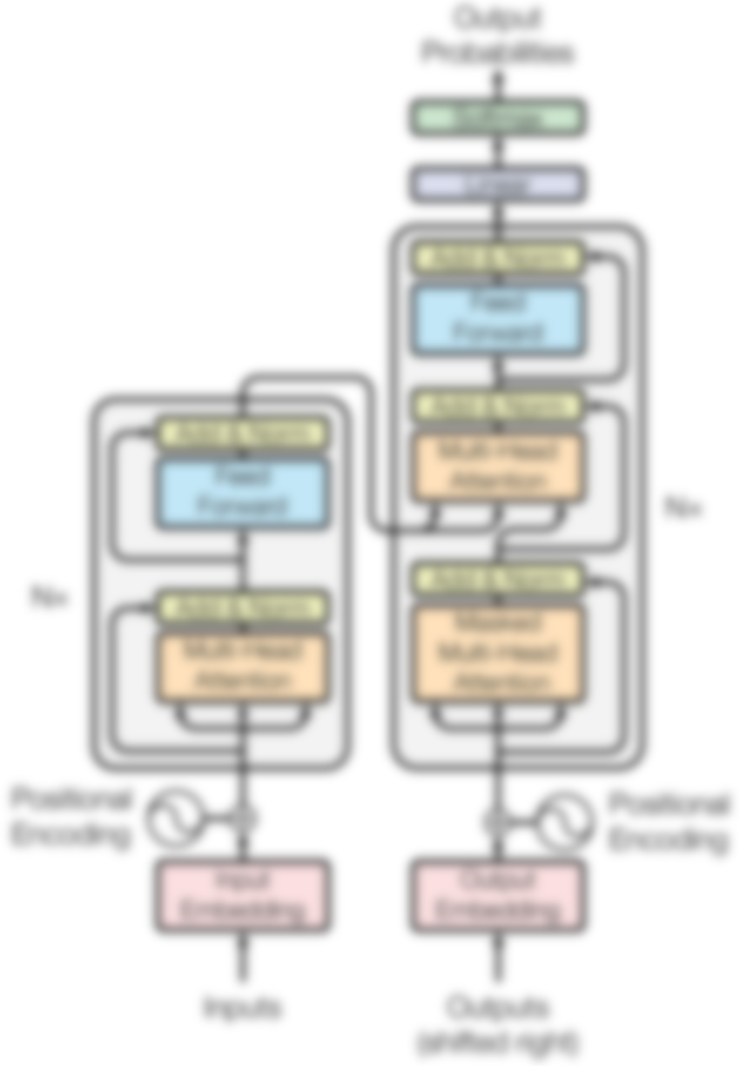

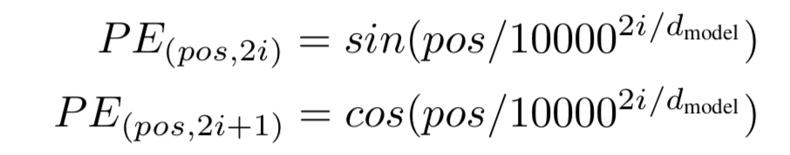
Transformers
Two sequences to give into the encoder:
Input Embeddings
Numerical representation of text (vectors)
Positional Embeddings
Helps with word positioning in a coherent sentence
“I like tea” vs “tea I like”
Notes:
https://www.turing.com/kb/brief-introduction-to-transformers-and-their-power

Slide 6
Transformers
Encoder blocks takes the input and applies multi-head self-attention to it, where each head can focus on a specific aspect of the input
Uses Query, Keys, Values to calculate attention scores
The result is passed to the Feed-Forward layer that is known to be where most of the memorization occurs

Slide 7
Transformers
Decoder Blocks receives information from the encoder, known as Cross Attention.
Decoders converts encodings back into probabilities and produces a sentence output
Can think of Decoder similar to Encoder when it sends outputs through Masked-MHA
Notes:
https://kikaben.com/transformers-encoder-decoder/

Slide 8
Challenges
OOM
Originally planned to create a Transformer from scratch
Proved too complicated and resource-heavy
Out-of-memory errors reigns supreme even for fine-tuning HuggingFace Transformers

Slide 9

Solution
Rented A10 24 GB GPU through LambdaLabs

Slide 10
Abstractive Methods
T5 model: Text-to-Text Transformer
Reframing all NLP tasks into a unified text-to-text-format where the input and output are always text strings
BART: Bidirectional and Auto-Regressive Transformers
Sequence-to-sequence model that is a denoising autoencoder
Uses a standard seq2seq/machine translation architecture with a bidirectional encoder (like BERT) and a left-to-right decoder (like GPT)
(From HuggingFace)

Slide 11
Results
Model | # Params | Epochs | LR | Batch | Rouge1 | Rouge2 | RougeL | Time
T5-Small | 60M | 3 | 1e-5 | 32 | 0.2845 | 0.1010 | 0.2668 | 40 mins
T5-Base | 220M | 3 | 4e-6 | 8 | 0.2994 | 0.1064 | 0.2789 | 1 hour
T5-Base | 220M | 10 | 4e-6 | 8 | 0.3094 | 0.1140 | 0.2919 | 4.7 hours
BART | 139M | 3 | 4e-5 | 4 | 0.1316 | 0.0162 | 0.1267 | 1.5 hours
WordFreq | NA | NA | NA | NA | 0.246 | 0.085 | 0.148 | NA
Best model is T5-Base!

Slide 12
Example Outputs
Actual Summary:
Theia, a bully breed mix, was apparently hit by a car, whacked with a hammer and buried in a field .\n"She\'s a true miracle dog and she deserves a good life," says Sara Mellado, who is looking for a home for Theia.
Prediction Summary:
Theia, a friendly white-and-black bully breed mix now named Theia, is receiving care at the Veterinary Teaching Hospital. Theia was found emaciated and dislocated in a field, but survived. Theia is a friendly white-and-black bully breed mix in Washington State. She has been receiving care at the Veterinary Teaching Hospital.

Slide 13
Summary and Next Steps
Two methods were used in this experiment: Extractive and Abstractive
The Abstractive methods performed better, specifically T5-Base
Next Steps:
GPT and BERT models
TF-IDF
Parameter Tuning

Slide 14
Resources
https://www.turing.com/kb/brief-introduction-to-transformers-and-their-power
https://techcommunity.microsoft.com/t5/ai-customer-engineering-team/bootstrap-your-text-summarization-solution-with-the-latest/ba-p/1268809
https://kikaben.com/transformers-encoder-decoder/
https://arxiv.org/abs/1706.03762
https://huggingface.co/docs/transformers/tasks/summarization
Blog.paperspace.com
TowardDataScience
https://towardsdatascience.com/build-your-own-transformer-from-scratch-using-pytorch-84c850470dcb

Slide 15
Thank You!

