Slide 1

Collaborative coding techniques
Code Review & Pair Programming

Slide 2

Code Review: An Overview
Developing, leaving source code available for other developers to review.
For finding bugs and design errors before the code becomes part of the product
Dramatically helps improve the quality of products

Slide 3
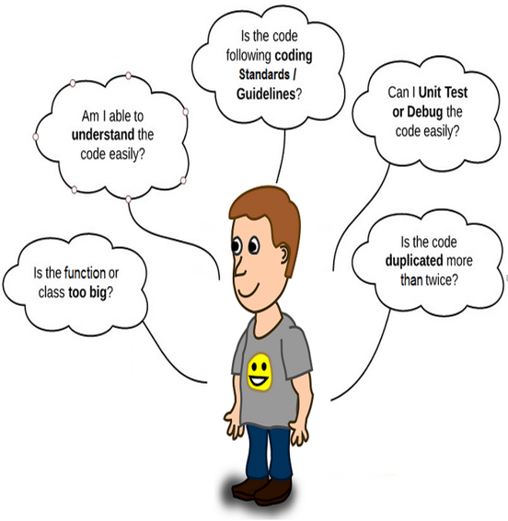
Code Review : What to look for
Reviewers look for:
Code Standards
Automated unit test quality and coverage
Style guidelines
Design
Simplicity, modularity, etc.
Alternatives
Performance and security concerns
Errors
Logic flaws
Regressions

Slide 4
Code Review : What to look for
Reviewers consider questions when reviewing changes in existing code like:
Are there any obvious logic errors in the code?
Looking at the requirements, are all cases fully implemented?
Are the new automated tests sufficient for the new code?
Do existing automated tests need to be rewritten to account for changes in the code?
Does the new code conform to existing style guidelines?

Slide 5
Why code reviews matter?
Early peer feedback to improve code
Find and fix issues early
Less future maintenance
Enable time off
Review all code
Mentor newer engineers
Learn the code base
Learn new technologies and techniques that grow their skill sets

Slide 6
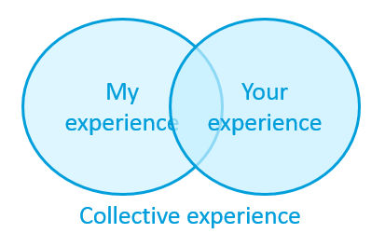
Pair Programming: An Overview
Pair programming is an Agile technique originating from XP in which two developers team together and work on one computer
Two developers work side by side on the same piece of work, sharing a keyboard and screen and working together to produce the code

Slide 7
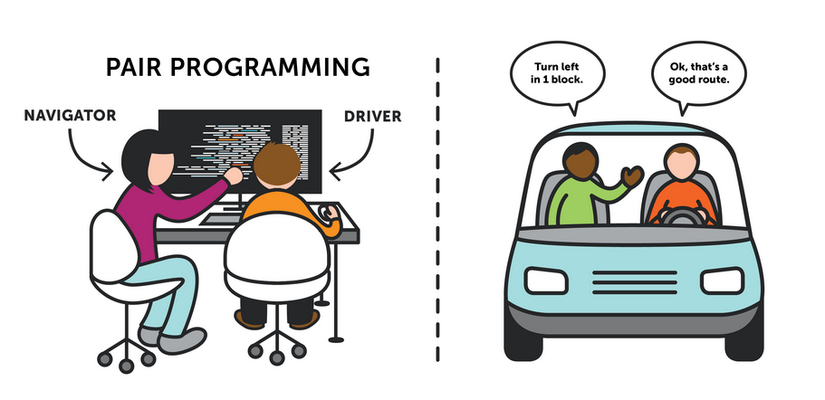
Pair Programming: Navigator and Driver

Slide 8
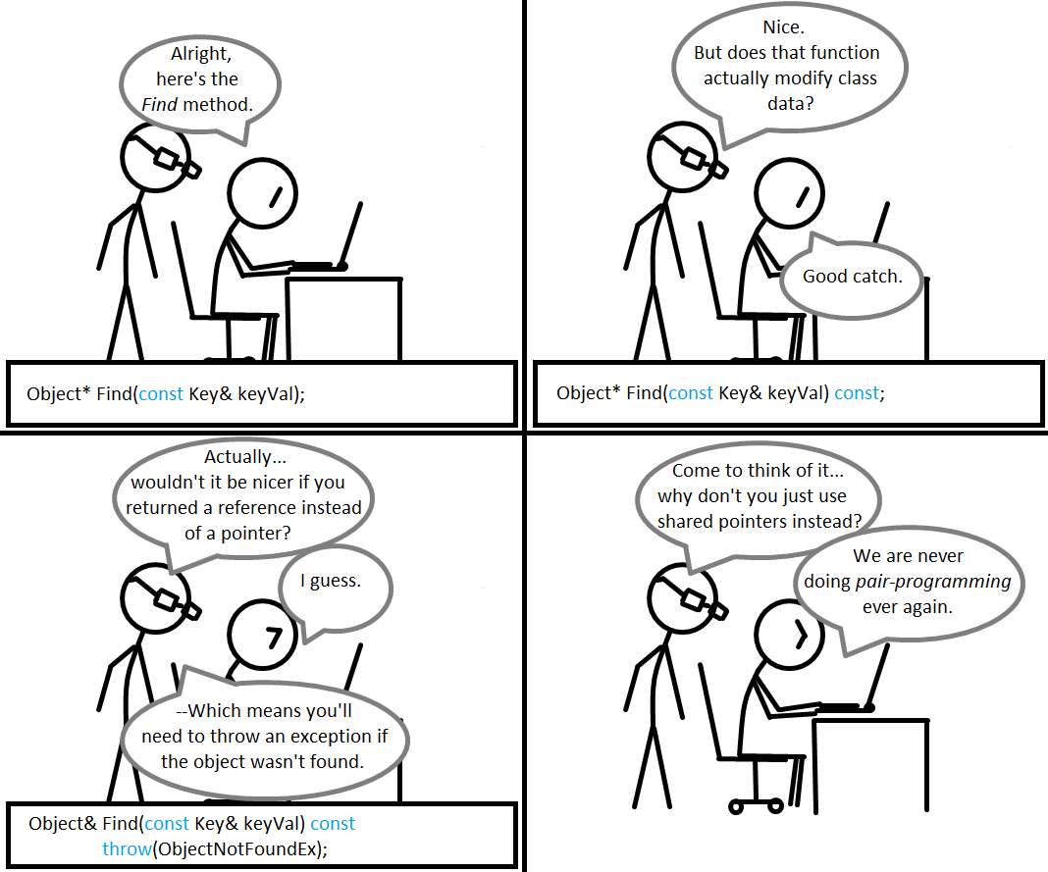
Pair Programming: Navigator and Driver

Slide 9
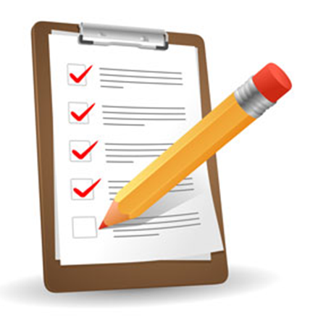
Start with a reasonably well-defined task before you sit down.
Pair Programming: Best Practices
The task should be something you are confident that you can complete in an hour or two

Slide 10

Agree on one tiny goal at a time
Pair Programming: Best Practices
Something you can complete within a few minutes
Stating the problem in words to another person helps focus
It also ensures that you both know what you are working on right now

Slide 11

Rely on your partner, support your partner
Pair Programming: Best Practices
Driver:
Complete the current tiny goal as quickly as you can, ignoring larger issues
Trust the navigator to be your safety net

Slide 12
Rely on your partner, support your partner
Pair Programming: Best Practices
Navigator/Observer:
Your job is code review
Read the code that the driver is writing as he or she writes it
Don't dictate the code - the driver should be actively thinking
You can, and should, think at a higher level
E.g. saying "That looks right. How about handling the case where we pass a null pointer now?"

Slide 13
Talk a lot!
Pair Programming: Best Practices
Say what you are about to do, ask for an implementation idea
Say while pairing,
"Do you think this is a valid test?“
"Does that look correct to you?“
"What's next?“
"Trust me" (when it's easier to write a little code to make your point than to say it out loud)

Slide 14

Take a moment to celebrate as you complete tasks and overcome problems
Pair Programming: Best Practices

Slide 15
Switch roles often - at least every half-hour
Pair Programming: Best Practices
Fully engaged
Switching roles recharges you
No longer than half an hour

Slide 16

Code Review & Pair Programming

