Slide 1
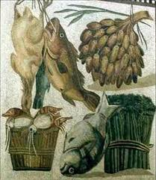
Roman Food

Slide 2
Festival dishes
To start with , Romans would usually begin their
meal with a starter also called a “gustatio”. This was usually a type of salad or small meat dish like clams , sea urchins or lightly salted snails .
Some vegetables were pickled like olives,carrots,
artichoke,watercress,capers and onions. It was
often eaten with a drink called muslum(a type of
wine and honey) and was assosiated with festivals.

Slide 3
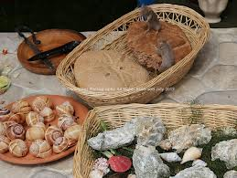
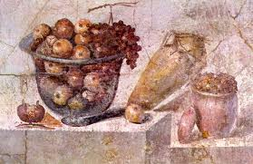
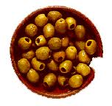
Main dish
The main dish was always a type of meat or fish.
The most common meat was pork and rabbit ,
while a goatfish was considered a luxury. Bread
was one of the only things that they ate with the
main dish along with a spread made from fish
Intestines called “garum”.

Slide 4
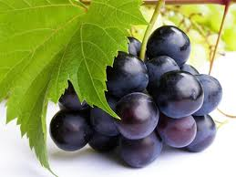
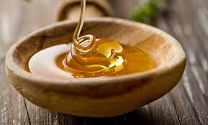
Desserts
Grapes were one of the most popular desserts.
They also had pomegranets ,figs , dates , quinces
and mulberries. They also ate nuts like walnuts ,
Hazelnuts , almonds and pine nuts.Cakes soaked
in honey were eaten a lot and so were fruit tarts
and sweet buns.

Slide 5
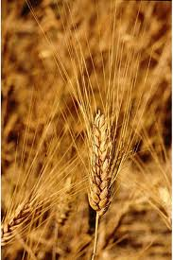
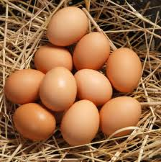
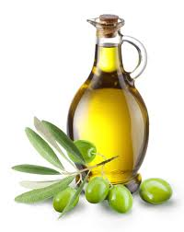
common food dishes
At home , people would not eat many big meals .
Their main food was “pottage”, a stew made from
wheat , millet or corn.Most of their food consisted
of wheat or barley , olive oil , a little fish , wine ,
home grown vegetables , chicken , cheese and
a few eggs .

Slide 6
A typical roman’s food for the day
Breakfast-This would be eaten early and would
include bread and fresh fruit .
Lunch-A little cooked meat like ham or salami ,
salad , cheese , hard-boiled eggs , vegetables
and bread.
Dinner-This would start at 4p.m and end at about
9p.m or 10p.m and was usually salad or a meat
dish .

Slide 7
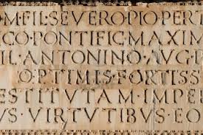
Food translated into latin
Pig-porcus Eggs-ova
Chicken-gallinaceo Vegetables-verdure
Wine-merum Cheese-caseus
Grapes-uvas Snails-cochleas
Bread-pane Olive oil-oleum olivae Apples-poma
Meat-cibus Salad-insalata Fish-piscis Clams-mollusci

Slide 8
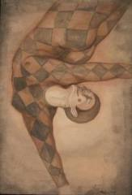
Entertainment
During a dinner for guests , musicians , acrobats,
poets or dancers would perform and dinner
conversation played an important role . Feet and hands were always washed before food . After the main course an offering was made to the spirit of the house with meat , wine and cake.
The cake was usually coloured with saffron.

Slide 9
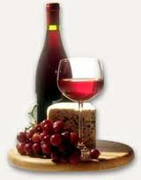
Beverages
The Romans loved wine , but they drank it
watered down , spiced , and heated.
Pasca was probably popular among lower classes.
It was a drink made from watering down a wine
or vinegar. Beer and mead were most commonly
drunk in northern towns . Milk was considered
barbaric and was reserved for making cheese.

Slide 10
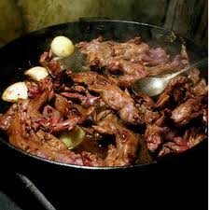
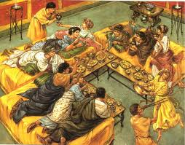
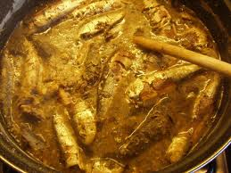
Pictures

Slide 11
Facts about roman food
1.The Romans invented fast food , there were
restaurants made to serve food quickly.
2.Romans thought it was crazy to drink undiluted
wine.
3.Romans would eat snails soaked in milk and
roasted flamingo tongues.
4.Romans liked fun food like hare with birds wings
stuck on to make it look like a flying horse.
5.Lettuce was eaten at the end of a meal because
it was supposed to make you sleep!!!!

Slide 12
Thank You

