Slide 1

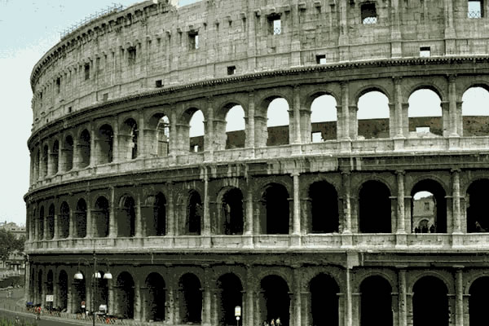
The Decline & Fall of the Roman Empire
GENA 2112 The Characteristics of Western Culture

Slide 2

The Decline and Fall of Roman Empire
Edward Gibbon, The Decline & Fall of the Roman Empire
(吉朋)
(6 volumes)
Donald Kagan, ed., Decline & Fall of the Roman Empire
Lynn White, Jr., ed., The Transformation of the Roman World

Slide 3
The Decline and Fall of Roman Empire
Edward Gibbon (1737-94)
Historical background (Age of Reason)
What (define)
Where (Western R.E.)
When 476 (180? 410? Or 800?) Henri Pirenne (“Pirenne’s Thesis”)
(Arnold Toynbee 湯恩比)
How & Why?

Slide 4
The Decline and Fall of Roman Empire
Internal | External
Christianity? Political disintegration Population ↓ : lead poisoning, homosexuality, tax? Social & economic↓ Slavery↓ Intellectual↓ Climate & soil↓ | Barbarian invasions + infiltration (barbarization)

Slide 5
Socio-Economic Historians
Lynn White, Jr.,
Henri Pirenne,
Marc Bloch

Slide 6
Henri Pirenne
Henri Pirenne (1920s)
“the Roman Empire survived in all its essentials until the coming of Islam---(800)destroyed the unity of the Mediterranean & ended the Roman World.”

Slide 7
The Decline and Fall of Roman Empire
Literary history: (180) = death of Aurelius
a Roman historian wrote: “Our history now descends from a kingdom of gold to one of iron & rust.”
Barbarian invasions:
Huns pushing in the rear (from Central Asia) → Attila, r. 434-53 Vandals
Goths
  Visigoths
  Ostrogoths
(Alaric 410 Sack of Rome)
Finally, 476 Odovacar (a Germanic general in R.E.)
Deposed Romulus Augustulus & became the King of the Romans

Slide 8
Effects of the Barbarian Invasion
Short-range / immediate results: not revolutionary
  ∵ life was similar
  still Roman – administration, & law (+ Germanic)
  (since the Germanic barbarians had no distinctive culture of their own, they accepted what they found in Italy)

Slide 9
Effects of the Barbarian Invasion
Medium-long range effects:
  a further acceleration of the decline in the west
  ∴ “West” = the “barbarian West”
  (the beginning of the Middle Ages)
  the Germanic principle of “personal loyalty”人治 prevailed in the west in the Middle Ages

Slide 10
Four Applicable Categories
Death by accident (J.B. Bury)
Natural causes (Gibbon, Boak, & Walbank)
Murder (: barbarians ) (Gibbon & Toynbee)
Suicide (Westermann)
(+ psychologically, strategically, & philosophically) stop expansion = the beginning of the end of the Roman Empire
Q:
Causes for the rise of Christianity
To what extent did Christianity cause the decline & fall of the Roman Empire?

