Slide 1

Replace a Chain in a Graph
Martin Skorsky

Slide 2
Agenda
Goal and Idea
Examples for Schedules
Examples for Git Log
How To: Use with xdot
The Algorithm

Slide 3
Goal
Large schedules are nasty to handle during debugging
Reduce the size (#vertices, #edges), but retain the structure

Slide 4
Idea
Graphs of schedules or git-logs contain long chains
Replace each chain with a new single vertex
Use the properties of the top vertex of the chain for the new vertex: pattern, color, shape
Label the new vertex with the top an bottom label of the chain
The difference #edges - #vertices is stable
The new graph has usually 20% to 30% vertices.

Slide 5
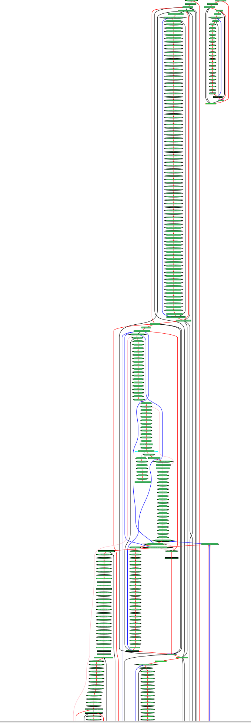
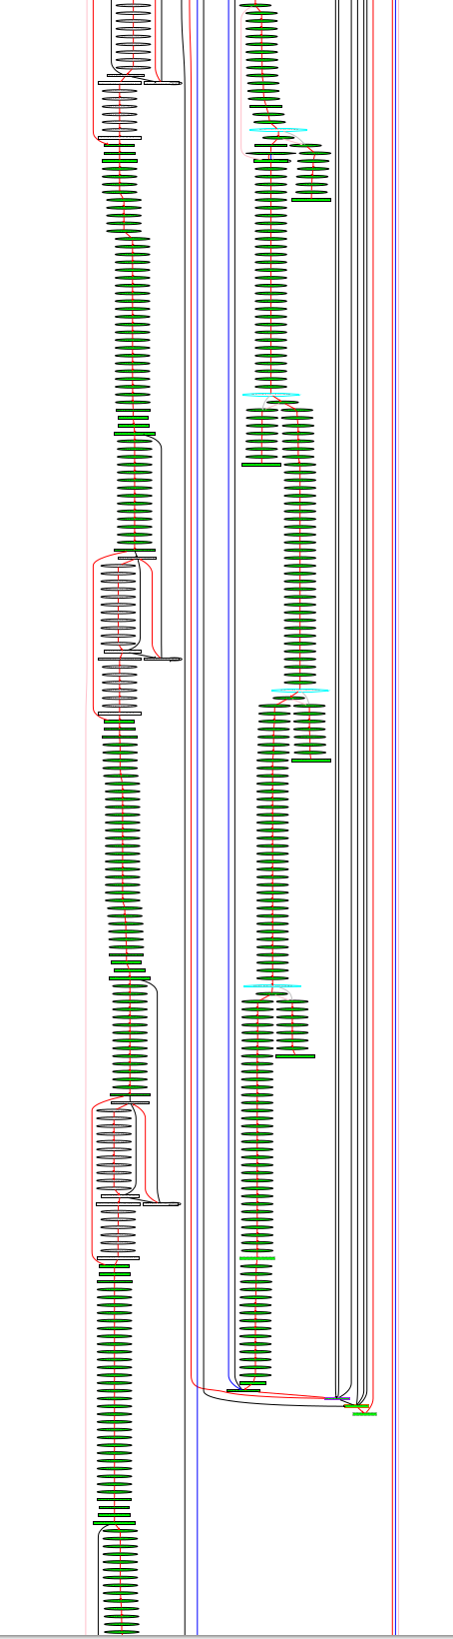
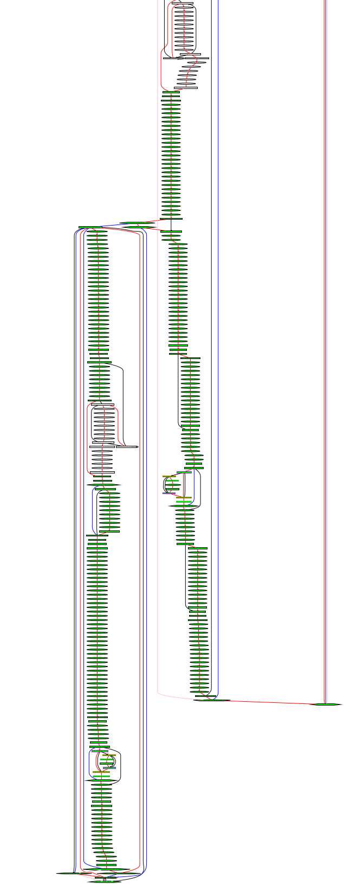
Schedule from INT environment (1057 vertices, 1173 edges)

Slide 6
Schedule from INT environment, chains replaced
(177 vertices, 293 edges)

Slide 7
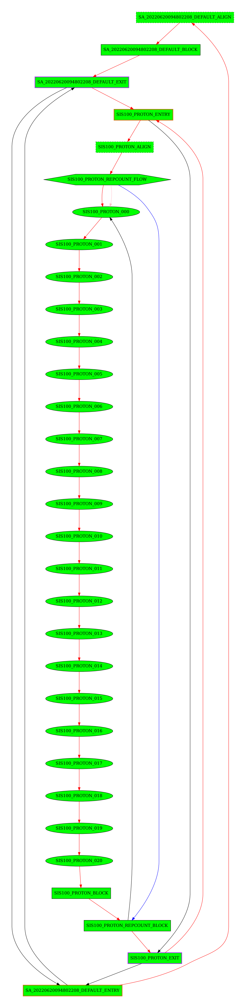
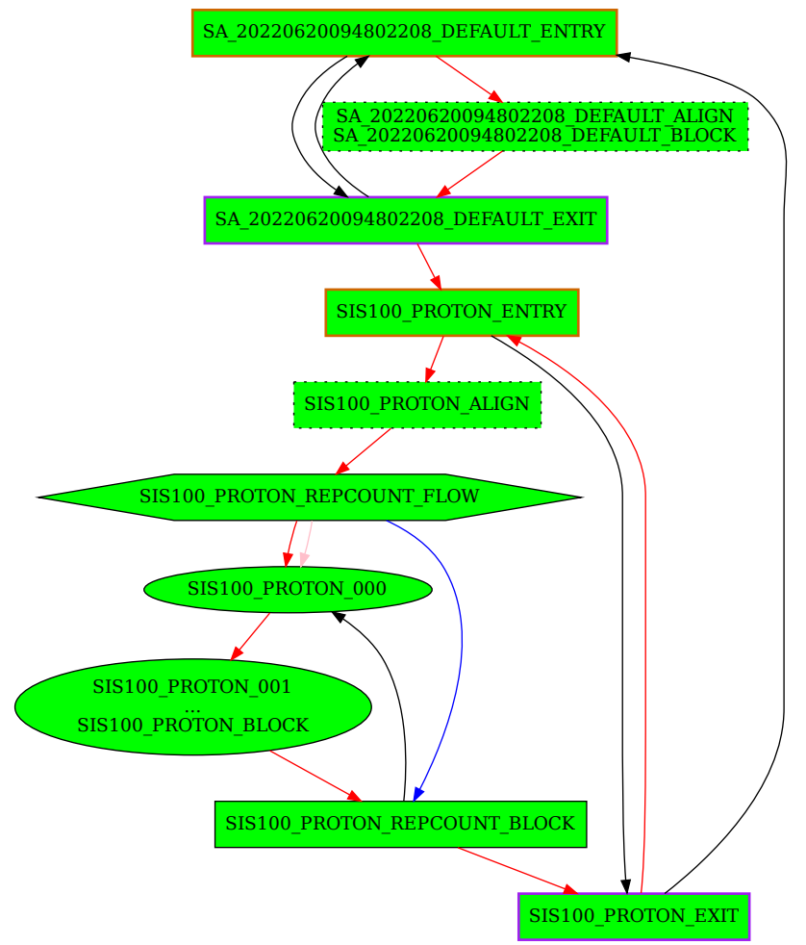
Part of the schedule from INT,
2 chains replaced

Slide 8
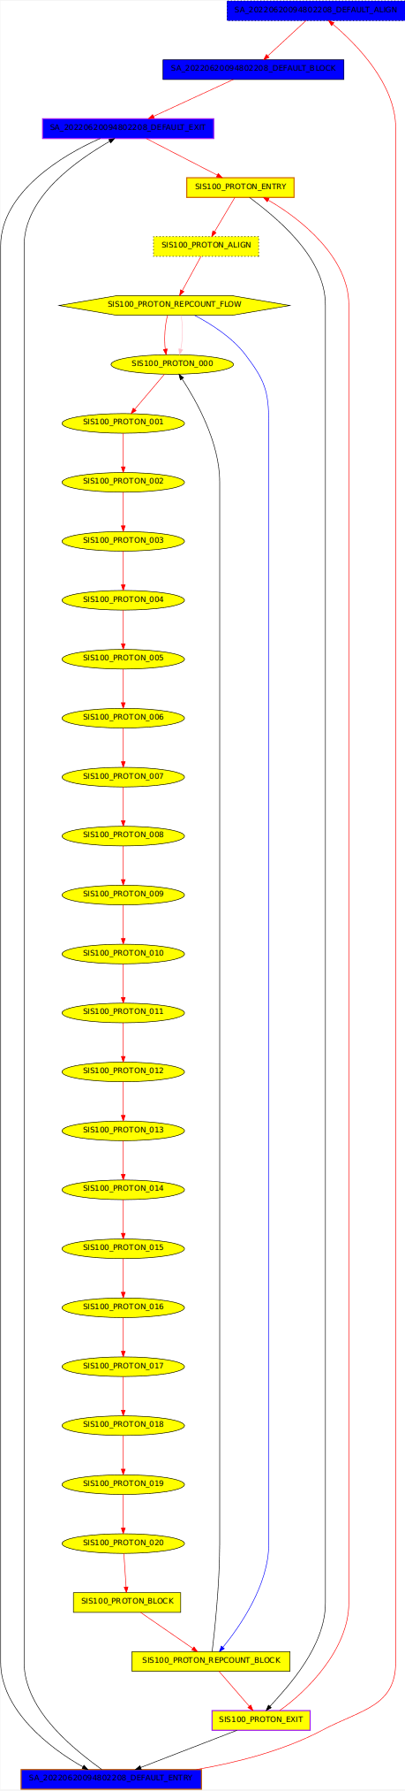
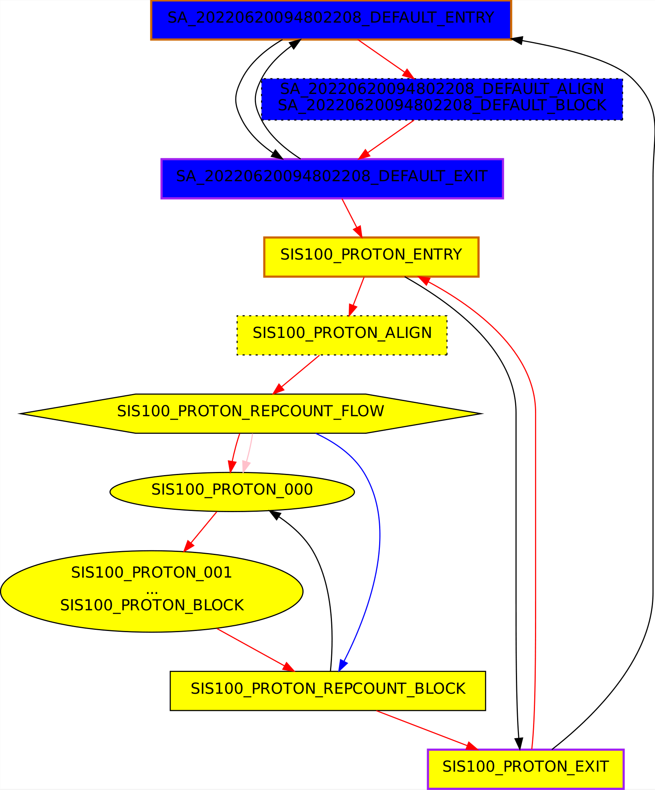
Part of the schedule from INT,
2 chains replaced, with patterns colored yellow and blue

Slide 9
Git: git log → dot
#!/usr/bin/env python3
import subprocess
import sys
import re
args = ['git', 'log', '--pretty=format:%x00%H%x01%h%x01%P%x01%d%x00'] + sys.argv[1:]
rows = subprocess.check_output(args).split(b'\x00')[1::2]
seen_commits = set([row.split(b'\x01')[0].decode() for row in rows])
print("digraph G {")
for row in rows:
columns = row.split(b'\x01')
commit = columns[0].decode()
label = columns[1].decode()
parents = columns[2].decode().split(' ')
tag = columns[3].decode()
print('"{}" [label="{} {}"];'.format(commit, label, tag))
for parent in parents:
if parent == "":
continue
if not parent in seen_commits:
continue
print('"{}" -> "{}"'.format(commit, parent))
print("}")
Use this script to create a dot-file from git log
Command-line arguments are the same as for git log
Visualize this log as a graph with xdot
Replace all chains by vertices

Slide 10
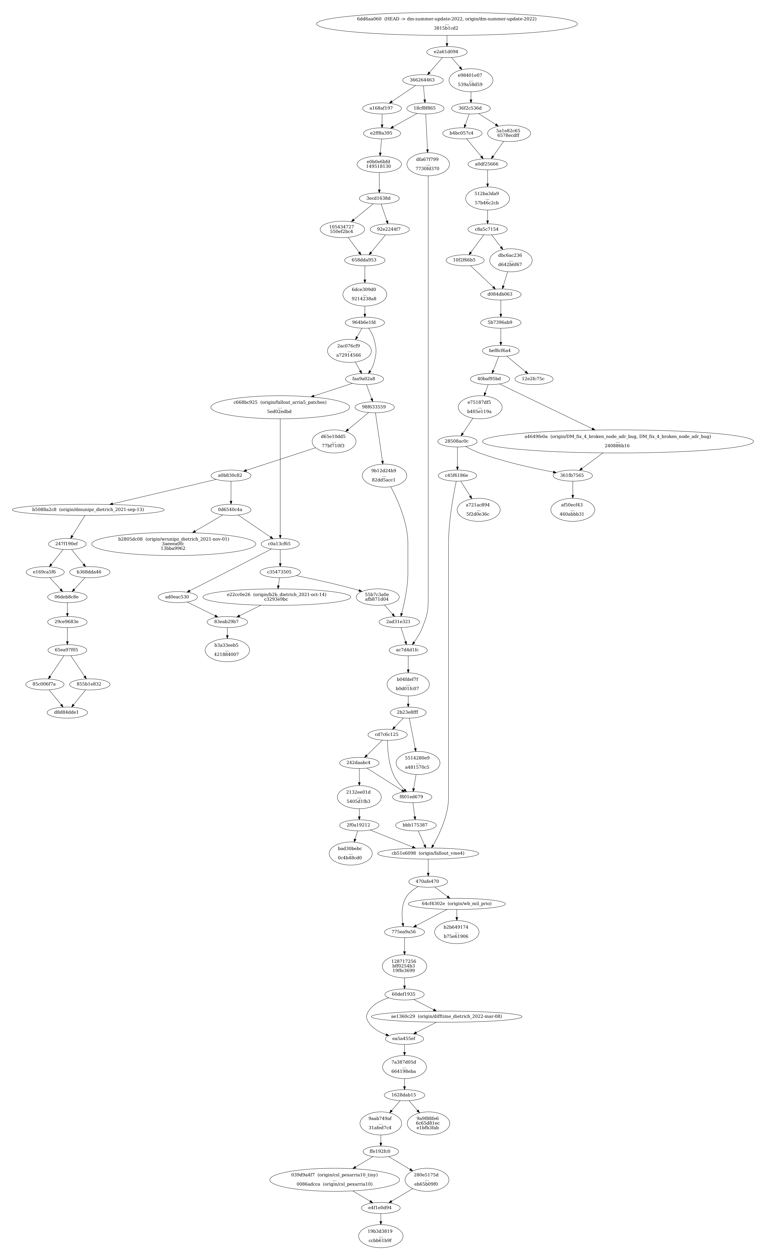
Example with 500 log entries from bel_projects git on branch dm-summer-update-2022

Slide 11
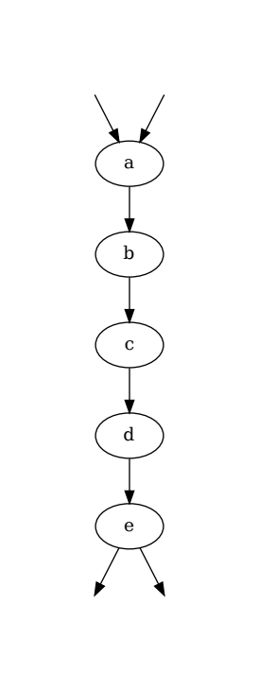
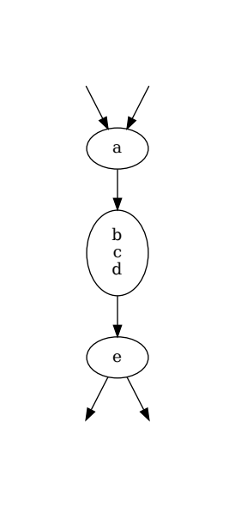
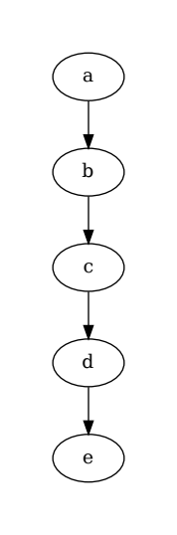
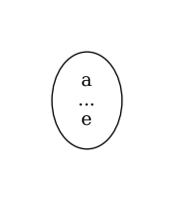
Chains
Vertices in a chain have
in-degree <= 1 and
out-degree <= 1
At least 2 vertices

Slide 12
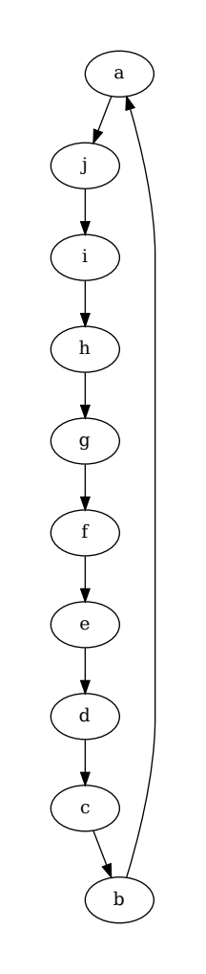
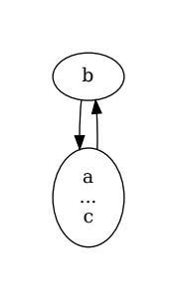
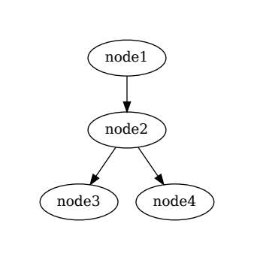
Cycles and Stars
Cycles: a cycle shrinks to a 2 vertex-cycle
Stars: unchanged

Slide 13
How To
Install replaceChain from bel_projects
Dump schedule with dm-sched dev/wbm0 dump -o <dot file>
replaceChain <dot file> -o <output dot file>
xdot <output dot file> &

Slide 14
Algorithm
Replace one chain with a new vertex and at most two edges
Run this in a loop to replace all chains
For one chain:
  Find the first vertex of a chain
  Check that there are at least two vertices in the chain
  Collect all vertices in this chain
  Create the new vertex with edges and labeling
  Remove chain

Slide 15
Future Features
Integration in xdot
Use the layout of the original graph
  Advantage: you see the new vertices at the position of the chain
  Disadvantage: the drawing has the same (large) size of the original drawing

