Slide 1
Efficient Smart Home Sub-Metering
ANALYSIS OF ENERGY USAGE HISTORY
IOT Analytics

Slide 2
Objectives/Goals
To provide evidence or positive reasons for adopting the use of electrical sub-metering devices used for power management in Smart Homes.
Statistically present the benefits of power usage analytics in power conservation.
Demonstrate the prediction of future energy consumption, utilizing sub-metering, to lower energy cost.

Slide 3
Agenda
What is the context of the project?
What are the objectives/goals?
How will the data be managed?
Information about the data analyzed.
Issues with the data.
Initial statistics within the data.
Recommendations

Slide 4
Background
The client has tasked IOT Analytics to explore their 47 months of historical power usage in order to provide positive evidence for utilizing electrical sub-metering in Smart Home development projects to support their marketing plans.

Slide 5
Data Management
The provided data will be processed locally on a fully secure MacBook Pro.
The data will remain on this singular password protetect and encrypted device.
Updates will be provided in the form of password protected archives.

Slide 6
Description of Data
The data is available remotely via SQL database
The data is also accessible in the archives at UCI Machine Learning Repository with missing data
Nealy 4 years of data (from January 2006 to November 2010)
Data origin is Sceaux (7km from Paris, France)
Data contains dates, timestamps, global active power in kW, global reactive power in kW, voltage in V, global intensity in ampere, 3 groups of sub-metering.
Global_active_power and 3 sub-metering groups represent the active energy consumed every minute (in watt hour) in the household.

Slide 7
Known issues with the data
Date and Time were separate and needed to be combined into one timestamp.
Time cycle attributes needed to be created (Year, Quarter, Month, Week, Day, Hour, and Minute)
Both Date and Time issues are solved with the R statistical language

Slide 8
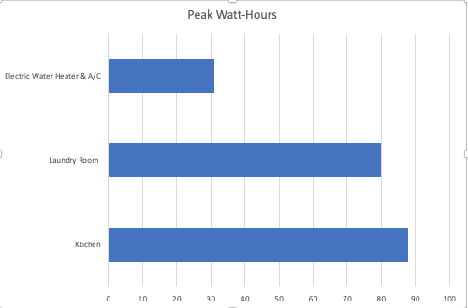
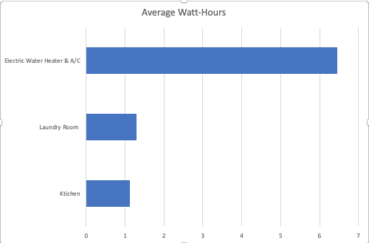
Descriptive statistics
The highest peak of energy consumption was seen on Sub_metering_1 at 88 watt hours of active energy. But the lowest energy consumption by average. The following appliances are included in this sub_meter: Kitchen containing a dishwasher, an oven, and a microwave.
The lowest energy consumption was seen on Sub_metering_3 at 31 watt hours of active energy. However, it was the highest average of energy consumption. This group contains the water-heater and air-conditioner.
Sub_metering_2 had only slightly lower values than Sub_metering_1. This group contains the laundry room appliances (washing-machine, tumble-drier, refrigerator, and a light)
Notes:
Are there differences in the age of customers between regions? A very slight difference. Therefore, cannot predict age by region.

Slide 9
High-Level Recommendations
Adding household size would provide more insight into energy consumption (how many rooms) *useful for future development projects
Separating electric water heater and a/c would help customers conserve power better; the same can be said about appliances in other sub_metering groups
Add a column with outside ambient temperature in order to see spikes in energy consumption due to temperature fluctuations
Notes:
Do customers in different regions spend more per transaction? Yes, they do.
Which regions spend the most/least? 4 (West) and 2 (South)

Slide 10
Conclusion
IOT Analytics has preliminarily processed power usage history in order to provide positive evidence of utilizing Sub-Metering in Smart Home apartment building development.
The data will show the benefit collecting real-time power usage statistics, which will lower costs for landlords and tenants.
s

