Slide 1
Impact of Machine Learning and Data Mining
Blackwell Electronics
Agila
Ashwini
Grant
Matthew
Romita

Slide 2
Supervised Machine Learning using R - Brand Preference Prediction
Like Python, R is also one of the most popular and commonly used open source statistical programming language used in the field of Data Science. Blackwell Electronics would definitely benefit from using R, which has a wide variety of analytical and visualizing techniques inbuilt, that can be used to find trends in huge data. These trends can be used to identify future patterns.
Predict computer brand preference of customers - Sony / Acer
Predict computer brand preference of customers from survey data captured from existing and new customers. The approach adopted for this task was ‘classification’ to make brand preference predictions. Using this approach, the goal was to develop different models to predict brand preference of customers using the existing survey data. An optimized model from above analyses, which makes predictions with a high confidence level, was chosen and applied to new products survey data to predict which brand customers would prefer. This information will help us decide with which manufacturer we should pursue a deeper strategic relationship.

Slide 3
Supervised Machine Learning using R - Product Type Preference and Sales Volume Prediction
Predict product type preferences and their sales volume
Two main goals of this task were -
Predict the sales of four different types of products: PC, Laptops, Netbooks and Smartphones
The approach adopted for this process was ‘regression’. The existing products data set was analyzed to build some machine learning models using different algorithms. An optimized model which predicts sales volumes of different product types with a high level of confidence was chosen. This model was applied to the new products data set to predict the sales volumes of four main types of products - PC, Laptops, Netbooks and Smartphones.
Assess the impacts of service reviews and customer reviews on different types of products
The other goal of this task was to assess and identify relationships between customer/service reviews and product types attributes in the dataset to help the sales team better understand how types of products might impact sales across the enterprise.

Slide 4
Introduction to Data Mining and Analytics using R - Discover associations between productions
The goal of this task was to perform an analysis to identify trends and understand the clientele of Electronidex using Electronidex’s customer transactions data set. The outcome of this analysis is to be used in decision making for partnering with/acquiring Electronidex.
An approach that was best suited for this task was “data mining”, as it helped in researching historical information and employ algorithms to uncover trends.
Market Basket Analysis - Unsupervised Machine Learning
The data set provided contains Electronidex’s online sale transactions in the form of items purchased(basket format). Usual data analyses methods cannot be applied for this type of information and process, and hence the particular process that best suits for this type of data called “Market Basket Analysis” was picked. This technique plays a great deal in identifying future patterns and its effects on business processes. Interesting relationships/associations between customer transactions and products purchased were developed using the ‘apriori’ algorithm. These associations in turn can be used to build sales strategies and decision making approaches.

Slide 5
TASK 2- Brand Preference Prediction
Goal:
Predicting the brand of laptop customers prefer based on the survey result of a market research
Classification Methods used:
Gradient Boosting Model
Random Forest Model

Slide 6
TASK 2- Predictions
For gradient boosting model, highest accuracy for the test dataset achieved was 93.1% while for train dataset it was 92.3%
For the random forest model, highest accuracy for the test dataset achieved was 92.6% while for train dataset it was 91.8%
Therefore, we see that the gradient boosting model provided the highest level of accuracy
As we achieved a high accuracy we can predict the brand the customers prefer with confidence

Slide 7
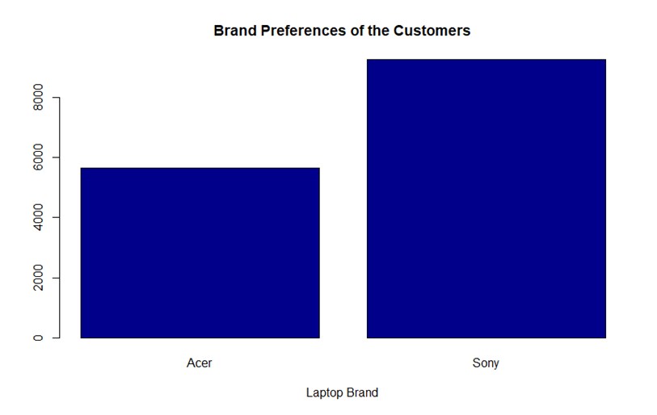
TASK 2- Predictions
From our analysis we can predict that customers prefer Sony laptops to Acer

Slide 8
Task 3 – Multiple Regression in R
Goals
Predicting sales of four different product types: PC, Laptops, Netbooks and Smartphones
Assessing the impact services reviews and customer reviews have on sales of different product types
Regression Methods using caret
10 different Random Forest models
9 different Support Vector Machine models
5 different Gradient Boosting models

Slide 9
Task 3 - Predictions
The provided sales data was a very small dataset and not usually advised for accurate predictions
Building of the models was adjusted to account for the small size of the dataset
The Random Forest model resulted in the highest level of confidence
Forecasted sales for the required product types:
PC - 636 predicted sales
Laptop - 336 predicted sales
Netbook - 1404 predicted sales
Smartphone - 1292 predicted sales

Slide 10
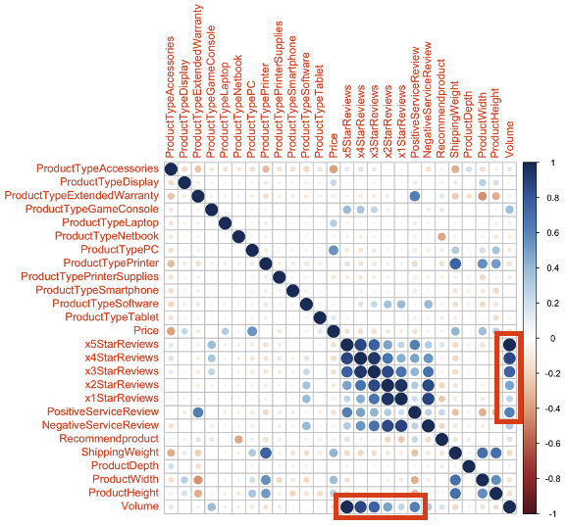
Impact reviews have on product sales
The boxes indicate how strongly reviews correlate with sales volume. The darker the blue dot shows a stronger relationship.
5 star reviews show a very dark blue dot which means products with a 5 star review sell much better than products with a 1 star review, which shows a pale light blue dot.
Positive service reviews also have an impact on sales volume, meaning, products have a higher sales.

Slide 11
Task 4 (Market Basket Analysis)
Goal :
Find interesting patterns within Electronidex transactions
Would Blackwell benefit from selling any of Electronidex recommendations
Should Blackwell acquire Electronidex
Recommendations after acquiring Electronidex

Slide 12
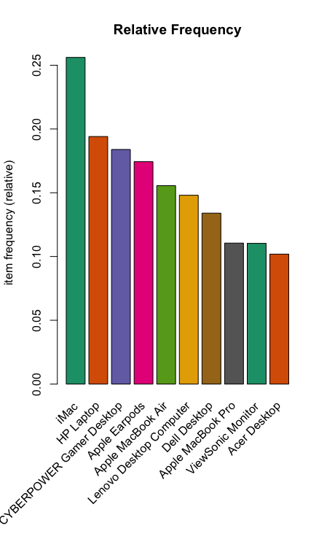
Top 10 Products

Slide 13
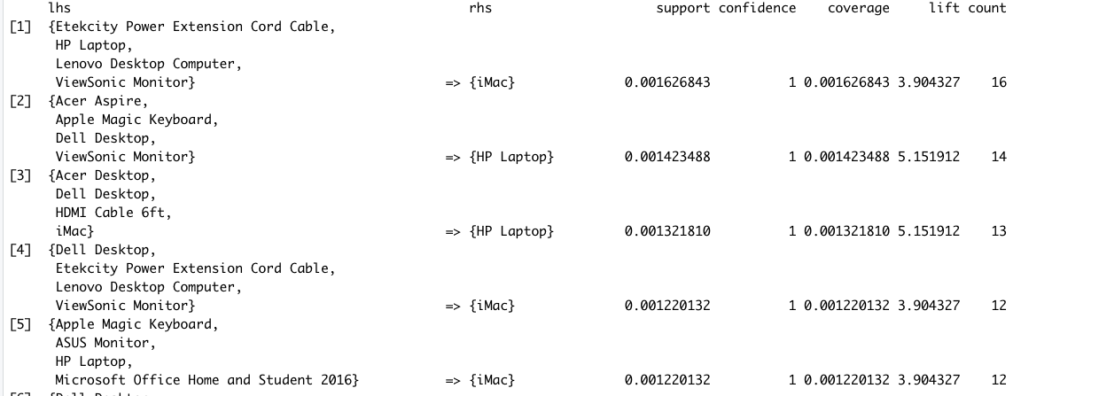
Basket Rules by Support (10% support, 95% confidence)

Slide 14
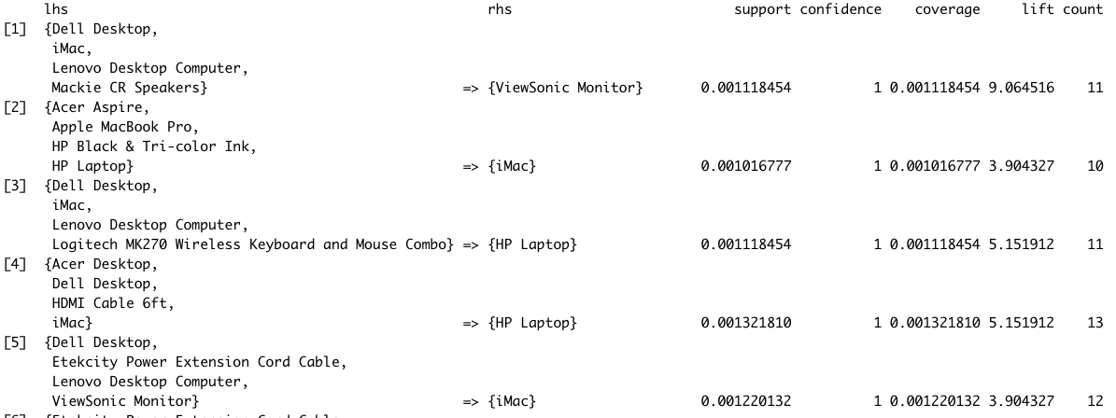
Basket Rules by Confidence

Slide 15
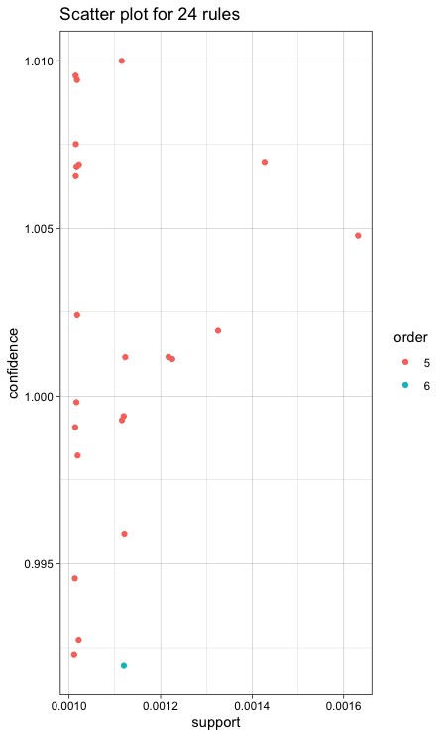
10% Support
95% confidence
Order: # of items in the basket
27 rules with redundancy
24 rules (without redundancy)

Slide 16
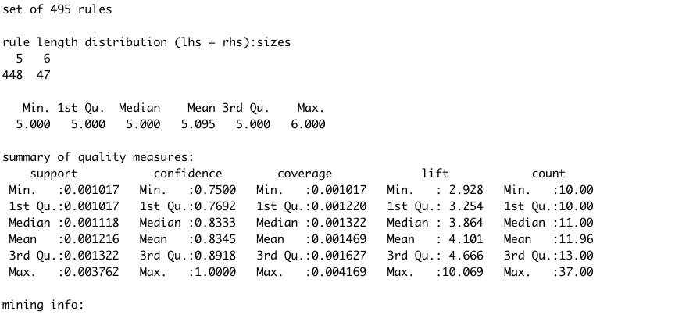
Basket Rules Summary (10% support, 75% confidence)

Slide 17
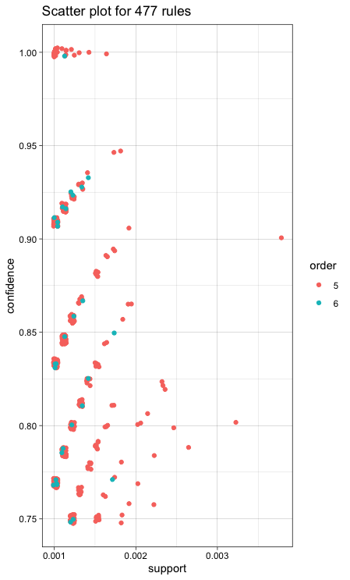
10% Support
75% confidence
Order: # of items in the basket
495 rules with redundancy
477 rules (without redundancy)

Slide 18
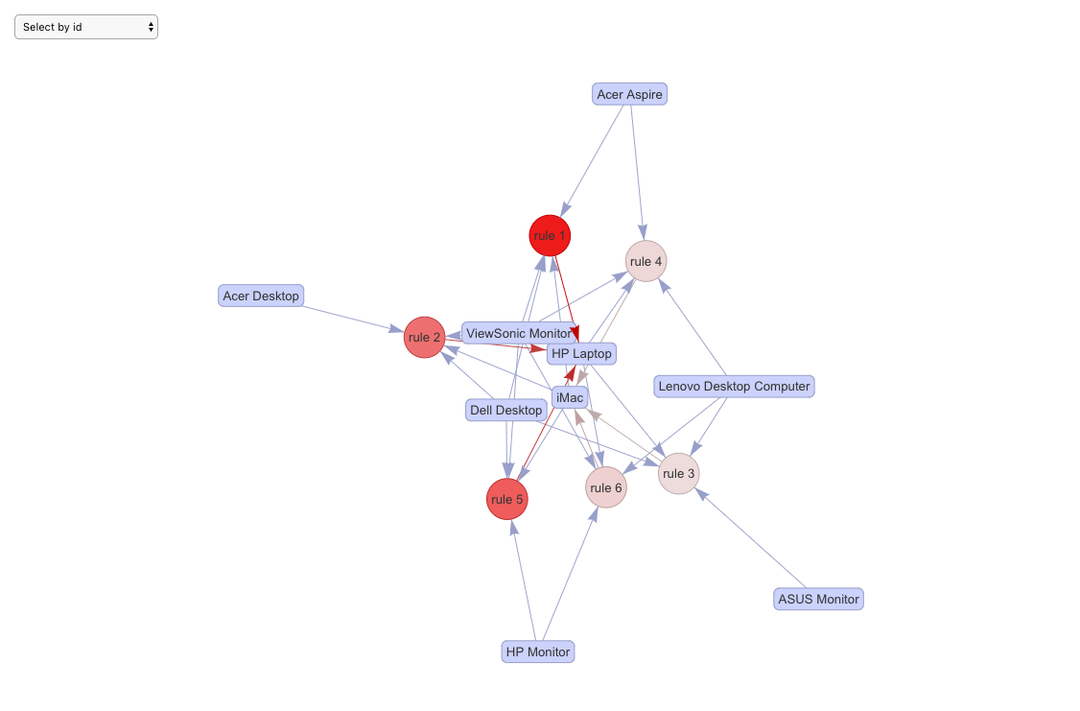
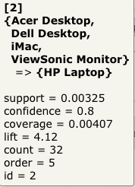
Top 6 rules by lift

Slide 19
Market Basket Analysis Recommendation
Blackwell Electronics sells its products both online and in-store. Though we don’t have enough information on the brand of computer products they sell on Blackwell, we have information on the product type and their reviews.
Electronindex collects data on transaction level. From the transaction data, it looks like Electronindex sells its products to some sort of businesses ( multiple orders of the same item type with different brands).
Blackwell Electronics would gain more customer base and have access to more sales analytics.
iMac is the top selling product. Blackwell can use the data and cross sell the same products in Blackwell Electronics as well. They can use the analytical tools and knowledge base to increase the sales in their stores as well.

Slide 20
Summary and lessons learned
Determined with greater than 90% accuracy the preferred brand is Sony.
Building multiple models will allow us to get the highest prediction accuracy
With limited data, were were able to predict sales of four new items.
The more data we have available for training the models the better
With Market basket analysis we were able to look at Electronidex and determine Imac is there top seller and look at strong relationships between products.
It is crucial to find the most productive support and confidence rating to maximize results.
Must evaluate results and filter out redundant rules.
Notes:
Matt

Slide 21
Conclusion
Data mining and Machine learning is proving to be a powerful tool. Aside from predicting brand preference, sales, and product relationships. We will be able to use data mining for various other company efficiencies. We will be able to use it for staffing and HR support, stock volume and distribution, as well as future marketing campaigns.
By funding in an expansion of data mining, Blackwell will be able save money on inventory and make sure the dollars being spent are beneficial to the company as a whole, Blackwell will be working smarter not harder.
Notes:
Matt

