Slide 1
Customer Purchasing Behavior
ANALYSIS OF E-COMMERCE SALES DATA
BLACKWELL ELECTRONICS

Slide 2
Introduction
Blackwell has been a pioneer in the electronics retail.
It recently launched its eCommerce Platform.
The goal of this study was to develop insights that can aid strategic planning and decision-making to improve online marketing, enhancements to ecommerce site, and so forth achieving business priority.

Slide 3
Agenda
Do customers in different regions spend more per transaction? Which regions spend the most/least?
Is there a relationship between number of items purchased and amount spent?
Are there differences in the age of customers between regions? If so, can we predict the age of a customer in a region based on other demographic data?
Is there any correlation between age of a customer and if the transaction was made online or in the store? Or do other factors correlate to an online or in-store transaction?

Slide 4
Dataset
CSV file - Customer transaction data from recent online and in-store sales.
The given dataset has 80,0001 entries with 80,0000 observations and 5 features. The in-store feature is a nominal attribute where 0 stands for online purchase and 1 stands for in-store purchase.
In-store Column Mapping:
1: in-store purchases
0: online purchases
Likewise, the region attribute takes one of the four values 1,2,3 and 4. The mapping of region values with their respective representations.
Region Column Mapping:
1: North
2: South
3: East
4: West

Slide 5
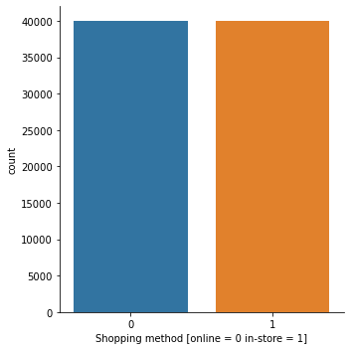

Shopping method vs No. of customers
Both in-store (39990) and online (39989) transactions are almost the same.
In-Store (0) vs Online (1)

Slide 6
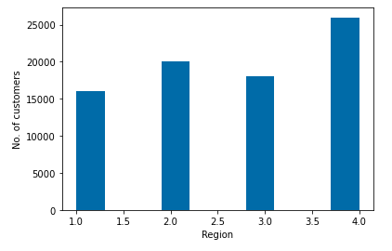

Region vs No. of customers
Region West (25988) has the highest no. of customers.
Region South (19994) has the second highest no. of customers.
Region North (15997) has the least no. of customers.
Region vs No. of transactions

Slide 7
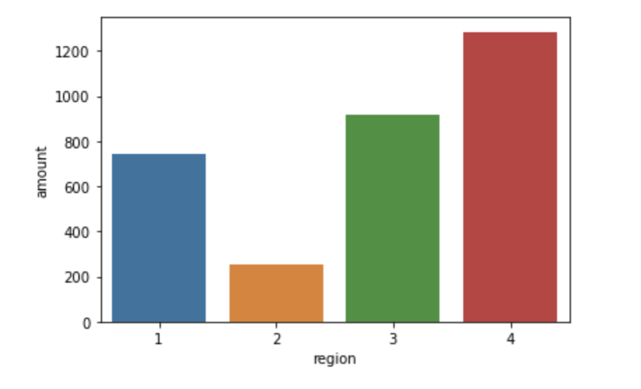
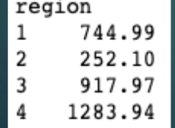
Region Vs Mean Amount Spent/transaction
Customers from the region West spend the most at an average of more than $1000 per transaction.
Customers from the region South spend the least at an average of more than $252 per transaction.
Customers from different regions spend different amounts on purchases.

Slide 8
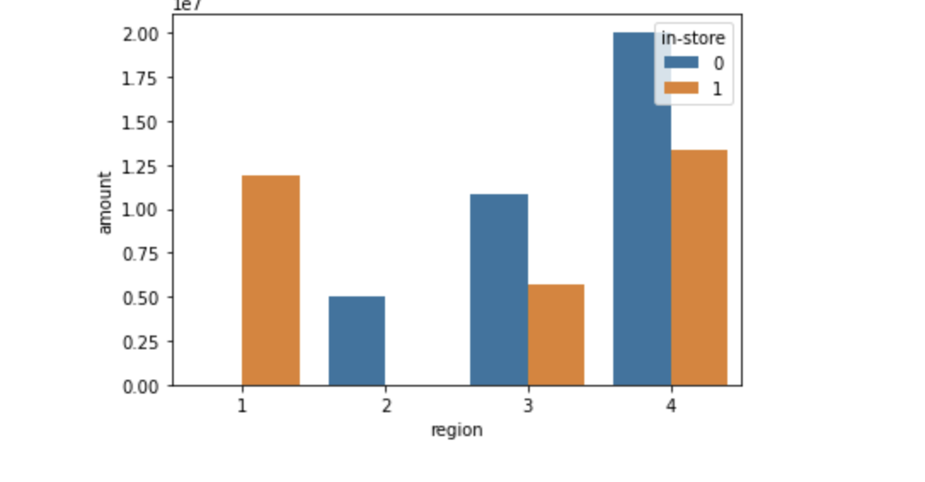
In-Store Vs online Purchase
There were no online purchases in region 1(North). On the other hand, there were no in-store purchases in region 2(South).
(1= in-store; 0= online)
The main reason behind low sales in region 2(South) could be because of no in-store customers.

Slide 9
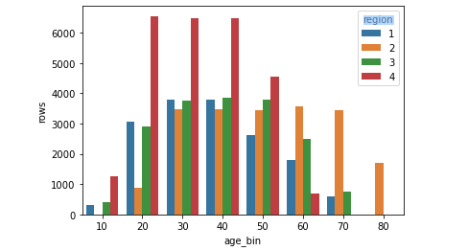
Number of transactions in each region based on the age group.
The only customers in the age group 80s are from region 2.
There were no customers from region 4 above the age of 70. There were no customers below age 20 from region 2. Most of the region 4 customers belong to the 20-50 age group.

Slide 10
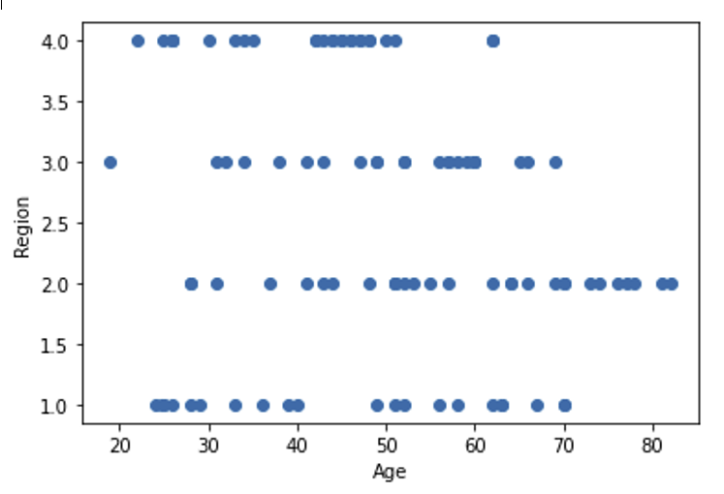
Age by Region
There are slight differences between Age and region.
A scatter plot helps to visualize the differences.
The South has the oldest customers, while the East has the youngest.
Notes:
Are there differences in the age of customers between regions? A very slight difference. Therefore, cannot predict age by region.

Slide 11
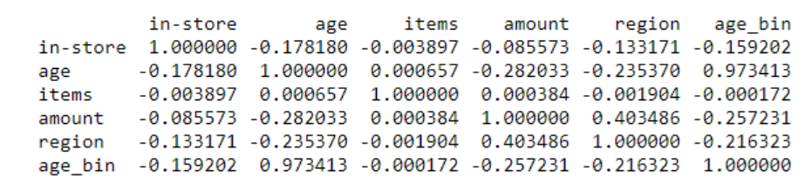
Correlation Matrix to study the relation between region vs amount
The correlation Matrix shows that there is a moderate positive correlation between amount and region with a value of 0.4.

Slide 12
Correlation Matrix to study the relation between items vs amount
From the above correlation matrix, it can be inferred that ‘items' and 'amount' have a correlation of 0.00384, showing a weak correlation. As the number of items purchased increases, it does not relate to the increase in amount spent/item relatively.
Notes:
Is there a relationship between number of items purchased and amount spent? No, there is not. There is a weak correlation.

Slide 13
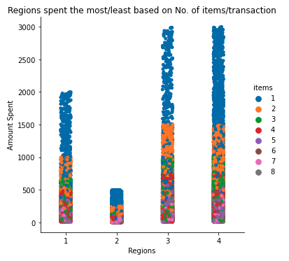
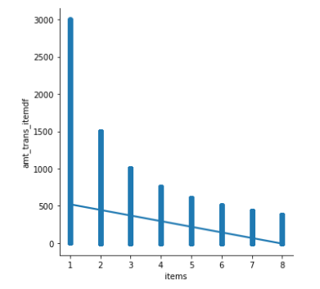
Trend Analysis of customer behavior using Scatterplot
Trend Analysis of Customer Behavior using Seaborn lmplot
From the plot, as the number of items each customer wants to buy increases, the tendency to spend more money per each item decreases.
Notes:
Start talking about the python libraries used to conduct the Exploratory Data Analysis (EDA) to create reports. Visualizations talk and convey stories that actual data points cannot show.
The first chart, which is a Scatterplot shows that there are customers have bought 1 item at the least and 8 items at the most. Customers who buy 1 or less number of items are willing to spend more on the items purchased. On the other hand, customers who buy more than 3 items per transaction are looking to cut down overall expense, inturn trying to cut down cost on each and every item. The regression model graph shows how the tendency to spend more lowers as the number of items increases.

Slide 14
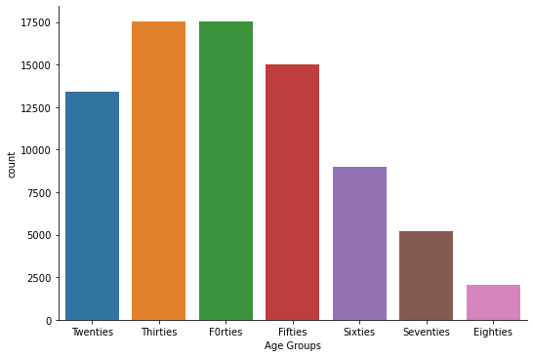
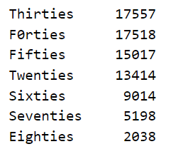
Study on Ages of Customers
Customers in THIRTIES are the
highest, FORTIES are the second highest
number of customers across all regions.
Customers in EIGHTIES are the least number
of customers across all regions.
Notes:
This plot shows the age groups of the highest number of customers and the age groups of lowest number of customers throughout all sales data collected.

Slide 15
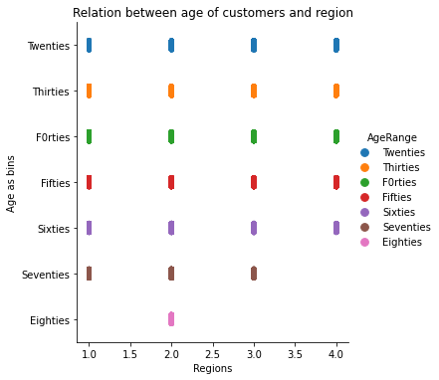
Differences in Ages of Customers vs Region
ALL REGIONS have customers from age range 18 to 69.
Region 1,3 and 4 (North, East and West) have no customers in age-range EIGHTIES.
Region 4 (West) has no customers in the age-range SEVENTIES AND EIGHTIES.
Region 2 (South) is the only region having customers in the age-range EIGHTIES.
Region 4 (West) has the highest and the majority of all its customers in the age range TWENTIES TO FIFTIES compared to all other regions.
Notes:
Are there differences in the ages of customers between regions?

Slide 16
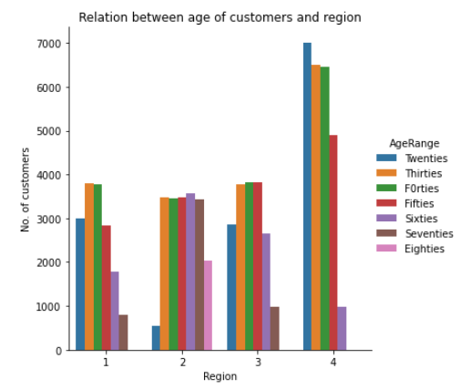
Differences in Ages of Customers vs Region
ALL REGIONS have customers from
age range 18 to 69.
Region 2 (South) is the only region having customers in the age-range EIGHTIES. Region 1,3 and 4 (North, East and West)have no customers in age-range EIGHTIES.
Region 4 (West) has no customers in the age-range SEVENTIES AND EIGHTIES.
Region 4 (West) has the highest and the majority of all its customers in the age-range TWENTIES TO FIFTIES compared to all other regions.
Notes:
One question that Martin , VP of Sales and the Sales team wanted research was , “Are there differences in the ages of customers between regions? “ From my study on the relationships between ages and shopping methods, I can conclude that region 2 (South), is the only region to have most of the overall customers in age range 70s and 80s. And, region South has only Online sales, but no in-store. All of those customers chose to purchase online. And though the sales was not high, the analysis revealed an answer to Blackwell’s VP of Sales, Martin’s perception that ‘customers who shop in the store are older than customers who shop online.” The results of the analysis contradict that and helps answer that we need to “consider marketing activities and potentially some design changes to the website to attract younger buyers to shop online, specifically targeting regions North, South and East.” Even the results on region 1 (North) which has only in-store purchases, has only younger buyers, which proves the previous results. Across N, S, E regions, we need to target buyers interests, both in-store and online improving both shopping experiences. In W we need to attract older buyers interests.

Slide 17
Correlation Matrix to understand age vs region
From the above correlation matrix, it can be inferred that 'age‘ and ‘region’ have a correlation of -0.235, showing a negative weak correlation. Also, ‘age’ and ‘region’ cannot be investigated relatively using the correlation matrix because ‘region’ does not take actual numerical values here.
All other factors too seem to have a weak correlation with the 'age'.
Predicting ‘age’ of a customer could not be achieved successfully. An efficient model using different algorithms, which could make an accurate prediction of age cannot be achieved.

Slide 18
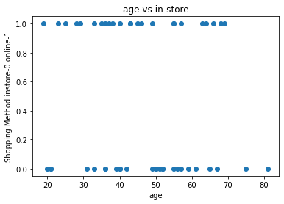
Scatter-plot to study age vs shopping method ‘in-store’ or ‘online’
Notes:
There is a slight correlation between the customer age and in in store vs online shopping.
the data provided shoes customers under the age of 50 slightly favor in store shopping while customers over 50 slightly favor online shopping with all customers over 75 utilising online shopping

Slide 19
Correlation Matrix to investigate shopping method ‘in-store’/‘online’ vs other factors
From the above correlation matrix, it can be inferred that 'in-store' and 'age' have a correlation of -0.178, showing a negative weak correlation. Also, ‘age’ and ‘in-store’ cannot be investigated relatively using the correlation matrix here because ‘in-store’ does not take actual numerical values here, but takes assigned nominal values 0(online) and 1(in-store). No other variable seems to have a positive strong relation to ‘age’.
Notes:
Is there any correlation between age of a customer and if the transaction was made online or in the store? Just looking at the top row, it shows that age and in-store have a negative weak correlation.

Slide 20
Predicting shopping method ‘in-store’ or ‘online’
Out of all variables, Shopping method 'in-store’ or ‘online' can be predicted efficiently (>84%) using both DTC (Decision Tree Classifier) AND RFC (Random Forest Classifier) models.
RFC created the model with the highest accuracy 86% and high CV (Cross Validation) scores.
Best Fit for predicting 'shopping method – in-store/online ‘ is the RFC model.
When predicting shopping method ‘in-store’, eliminating ‘age’ from being used as one of the independent variables does not impact accuracy. Whereas, other variables ‘region’ and ‘amount’ seems to improve the accuracy of the model when used as independent variables.

Slide 21
Conclusion
Customers from different regions do spend different amounts on purchases. Customers from the region West spend the most at an average of more than $1000 per transaction. Customers from the region South spend the least at an average of more than $250 per transaction
From the analysis, as the number of items each customer wants to buy increases, the tendency to spend more money on each item decreases.
We split the data, trained and tested the data using various algorithms to be able to predict the customer behaviors.
Out of all variables, Shopping method 'in-store’ or ‘online' can be predicted efficiently (>86%) using Random Forest Classifier(RFC) algorithm model.
‘Region’ can be predicted second best, with an accuracy of (>65%) using the Decision Tree Classifier(DTC) algorithm model.

Slide 22
Conclusion
An efficient model to predict age cannot be achieved due to poor accuracy results from all models.
Analysis of ages of customers across different regions shows results which imply that catering to customers in the age group of SEVENTIES and EIGHTIES should be improved in regions North, East and West. Overall, only region West shows maximum number of customers in all age groups. So, steps to improve sales in other regions needs to planned and strategized.

Slide 23
Data Mining and its impact on decision making
Data Mining serves as a key tool to address business priority, which in our case is to maximize sales and in turn revenue.
Data Mining methods help develop insights that aid strategic planning and efficient decision-making on areas such as online-marketing, enhancements to ecommerce site, and so forth while achieving business priority at low costs.
The main aspect of data mining is to store, distribute and turn raw data to helpful information.
Understanding, exploring and identifying patterns can be efficiently achieved in less time.
Predicting future outcomes and results on a given large data set helps solve business problems.
Exploratory Data Analysis (EDA) can help build visualizations, reports and tell stories of pattern and trend that are hidden behind raw data.

