Slide 1
A Multi-Dimensional Framework for Ethical and Environmental Evaluation of Generative AI Systems
Responsible AI Scoring Model | Green AI | Ethical Risk Detection
Bugatha Ganasyam Mani Sankar | JNTU-GV College of Engineering | Mentor: Mohammad Sameer (Phinerd)

Slide 2
The Dual Crisis: Ethics & Environment
• Generative AI powers military simulations, policy recommendations, and crisis response — but lacks accountability
• AI systems consumed 50+ million metric tonnes of CO₂ in 2025 alone (equivalent to New York City's annual emissions)
• Water consumption could equal basic needs of 1.3 billion people by 2030 (UNU-INWEH 2026)
• Data center energy demand projected to quadruple by 2030; only ~50% met by renewables (IEA 2025)
• No existing framework integrates ethical risk AND environmental sustainability into unified governance metrics
• Current approaches treat ethics and sustainability as orthogonal concerns — this research bridges the gap

Slide 3
Research Objectives & Contributions
• Develop a unified Responsible AI (RAI) scoring model combining Ethics + Environment + Transparency
• Propose Ethical Risk Modeling with Bias Score (B), Explainability Score (X), and Decision Risk Factor (D)
• Quantify environmental impact across energy (kWh), water (liters), and carbon (kgCO₂e) footprints
• Validate framework across 150 high-stakes tactical scenarios: Military, Crisis, Policy
• Provide optimization strategies projected to achieve substantial carbon and water footprint reductions
• Align with ISO/IEC TR 20226:2025, EU AI Act, and UN Sustainable Development Goals

Slide 4
Proposed Methodology: Four Integrated Modules
• Module 1 — Ethical Risk Modeling: NLP-based bias detection, LIME explainability, hierarchical risk classification
• Module 2 — Environmental Impact Estimation: PUE/WUE metrics, GPU energy modeling, regional carbon intensity mapping
• Module 3 — Responsible AI Scoring: RAI = w₁E + w₂S + w₃T (weighted aggregation with literature-grounded coefficients)
• Module 4 — Tactical Scenario Simulation: Military, Crisis Response, Policy domains
• System Pipeline: Scenario Input → AI Output → Ethical Analysis → Resource Estimation → Scoring → Recommendations

Slide 5
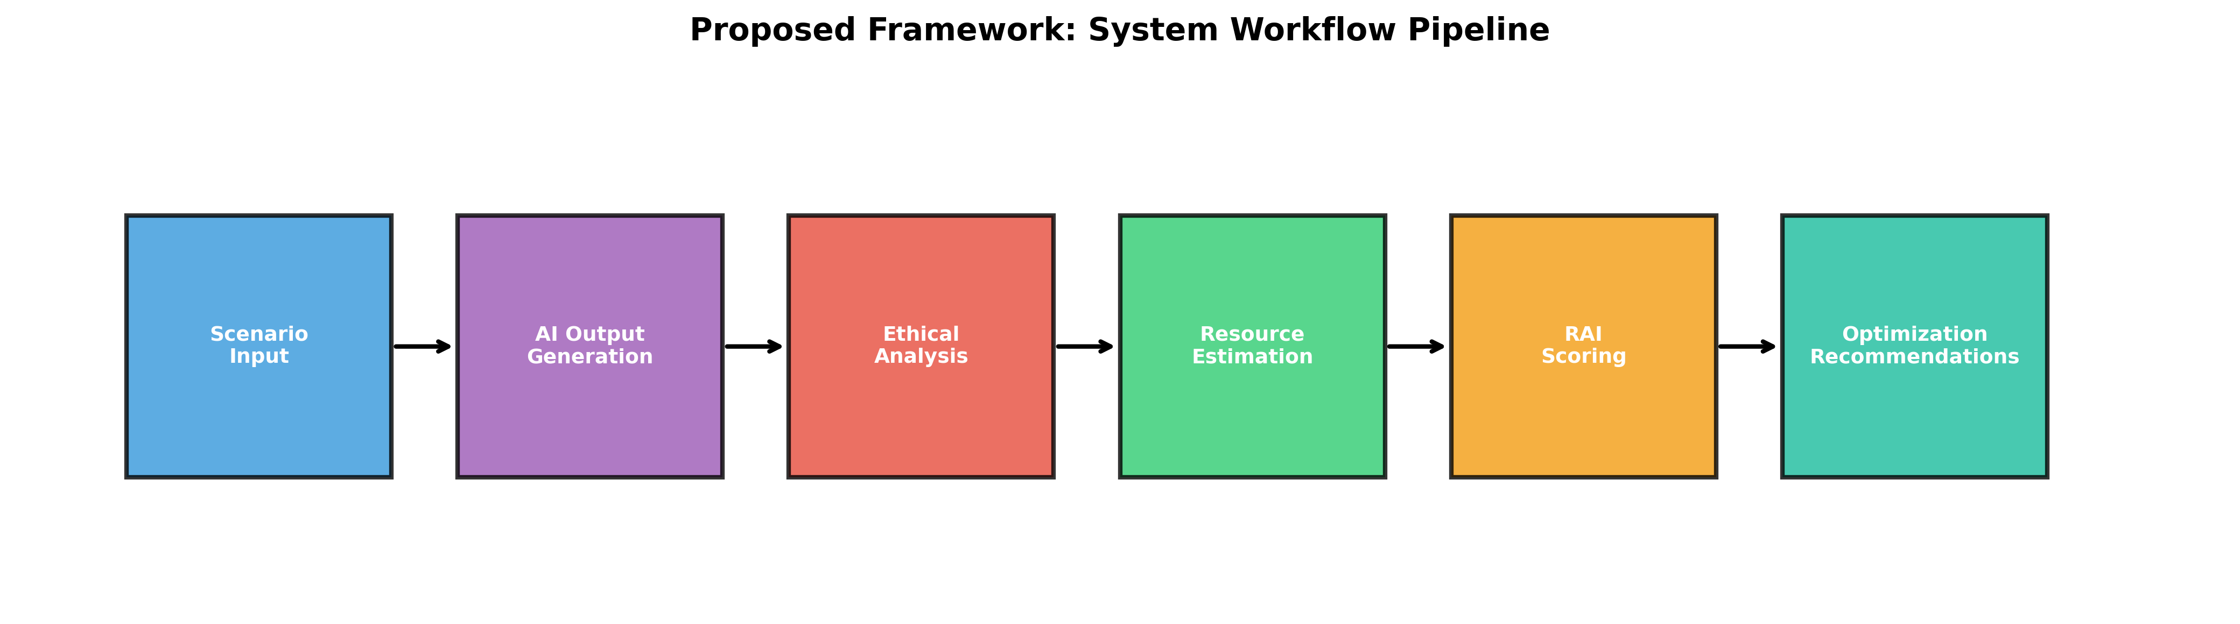
System Workflow Pipeline

Slide 6
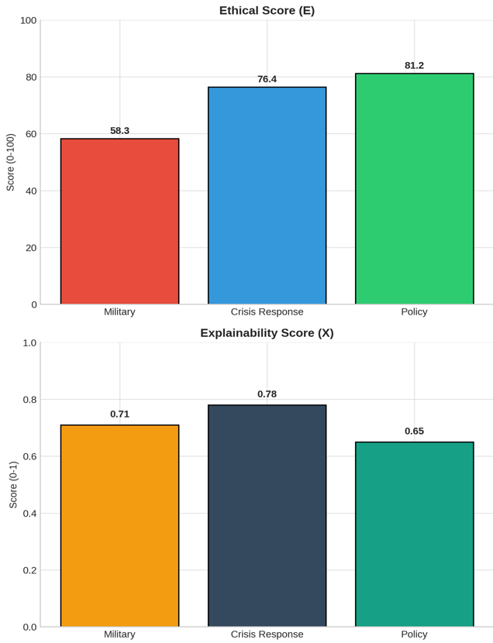
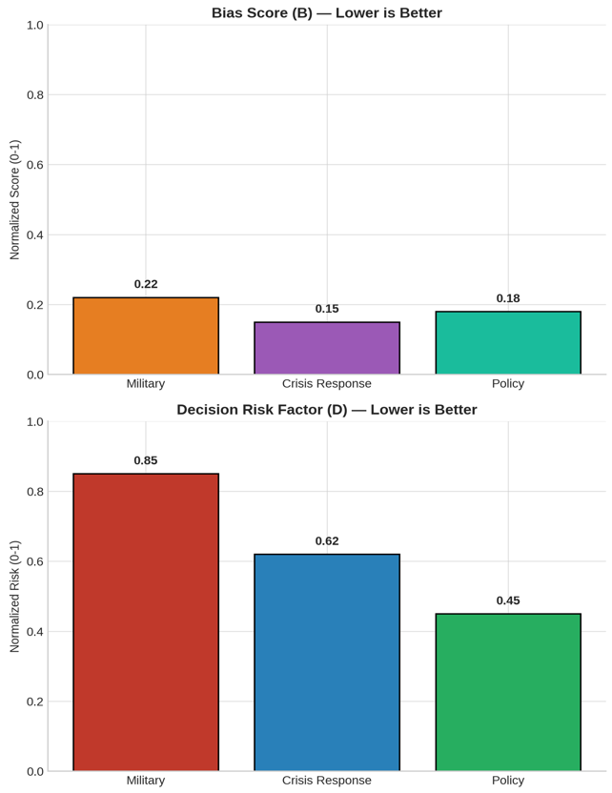
Ethical Risk Analysis Across Scenario Categories

Slide 7
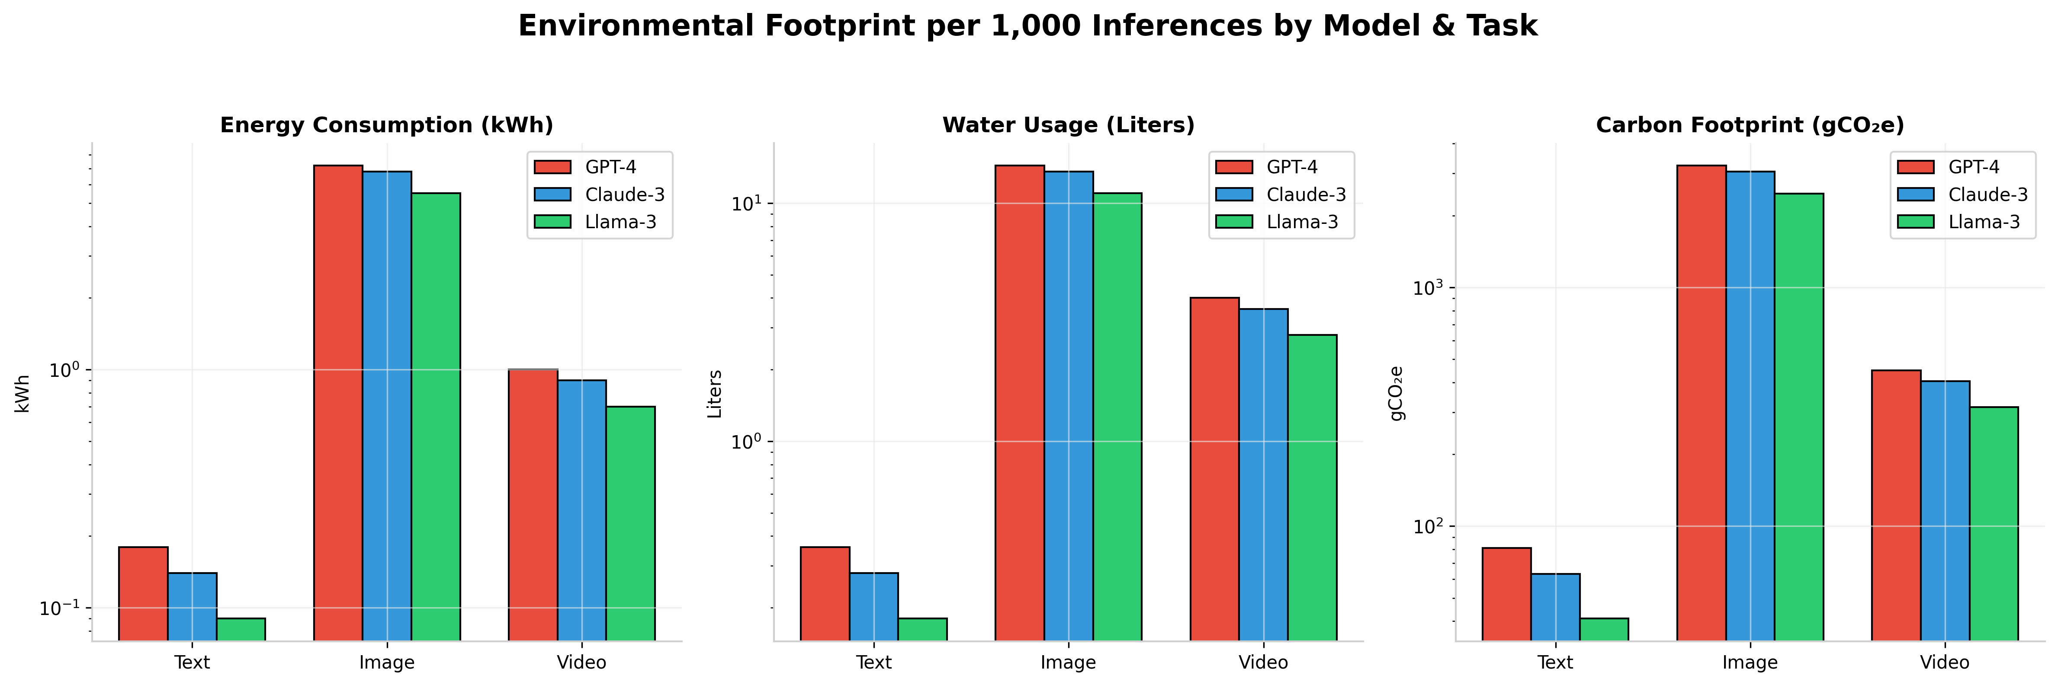
Environmental Footprint: Model & Task Comparison

Slide 8
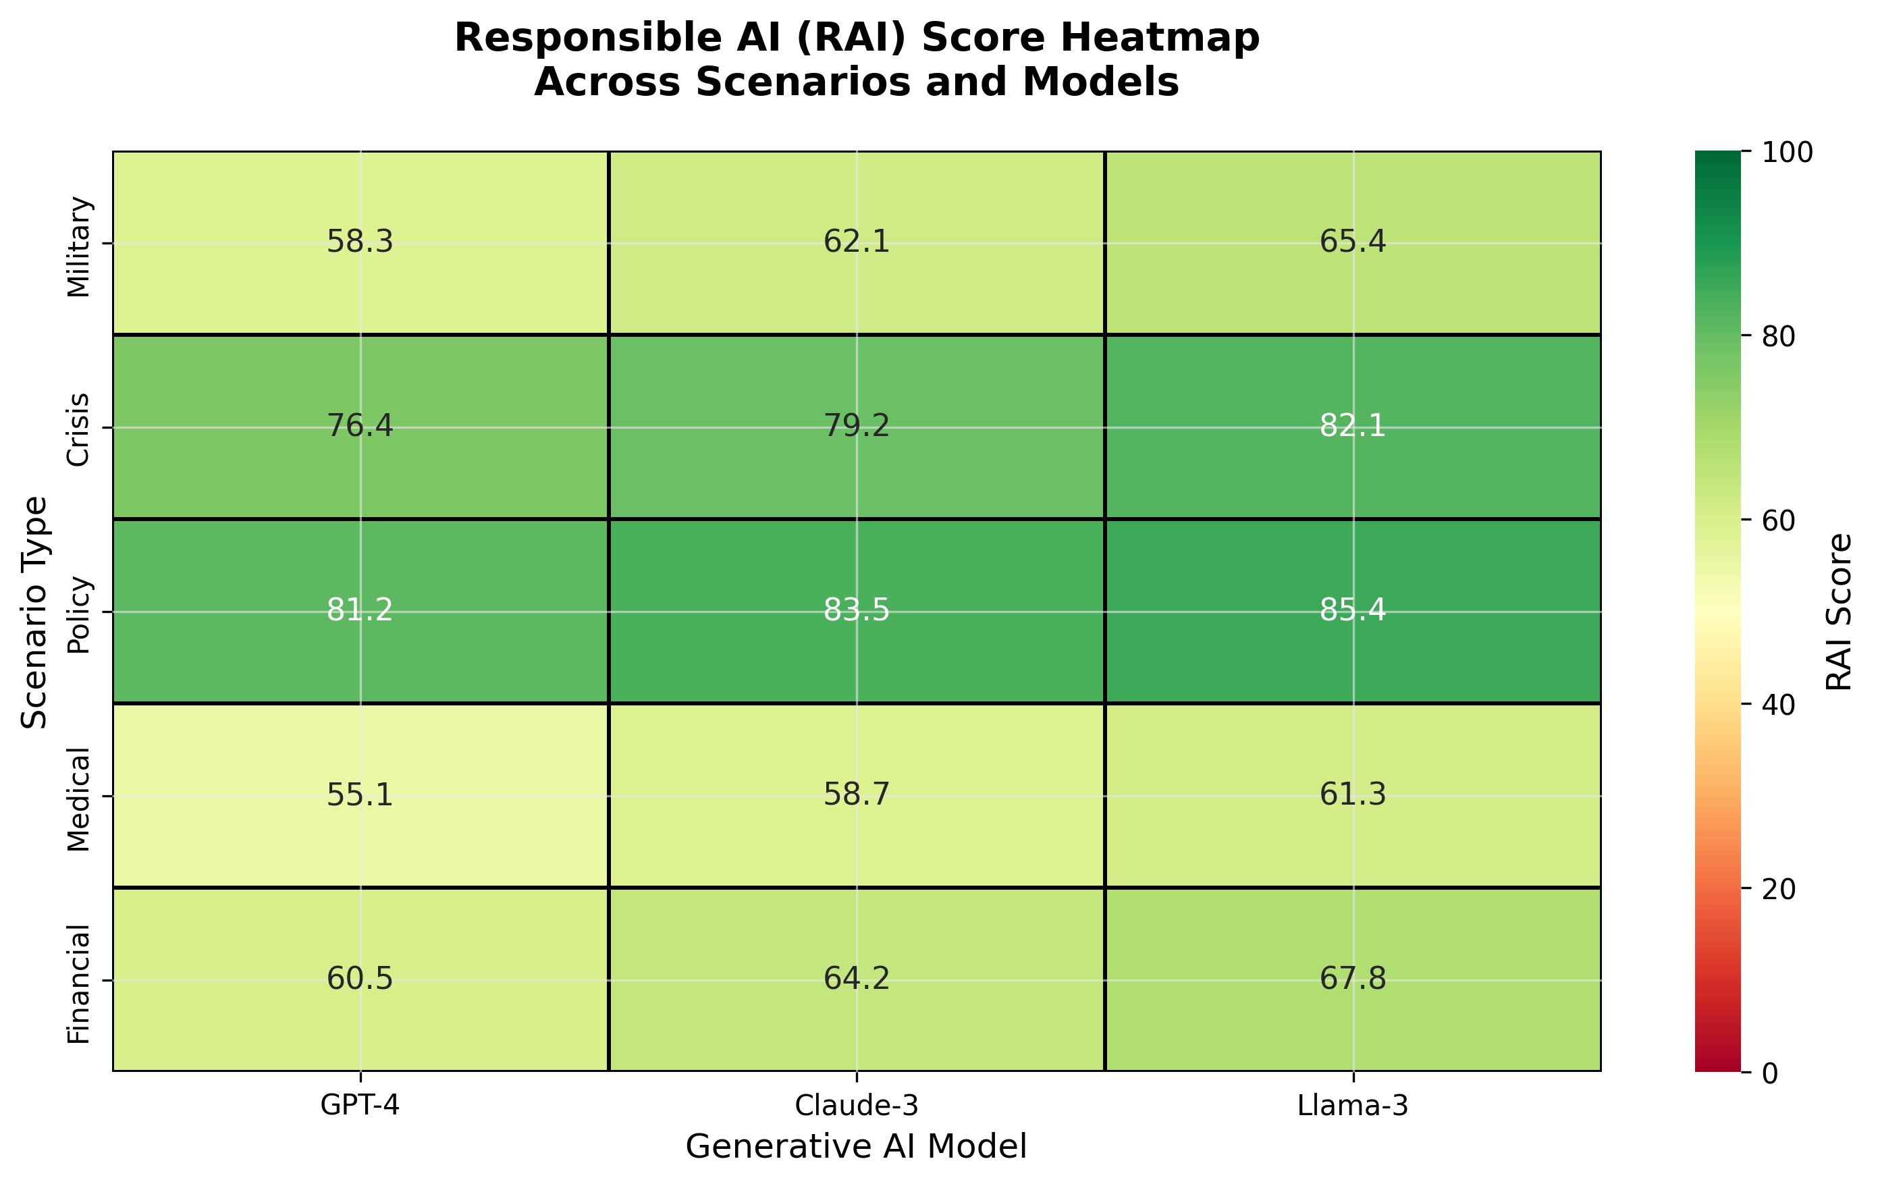
Responsible AI (RAI) Score Heatmap

Slide 9
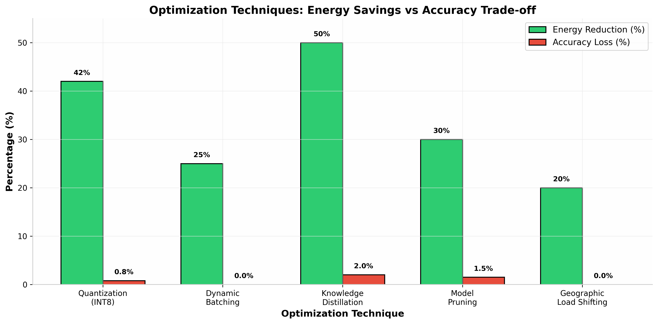
Optimization Strategies: Energy vs Accuracy Trade-offs

Slide 10
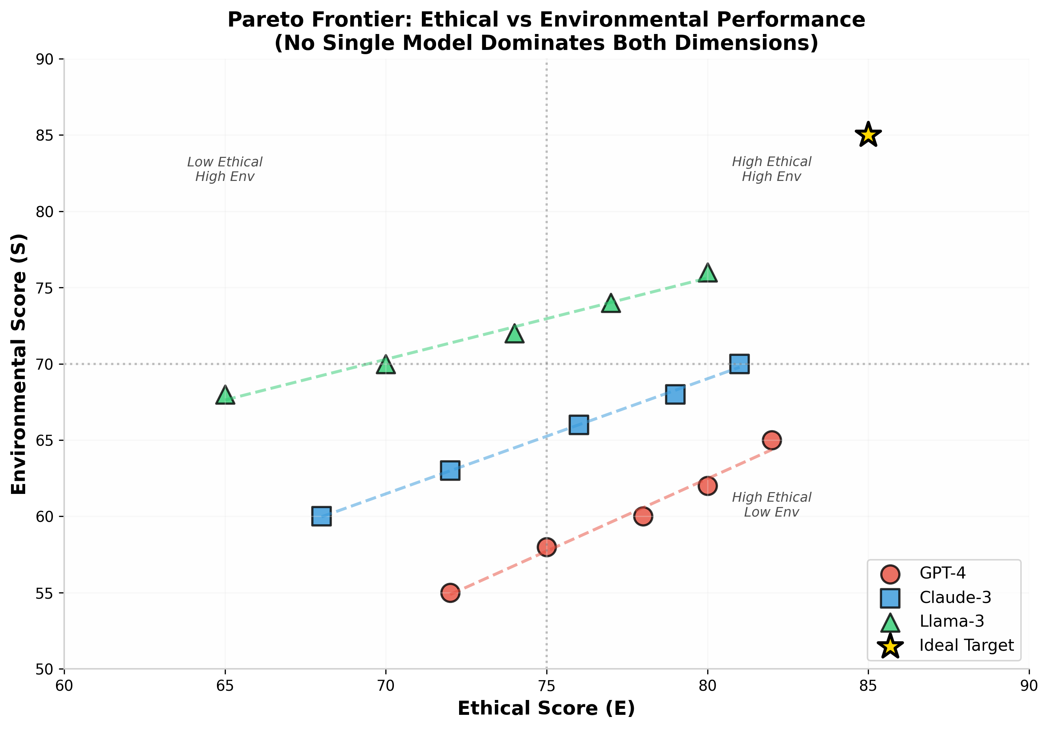
Pareto Frontier: Ethical vs Environmental Performance

Slide 11
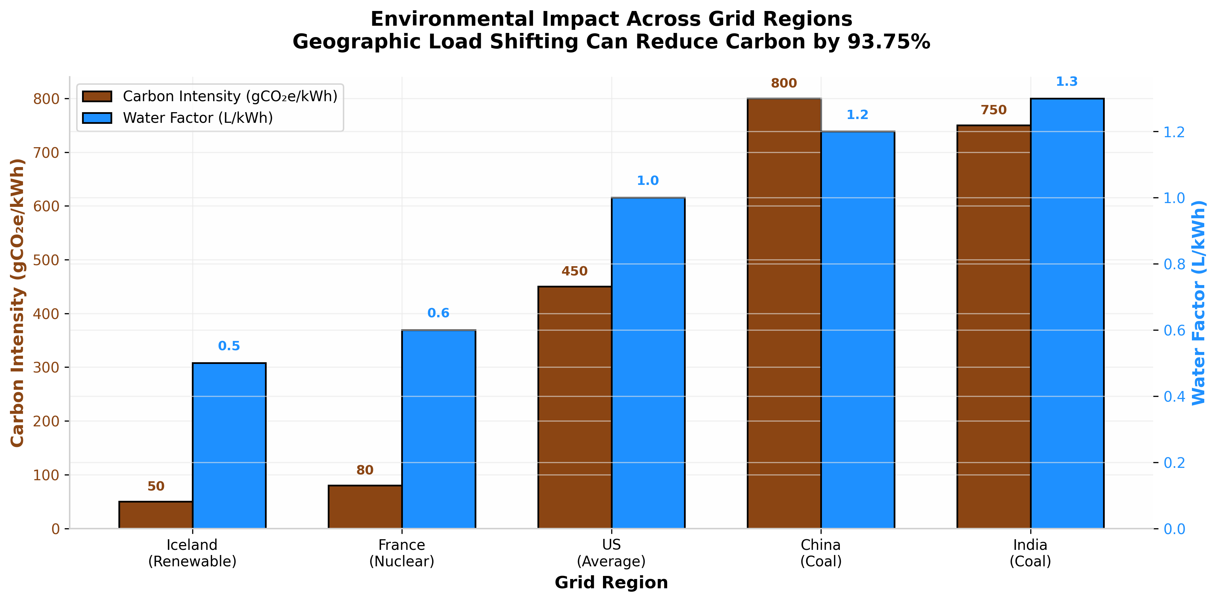
Geographic Impact: Carbon & Water Across Grid Regions

Slide 12
Key Findings & Insights
• Military scenarios show highest risk (0.85) and lowest ethical scores (58.3) — demand strict human oversight
• Image generation consumes ~50× more energy than text; estimated video generation shows highest per-unit impact
• Llama-3 achieves best environmental efficiency with 50% lower energy than GPT-4, though its RAI score (73.9) is moderated by higher residual bias
• Geographic load shifting from coal to renewable grids reduces carbon by 93.75% without hardware changes
• 34% of simulated policy recommendations exhibited subtle demographic biases invisible to surface-level fairness metrics
• Inference (not training) dominates lifecycle costs (80-90%) — optimization must focus on deployment efficiency

Slide 13
Future Work & Impact
• Integrate land footprint metrics from critical mineral extraction (lithium, cobalt, rare earth elements)
• Develop real-time API monitoring for continuous RAI scoring in production environments
• Expand to healthcare and financial domains with domain-specific ethical constraints
• Investigate rebound effects: does efficiency improvement lead to increased aggregate consumption?
• Publish framework as open-source toolkit for AI developers and policymakers
• Target venues: Scopus Q1 Journals, IEEE AI Ethics, ACM FAccT, Sustainable Computing conferences

Slide 14
Thank You
Questions & Discussion Bugatha Ganasyam Mani Sankar JNTU-GV College of Engineering, Vizianagaram ganasyammanisankarbugatha@gmail.com

