Slide 1
AUTOMATIC PRODUCTION PLANNING & SCHEDULING OF SIZE
PIP2001 Capstone Project
Final Review
Batch Number: CSE-G129
Under the Supervision of,
Dr. Venkataravana Nayak K
Assistant Professor
School of Computer Science and Engineering
Presidency University
Roll Number | Student Name
20211CSE0221 | Manvitha G S
20211CSE0248 | Harshitha K B
20211CSE0213 | Sahana G
20211CSE0199 | Bhoomika V
Name of the Program: B.Tech
Name of the HoD: Dr. Asif Mohammed H B
Name of the Program Project Coordinator: Mr. Amarnath J L
Name of the School Project Coordinators: Dr. Sampath A K / Dr. Abdul Khadar A / Mr. Md Ziaur Rahman

Slide 2
Introduction
Automatic Production Planning and Scheduling systems are pivotal in modern manufacturing environments.
These systems enable manufacturers to optimize their resources, minimize costs, and streamline production processes.
By leveraging advanced computational techniques and automation, they enhance efficiency and reduce human intervention, addressing challenges like resource misallocation, production delays, and inefficiencies.

Slide 3
Hardware/Software components
Hardware:-
Laptop (11th Gen Intel(R) Core(TM) i5-11320H @ 3.20GHz 2.50 GHz, 16 GB RAM)
Software:-
i. Operating System: Windows
ii. Programming Language: Python 3.7 or higher - The primary language for machine learning
iii. Machine Learning Libraries:
•NumPy, Pandas: For data manipulation and analysis.
•Matplotlib, Seaborn: For data visualization.
iv. Google colab notebook : For running interactive Python code and sharing results with the research team.
v. Git: For version control and collaboration.

Slide 4
Literature Review
Research Paper | Method | Advantages | Disadvantages
Study on the Optimization of Production Scheduling in Manufacturing Systems | Genetic Algorithm for Production Planning | Helps in optimizing the scheduling process based on available resources and required sizes. Reduces lead time and improves on-time delivery. | Computationally intensive, especially for large production systems.
Scheduling and Size Optimization in Automated Factories | Mixed Integer Linear Programming (MILP) for scheduling production sizes | MILP provides precise scheduling and can accommodate various size-related constraints for production. Ensures balanced utilization of resources. | Difficult to scale for complex production systems with many variables. Requires accurate input data to be effective.

Slide 5
Research Paper | Method | Advantages | Disadvantages
Real-time Automated Scheduling of Production Lines | Real-time scheduling using AI and Machine Learning algorithms | Optimizes schedules based on real-time data and adjusts for size requirements dynamically. Improves flexibility and efficiency. | Requires large amounts of real-time data and sophisticated algorithms, making implementation costly and complex.
Adaptive Scheduling for Size-Based Manufacturing | Constraint Programming for size-specific scheduling | Allows for efficient scheduling based on size constraints, such as machine capacity, available raw materials, and time. Enhances production flow. | May not handle uncertainty in demand or sudden changes in production requirements effectively.

Slide 6
Research Paper | Method | Advantages | Disadvantages
Smart Manufacturing and Dynamic Scheduling | Internet of Things (IoT) and Cloud Computing for dynamic scheduling | Enables automatic adjustment of production schedules based on machine status, size requirements, and inventory levels. Increases overall production efficiency. | Integration of IoT devices can be expensive. Dependence on the cloud may raise concerns about data security.

Slide 7
Existing method Drawback
LACK OF FLEXIBILITY IN HANDLING DYNAMIC CHANGES
INTEGRATION CHALLENGES BETWEEN LEGACY AND MODERN SYSTEMS
UNCERTAINTY AND RISK MANAGEMENT IN SCHEDULING
SCALABILITY OF SCHEDULING ALGORITHMS
REAL-TIME DATA INTEGRATION AND FEEDBACK LOOPS
HUMAN AND MACHINE INTERACTION IN SCHEDULING

Slide 8
Objectives
AUTOMATED SCHEDULING PREDICTION
EFFICIENT RESOURCE UTILIZATION
DATA-DRIVEN DECISION MAKING
DYNAMIC GANTT CHART GENERATION
INTERACTIVE INPUT SYSTEM
EXPORTING DATA TO EXCEL
IMPROVED ACCURACY IN PREDICTIONS

Slide 9
Proposed Methodology
DATA COLLECTION AND PREPROCESSING
Input Data Collection
Historical Data
MODEL TRAINING AND PREDICTION
Model Selection
Training the Model
Prediction of Scheduling Time
SCHEDULING TIME CALCULATION
Sequential Production Scheduling:
Start Time Calculation:
Formula:
Start Time for Product n = End Time of Product (n-1).
The end time for product n is calculated as:
End Time = Start Time + Scheduling Time
GANTT CHART GENERATION
DATA EXPORT TO EXCEL
USER INTERACTION AND OUTPUT

Slide 10
SYSTEM OVERVIEW
The system leverages a combination of machine learning for predicting scheduling times
and interactive tools for visualizing and exporting production schedules. The key components
of the system include:
File Upload: Users upload historical data in CSV format, which is used to train the machine learning model.
Linear Regression Model: A Linear Regression model is trained using historical data to predict the scheduling time for new products based on factors like product availability and sales.
Gantt Chart Visualization: The scheduling information is displayed as a Gantt chart to provide a clear timeline of production activities.
Excel Export: Users can export the production schedule, including the Gantt chart, to Data Flow
File Upload: The user uploads the historical data CSV file.
Data Preprocessing: The data is cleaned and organized into features (product availability, sales) and the target (scheduling time).
Model Training: The model is trained on the preprocessed historical data.

Slide 11
Prediction: The model predicts the scheduling time for newly entered product data.
Gantt Chart Generation: The system visualizes the predicted scheduling times in a Gantt chart.
Export: The production schedule, including the Gantt chart, is exported to an Excel file.
SYSTEM IMPLEMENTATION
File Upload and Data Handling
The system begins by prompting the user to upload a CSV file containing historical
production data. The uploaded file is read using Pandas to convert it into a DataFrame. This
data contains columns for the product, its availability, the number of products sold, and the
corresponding scheduling times.
Model Training and Prediction
Using Linear Regression, the model is trained to predict scheduling time based on the
product’s availability and sales data. The data is split into training and testing sets to evaluate
the model's performance. The training process involves learning the relationship between the
input features (availability and sales) and the target variable (scheduling time).
Gantt Chart Generation
After predicting the scheduling times for new products, the system generates a Gantt chart
using Matplotlib. Each product’s scheduling time is represented by a colored horizontal bar,
with the length of the bar indicating the time required for production. The chart also includes a legend and labels for clarity.

Slide 12
EVALUATION AND TESTING
Model Evaluation
The performance of the Linear Regression model is evaluated using the Mean Squared
Error (MSE) and R² score. The MSE measures the average squared difference between
predicted and actual values, while the R² score indicates the proportion of variance in the target
variable explained by the model. Higher R² scores and lower MSE values indicate better model
performance.
Testing the Gantt Chart
The Gantt chart is visually inspected for accuracy and clarity. The system ensures that
the bars correctly represent the start and end times for each product, and the chart is legible
with appropriate color coding and labels.

Slide 13
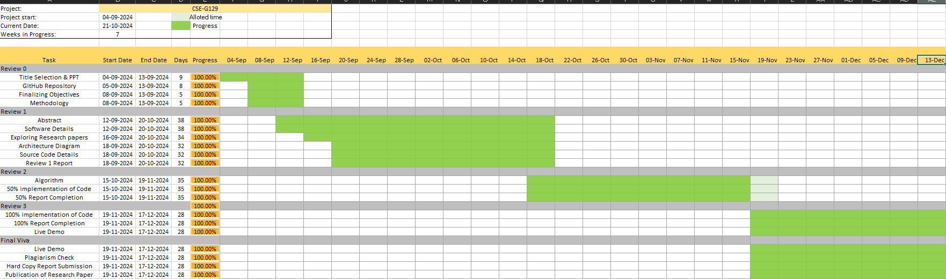
Timeline of Project

Slide 14
Expected Outcomes
Machine Learning Model: Accurately predicts scheduling times for products based on historical sales and availability data.
Gantt Chart Visualization: Provides a clear, visually appealing representation of the production schedule.
Excel Export: Allows users to share and further analyze the production schedule outside the system.
Scalability and Performance: The system can handle varying datasets and adapt to different production environments.
Data-Driven Decision-Making: Empowers production managers to make informed decisions based on real-time and historical data.

Slide 15
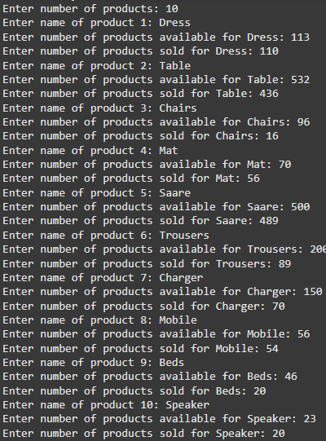
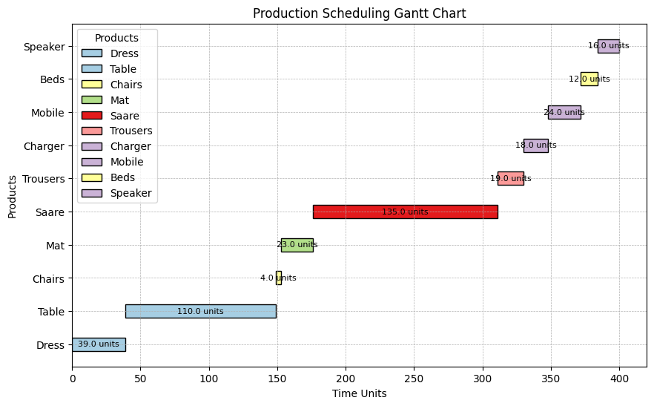
Results
Production Scheduling Gantt Chart
Data Entry of the products

Slide 16
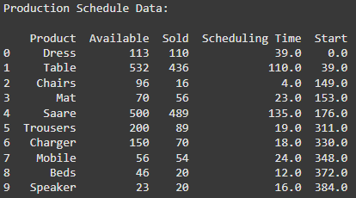
Scheduled Data

Slide 17
Conclusion
The presented code effectively demonstrates an end-to-end solution for production scheduling by integrating machine learning, data visualization, and report generation into a cohesive workflow.
Leveraging a Linear Regression model trained on historical data, the program predicts scheduling times based on critical production parameters such as the number of items available and sold
This predictive capability is crucial for optimizing manufacturing workflows, enabling users to plan and allocate resources efficiently.
The incorporation of a Gantt chart provides a visual representation of the production timeline, facilitating better communication and understanding of scheduling among stakeholders.
The design emphasizes user-friendliness, starting from the intuitive data upload process to the structured data input prompts for new product entries.
The production scheduling system demonstrates significant potential to improve efficiency and decision-making in manufacturing processes.

Slide 18
Github Link
https://github.com/GSManvitha?tab=repositories

Slide 19
References
Multivariate Probabilistic Range Queries for Scalable Interactive 3D Visualization–2023: https://ieeexplore.ieee.org/document/9903339/
Hardware Implementation of Timed Logical Control FSM – 2020: https://ieeexplore.ieee.org/document/9225129
Sliced Lattice Gaussian Sampling: Convergence Improvement and Decoding Optimization – 2020: https://ieeexplore.ieee.org/document/9249415
Smart Scheduling for Flexible and Hybrid Production with Multi Agent Deep Reinforcement Learning – 2021: https://ieeexplore.ieee.org/document/9688235
The Study of Monte Carlo Algorithm Based on Topology and Dynamic Programming in Production Scheduling Scenario – 2021: https://ieeexplore.ieee.org/document/9445957
Auto-MPS: an automated master production scheduling system for large volume manufacturing – 2002: https://ieeexplore.ieee.org/document/323696
A review and classification of scheduling objectives in unpaced flow shops for discrete manufacturing – 2023: https://www.researchgate.net/publication/375418139_A_review_and_classification_of_scheduling_objectives_in_unpaced_flow_shops_for_discrete_manufacturing
Conception of self- construction production scheduling system – 2009: https://ieeexplore.ieee.org/document/4120401/similar#similar
A hybrid algorithm for order acceptance and scheduling problem in make-to- stock/make-to-order industries – 2023: https://www.researchgate.net/publication/328971941_A_Hybrid_Algorithm_for_Order_Acceptance_and_Scheduling_Problem_in_Make-To-StockMake-To-Order_Industries
A Novel Patient Similarity Network (PSN) Framework Based on Multi-Model Deep Learning for Precision Medicine – 2022: https://doi.org/10.3390/jpm12050768
A Scheduling Model of Intelligent Manufacturing System Based on GA Optimization – 2022: https://ieeexplore.ieee.org/document/9723927

Slide 20
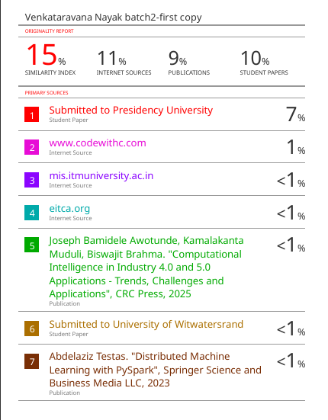
Plagiarism Check

Slide 21

Project work mapping with SDG
The Project work carried out here is mapped to SDG-9: Industry, Innovation, and Infrastructure.
The project work carried supports SDG 9 by promoting and enhancing industrial efficiency through automation. It optimizes resource use, reduces downtime, and improves productivity, fostering resilient infrastructure. The project enables sustainable industrialization by minimizing waste and operational costs. This innovation strengthens industries to adapt to evolving demands while promoting sustainable growth.

Slide 22
Thank You

