Slide 1
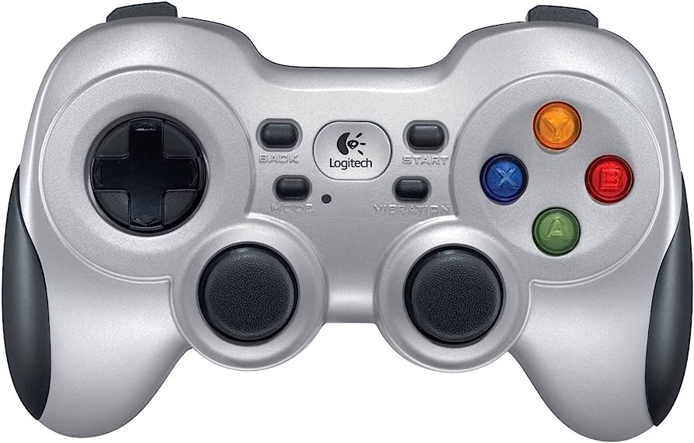
Tele-op instruction
LB: Press to record commands
LT: Press to Enable teleop (current pose will be the initial set point)
RB: decrease desired depth (going up in NED)
RT: increase depth increase (going down in NED)
Enable the controller
Disable the controller
Disable teleoperation
Y: decrease pitch (nose down in NED)
B: increase yaw (turn to starboard)
Surge +
A: increase pitch (nose up in NED)
Sway -
Sway +
X: decrease yaw (turn to port)
Surge -

Slide 2
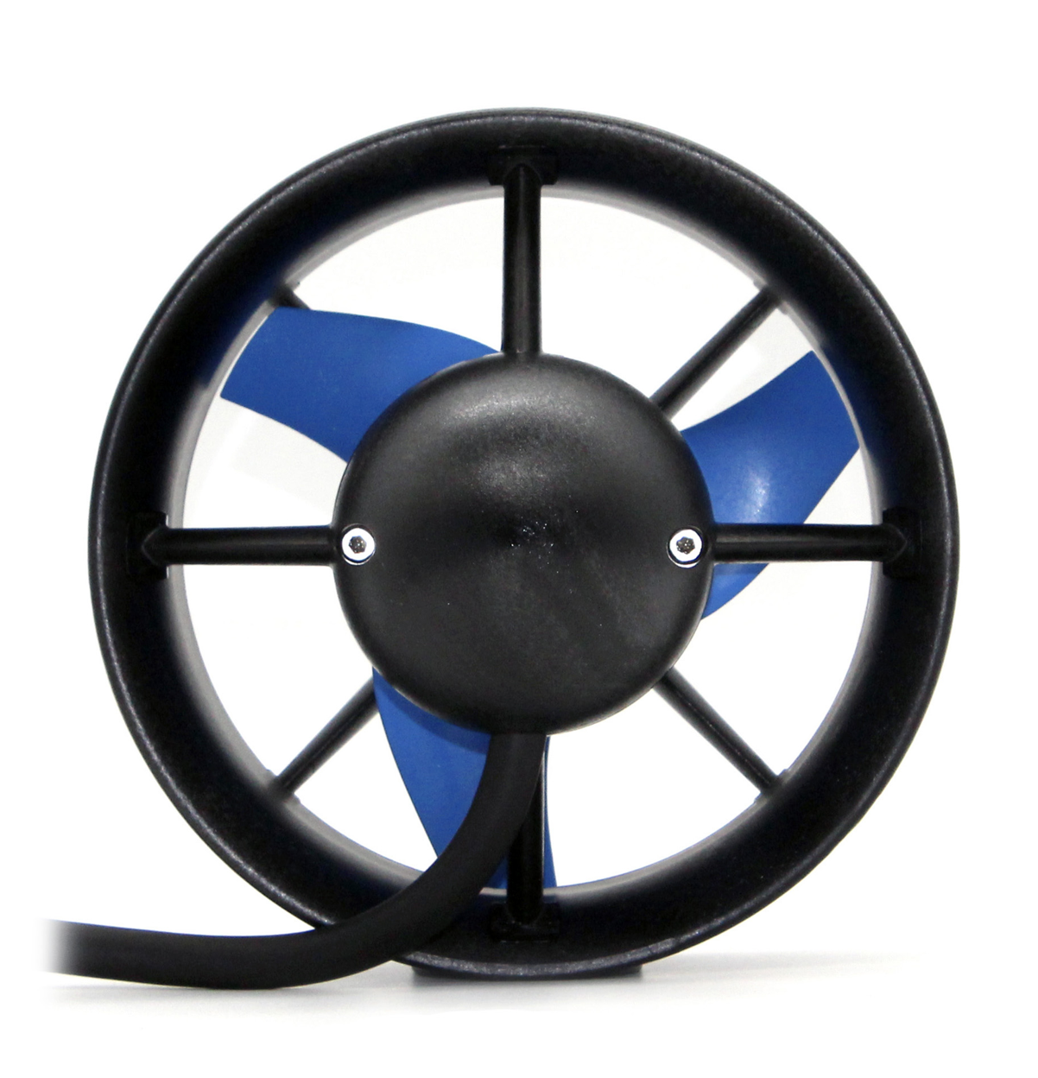
Thruster propeller installation
Prop spinning direction
Force pointing outward from the photo
F

Slide 3
HS
HB
Forward
Surge

