Slide 1
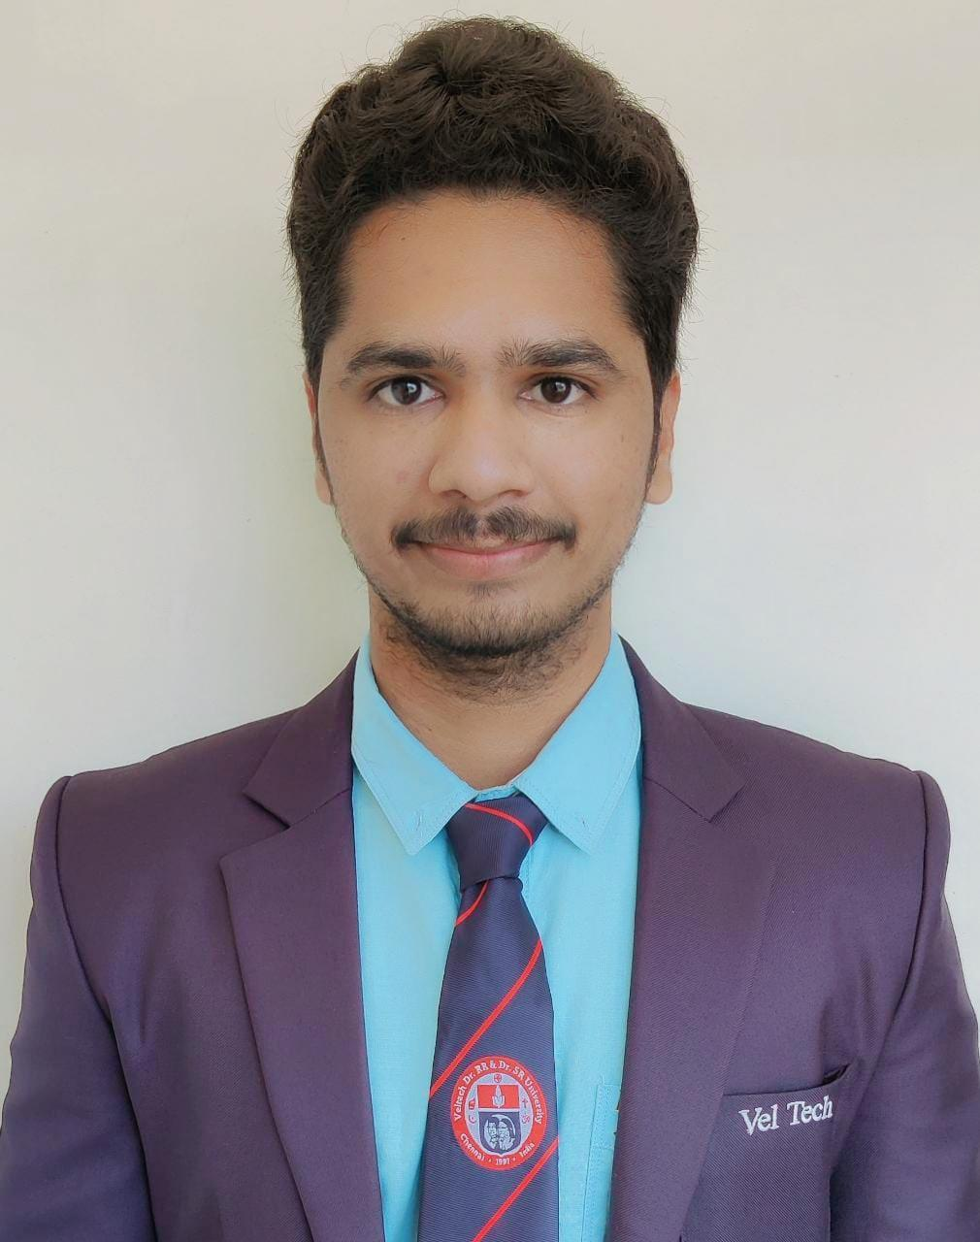


Sarath Sai Krishna Babu Gunupudi
Analyst/Software Engineer
ITransform L&D Left Shift Batch
Bachelor of Technlogy, Electronics and Communications : 2019 - 2022
Certification:
AZ-900-Microsoft Azure Fundamentals and AZ-104 Azure Administrator Associate
Mumbai
GUNUPUDI-SARATH-SAI-KRISHNA.BABU@CAPGEMINI.com
+91 9966861649
Skills
A4
C# | Basics, OOPS, Exception Handling ,Arrays ,Collection and Generics,
.NET Framework | ADO.NET,ASP.NET with MVC5 and WEB API,Entity Framework
Ado.net | Basic Architecture
Database | SQL
Tools | GIT,Swagger
UI Technology | HTML5 ,CSS & Angular
Add On Skills | SharePoint,PowerApps,Communication Skills and Team Management
Full Stack Developer
Understanding of RDMS concepts using SQL Server.
Practical understanding of C# and SQL concepts using Visual Studio and SQL Server.
Hands on experience in developing applications using .NET Framework, ADO.NET Core, ASP.NET and JWT based authentication.
Understanding of HTML5 , CSS and Angular Cli
Trained under iTransform
Online Flight Booking System Video link
Completed case study on Online Flight Booking System along with API Gateway, Swagger, payment, JWT Based Authentication ,responsive UI with HTML5, CSS, Bootstrap and Angular used as User Interface. This application enables a customer to book a flight reservation in advance and can cancel the booking or Check in into the flight and also an admin can perform various administrative operations like Airport management, Flight Management and Customer management.
Technologies used:
ANGULAR
ASP.NET CORE
Microsoft SQL Server
Check out my GitHub Repository

