Slide 1
MODULE 4
CONVOLUTIONAL NEURAL NETWORKS

Slide 2
CONVOLUTIONAL NEURAL NETWORK
KERNEL → FEATURE MAP
STRIDE
PADDING
POOLING
MOTIVATION
CONVOLUTION
DIMENSIONALITY

Slide 3
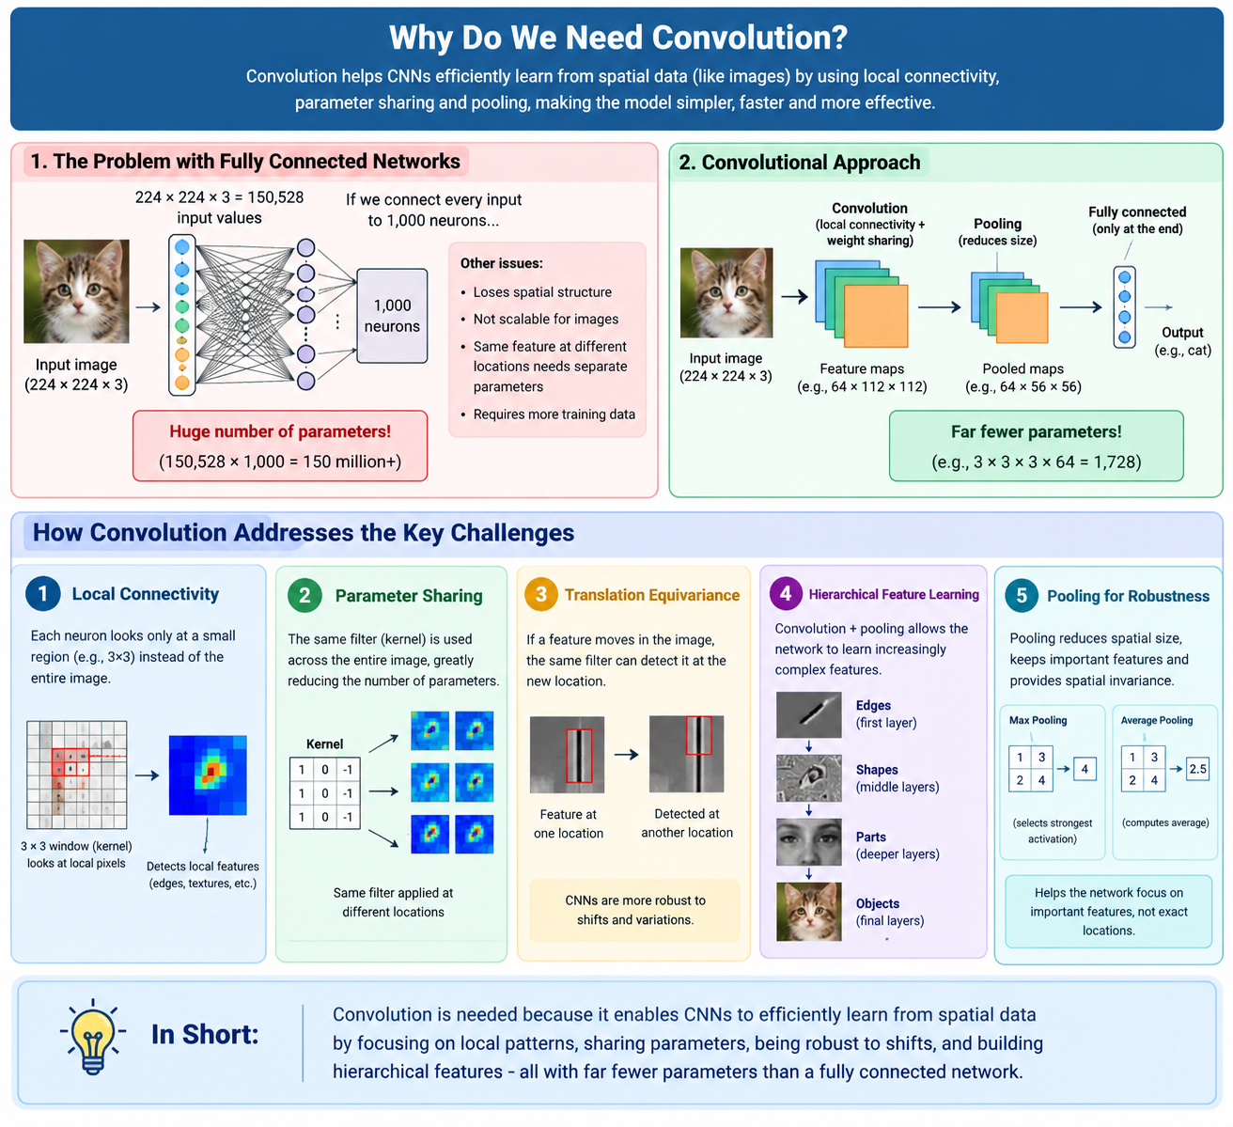

Slide 4
Introduction & Motivation
WHY WE NEED CONVOLUTION?
Parameter explosion leads to CNN
ANN has limitation → Huge number of parameters
→ Loss of spatial structure
→Poor scalability for images
→Same feature may occur at different locations
→Requires more training data

Slide 5
MOTIVATION FOR CONVOLUTION
1. Local Connectivity
A neuron looks only at a small region.
2. Parameter Sharing
The same filter is used throughout the image.
3. Translation Equivariance
If a feature moves in the image, the convolution can detect it at the new location.
Pixels → Edges → Shapes → Parts → Objects

Slide 6
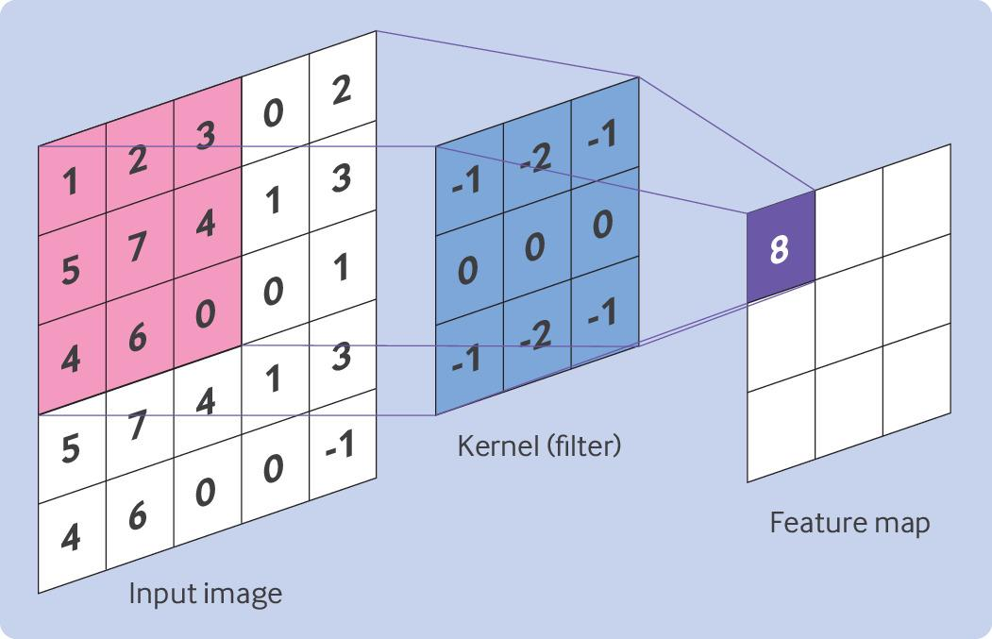
CONVOLUTION OPERATION
Input image
Kernel/filter
Element-wise multiplication
Summation
Feature map
Stride
Padding

Slide 7
CONVOLUTION FILTERS
Filter | Detects
Horizontal edge filter | Horizontal edges
Vertical edge filter | Vertical edges
Blur filter | Smoothness
Sharpening filter | Sharp features

Slide 8
Convolutional output size numerical
O = N-F+2P
N = Input pixel size F= Filter size
P = Padding size
S = Stride
+1
S
Question
An image of size 28 × 28 is convolved with a 3 × 3 filter, using:
Stride = 1
Padding = 0
Find the output size.

Slide 9
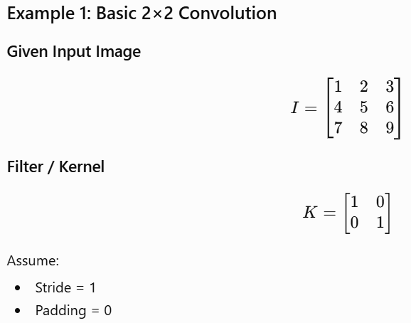
NUMERICALS

Slide 10
POOLING
Pooling and Dimensionality Reduction
Max Pooling | Average Pooling
Selects strongest activation | Computes average
Preserves prominent features | Smooths information
Common in traditional CNNs | Used in several architectures

Slide 11
Convolution & Pooling as an infinitely strong prior
How CNNs use prior knowledge to learn images efficiently
Prior = Assumption before learning

Slide 12
Inductive Bias
Inductive bias = assumptions that help a learning algorithm generalize from limited data.

Slide 13
CNN’S STRONG PRIOR
Locality
Parameter Sharing
Spatial hierarchy
Pooling / downsampling

Slide 14
Prior 1 #Locality
CNN assumes that local regions contain useful information

Slide 15
Prior 2 Parameter sharing
Parameter sharing allows the same filter to detect the same feature at different locations.

Slide 16
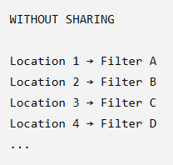
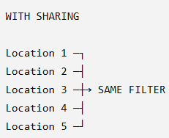
What if there is no parameter sharing?
Which requires more parameters?

Slide 17
Prior 3 Hierarchical Features
CNN assumes that complex visual concepts can be constructed from simpler local features

Slide 18
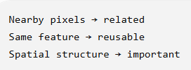
Infinitely Strong Prior
constrained to follow certain assumptions
Architectural Constraint

Slide 19
Pooling as prior
Assumption: Small changes in exact feature location may not matter for the final decision
I care more about whether a strong feature exists in this region than its exact pixel-level location. → MAX POOLING IDEA

Slide 20
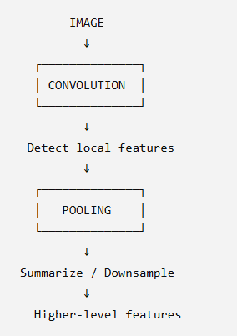
CONVOLUTION + POOLING
Reason why CNN usually is better suited for images

Slide 21
CNN DETECTION
SMALL FEATURES
EDGES, CURVES etc
HIGHER FEATURES
Ears, nose,
etc
CNN hierarchy
OBJECT
CAT

Slide 22
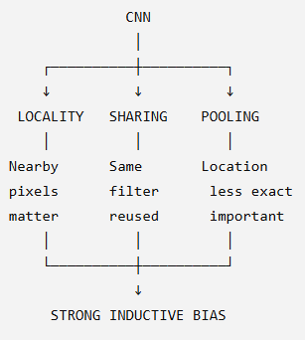
MEMORY DIAGRAM

Slide 23
Variants of the Basic Convolution Function
Different ways of looking at an image

Slide 24
Why Do We Need Variants?
Different convolution variants are designed for different purposes

Slide 25
5 CNN VARIANTS
CONVOLUTION
1X1
STRIDED
DILATED
TRANSPOSED
SEPARABLE

Slide 26
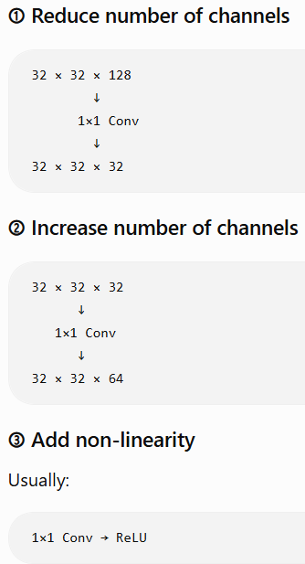
1X1 CONVOLUTION
1×1 convolution operates across channels.
Mixing of channels

Slide 27
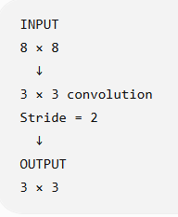
STRIDED CONVOLUTION
Strided convolution can perform downsampling while learning features

Slide 28
DILATED CONVOLUTION
Larger receptive field without proportionally increasing parameters
Semantic segmentation
Dense prediction
Audio/time-series applications
Tasks requiring wider context
Look farther without adding many more weights

Slide 29
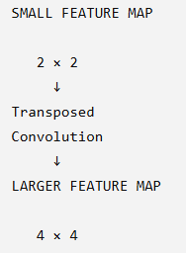
TRANSPOSED CONVOLUTION
increase spatial dimensions
LARGER FEATURE MAP
Transposed convolution = Learnable upsampling

Slide 30
SEPARABLE CONVOLUTION
Two steps:
Step 1 — Depthwise convolution
Each channel gets its own spatial filter.
Step 2 — Pointwise convolution
A 1×1 convolution combines information across channels.
fewer parameters and computations.

Slide 31
COMPARING THE VARIANTS
Variant | Main Purpose
1×1 convolution | Channel mixing / channel reduction
Strided convolution | Downsampling
Dilated convolution | Increase receptive field
Transposed convolution | Learnable upsampling
Separable convolution | Reduce parameters/computation

Slide 32
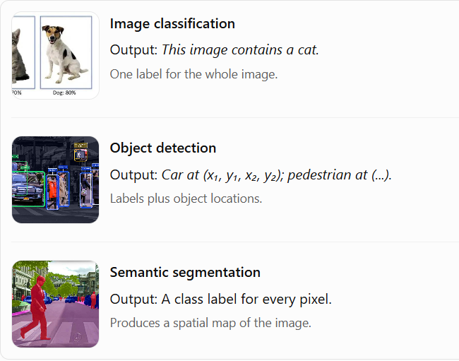
STRUCTURED OUTPUTS

Slide 33
DATA TYPES
“What kind of data are we processing?”
CNN type | Input example | Typical application
1D CNN | A sequence of sensor values | Time-series forecasting, ECG analysis, audio
2D CNN | Height × width image | Image classification, object recognition
3D CNN | Depth × height × width volume | CT/MRI volume analysis, video action recognition

Slide 34
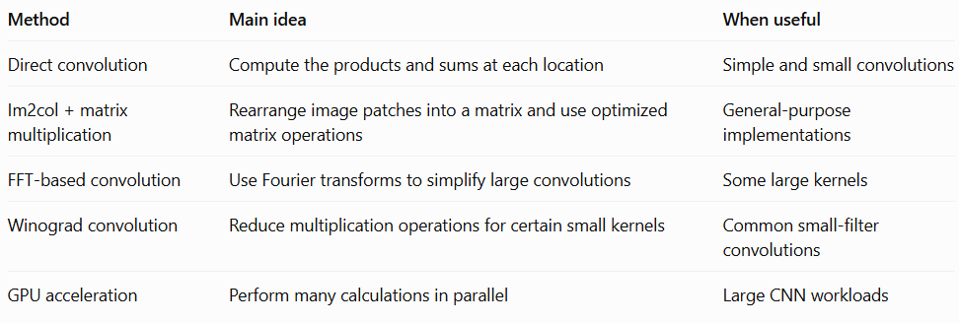
CONVOLUTION ALGORITHMS
CNNs repeatedly perform convolution across many pixels, channels and filters

Slide 35
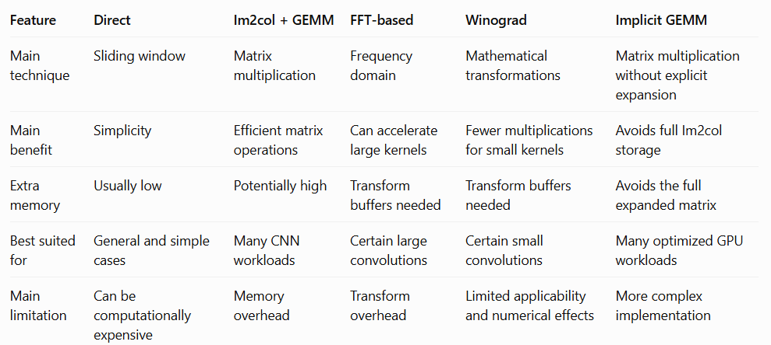
COMPARISON

Slide 36
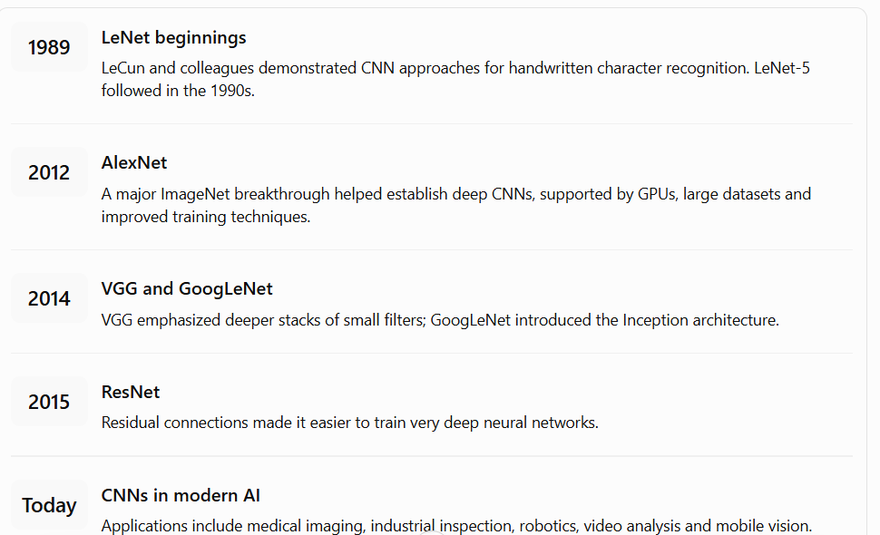
History of DL CNN’s

