Slide 1
Project Review
16.09.2022
1
Prediction of Happiness Index Using Learning Techniques
Group Id- B-19
Ms. Rane Akshata Chandrakant(4238) Ms. Pawar Bhagyashree Anil(4226)
Ms. Sonawane Rutuja Ganesh(4262) Ms. Shinde Snehal Bhausaheb(4258)
Project Guide :- Ms. S. B. Bhonde
Department of Computer Engineering
Amrutvahini College of Engineering, Sangamner

Slide 2


Problem Statement
2
To develop learning techniques to measure people’s happiness index rationally and visually.

Slide 3
Motivation
3
The happiness index is a significant index to measure social harmony and an inevitable requirement of the scientific outlook on development.
Since happiness is a scorching topic in people’s daily lives, it is meaningful to have a deep insight into that for the government to make more beneficial policies and thoughtful improvements for people.
When the changes from the research on happiness index becomes a reality, people will become happier and the society will become more harmonious, forming a virtuous circle.

Slide 4
Objectives
4
To study existing literature to calculate happiness index.
To learn preprocessing techniques and apply it on given dataset.
To apply learning techniques to calculate happiness index of people.
To validate the performance of model.

Slide 5
Literature Survey Paper 1
5
Title : Utilizing Machine Learning to Predict Happiness Index.
Name of Author : Lexin You The Frederick Gunn School, Washington CT, The US.
Year : 2021
Publisher : ResearchGate
Methodology : This paper utilizes the linear model and some tree models to analyze the features that are related to the happiness index and to make some predictions.
Limitations : The result of that are far more inaccurate than that of the other decision tree and random forest models. The mean square error is even close to 1.

Slide 6
Paper 2
6
Title : Analysis of World Happiness Report Dataset Using Machine Learning Approaches
Name of Author : Moaiad Ahmad Khder, Mohammad Adnan Sayfi, Samah Fujo
Year : 2021
Publisher : IEEE
Methodology : The main features is applying the supervised machine learning approaches using the Neural Network training model and the OneR models in classifications and feature selection.
Limitations : The dataset used has smaller range.

Slide 7
Paper 3
7
Title : Applying Machine Learning to Predict Happiness: A case study of 20 Countries
Name of Author : Yu Tan, Charuk Singhapreecha, Woraphon Yamaka
Year : 2020
Publisher : IEEE
Methodology : The contribution of this paper is to show the advantages of machine learning in traditional statistical models to a certain extent.
Limitations : Due to the correlation between various explanatory variables, the traditional linear regression model cannot accurately estimate the coefficients, making predictions risky.

Slide 8
Paper 4
8
Title : Understanding World Happiness using Machine Learning Techniques.
Name of Author : Fabiha Ibnat, Jigmey Gyalmo, Zulfikar Alom, Md. Abdul Awal, Mohammad Abdul Azim.
Year : 2021
Publisher : IEEE
Methodology :The paper presents supervised machine-learning-based analytical models that can predict the life satisfaction score of any specific country based on the defined parameters, emphasizing the happiest countries.
Limitations : Supervised machine-learning-based analytical models that can predict the life satisfaction score of any specific country based on the defined parameters are not accurate.

Slide 9
Paper 5
9
Title : E-happiness physiological indicators of construction workers’ productivity: A machine learning approach
Name of Author : Hamad Al Jassmi, Soha Ahmed, Babitha Philip, Fadwa Al Mughairbi
Year : 2019
Publisher : ResearchGate
Methodology : An emotion detection method was developed using a Random Forest ML classifier, which is able to detect neutral vs. non-neutral emotions.
Limitations : The main limitation of this study was the small sample size, especially in terms of the number of workers tracked and number of days each worker was tracked.

Slide 10
Paper 6
10
Title : Happiness Level Prediction with Sequential Inputs via Multiple Regressions.
Name of Author : Jianshu Li ,Sujoy Roy, Jiashi Feng , Terence Sim
Year : 2018
Publisher : ResearchGate
Methodology : Linear and ordinal regression incorporates both global and local components in group level happiness prediction task by considering both the holistic scene features and face level features.
Limitations : Happiness is calculated from image only it doesn't consider scene and text so accuracy is less.

Slide 11
Paper 7
Title : Future Prediction of World Countries Emotions Status to Understand Economic Status using Happiness Index and SVM Kernel.
Name of Author : B. Prashanth,Dr. R. Ponnusam
Year : 2019
Publisher : IRJET
Methodology : Supervised two tier assemble approach for predicting a country’s BLI (Better Life Index) score was proposed.
Limitations : The classification model results in 56.25% accuracy.
11

Slide 12
Paper 8
Title : Predicting Quality of Life using Machine Learning: case of World Happiness Index.
Name of Author : Ayoub Jannani, Nawal Sael , Faouzia Benabbou
Year : 2021
Publisher : IEEE
Methodology : Linear Regression and LSTM algorithms were used for predicting the QoL(Quality Of Life) indicator for the year 2021.
Limitations : Linear regression assumes a linear relationship between the input and output variables, it fails to fit complex datasets properly.
12

Slide 13
Paper 9
13
Title : National happiness index monitoring using Twitter for bilanguages.
Name of Author : Ahmad Al-Rubaie Benjamin Hirsch Gregory Cameron Pole.
Year : 2021
Publisher : Springer
Methodology : Bilanguage and sentiment analysis is used to predict happiness index. This paper proposes a system for general population sentiment monitoring from a social media stream (Twitter), through comprehensive multi-level filters.
Limitation : Limited information in very short messages the use of short text with informal expressions and word variations caused by spelling errors, tweet slang and abbreviations.

Slide 14
Scope
14
The project can be used to measure the conditions of people being happy and satisfaction of life.
It can also be used to define income inequality, trust in government, sense of community and other aspects of well-being within specific demographics of a population.
To improve societal well-being by increasing public understanding and appreciation of factors that lead to life satisfaction, resilience, and sustainability.

Slide 15
Feasibility
15
Economic Feasibilty : Prediction of happiness index is deep learning based. This project would not demand a cost for software and related products, as most of the products are open source and free to use. Also datasets used for the training purpose are freely available. Hence the project would consume minimal cost and is economically feasible.
Technical Feasibility : Since Deep learning algorithms is based on pure maths there is very less requirement for any professional software. Also, most of the tools are open source. Most of the documentation and tutorials make easy to learn technology.
Social Feasibility : The output of the project can be used for analysis of happiness index of people in various sector, it can be useful for students, workers, company employees. Government can also use this index for more beneficial policies.

Slide 16
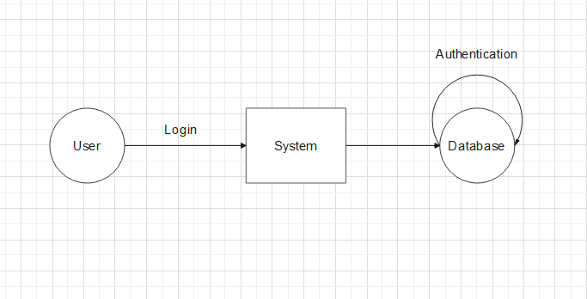
Data Flow Level 0

Slide 17
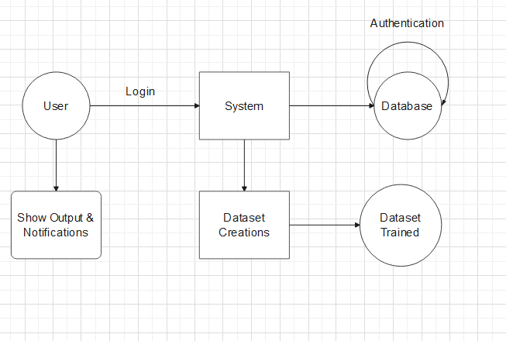
Data Flow Level 1

Slide 18
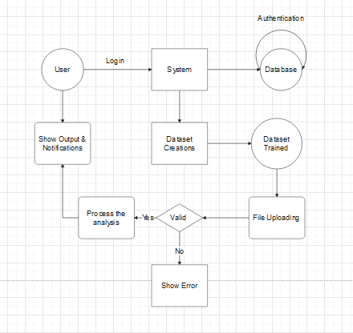
Data Flow Level 2

Slide 19
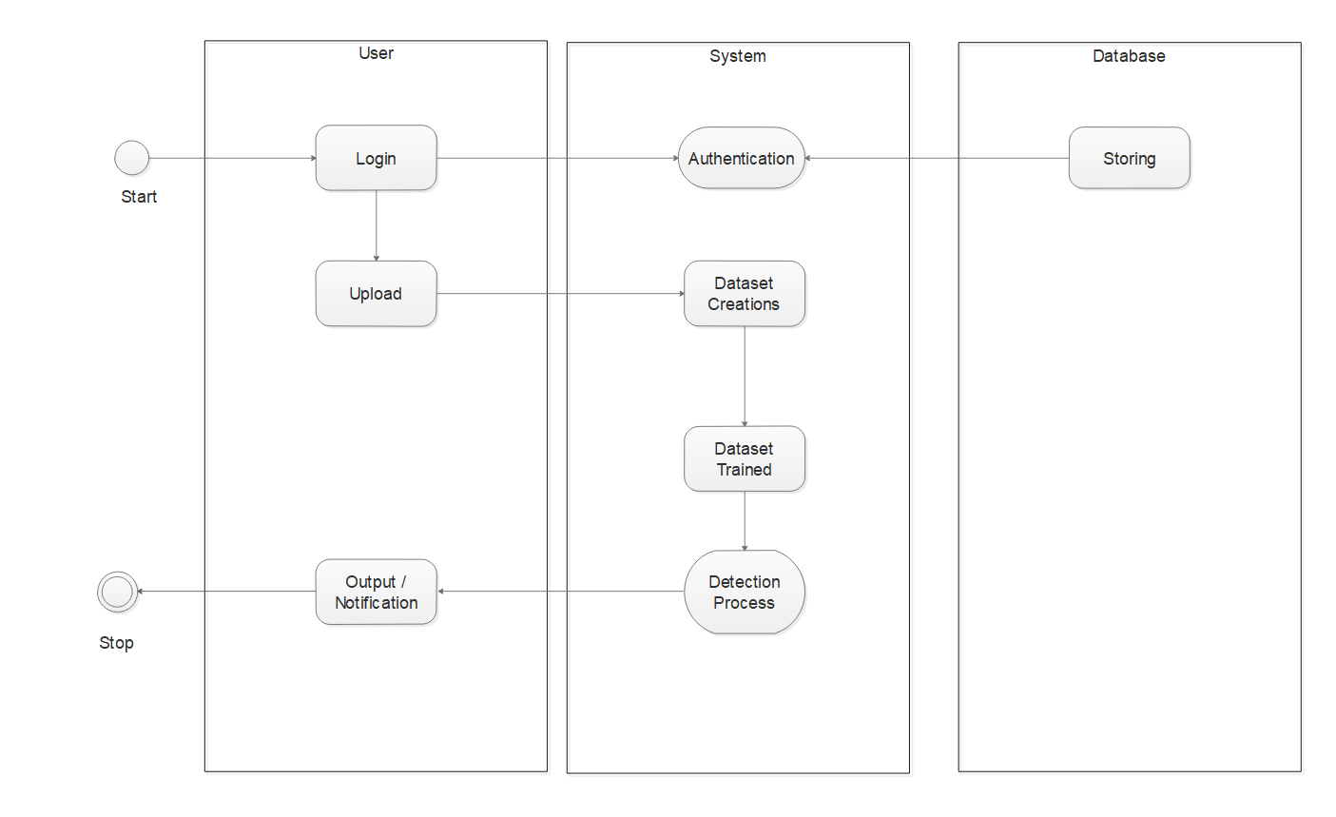
Activity Diagram

Slide 20
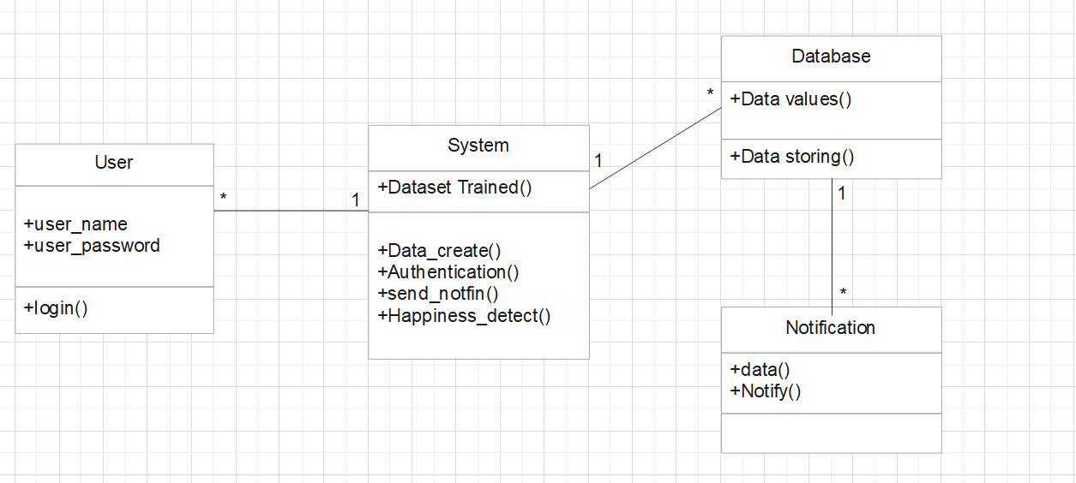
Class Diagram

Slide 21
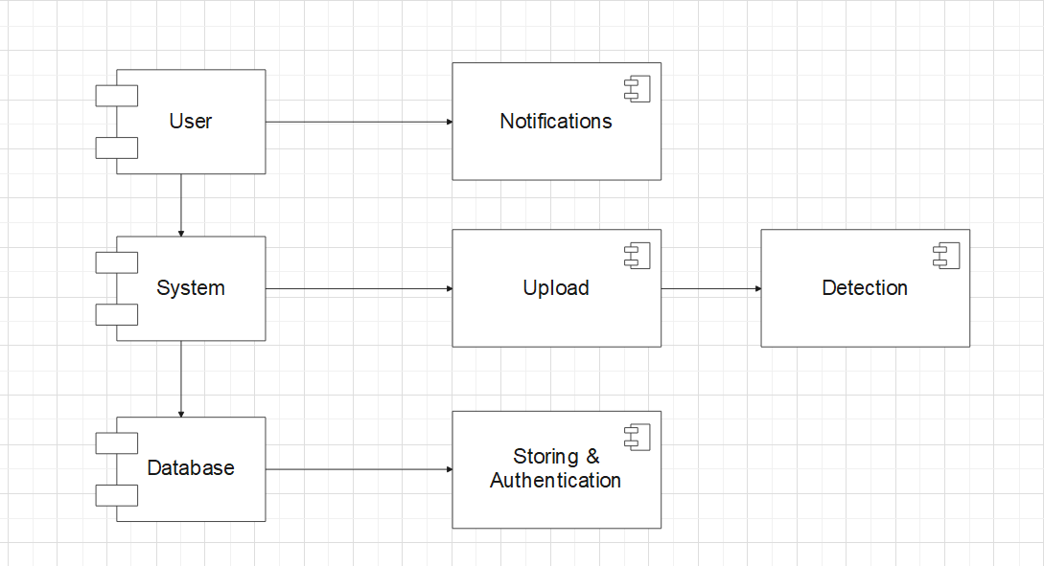
Component Diagram

Slide 22
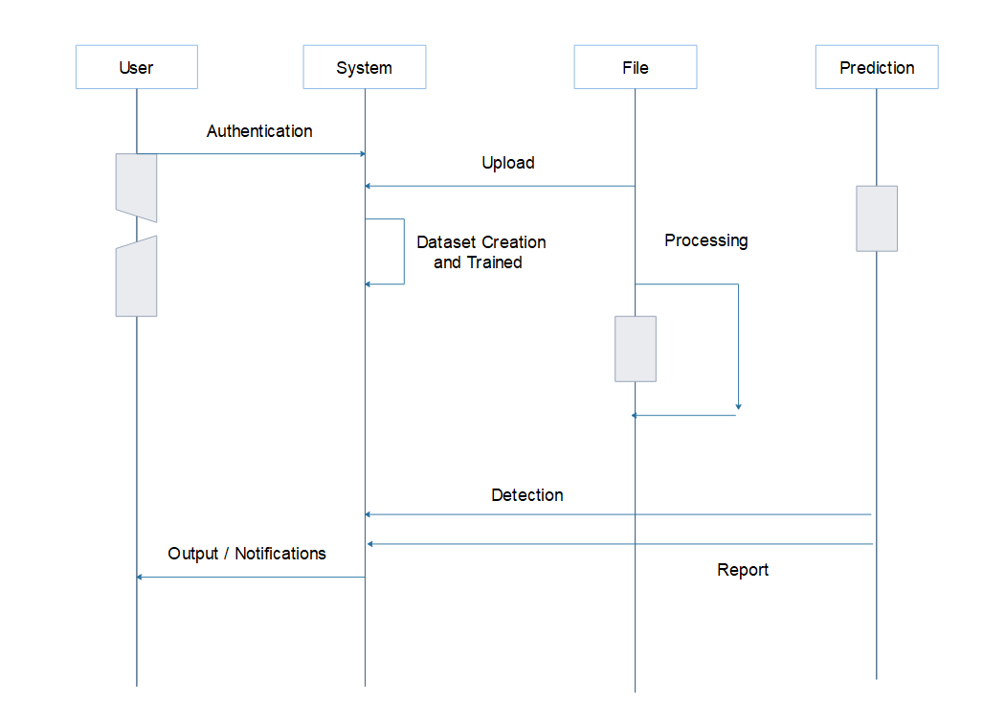
Sequence Diagram

Slide 23
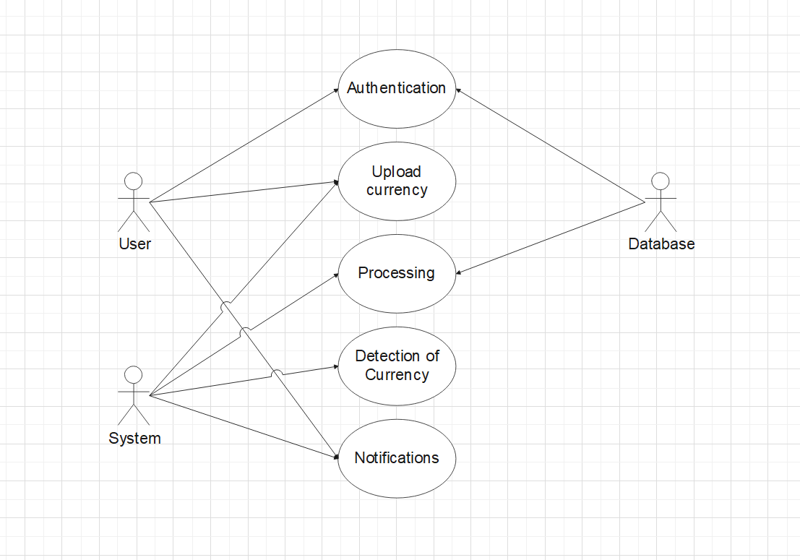
Use case Diagram

Slide 24
Software And Hardware Requirements
Software:
Python 4.4 or above
PyCharm / VS code
Windows Operation system 10
Hardware:
i3 Processor or above
RAM 4GB or above
150 SSD hard disk

Slide 25
Details of Modules
Authentication
Dataset Creation & Trained
Processing
Prediction
Model 1
Model 2
Model 3
Model 4
Output/report
Model 5

Slide 26
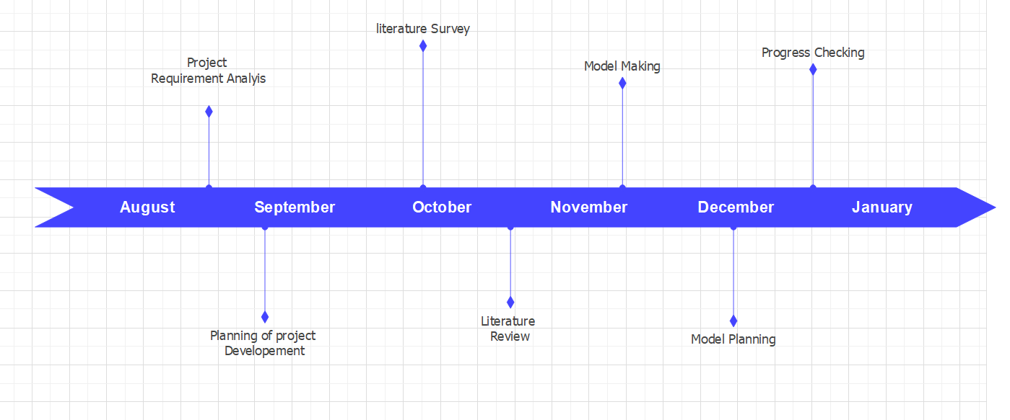
Project Plan

Slide 27
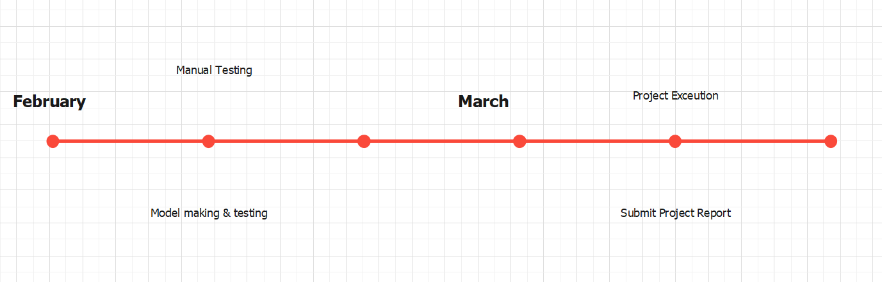
Project Plan Continue…

Slide 28


14

