Slide 2
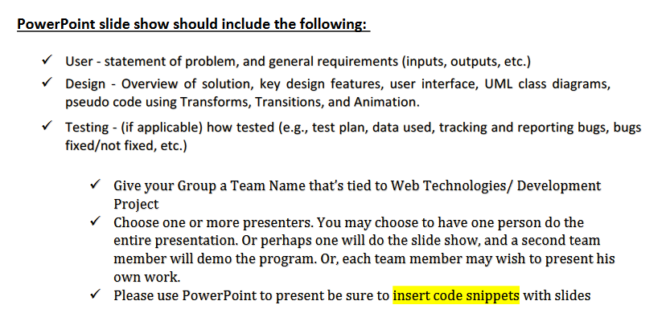
Powerpoint Requirements

