Slide 1
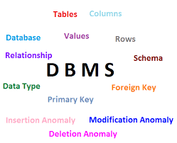

Slide 2
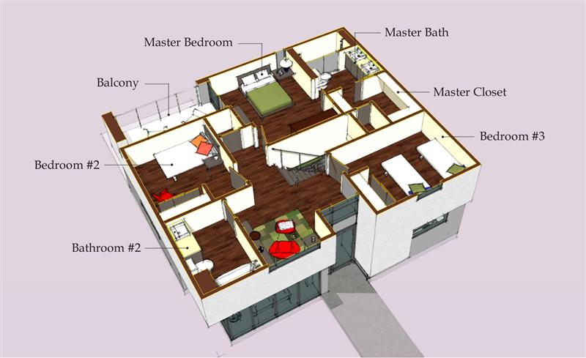
Creation ? Requirement ?

Slide 3
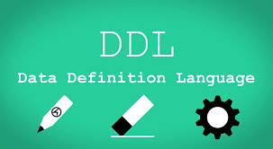
A data definition or data description language is a syntax similar to a computer programming language for defining data structures, especially database schemas.
DDL changes the structure of the table like creating a table, deleting a table, altering a table, etc.
All the command of DDL are auto-committed that means it permanently save all the changes in the database.

Slide 4
Commands Under DDL

Slide 5
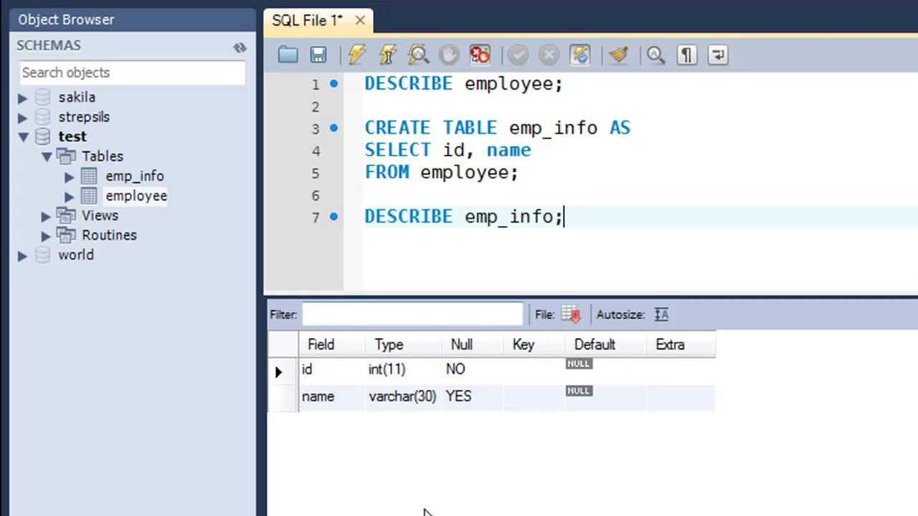
CREATE

Slide 6

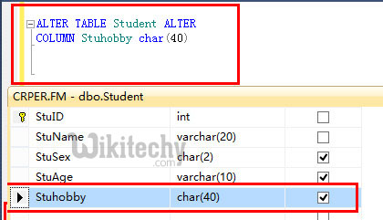
ALTER

Slide 7
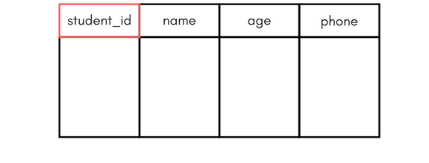
TRUNCATE
TRUNCATE TABLE table_name;
SELECT * FROM table_name;
RESULT :-

Slide 8

DROP
DROP TABLE table_name;
SELECT * FROM table_name;
RESULT : -

Slide 9


