Slide 1

Introduction
Why Modification?

Slide 2
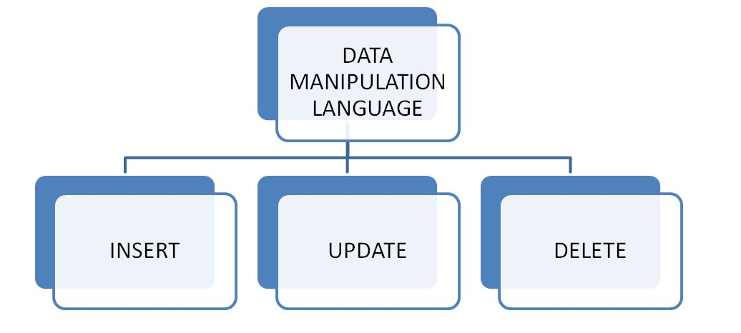

Slide 3

?

Slide 4

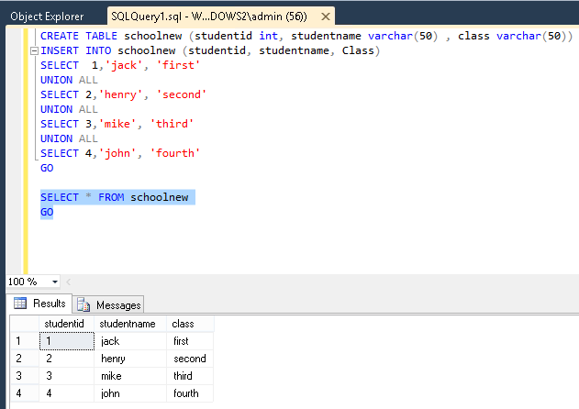
INSERT INTO Customer (First Name, Last Name, City, Country, Phone)
VALUES ('Craig', 'Smith', 'New York', 'USA', 1-01-993 2800)

Slide 5

?

Slide 6

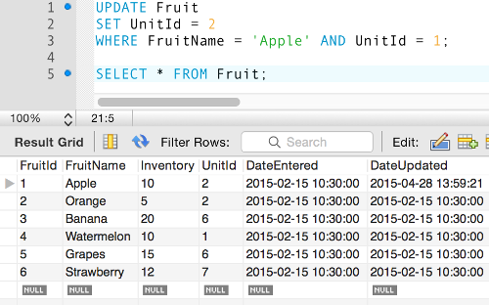
UPDATE table_name SET column1 = value1, column2 = value2, ... WHERE condition;

Slide 7

?

Slide 8

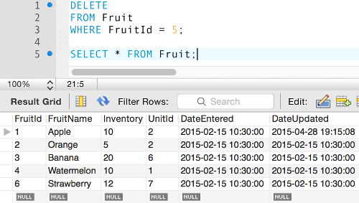
DELETE FROM table_name WHERE condition;

Slide 9


