Slide 1

UK Road accident severity
An Analysis, Visualization and Predictive Model

Slide 2
Introduction
IBM Data Science Capstone Project
Data Source:
Road Safety Data – Accidents 2018
UK Department for Transport
Data.gov.uk

Slide 3
Problem
Thousands of road accidents each year
How to improve road safety through a data science solution
Machine Learning: A predictive model for crash likelihood based on location, weather conditions, road conditions

Slide 4
Data
122,635 samples
32 features
Accident Severity
1 – Fatal
2 – Serious
3 – Slight

Slide 5
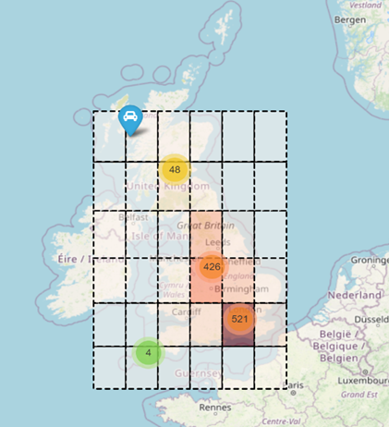
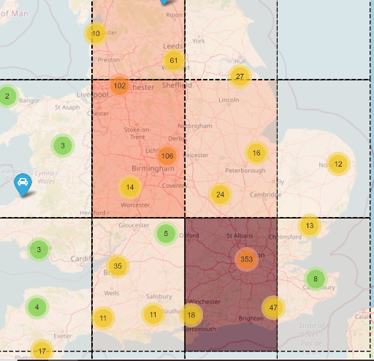



Initial Solution

Slide 6
Map Visualization of Road Accidents
Sample set of 1000 random accidents.
Easy visualization of accident ‘hot-spots’.
Three clear ‘high-risk’ zones for chance of accident and severity in descending order:
London
Birmingham
Leeds

Slide 7

Predictive Model

Slide 8
Creating the Model
Focus on 4 factors:
Day of week
Weather Conditions
Light Conditions
Road Conditions
3 Models:
Logistic Regression
Decision Tree
Random Forest

Slide 9
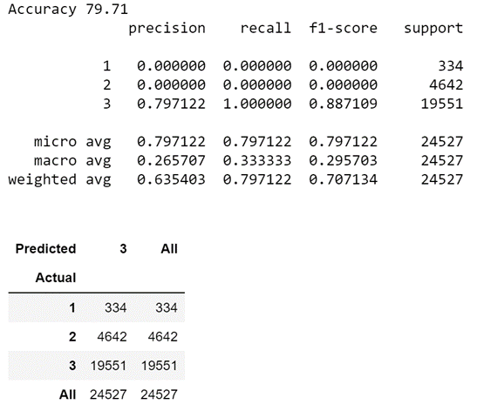
Decision Tree
Scored best accuracy after adjustments.
Successfully predicted 19551 serious accidents.
Accuracy of 79.71%

Slide 10
Conclusion
Great visualization system for localizing ‘hot-spots’
Predictive model needs more work and is not implementable in the real world
Expand with more data and features
Potentially include factors such as
Age of driver
Model of car
Speed

Slide 11

Thank You

