Slide 1
第五讲
图形用户界面(GUI) 设计

Slide 2
图形用户界面(GUI) 设计
GUI的基本图形对象：
  用户界面控件对象 (uicontrol)
  建立如按钮、滚动条、弹出式菜单以及文本框等对象
  用户界面菜单对象 (uimenu)
  在图形窗口中产生下拉式菜单和子菜单

Slide 3
菜单设计
控件设计
用户界面设计工具

Slide 4
5.1 菜单设计
一、 用户菜单的建立
建立一级菜单项的函数调用形式为：
主菜单对象句柄=uimenu(图形窗口句柄，属性名1，属性值1，属性名2，属性值2，…)
plotopt=uimenu(gcf,'label','plotoptions')
建立子菜单项的函数调用形式为：
子菜单对象句柄=uimenu(父菜单对象句柄，属性名1，属性值1，属性名2，属性值2，…)
plotlt=uimenu(plotopt,'Label','Line Types');
plotsym=uimenu(plotopt,'Label','Plot Symbol', 'Separator', 'on' );
plotcol=uimenu(plotopt,'Label','Plot color','Separator','on');

Slide 5
例5.1 建立“图形演示系统”菜单。菜单条中含有3个菜单项：Plot、Option和Quit。Plot中有Sine Wave和Cosine Wave两个子菜单项，分别控制在本图形窗口画出正弦和余弦曲线。Option菜单项的内容包括：Grid on和Grid off控制给坐标轴加网格线，Box on和Box off控制给坐标轴加边框，而且这4项只有在画有曲线时才是可选的，Figure Color控制图形窗口背景颜色。Quit控制是否退出系统。

Slide 6
screen = get(0,'ScreenSize');
W = screen(3); H = screen(4);
figure('Color',[1,1,1],'Position',[0.2*H,0.2*H,0.6*W,0.4*H],...
'Name','图形演示系统','NumberTitle','off','MenuBar','none');
%定义Plot菜单项
hplot = uimenu(gcf,'Label','&Plot');
uimenu(hplot,'Label','Sine Wave','Call',['t=-pi:pi/20:pi;','plot(t,sin(t));',...
'set(hgon,''Enable'',''on'');','set(hgoff,''Enable'',''on'');',...
'set(hbon,''Enable'',''on'');','set(hboff,''Enable'',''on'');']);
uimenu(hplot,'Label','Cosine Wave','Call',['t=-pi:pi/20:pi;','plot(t,cos(t));',...
'set(hgon,''Enable'',''on'');','set(hgoff,''Enable'',''on'');',...
'set(hbon,''Enable'',''on'');','set(hboff,''Enable'',''on'');']);
%定义Option菜单项
hoption = uimenu(gcf,'Label','&Option');
hgon = uimenu(hoption,'Label','&Grig on','Call','grid on','Enable','off');
hgoff = uimenu(hoption,'Label','&Grig off','Call','grid off','Enable','off');
hbon = uimenu(hoption,'Label','&Box on','separator','on','Call','box on','Enable','off');
hboff = uimenu(hoption,'Label','&Box off','Call','box off','Enable','off');
hfigcor = uimenu(hoption,'Label','&Figure Color','Separator','on');
uimenu(hfigcor,'Label','&Red','Accelerator','r','Call','set(gcf,''Color'',''r'');');
uimenu(hfigcor,'Label','&Blue','Accelerator','b','Call','set(gcf,''Color'',''b'');');
uimenu(hfigcor,'Label','&Yellow','Call','set(gcf,''Color'',''y'');');
uimenu(hfigcor,'Label','&White','Call','set(gcf,''Color'',''w'');');
%定义Quit菜单项
uimenu(gcf,'Label','&Quit','Call','close(gcf)');

Slide 7
二 快捷菜单
在MATLAB中，可以使用uicontextmenu函数和图形对象的UIContextMenu属性来建立快捷菜单，具体步骤为：
(1)利用uicontextmenu函数建立快捷菜单。
(2)利用uimenu函数为快捷菜单建立菜单项。
(3)利用set函数将该快捷菜单和某图形对象联系起来。

Slide 8
例5.2 绘制曲线y=2e^{-0.5x}sin(2πx)，并建立一个与之相联系的快捷菜单，用以控制曲线的线型和曲线宽度。
x = 0:pi/100:2*pi;
y = 2*exp(-0.5*x).*sin(2*pi*x);
hl = plot(x,y);
hc = uicontextmenu; %建立快捷菜单
hls = uimenu(hc,'Label','线型'); %建立菜单项
hlw = uimenu(hc,'Label','线宽');
uimenu(hls,'Label','虚线','Call','set(hl,''LineStyle'','':'');');
uimenu(hls,'Label','实线','Call','set(hl,''LineStyle'',''-'');');
uimenu(hlw,'Label','加宽','Call','set(hl,''LineWidth'',2);');
uimenu(hlw,'Label','变细','Call','set(hl,''LineWidth'',0.5);');
set(hl,'UIContextMenu',hc); %将该快捷菜单和曲线对象联系起来

Slide 9
5.2 控件设计
5.2.1 控件
(1)按钮(Push Button)。
(2)切换(按下/弹起)按钮(Toggle Button)。
(3)单选按钮(Radio Button)。
(4)复选框(Check Box)。
(5)列表框(List Box)。
(6)弹出框(Popup Menu)。
(7)编辑框(Edit Box)。
(8)滑动条(Slider)。
(9)静态文本(Static Text)。
(10)边框(Frame)。

Slide 10
5.2.2 对话框的设计
1. 建立控件对象
MATLAB提供了用于建立控件对象的函数uicontrol，其调用格式为：
对象句柄 = uicontrol(图形窗口句柄，属性名1，属性值1，属性名2，属性值2，…)
其中各个属性名及可取的值和前面介绍的uimenu函数相似，但也不尽相同，下面将介绍一些常用的属性。
2. 控件对象的属性
MATLAB的10种控件对象使用相同的属性类型，但是这些属性对于不同类型的控件对象，其含义不尽相同。除Children、Parent、Tag、Type、UserData、Visible等公共属性外，还有一些常用的特殊属性。

Slide 11
例5.3 建立数制转换对话框。在左边输入一个十进制整数和2～16之间的数，单击“转换”按钮能在右边得到十进制数所对应的2～16进制字符串，单击“退出”按钮退出对话框。

Slide 12
hf = figure('Color',[0,1,1],'Position',[100,200,400,200],...
'Name','数制转换','NumberTitle','off','MenuBar','none');
uicontrol(hf,'Style','Text', 'Units','normalized', 'Position',[0.05,0.8,0.45,0.1],'Horizontal','center', ...
'String','输 入 框','Back',[0,1,1]);
uicontrol(hf,'Style','Text','Position',[0.5,0.8,0.45,0.1],'Units','normalized','Horizontal','center', ...
'String','输 出 框','Back',[0,1,1]);
uicontrol(hf,'Style','Frame','Position',[0.04,0.33,0.45,0.45],'Units','normalized','Back',[1,1,0]);
uicontrol(hf,'Style','Text','Position',[0.05,0.6,0.25,0.1],'Units','normalized','Horizontal','center', ...
'String','十进制数','Back',[1,1,0]);
uicontrol(hf,'Style','Text','Position',[0.05,0.4,0.25,0.1], ...
'Units','normalized','Horizontal','center','String','2～16进制','Back',[1,1,0]);
he1 = uicontrol(hf,'Style','Edit','Position',[0.25,0.6,0.2,0.1], 'Units','normalized','Back',[0,1,0]);
he2 = uicontrol(hf,'Style','Edit','Position',[0.25,0.4,0.2,0.1], 'Units','normalized','Back',[0,1,0]);
uicontrol(hf,'Style','Frame','Position',[0.52,0.33,0.45,0.45], 'Units','normalized','Back',[1,1,0]);
ht = uicontrol(hf,'Style','Text','Position',[0.6,0.5,0.3,0.1], ...
'Units','normalized','Horizontal','center','Back',[0,1,0]);
COMM = ['n=str2num(get(he1,''String''));','b=str2num(get(he2,''String''));',...
'dec=trdec(n,b);','set(ht,''string'',dec);'];
uicontrol(hf,'Style','Push','Position',[0.18,0.1,0.2,0.12], ...
'String','转 换','Units','normalized','Call',COMM);
uicontrol(hf,'Style','Push','Position',[0.65,0.1,0.2,0.12], ...
'String','退 出','Units','normalized','Call','close(hf)');

Slide 13
程序调用了trdec.m函数文件，该函数的作用是将任意十进制整数转换为2~16进制字符串。trdec.m函数文件如下：
function dec=trdec(n,b)
ch1 = '0123456789ABCDEF'; %十六进制的16个符号
k = 1;
while n~=0 %不断除某进制基数取余直到商为0
p(k)=rem(n,b);
n=fix(n/b);
k=k+1;
end
k = k-1;
strdec = '';
while k>=1 %形成某进制数的字符串
kb = p(k);
strdec = strcat(strdec,ch1(kb+1:kb+1));
k = k-1;
end
dec = strdec;

Slide 14
例5.4 建立图形演示对话框。在编辑框输入绘图命令，单击“绘图”按钮能在左边坐标轴得到所对应的图形，弹出框提供色图控制，列表框提供坐标网格线和坐标边框控制。

Slide 15
clf;
set(gcf,'Unit','normalized','Position',[0.2,0.3,0.65,0.35]);
set(gcf,'Menubar','none','Name','图形演示','NumberTitle','off');
axes('Position',[0.05,0.15,0.55,0.7]);
uicontrol(gcf,'Style','text', 'Unit','normalized',...
'Posi',[0.63,0.85,0.2,0.1],'String','输入绘图命令','Horizontal','center');
hedit=uicontrol(gcf,'Style','edit','Unit','normalized','Posi',[0.63,0.15,0.2,0.68],...
'Max',2); %Max取2，使Max-Min>1，从而允许多行输入
hpopup=uicontrol(gcf,'Style','popup','Unit','normalized',...
'Posi',[0.85,0.8,0.15,0.15],'String','Spring|Summer|Autumn|Winter');
hlist=uicontrol(gcf,'Style','list','Unit','normalized',...
'Posi',[0.85,0.55,0.15,0.25],'String','Grid on|Grid off|Box on|Box off');
hpush1=uicontrol(gcf,'Style','push','Unit','normalized',...
'Posi',[0.85,0.35,0.15,0.15],'String','绘 图');
uicontrol(gcf,'Style','push','Unit','normalized',...
'Posi',[0.85,0.15,0.15,0.15],'String','关 闭','Call','close all');
set(hpush1,'Call','COMM(hedit,hpopup,hlist)');
set(hlist,'Call','COMM(hedit,hpopup,hlist)');
set(hpopup,'Call','COMM(hedit,hpopup,hlist)');
%COMM.m函数文件：
function COMM(hedit,hpopup,hlist)
com=get(hedit,'String');
n1=get(hpopup,'Value');
n2=get(hlist,'Value');
if ~isempty(com) %编辑框输入非空时
eval(com'); %执行从编辑框输入的命令
chpop={'spring','summer','autumn','winter'};
chlist={'grid on','grid off','box on','box off'};
colormap(eval(chpop{n1}));
eval(chlist{n2});
end

Slide 16
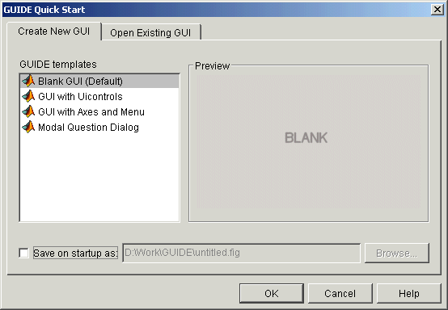
5.3 用户界面设计工具
(Graphical user interface development environment)
reference: getstart.pdf, chapter6, pp.197

Slide 17
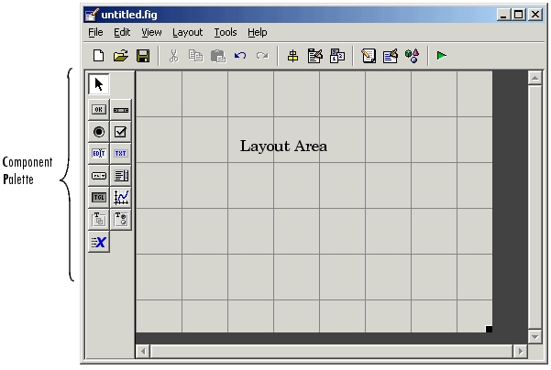
The Layout Editor with a blank GUI template

Slide 18
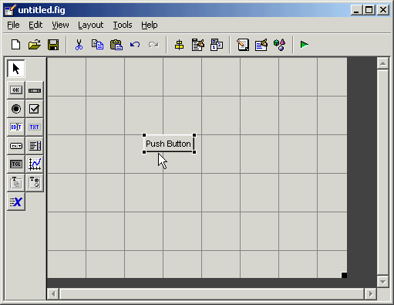
drag a push button into the layout area

Slide 19
GUI FIG-Files and M-Files
GUIDE stores a GUI in two files, which are generated the first time you save or run the GUI:
A FIG-file, with extension .fig, which contains a complete description of the GUI layout and the components of the GUI: push buttons, menus, axes, and so on.
A M-file, with extension .m, that contains the code that controls the GUI, including the callbacks for its components.
These two files correspond to the tasks of laying out and programming the GUI. When you lay out of the GUI in the Layout Editor, your work is stored in the FIG-file. When you program the GUI, your work is stored in the M-file

Slide 20
Creating Graphical User Interfaces
Designing the GUI
Laying Out the GUI
Setting Properties for GUI Components
Programming the GUI
Saving and Running a GUI

Slide 21
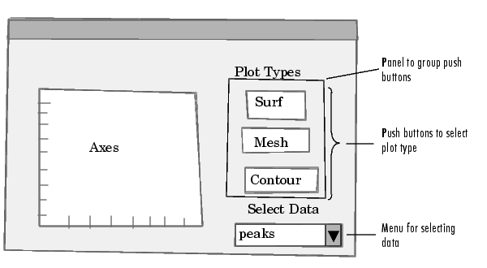
Designing the GUI
An axes that displays plot of the data
Three push buttons that enable you to select the type of plot you want.
The pop-up menu contains three strings -- peaks, membrane, and sinc, which correspond to MATLAB functions. You can select the data to plot from this menu.

Slide 22
Laying Out the GUI
Open a New GUI in the Layout Editor
Set the GUI Figure Size.
Add the Components
Align the Components.

Slide 23
>> guide

Slide 24
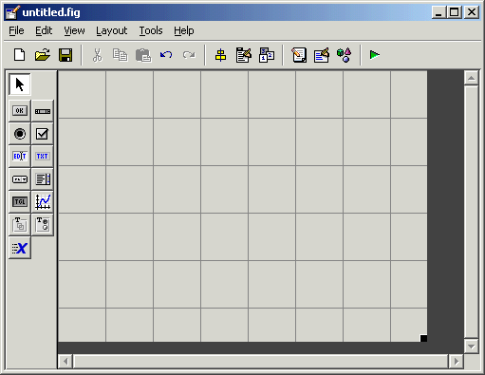
Select the Blank GUI (default) template. Click OK

Slide 25
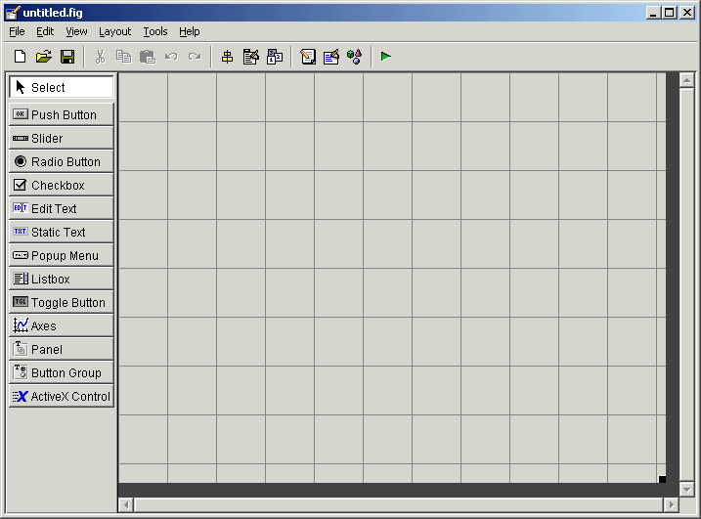
若要显示组件面板（component palette）的GUI组件的名称, 选择 File → Preferences→ Show names in component palette

Slide 26
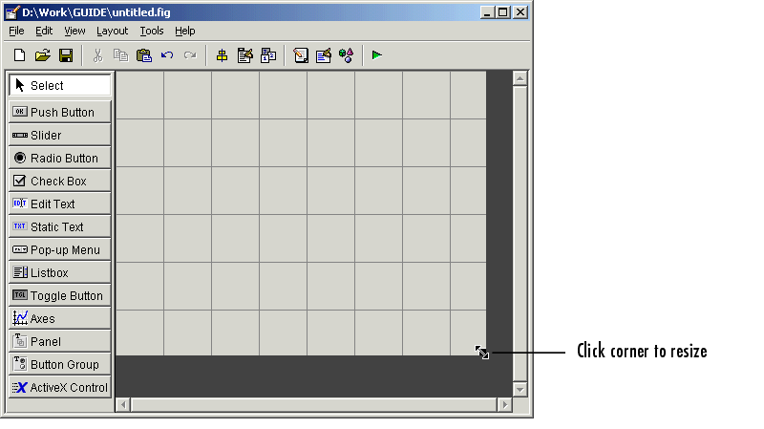
Set the GUI Figure Size

Slide 27
If you want to set the position or size of the GUI to an exact value:
1. Select Property Inspector from the View menu.
2. Select the button next to Units and then select inches from the pop-up menu
3. Click the + sign next to Position.
4. Type the x and y coordinates of the point where you want the lower left corner of the GUI to appear, and its width and height, as shown in the following figure.
5. Reset the Units property to characters.

Slide 28
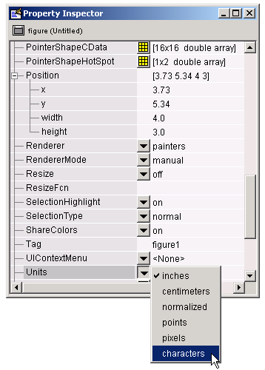

Slide 29
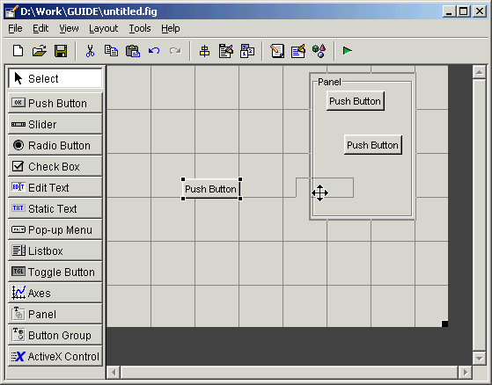
Add the Components
1. Add the panel and push buttons to the GUI.

Slide 30
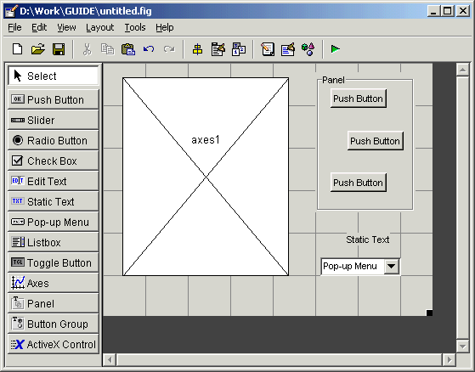
Add the remaining components to the GUI: a static text , a pop-up menu, an axes

Slide 31
Align the Components
Alignment Tool : 将有同一父代的组件对齐
如：将上面的三个push buttons对齐
pressing Ctrl and clicking them.
Tools menu → Align Objects ,出现 Alignment Object.
本例中采用如下设置:
  20 pixels spacing between push buttons in the vertical direction.
  Left-aligned in the horizontal direction.

Slide 32
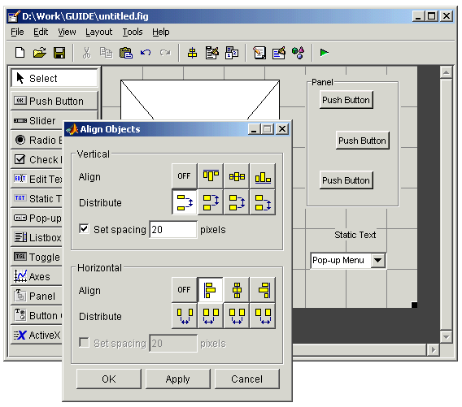

Slide 33
Setting Properties for GUI Components
View →Property Inspector from the menu to display the Property Inspector dialog box
Name Property
Title Property
String Property for Push Buttons and Static Text
String Property for Pop-Up Menus
Callback Properties
The Tag Property

Slide 34
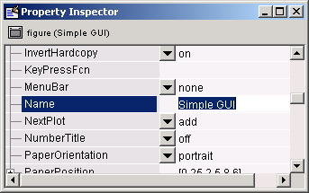
Name Property

Slide 35
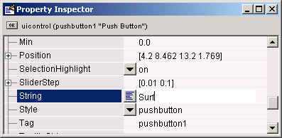
Title Property
String Property for Push Buttons and Static Text

Slide 36
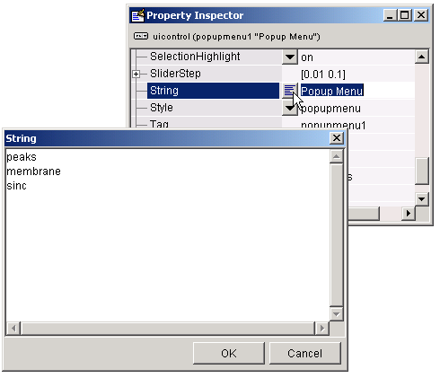
String Property for Pop-up Menus

Slide 37
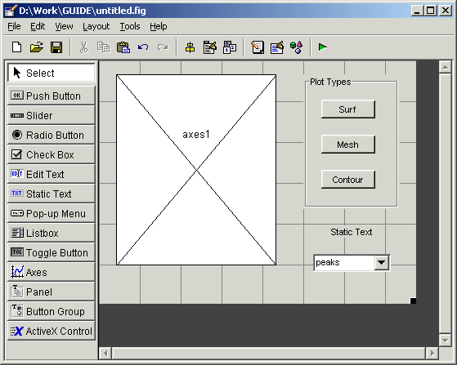
the current layout of the GUI appears as :

Slide 38
Callback Properties
Components use callbacks to do their work.
Each component and menu item has properties that specify its callbacks. When you create a GUI, you must program the callbacks you need to control operation of the GUI
The Tag Property
The Tag property provides a string as a unique identifier for each component. GUIDE uses this identifier to construct unique callback names for the different components in the GUI

Slide 39
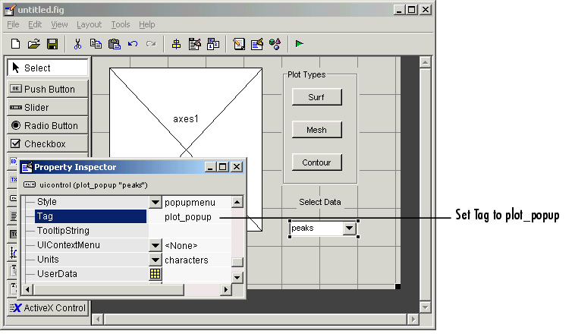
When you save or run the GUI, GUIDE sets the name of the callback subfunction in the pop-up menu Callback property to plot_popup_Callback.

Slide 40
Programming the GUI
Creating the GUI M-File
Opening the GUI M-File
Sharing Data Between Callbacks
Adding Code to the Opening Function
Adding Code to the Callbacks
Using the Object Browser to Identify Callbacks

Slide 41
Opening the GUI M-File
Add code to the callbacks for the three push buttons and the pop-up menu.
open the created M-file by clicking the M-file Editor icon on the toolbar. In the editor, move the cursor to a specific callback by clicking the function icon on the toolbar, then selecting the callback you want in the pop-up menu that displays.

Slide 42
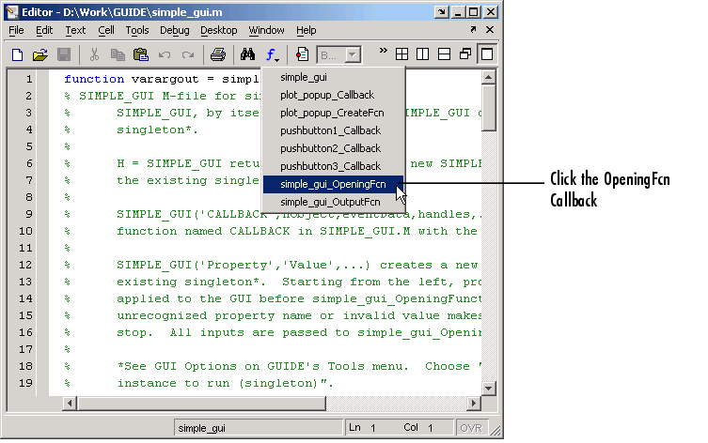

Slide 43
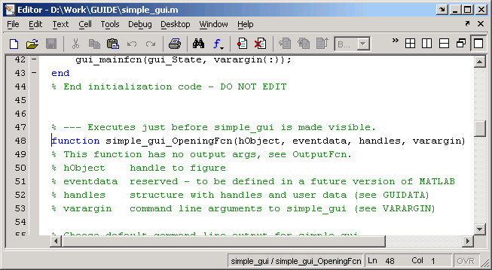

Slide 44
Sharing Data Between Callbacks
Storing the data in the MATLAB handles structure. All components in a GUI share the same handles structure.
Eg. Store vector X in the handles structure:
1. Choose a name for the field of the handles structure where you want to store the data, for example, handles.my_data
2. Add the field to the handles structure:
handles.my_data = X;
3. Save the handles structure with the guidata function:
guidata(hObject,handles)
hObject is the handle to the component object that executes the callback.
hObject and handles are input arguments for all the callbacks generated by GUIDE

Slide 45
Adding Code to the Opening Function
The Opening Function: is the first callback in every GUI M-file.
Name: GUI M-文件的名字_OpeningFcn，例如：
simple_gui_OpeningFcn
Eg. Add code that creates three data sets in the opening function, using peaks, membrane, and sinc.

Slide 46
% --- Executes just before simple_gui is made visible.
function simple_gui_OpeningFcn(hObject, eventdata, handles, varargin)
% This function has no output args, see OutputFcn.
% hObject handle to figure
% eventdata reserved - to be defined in a future version of MATLAB
% handles structure with handles and user data (see GUIDATA)
% varargin command line arguments to untitled (see VARARGIN)
% Create the data to plot
handles.peaks=peaks(35);
handles.membrane=membrane;
[x,y] = meshgrid(-8:.5:8);
r = sqrt(x.^2+y.^2) + eps;
sinc = sin(r)./r;
handles.sinc = sinc;
handles.current_data = handles.peaks;
surf(handles.current_data)
Autogenerated code
Add this code

Slide 47
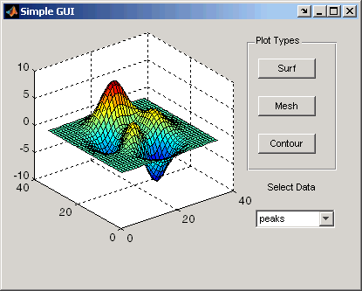

Slide 48
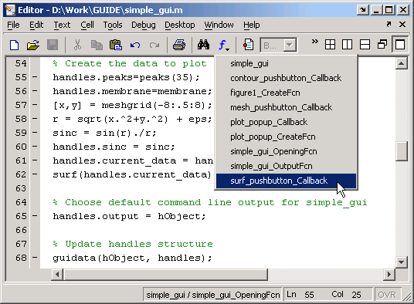
Adding Code to the Callbacks
Push Button Callbacks

Slide 49
Push Button Callbacks
% --- Executes on button press in surf_pushbutton.
function surf_pushbutton_Callback(hObject, eventdata, handles)
% hObject handle to surf_pushbutton (see GCBO)
% eventdata reserved - to be defined in a future version of MATLAB
% handles structure with handles and user data (see GUIDATA)
% Display surf plot of the currently selected data
surf(handles.current_data);
Autogenerated code
Add this code

Slide 50
Add this code to the Mesh push button callback:
% Display mesh plot of the currently selected data
mesh(handles.current_data);
Add this code to the Contour push button callback:
% Display contour plot of the currently selected data
contour(handles.current_data);

Slide 51
Pop-up Menu Callback
% --- Executes on selection change in plot_popup.
function plot_popup_Callback(hObject, eventdata, handles)
% hObject handle to plot_popup (see GCBO)
% eventdata reserved - to be defined in a future version of MATLAB
% handles structure with handles and user data (see GUIDATA)
val = get(hObject,'Value');
str = get(hObject, 'String');
switch str{val};
case 'peaks' % User selects peaks
handles.current_data = handles.peaks;
case 'membrane' % User selects membrane
handles.current_data = handles.membrane;
case 'sinc' % User selects sinc
handles.current_data = handles.sinc;
end
guidata(hObject,handles)
Autogenerated code
Add this code

Slide 52
Using the Object Browser to Identify Callbacks
In a complicated GUI, keeping track of callbacks can be difficult. To identify the component corresponding to a callback, select Object Browser from the View menu.
The Object Browser lists the tag and string properties of each component of the GUI.

Slide 53
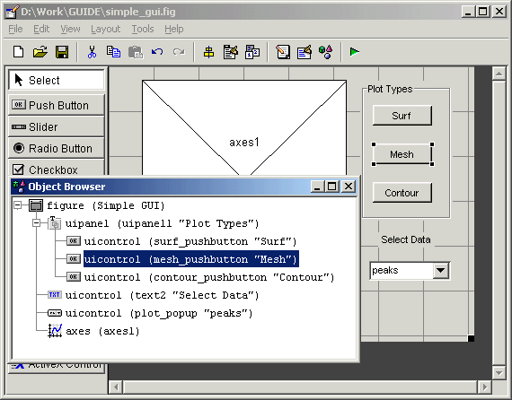
Using the Object Browser to Identify Callbacks

