Slide 1
Threats, Attacks And Assets…
By: Rachael L. Fernandes
Roll no:411111

Slide 2
Threats and attacks
Threat action(attacks) | Threats consequence
Exposure: Sensitive data are directly released to an unauthorised entity. E.g.: a person giving his/her credit card numbers, to an outsider. Interception: An unauthorized entity directly accesses sensitive data traveling between authorized sources and destinations. E.g.: On a shared LAN, such as wireless LAN or a broadcast Ethernet, any device attached to the LAN can receive a copy of packets intended for another device. Inference: A threat action whereby an unauthorized entity indirectly accesses sensitive data (but not necessarily the data contained in the communication) by reasoning from characteristics or by-products of communications. E.g.: Traffic analysis, in which an adversary is able to gain info from observing the pattern of traffic on the network. Intrusion: An unauthorized entity gains access to sensitive data by overcoming a system’s security protections. | Unauthorised disclosure: A circumstances or event whereby an entity gains access to data for which the entity is not authorised.

Slide 3
Cont...
Masquerade: An unauthorized entity gains access to a system or performs a malicious act by posing as an authorized entity. E.g.: This can happen if an unauthorized user has learned another user’s logon ID and password. Another e.g. is malicious logic, such as a Trojan horse, that appears to perform a useful or desirable function but actually gains unauthorized access to the system resources or tricks a user into executing other malicious logic. Falsification: This refers to the altering or replacing of valid data or the introduction of false data into a file or database. E.g.: A student may alter his/her grades on a school database. Repudiation: In this case, a user either denies sending data or a user denies receiving or possessing the data. | Deception: A circumstance or event that may result in an authorized entity receiving false data and believing it to be true. It is a threat to either system integrity or data integrity.

Slide 4
Cont...
Incapacitation: Prevents or interrupts system operation by disabling a system component. This is an attack on system availability. This could occur as a result of physical destruction of or damage to system h/w. E.g.: Viruses, Trojan horses, or worms. Corruption: Undesirably alters system operation by adversely modifying system functions or data. It is an attack on system integrity. E.g.: Malicious s/w could operate in such a way that system resources or services function in an unintended manner. Obstruction: A threat action that interrupts delivery of system services by hindering system operation. One way to obstruct system operation is to interfere with communications by disabling communication links or altering communication control info. | Disruption: A circumstance or event that interrupts or prevents the correct operation of system services and functions. It is a threat to availability or system integrity.

Slide 5
Cont...
Misappropriation: An entity assumes unauthorized logical or physical control of a system resource. E.g.: A distributed denial of service attack, when malicious s/w is installed on a number of hosts to be used as platforms to launch traffic at a target host. In this case, the malicious s/w makes unauthorized use of processor and operating system resources. Misuse: Causes a system component to perform a function or service that is determined to system security. Misuse can occur either by means of malicious logic or a hacker that has gained unauthorized access to a system. | Usurpation: A circumstance or event that results in control of system services or functions by an unauthorized entity. It is a threat to system integrity.

Slide 6
Threats and assets
The assets of a computer system can be categorized as hardware, software, data, and communication lines and networks.

Slide 7
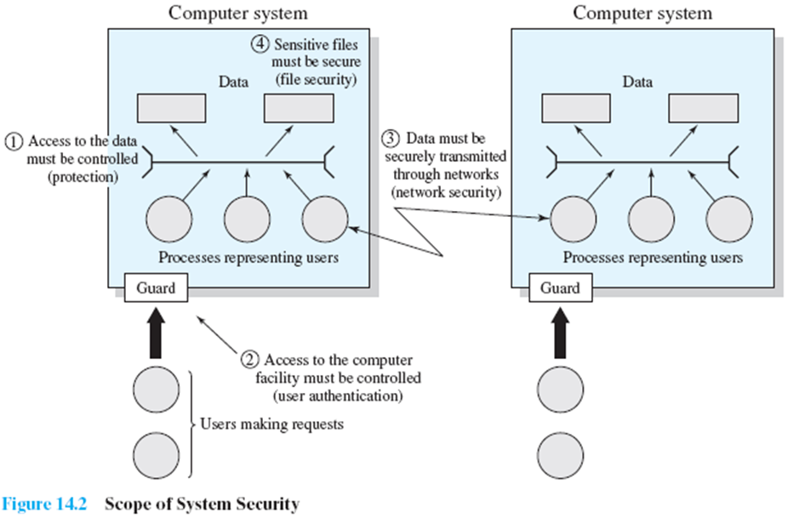
Scope of system Security

Slide 8
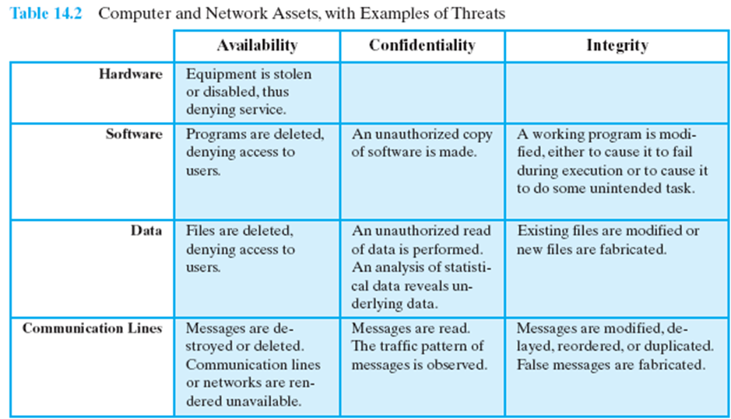

Slide 9
Hardware
A major threat to computer system hardware is the threat to availability.
Hardware is the most vulnerable to attack and the least susceptible to automated controls.
Threats include accidental and deliberate damage to equipment as well as theft.
The proliferation of personal computers and workstations and the widespread use of LANs increase the potential for losses in this area.
Theft of CD-ROMs and DVDs can lead to loss of confidentiality.
Physical and administrative security measures are needed to deal with these threats.

Slide 10
Software
Software includes the operating system, utilities, and application programs.
A key threat to software is an attack on availability.
Software, especially application Software, is often easy to delete.
Software can also be altered or damaged to render it useless.
Careful software configuration management, which includes making backups of the most recent version of software, can maintain high availability.
A more difficult problem to deal with is software modification that results in a program that still functions but that behaves differently than before, which is a threat to integrity/authenticity.
Computer viruses and related attacks fall into this category.
A final problem is protection against software piracy. Although certain countermeasures are available, by and large the problem of unauthorized copying of software has not been solved.

Slide 11
Data
Data security, which involves files and other forms of data controlled by individuals, groups, and business organizations.
Security concerns with respect to data are broad, encompassing availability, secrecy, and integrity.
In the case of availability, the concern is with the destruction of data files, which can occur either accidentally or maliciously.

Slide 12
Communication Lines and Networks
Network security attacks can be classified as passive attacks and active attacks.
A passive attack attempts to learn or make use of information from the system but does not affect system resources.
An active attack attempts to alter system resources or affect their operation.

Slide 13
Passive attacks
Passive attacks are in the nature of eavesdropping on, or monitoring of, transmissions. The goal of the attacker is to obtain information that is being transmitted. Two types of passive attacks are release of message contents and traffic analysis.
The release of message contents is easily understood. A telephone conversation, an electronic mail message, and a transferred file may contain sensitive or confidential information.
A second type of passive attack is traffic analysis.

Slide 14
Disadvantage of passive attacks
Passive attacks are very difficult to detect because they do not involve any alteration of the data.
Typically, the message traffic is sent and received in an apparently normal fashion and neither the sender nor receiver is aware that a third party has read the messages or observed the traffic pattern.
However, it is feasible to prevent the success of these attacks, usually by means of encryption.
Thus, the emphasis in dealing with passive attacks is on prevention rather than detection.

Slide 15
Active attacks
Active attacks involve some modification of the data stream or the creation of a false stream.
They can be subdivided into four categories:
replay,
masquerade,
modification of messages, and
denial of service.

Slide 16
Cont…
Replay involves the passive capture of a data unit and its subsequent retransmission to produce an unauthorized effect.
A masquerade takes place when one entity pretends to be a different entity. A masquerade attack usually includes one of the other forms of active attack.
Modification of messages simply means that some portion of a legitimate message is altered, or that messages are delayed or reordered, to produce an unauthorized effect. For example, a message stating “Allow John Smith to read confidential file accounts” is modified to say “Allow Fred Brown to read confidential file accounts.”

Slide 17
Cont…
4. The denial of service prevents or inhibits the normal use or management of communications facilities.

Slide 18
Disadvantage of active attacks
It is quite difficult to prevent active attacks absolutely, because to do so would require physical protection of all communications facilities and paths at all times.
Instead, the goal is to detect them and to recover from any disruption or delays caused by them. Because the detection has a deterrent effect, it may also contribute to prevention.

Slide 19
References
Textbook : Operating Systems by: William Stallings (Sixth Edition)
Chapter 14. Computer Security Threats
Page no: 638-643

Slide 20
Questions
What are intruders? (3mks)
Explain the various categories of attacks.(6mks)

Slide 21
THANK YOU

