Slide 1
Food Demand Forecasting
Gummadi Sai Dheeraj
Internship ID: H2HBABBA2945
Employee ID: 14244

Slide 2
Introduction
What is the Use Case?
The replenishment of raw materials is done only on weekly basis and since the raw material is perishable, the procurement planning is of utmost importance.
Predicting the Demand helps in reducing the wastage of raw materials which would result in the reduced cost of operation. Increased customer satisfaction by timely fulfilling their expectations and requirements.

Slide 3
Dependent & Independent Variables
What is the target Column?
Since the problem statement is to find the demand of the Food supply , num_orders which gives the information orders count will be the target variable because if a particular food item x was order n number of times and food item y ordered 2x number of times we can tell item y has more demand and we nee to predict that demand.
In addition to the above point the “num_order” column was not given in test.csv file.😝
Question) There are some other columns as well that aren't given in test.csv file what about those?
Answer) Probably we can use them for feature engineering purpose(For creating more features)

Slide 4
Pre-Processing
As a part of pre-processing three CSV files were merged based on the common columns. From the data sets we can see that meal id column was common in “meal_info.csv” and “train.csv”, center_id was common in “train.csv” and “fulfilment_center_info.csv” .
Why to use merge instead of join?
Well, Join combines the data frame based on indexes, where as merge combines the data frame based on particular column left_on and right_on options gives the desired output.
There are no null values in the data set after merging the data. So no need of handling null values.
Checked the data types of the each column.(3 categorical and 12 are numerical datatypes)

Slide 5
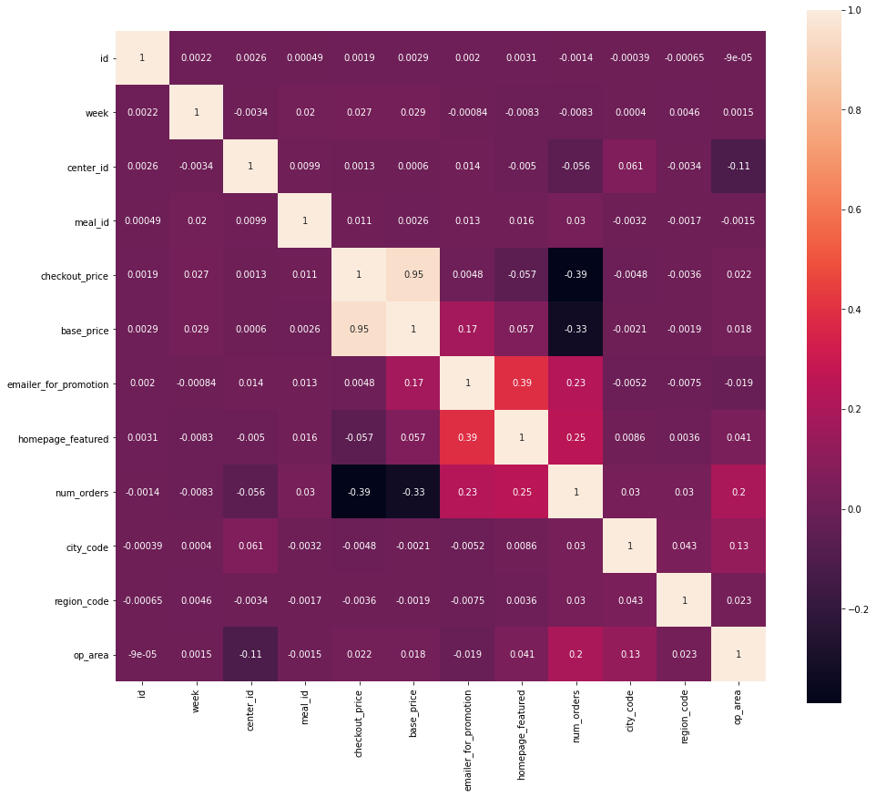
Correlation
Correlation plot gives the information of the correlation between the features and target feature.
This helps in removing the highly correlated features and keep the features that are highly correlated with the target feature.
We can see only base_price and checkout_price are highly correlated but they are important.
The correlation matrix was showing the values between -1 to 1 where -1 indicates the inverse correlation and 0 indicates the no correlation and 1 indicates the highly correlated

Slide 6
Univariate Analysis

Slide 7
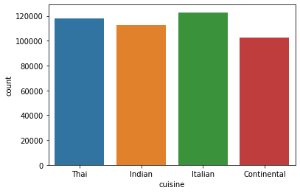
Cuisine Count Plot
Count plot of the cuisines tell that most popular cuisine.
From the cuisine count plot we can see that Italian cuisine was more popular followed with Thai and Indian cuisines.
Usually, Hotel people while ordering raw materials for preparing the food they need to analyse the sale of the cuisines, which helps in satisfying the customers according to their needs and reduce the wastage.
As per the count plot, Italian cuisines are most popular most number of people order it, So Management can order raw materials required for Italian cuisines more compared to Continental.

Slide 8
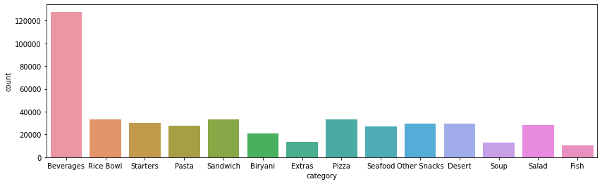
Category Count Plot
According to the above count plot, beverages were sold more compared to the any other category.
Hotel people can maintain more stock of beverages, So that hotel management may not disappoint the customers.

Slide 9
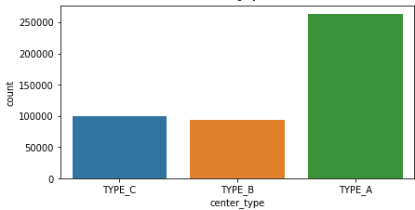
Center_type Count Plot
From the above plot. Type_A centers has more number_of_orders.
Hotels of Type_A has more sale compared to the Type_B and Tyep_C.
Type_A Hotels needs to maintain more raw material compared to Type_B and Type_C.

Slide 10
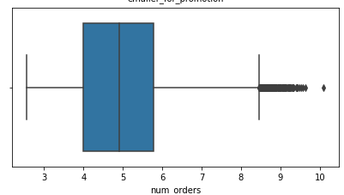
Num_orders Box plot
There are some outliers in the num_orders column
The boxplot was plotted before converting the distribution into log normal distribution.
Explanation:
Upper Whisker of the box plot gives the information of lower value, next line give the information of the 25 percentile value, middle line gives the value of median, end line of the box gives the information of 75th percentile and upper whisker gives the information of maximum value. The points lie outer surface of whiskers are considered as outliers
There are only good outliers in the data set, which means they are good to have. For example if a entire class score 70% and a guy scores 90% he’ll be considered as good outlier.
In the similar way, The outliers in this case were letting us know that there are some food with very high demand.

Slide 11
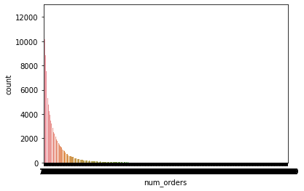
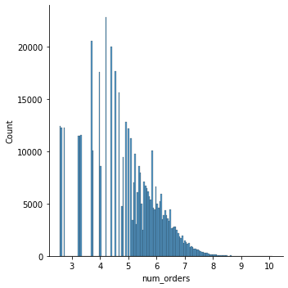
Number_of Orders Distribution Plot
Distribution plot of the number_of_orders feature.
This gives the information of the distribution of the feature.
We usually prefer the normal distribution, if the feature is not normally distributed the we will apply the log normal distribution for making it normal distribution.

Slide 12
Bivariate Analysis

Slide 13
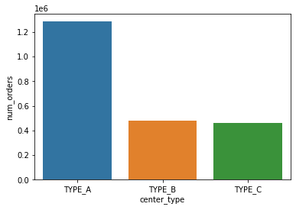
Center_type vs Num_Orders
This gives the information of number of orders that each type of center get.
The plot shows the center_type of Type_A gets the more number of orders.
So, Hotels belong to Type_A should have stock of more raw materials compared to the remaining types
Type_B and Type_C are getting almost same amount of orders.

Slide 14
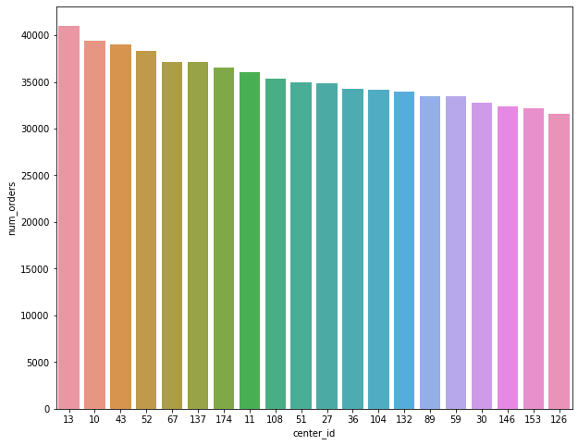
Center_id Vs num_orders Bar Plot
The plot gives the information of the total number of orders received by the top 20 center_id’s.
Hotel Management can maintain a good amount of stock in these center_id ‘s and management also can apply the strategies that are applying at center_id 13 at different centers as it got the hughes number of orders.
Reason for top 20 is, since there are many center id’s, printing all center_id was messing up and unable to see the center_id properly and also can get an idea of other centers by seeing the trend of top 20 centers.

Slide 15
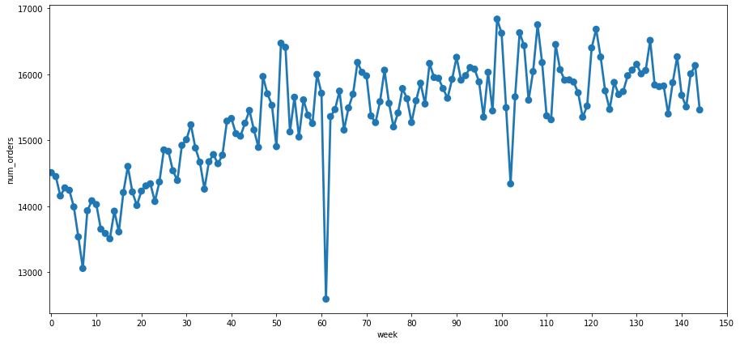
Week vs Num_orders
Above plot shows the week wise num_orders.
We can see that sales in the week 62 went too low and in the week 98 and 109 went peak.
What’s the difference between those weeks? Let’s Analyze.

Slide 16
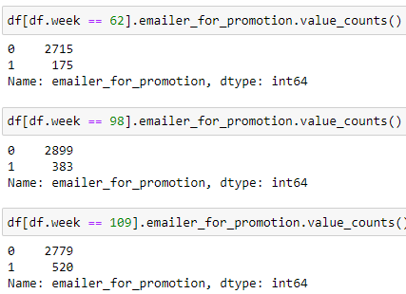
Why did num_orders in week 98 and 109 are greater than week 62?
From the previous graph we can see that week 109 and 98 have highest num_orders.
Reason:
In week 98 and 109 emailer_for_promotions were almost double than week 62.

Slide 17
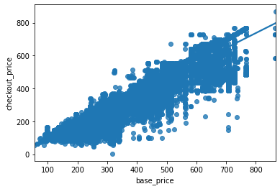
Base price vs checkout_price Regression Plot
According to the graph as the base price of the meal increases the checkout price of the meal also increases
There are few meals with the base price of 700 and checkout_price of below 250. Probably because of low popularity of the food type.
There are 1-2 meals of which base_price and checkout_price were same, probably because of high demand. During the low num_orders. Hotel Management can have offer on this kind of meals. So that there is a chance of ordering the item.

Slide 18
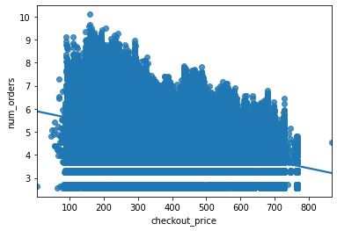
Checkout_price vs num_orders Regression plot
According the plot as check_out price increases num_orders slightly decreased.
The meals with checkout_price of around 150 were sold a lot compared to any other.
Hotel management should maintain the stock accordingly and management can add new dishes that costs similar amount.

Slide 19
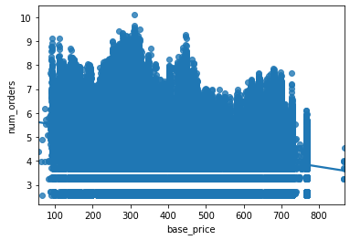
base_price vs num_orders Regression plot
According to the graph we can see food which costs around 300 were sold more.If we map the graph with previous graph checkout_price at 150 and base_price of 300 has the highest and similar kind of plot.
So there is a probability that people are interested in buying the food with 50% discount and more.

Slide 20
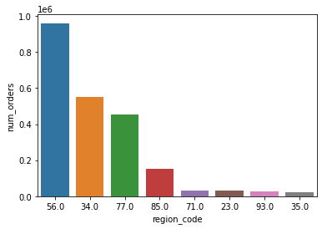
Region_code vs num_orders
The plot give the information of number of orders according to the region.
We can see that the region 56 has more number of orders.
From the knowledge we have till now:
The hotel management should maintain a good amount of stock of food that costs around 150 - 300 at Type_A hotels those are belong to region 56. Region 56 Type_A hotels are important to have high profits.

Slide 21
Multivariate Analysis

Slide 22
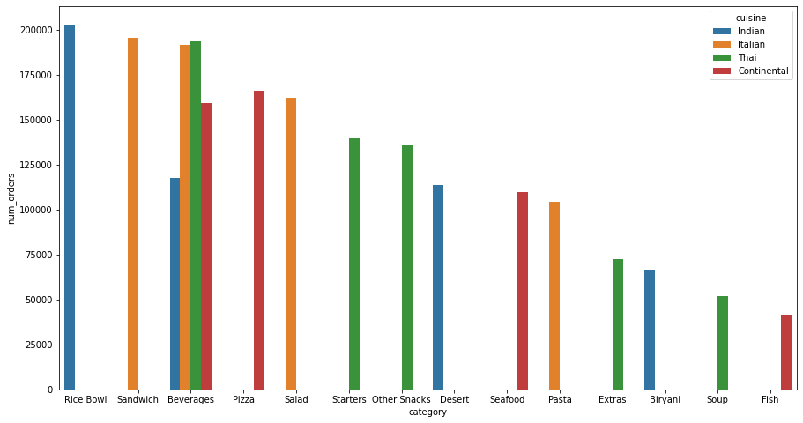
Category vs num_orders vs cuisine
The plot gives us a lot of information that Indian Rice bowl has the hughes number of orders followed by Italian Sandwich.
In beverages, Thai beverages are more popular followed by Italian beverages compared to the Indian beverages.
The graph gives the information of special category of each country.
Note: Please increase the size of the graph to see clearly. Due to space complexity I plotted the image of size (15,8)

Slide 23
Auto EDA: Autoviz Tool

Slide 24
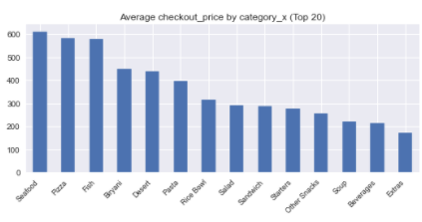
Category vs Checkout_price Bar Plot
The plot give the information of the average price of each category.
Since from the previous plots we understood that foods that cost around 150-300 has more number of orders. From this graph we can see the categories that has checkout_price of 150-300.
Salads, Sandwich, Staters, Other Snacks, Soups, Beverages has more number of orders. If the hotel management want to start a new branch/hotel these are must and should categories for having profits.
Note: plotted only top 20 categories.

Slide 25
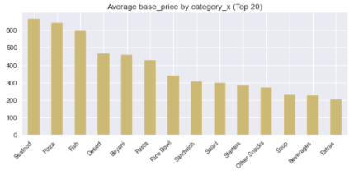
Category vs base_price Bar plot
The plot gives the information of top 20 categories base price.

Slide 26
Thank you

