Slide 1

Rust: Refactoring Rust Programs
Garming Sam

Slide 2
THE PROBLEM
?
Rust nearing 1.0 release
Modern memory-safe systems programming language
But, tooling is still immature
The task is to create a Rust refactoring tool that people could actually use. In doing so, this will help identify which refactorings are easy, which are hard and how this compares to other languages.

Slide 3
PROPOSED SOLUTION
Written in Rust
Variable, function renaming?
Moving methods?
Extracting methods?
Start off as a standalone library, but a more comprehensive tool may require more feedback from the compiler. Development will be incremental and new features will be chosen based on current progress and expected difficulty. Time permitting, a GUI tool?

Slide 4
RISKS
!
“Time” – Lots of concepts and code to understand
No prior experience with Rust
Unknown complexity, unknown support
BUGS + documentation
Up-streaming code – coding style, testing

Slide 5
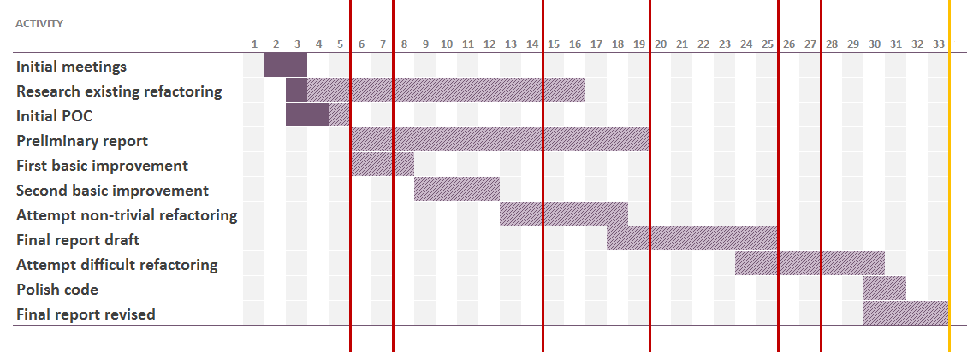
TIMELINE
Fairly optimistic, still lots of unknowns!

