Slide 1
Personalized Medicine
Gianna Sanone

Slide 2
Overview
History
Pros
Cons
Plan and Implementation
Graph 1
Graph 2
Fun Facts
Summary
References

Slide 3
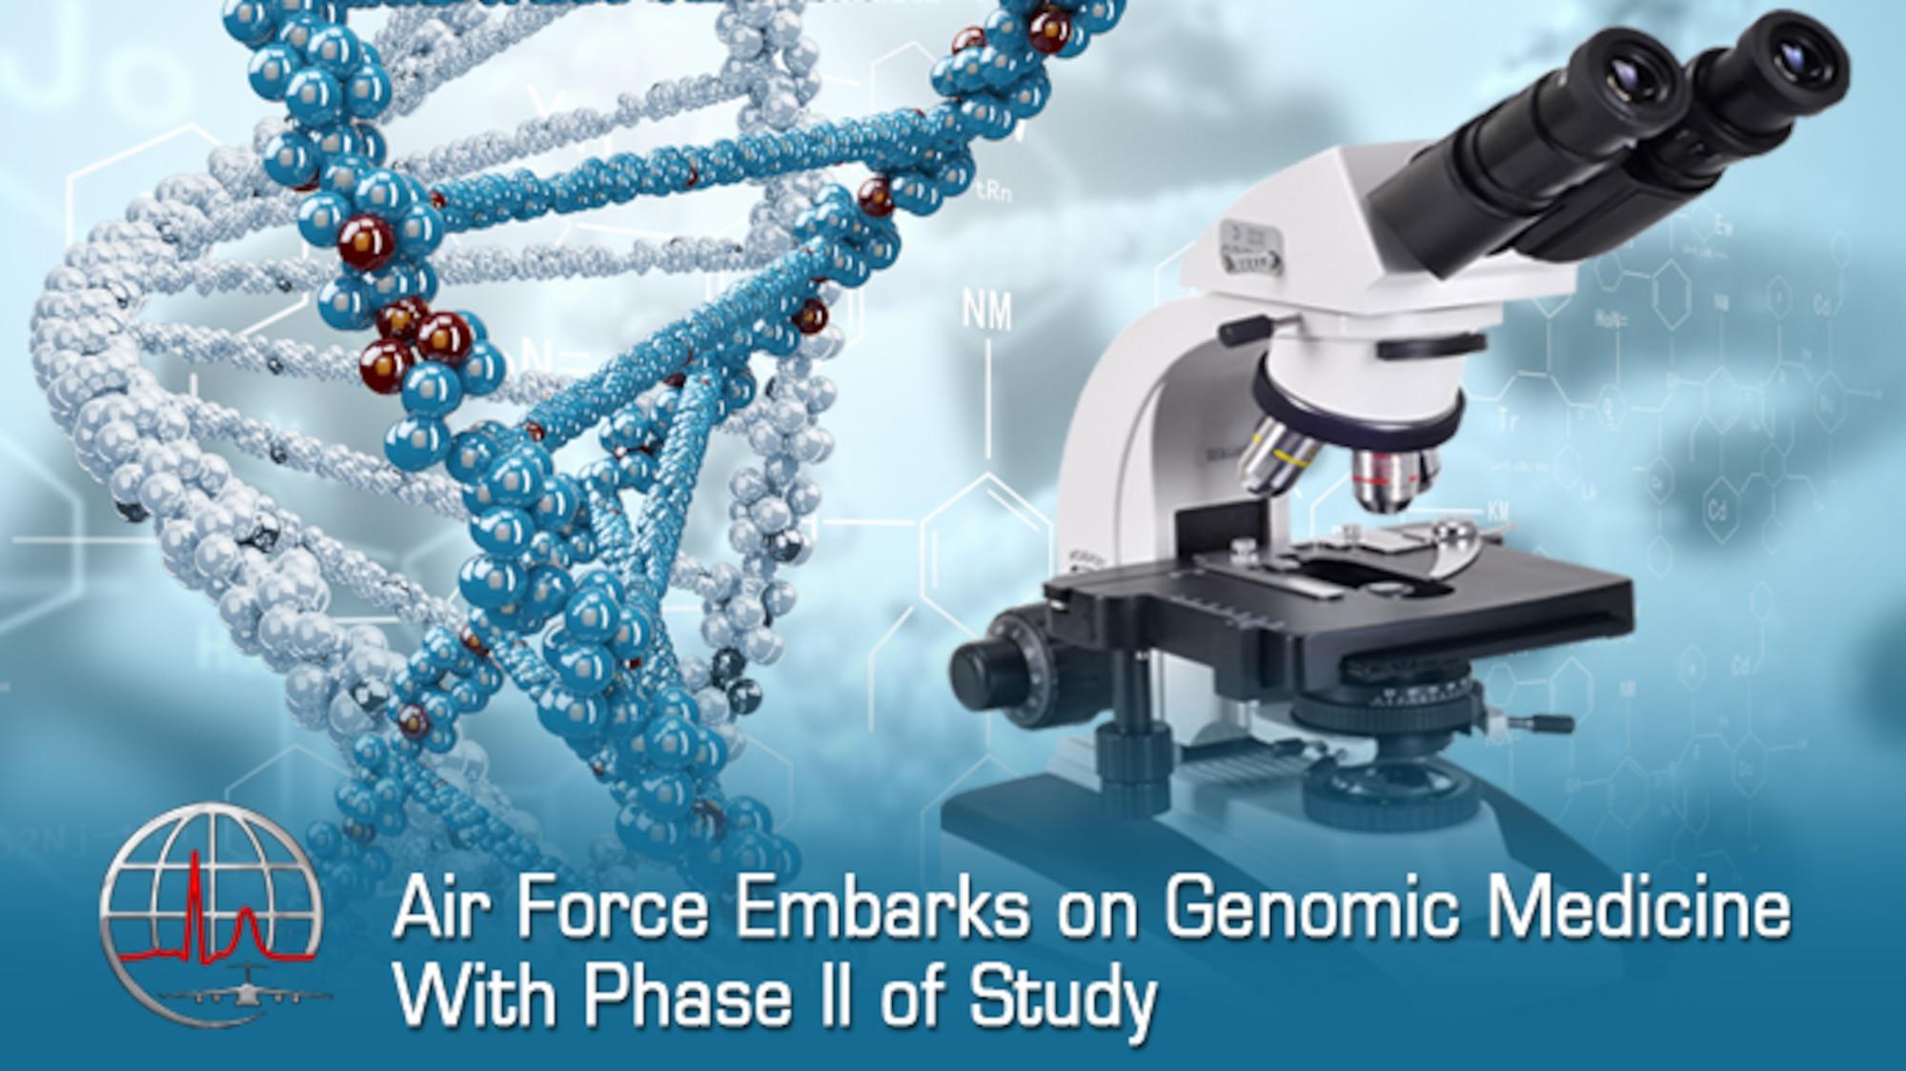
History/Definition
Personalized medicine relies on technology to identify a person’s biology before giving medication, and if the medication will have a reaction to the person then technology and doctors can customize a different medicine that will be safe for the patient.
Scientists wanting to know beforehand what response a patient will have to a drug before giving it to them
Field of molecular biology- created better understanding of a person's biology
They do this because a person health stems change because of gene variation and influences of the environment
Notes:
A form of medicine that uses information about a person's genes, proteins, and environment to prevent, diagnose, and treat disease. In cancer, personalized medicine uses specific information about a person's tumor to help diagnose, plan treatment, find out how well treatment is working, or make a prognosis

Slide 4
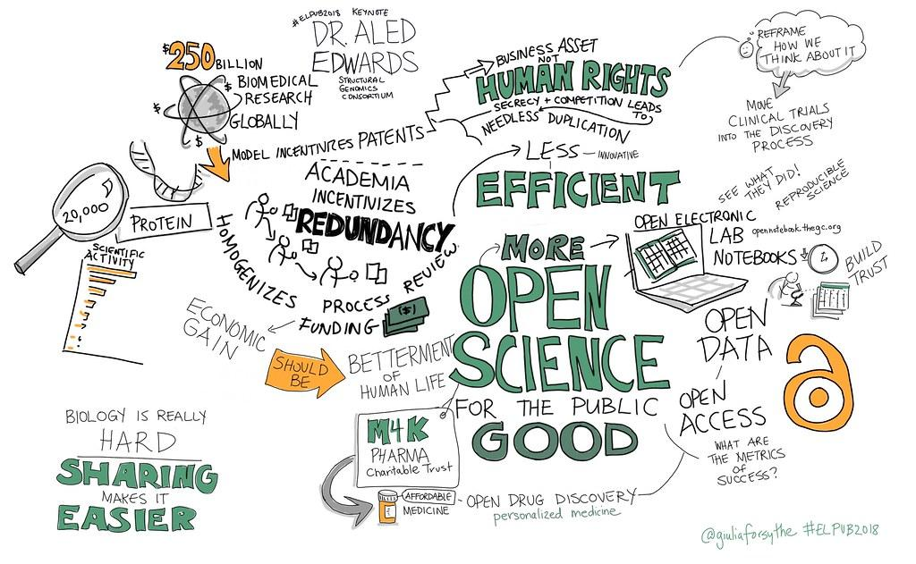
Pros
Know what is reactant to your body and what treatment is not
Could give the healthcare provider a prediction of how to prevent a disease from entering your body
Improve disease detection
Helps disease from progressing
Disease-prevention strategies
Prescribe more safer protective drugs
Prevention of negative side-effects
Gets rid of trial and error options
Notes:
Precision medicine helps health care providers better understand the many things—including environment, lifestyle, and heredity—that play a role in a patient's health, disease, or condition. This information lets them more accurately predict which treatments will be most effective and safe, or possibly how to prevent the illness from starting in the first place.

Slide 5
Cons
High cost
Fear of genetic discrimination
Messed up data
Access to genetic testing
Unprepared primary care workforce

Slide 6
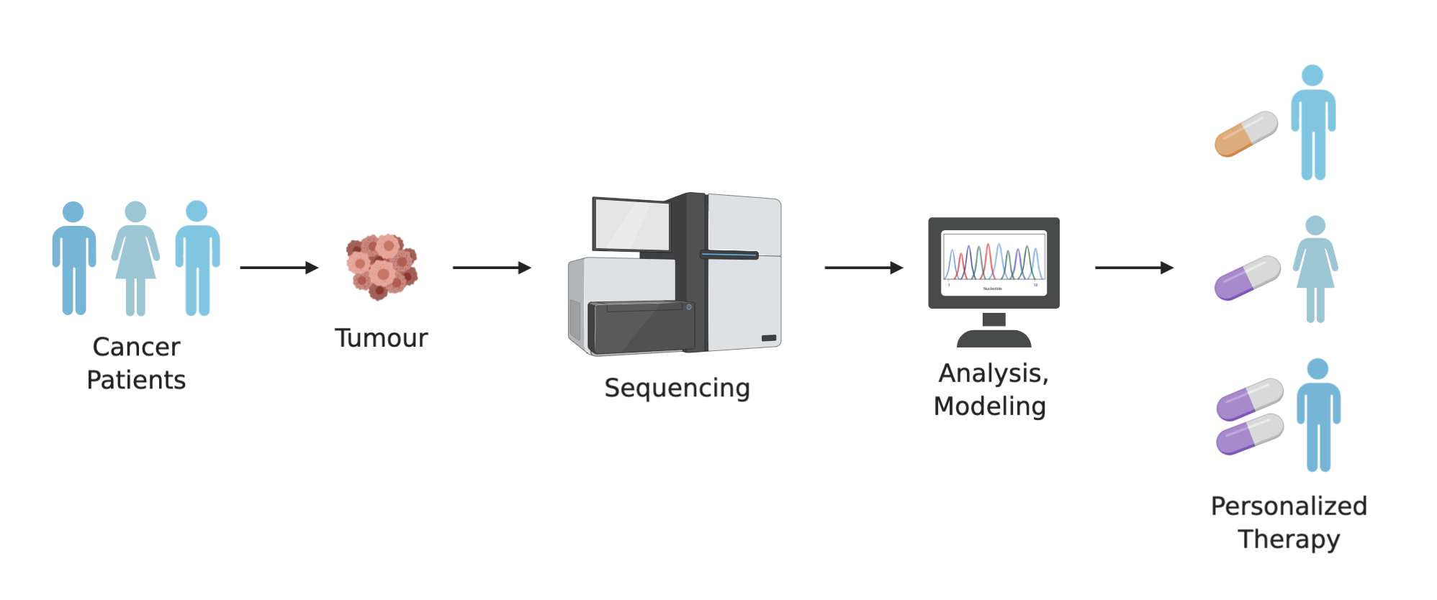
Plan/Implementation
New technology advancements are providing a real-time image of a person and looks at the structure to see any effects the drug might have on them.
No more reactive treatment for disease
More reliance and protection of treatment
Notes:
While precision medicine currently individualizes treatment mainly on the basis of genomic tests (e.g. Oncotype DX^{[38]}), several promising technology modalities are being developed, from techniques combining spectrometry and computational power to real-time imaging of drug effects in the body
Personalized medicine will shift medical practices upstream from the reactive treatment of disease, to proactive healthcare management including screening, early treatment, and prevention, and will alter the roles of both physician and patient

Slide 7
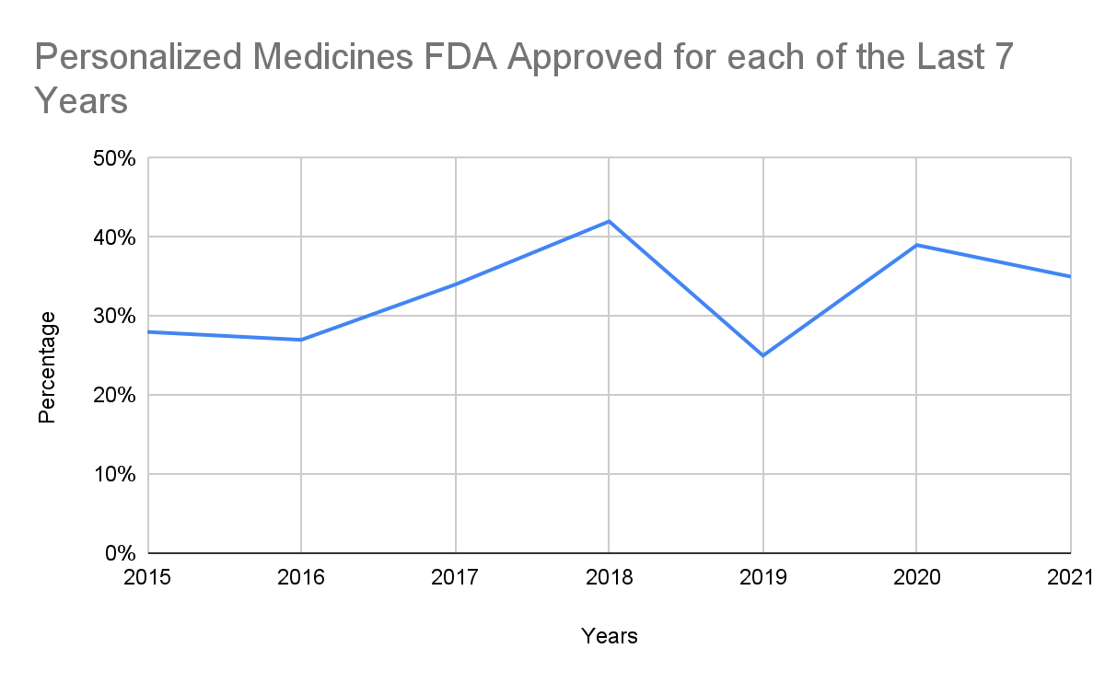
Notes:
This graph shows how much of personalized medicine has been used over the years, at first it wasn’t approved as much but it started to increase and then decrease by a lot in 2019 by the FDA.

Slide 8
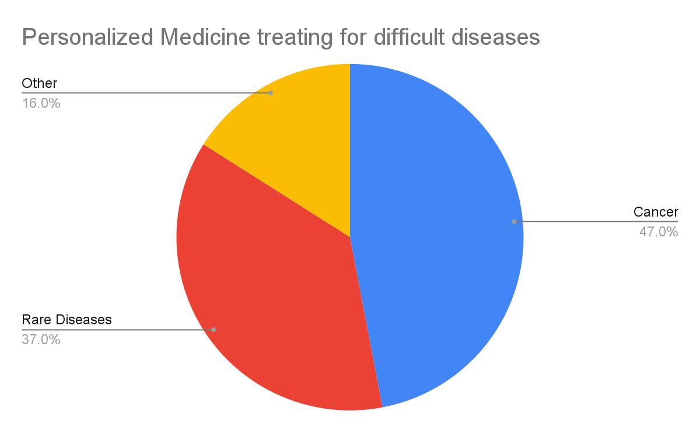
Notes:
This is the number of how personalized medicine is helping people with more complex diseases.

Slide 9
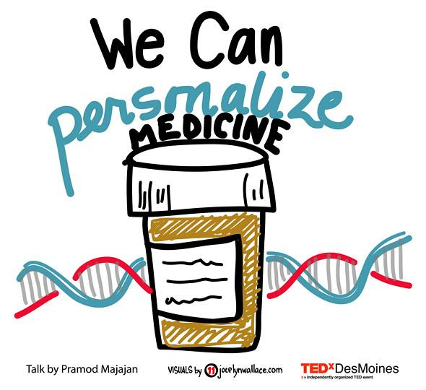
Fun Facts
Personalized medicine is also helping us understand the biology of people with more complex diseases(cancer), and is the best treatment for cancer
Uses your DNA to customize your treatment
Identifies gene mutations
Minimizing side effects
Starting to be useful in treating cardiovascular disorders, depression, pain management

Slide 10
Summary
I am very much with this advancement of technology of medicine. This will allow us to understand a certain person’s structure and biology which will help doctors to protect people from diseases or from a disease becoming worse. This advancement has started from the 1950’s so it’s nothing new. It has been used more than you think it could be used for everyone but not everyone needs special attention. Some might disagree with me though.

Slide 11
References
Milestones in Personalized Medicine: From the Ancient Time to Nowaday
Personalized Medicine- National Human Genome Research Institute
The Personalized Medicine Coalition: goals and strategies
Limitations Persist in Growth of Precision Medicine
10 Things You Should Know About Personalized Medicine
Twenty Years with Personalized Medicine: Past, Present, and Future of Individualized Pharmacotherapy

