Slide 1
Case Study (Projected)
Our projected case study for a banking legacy system modernization demonstrates the significant advantages of our approach.
Traditional Approach
With RPG Modernization Assistant
250,000 lines of Synon-generated RPG code
Initial artifacts generated in days instead of months
18 months timeline
Development team reduced by 30%
12 developers required
Timeline shortened by 40%
High risk of knowledge gaps
Higher quality, more maintainable output
Inconsistent quality outcomes
Comprehensive knowledge preservation

Slide 2
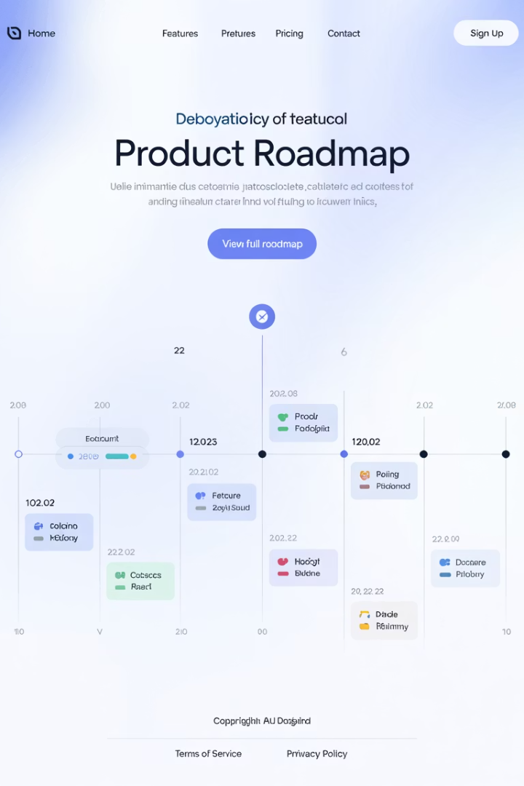
Development Roadmap
Our product development follows a strategic three-phase approach to deliver increasing value and capabilities over time.
1
Phase 1 (Current)
Core functionality with CLI interface
Single file processing
Basic artifact generation
Spring Boot and Python output
2
Phase 2
Enhanced capabilities
Batch processing of multiple files
Integration with related artifacts (DSPF, PRTF)
Enhanced structure generation
3
Phase 3
Enterprise integration
Integration with enterprise modernization tools
Advanced database schema migration
Performance optimization

Slide 3












Next Steps
We have a clear path forward to bring this solution to production and scale it across enterprise modernization efforts.
Validate Outputs
Run Pilot Project
Complete final validation of generated artifacts against quality standards
Test with selected RPG codebase to measure real-world performance
Scale Deployment
Collect Metrics
Expand to enterprise-wide modernization initiatives
Gather feedback and performance data to guide improvements
Integrate Tools
Refine Process
Connect with Cursor AI IDE for seamless vibe coding experience
Enhance prompts and generation process based on pilot results

Slide 4

Q&A
Thank you for your attention! We're now open for questions about any aspect of the RPG Modernization Assistant Tool.
Our team is ready to discuss implementation details, customization options, integration possibilities, and how this solution can address your specific modernization challenges.
We welcome inquiries about technical architecture, AI capabilities, supported RPG variants, and potential ROI for your organization's specific modernization needs.

Slide 5
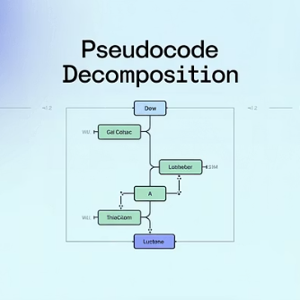
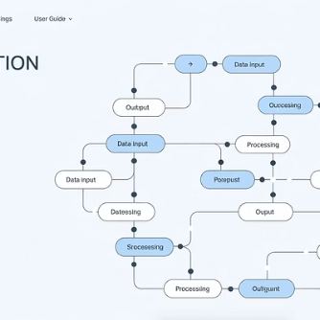
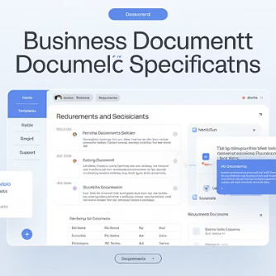
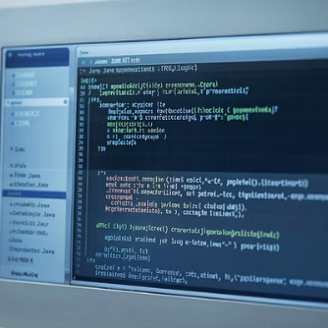
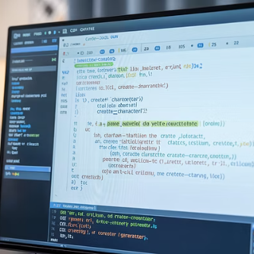
Appendix: Sample Outputs
Below are examples of the artifacts generated by our RPG Modernization Assistant Tool, demonstrating the comprehensive nature of our solution.
These sample outputs illustrate how our tool preserves business logic while transforming it into modern, maintainable code with comprehensive documentation. The combination of pseudocode, visual diagrams, business documentation, and implementation code provides a complete picture of the application for developers.

