Slide 1
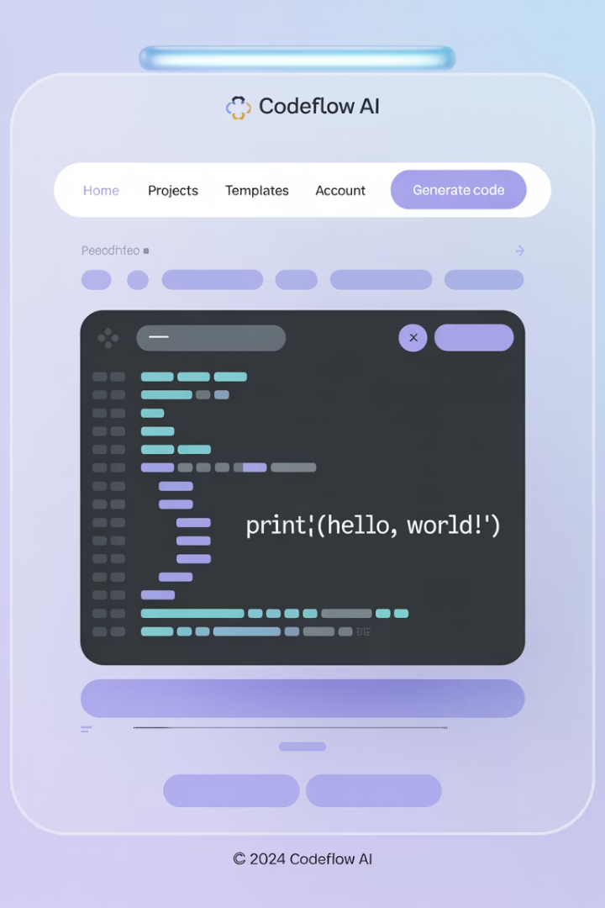
FigmaDev Accelerator: Design-to-Code Automation
Bridging design and development with AI-powered extraction
AS
by Advik Sarang

Slide 2

Plugin Architecture
Main Controller
Extractors
UI Components
Handles initialization and UI events
Specialized classes for design aspects
Configuration and output interface

Slide 3








Extraction Capabilities
HTML Structure
CSS Styles
DOM-like representation
Complete styling info
Layout Data
Design Tokens
Auto layout, constraints
Colors, typography, spacing

Slide 4





Code Extraction Process
HTML Extraction
Determine tags and attributes
CSS Extraction
Convert visual styles to properties
Token Extraction
Identify reusable design elements
Layout Analysis
Map auto layout to CSS flexbox

Slide 5
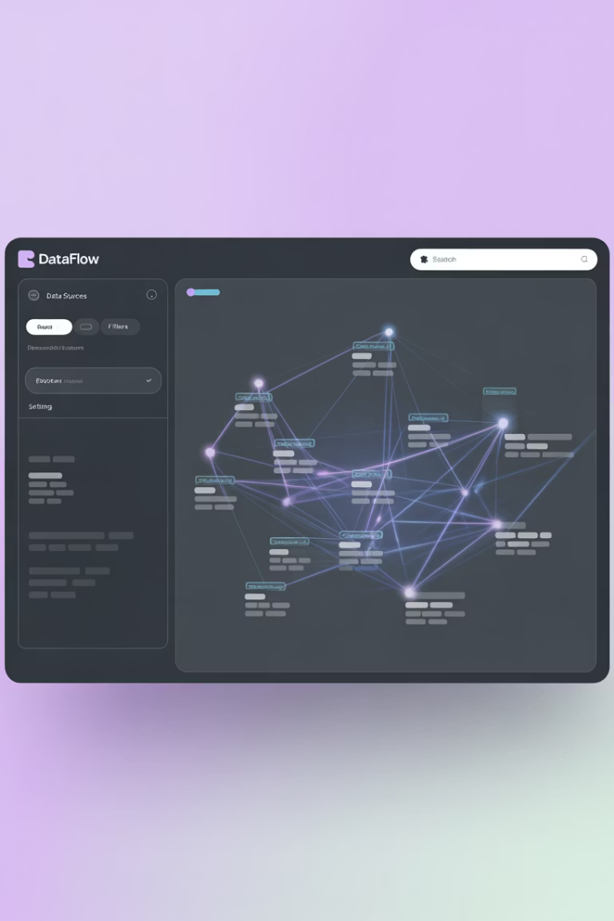
AI Package Format
{
"html": "
...
", "css": ".product-card { display: flex; ... }", "designTokens": { "colors": { "primary": "#426B1F" } }, "layout": { "autoLayout": [{ "direction": "row" }] } }
1
Extract
Plugin captures design data
2
Format
Convert to structured JSON
3
Process
LLM generates code

Slide 6



Benefits For Teams
Developers
Designers
Tech Leaders
Less tedious work, focus on logic
More iterations, guaranteed implementation
Reduced debt, better resource planning

