Slide 1

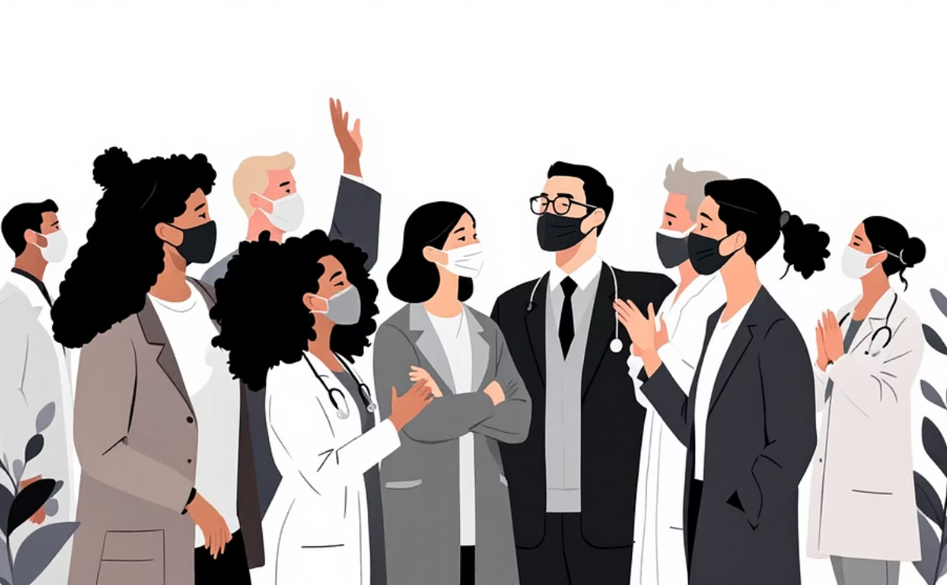
Driving Innovation: Introducing Our AI Innovation Team
We are a dedicated AI Innovation team established to identify, build, and scale AI-powered solutions. Our mission is to accelerate delivery, reduce manual effort, and support critical initiatives in regulatory compliance and technology modernization. We partner closely with engineering, business, and Centers of Excellence (COE) to transform ideas from initial concept to enterprise-wide adoption, ensuring practical and impactful results.
How We Identify Opportunities
How We Benefit the Business & Teams
Where We Look: Pain points from delivery, operations, and compliance; legacy tech debt and manual workflows; regulatory and process bottlenecks.
What We Do: Partner with DDAT, Medicare/Medicaid, and Regulatory COE to surface high-effort, high-impact problems. Map modernization and automation opportunities (e.g., legacy code conversion, API creation, incident triage). Identify repeatable workflows that AI can ingest, classify, and accelerate (e.g., mandates, requirements).
For the Business: Faster time-to-compliance, lower regulatory risk, reduced cost of legacy support and modernization, and scalable, repeatable processes.
For Delivery & Product Teams: Less firefighting and more time for feature work (e.g., faster incident resolution, automated triage). Automated code and API generation; fewer manual conversions and rework. Clearer requirements, traceable user stories, and consistent patterns.
We strategically focus on use cases that significantly reduce manual effort, speed time-to-market, and directly align with our core objectives of Technology Modernization and Regulatory & Compliance excellence.
We work across:
DDAT ENGINEERING
MEDICARE/MEDICAID & EXCHANGE
REGULATORY & ADJUDICATION COE
PRODUCT & PROGRAM MANAGEMENT

Slide 2


This section outlines our strategic focus on accelerating key program areas and our methodical approach to bringing AI solutions to fruition.
Slide 1 of 2 • Page # • CVS Health.

Slide 3
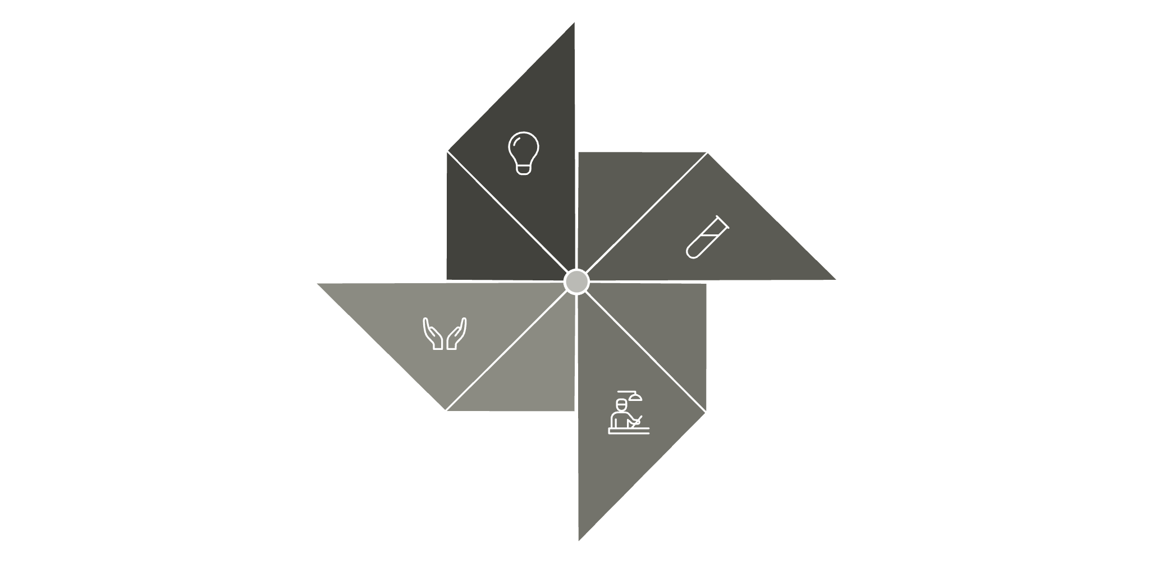

What We Accelerate & How We Get There
1
2
Use Cases That Accelerate the Program
Our Path: Ideation → POC → Production → Widespread Adoption
Ops & Incident Resolution: Proves AI value in day-to-day operations, builds trust and adoption by directly addressing immediate operational challenges.
Legacy Modernization & APIs: Unblocks critical technical debt and provides visible "before/after" improvements for leadership, showcasing tangible progress.
Regulatory & Requirement Automation: Delivers direct compliance and delivery impact, generating strong pull from COE and Program Management teams due to its critical nature.
Developer Productivity & Code Generation: Offers quick wins and broad adoption across engineering teams by directly enhancing their efficiency and output.
Ideate: Discover and prioritize opportunities with business and teams, ensuring alignment with strategic organizational goals and objectives.
POC (Proof of Concept): Build minimal viable solutions, validate technical feasibility, and measure tangible outcomes like time saved, compliance improvements, and developer productivity gains.
Produce: Launch solutions with pilot teams, iterate on feedback to refine the product, and prepare for broader organizational scaling.
Adopt: Scale solutions across the entire organization, embed them into existing standards, governance frameworks, and future roadmaps to ensure long-term impact.
Prioritizing these use-case types helps us demonstrate value early, build momentum, and create significant pull for enterprise-wide adoption, ensuring our AI solutions deliver maximum impact.
POC
Ideate
Produce
Adopt

