Slide 1
Company to Buy Shares
Sedi Gamidov

Slide 2

Notes:
The 3M Company, formerly known as the Minnesota Mining and Manufacturing Company, is an American multinationalconglomerate corporation operating in the fields of industry, worker safety, health care, and consumer goods.

Slide 3
History
Notes:
https://en.wikipedia.org/wiki/3M#Expansion_and_modern_history
https://ru.wikipedia.org/wiki/3M

Slide 4
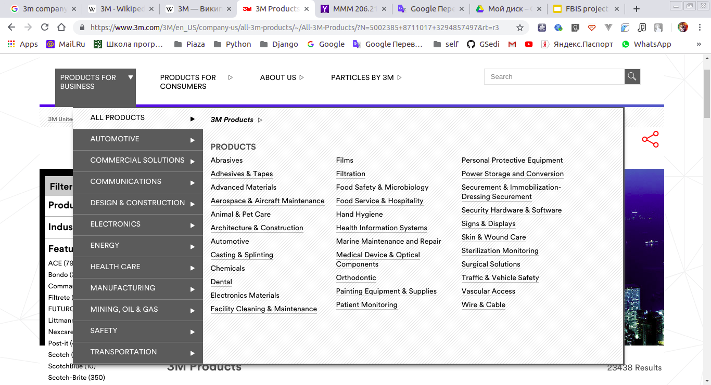

Slide 5
