Slide 1
Virtualization
Concepts

Slide 2
Architecture & Interfaces
Architecture: formal specification of a system’s interface and the logical behavior of its visible resources.
API
Applications
Libraries
System Calls
ABI
Operating
System
ISA
System ISA
User ISA
Hardware
API – application Program interface
ABI – application binary interface
ISA – instruction set architecture

Slide 3
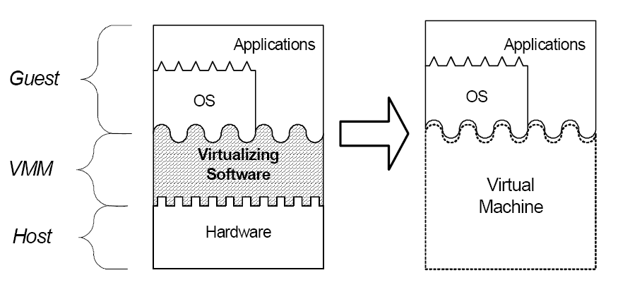
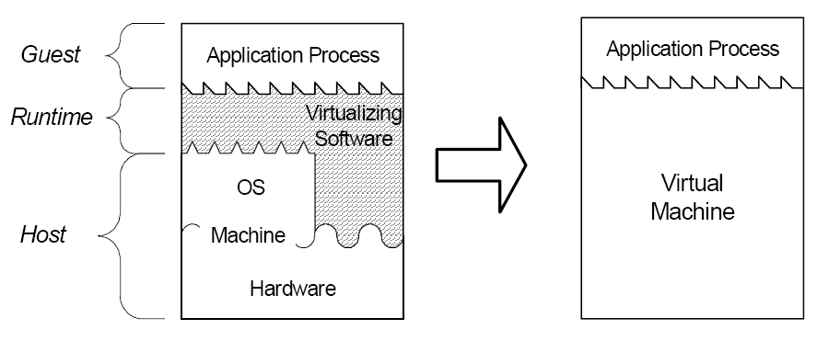
VMM Types
System
  Provides ABI interface
  Efficient execution
  Can add OS-independent services (e.g., migration, intrustion detection)
Process
  Provdes API interface
  Easier installation
  Leverage OS services (e.g., device drivers)
  Execution overhead (possibly mitigated by just-in-time compilation)

Slide 4
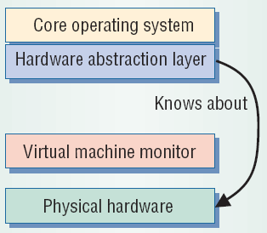
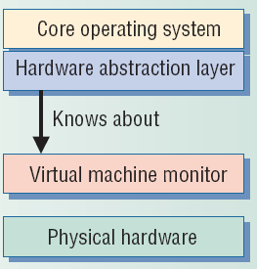
System-level Design Approaches
Full virtualization (direct execution)
  Exact hardware exposed to OS
  Efficient execution
  OS runs unchanged
  Requires a “virtualizable” architecture
  Example: VMWare
Paravirtualization
  OS modified to execute under VMM
  Requires porting OS code
  Execution overhead
  Necessary for some (popular) architectures (e.g., x86)
  Examples: Xen, Denali

Slide 5
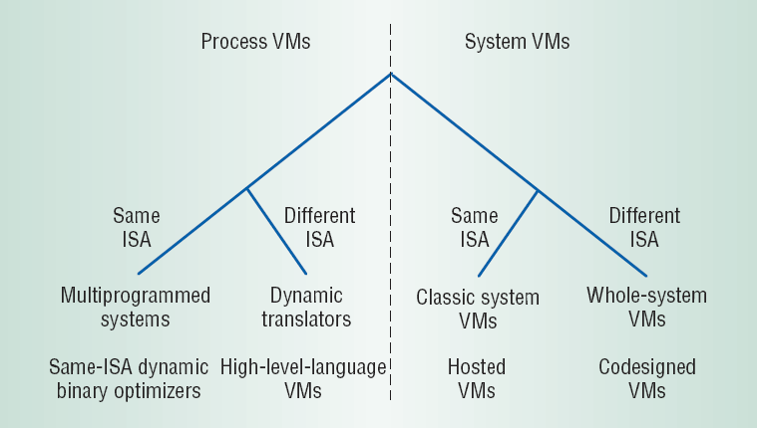
Design Space (level vs. ISA)
API interface
ABI interface
Variety of techniques and approaches available
Critical technology space highlighted

Slide 6
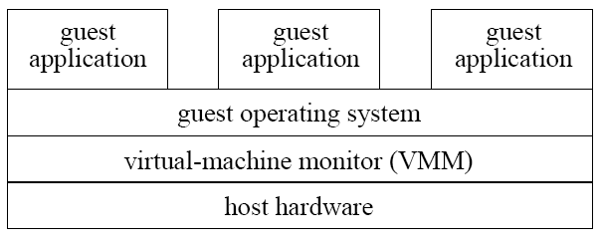
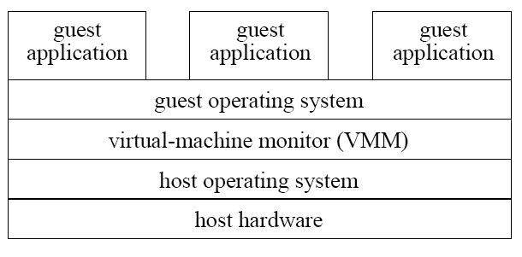
System VMMs
Type 1
Structure
  Type 1: runs directly on host hardware
  Type 2: runs on HostOS
Primary goals
  Type 1: High performance
  Type 2: Ease of construction/installation/acceptability
Examples
  Type 1: VMWare ESX Server, Xen, OS/370
  Type 2: User-mode Linux
Type 2

Slide 7
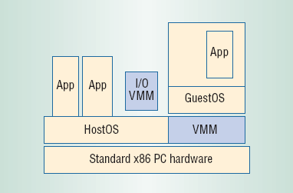
Hosted VMMs
Structure
  Hybrid between Type1 and Type2
  Core VMM executes directly on hardware
  I/O services provided by code running on HostOS
Goals
  Improve performance overall
  leverages I/O device support on the HostOS
Disadvantages
  Incurs overhead on I/O operations
  Lacks performance isolation and performance guarantees
Example: VMWare (Workstation)

Slide 8
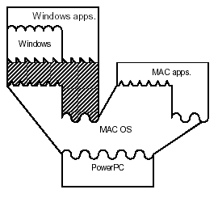
Whole-system VMMs
Challenge: GuestOS ISA differs from HostOS ISA
Requires full emulation of GuestOS and its applications
Example: VirtualPC

Slide 9
Strategies
De-privileging
  VMM emulates the effect on system/hardware resources of privileged instructions whose execution traps into the VMM
  aka trap-and-emulate
  Typically achieved by running GuestOS at a lower hardware priority level than the VMM
  Problematic on some architectures where privileged instructions do not trap when executed at deprivileged priority
Primary/shadow structures
  VMM maintains “shadow” copies of critical structures whose “primary” versions are manipulated by the GuestOS
  e.g., page tables
  Primary copies needed to insure correct environment visible to GuestOS
Memory traces
  Controlling access to memory so that the shadow and primary structure remain coherent
  Common strategy: write-protect primary copies so that update operations cause page faults which can be caught, interpreted, and emulated.
GuestOS
privileged
instruction
trap
resource
emulate change
vmm
change
resource

Slide 10
Virtualizing the IA-32 (x86) architecture
Architecture has protection rings 0..3 with OS normally in ring 0 and applications in ring 3…
…and VMM must run in ring 0 to maintain its integrity and control
…but GuestOS not running in ring 0 is problematic:
  Some privileged instructions execute only in ring 0 but do not fault when executed outside ring 0 (remember privileged vs. sensitive?)
  instructions for low latency system calls (SYSENTER/SYSEXIT) always transition to ring 0 forcing the VMM into unwanted emulation or overhead
  For the Itanium architecture, interrupt registers only accessible in ring 0; forcing VMM to intercept each device driver access to these registers has severe performance consequences
  Masking interrupts can only be done in ring 0
  Ring compression: paging does not distinguish privilege levels 0-2, GuestOS must run in ring 3 but is then not protected from its applications also running in ring 3
  Cannot be used for 64-bit guests on IA-32
  The fact that it is not running in ring 0 can be detected (is this important?)

Slide 11
Memory Management
VMM
machine
OS
physical
process
virtual
entity
address space
VMM
GuestOS
Isolation/protection of Guest OS address spaces
Efficient MM address translation
“shadow” page tables
page tables

