Slide 1

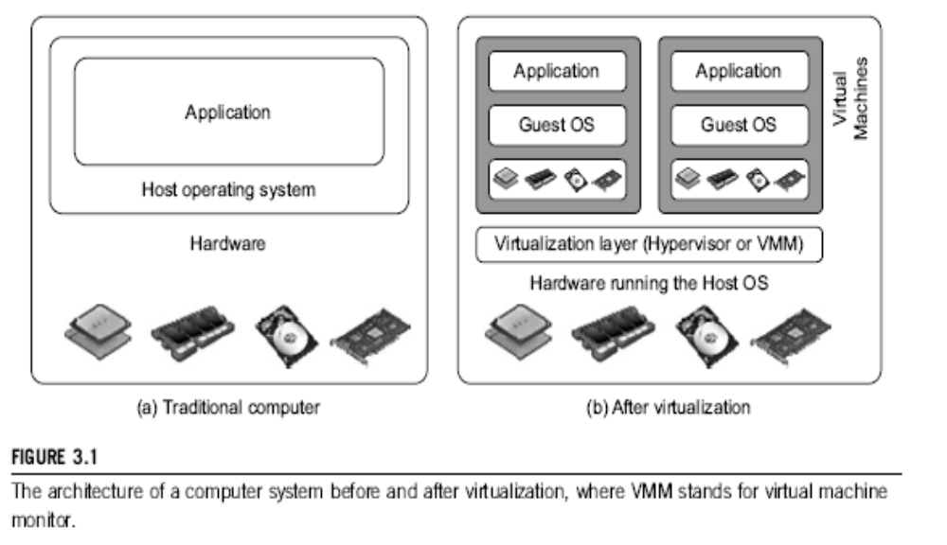
Difference between Traditional Computer and Virtual machines
(Courtesy of VMWare, 2008)

Slide 2
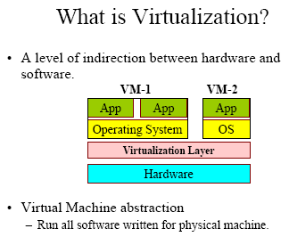
What is Virtualization ?

Slide 3
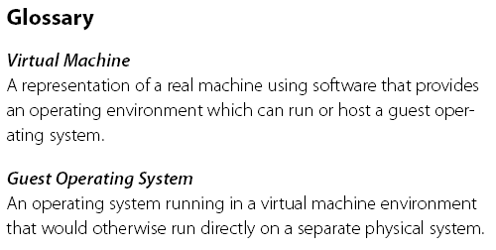
Virtual Machine, Guest Operating System,
and VMM (Virtual Machine Monitor) :
The Virtualization layer is the middleware between the underlying hardware and virtual machines represented in the system, also known as virtual machine monitor (VMM).

Slide 4
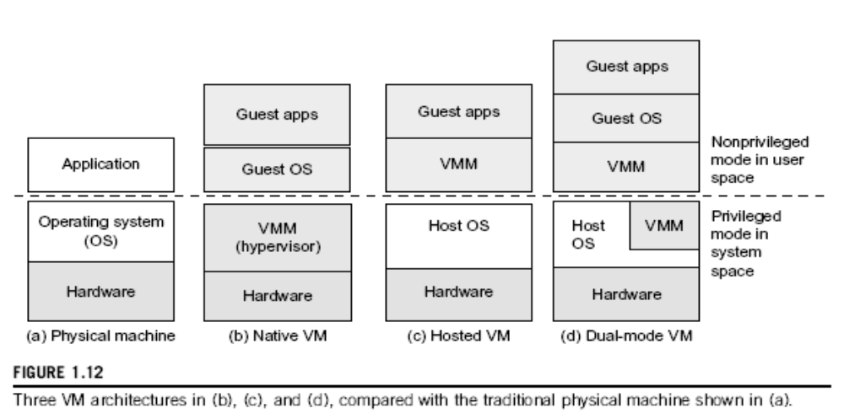

Slide 5
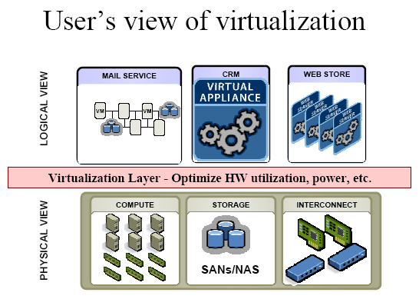
(Courtesy of VMWare, 2008)

Slide 6
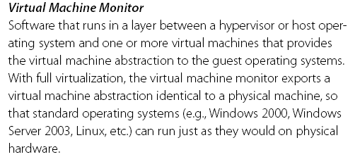
VMM : Virtual Machine Monitor
(Courtesy of Mendel Rosenblum, 2005)

Slide 7
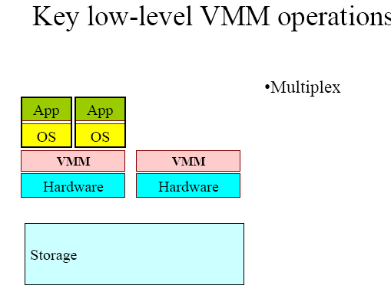
Low-Level VMM Operations (1)
(Courtesy of Mendel Rosenblum, 2006)

Slide 8
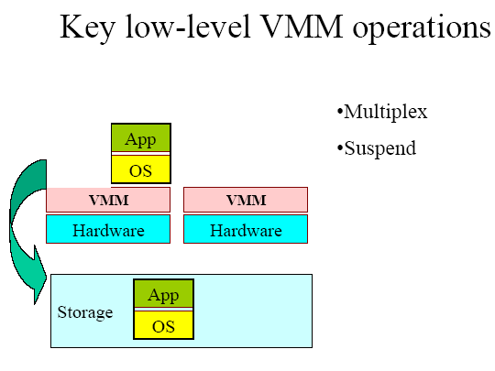
Low-Level VMM Operations (2)
(Courtesy of Mendel Rosenblum, 2006)

Slide 9
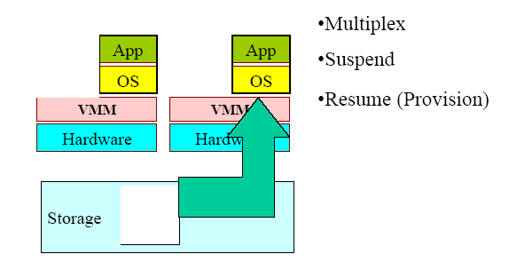
Low-Level VMM Operations (3)
(Courtesy of Mendel Rosenblum, 2006)

Slide 10
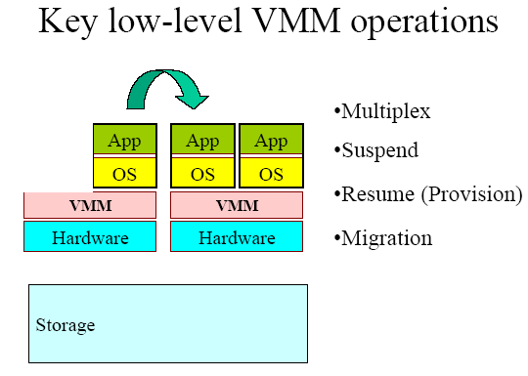
Low-Level VMM Operations (4)
(Courtesy of Mendel Rosenblum, 2006)

Slide 11
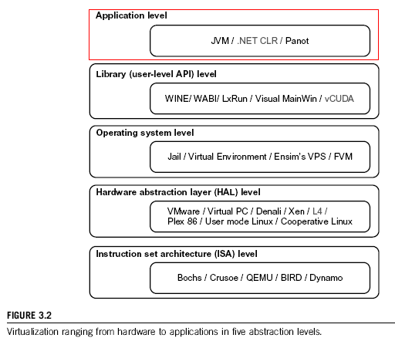

Slide 12
Virtualization at ISA level:
Emulating a given ISA by the ISA of the host machine. For example, MIPS binary code can run on an x-86-based host machine with the help of ISA emulation. Typical systems: Bochs, Crusoe, Quemu, BIRD, Dynamo
Advantage: It can run a large amount of legacy binary codes written for various processors on any given new hardware host machines; best application flexibility
Shortcoming & limitation: One source instruction may require tens or hundreds of native target instructions to perform its function, which is relatively slow. V-ISA requires adding a processor-specific software translation layer in the complier.

Slide 13
Virtualization at Hardware Abstraction level:
Virtualization is performed right on top of the hardware. It generates virtual hardware environments for VMs, and manages the underlying hardware through virtualization. Typical systems: VMware, Virtual PC, Denali, Xen
Advantage: has higher performance and good application isolation
Shortcoming & limitation: very expensive to implement (complexity)

Slide 14
Virtualization at Operating System level:
It is an abstraction layer between traditional OS and user placations. This virtualization creates isolated containers on a single physical server and the OS-instance to utilize the hardware and software in datacenters. Typical systems: Jail / Virtual Environment / Ensim's VPS / FVM
Advantage: have minimal starup/shutdown cost, low resource requirement, and high scalability; synchronize VM and host state changes.
Shortcoming & limitation: all VMs at the operating system level must have the same kind of guest OS; poor application flexibility and isolation.

Slide 15
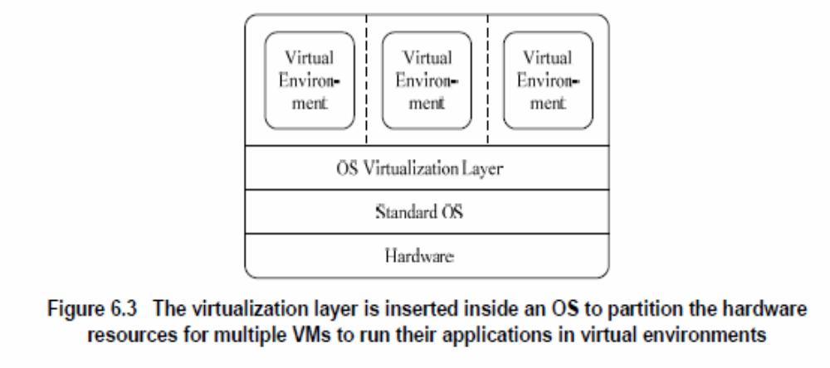
Virtualization at OS Level

Slide 16
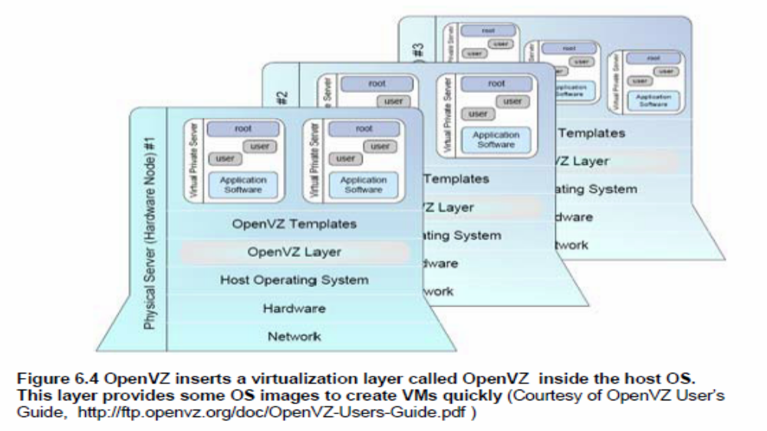
Virtualization for Linux and
Windows NT Platforms

Slide 17
Library Support level:
It creates execution environments for running alien programs on a platform rather than creating VM to run the entire operating system. It is done by API call interception and remapping. Typical systems: Wine, WAB, LxRun , VisualMainWin
Advantage: It has very low implementation effort
Shortcoming & limitation: poor application flexibility and isolation

Slide 18
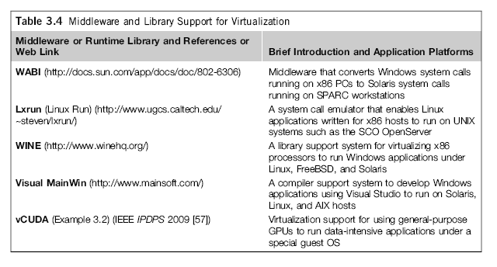
Virtualization with Middleware/Library Support

Slide 19
User-Application level:
It virtualizes an application as a virtual machine. This layer sits as an application program on top of an operating system and exports an abstraction of a VM that can run programs written and compiled to a particular abstract machine definition. Typical systems:
JVM , NET CLI , Panot
Advantage: has the best application isolation
Shortcoming & limitation: low performance, low application flexibility and high implementation complexity.

Slide 20
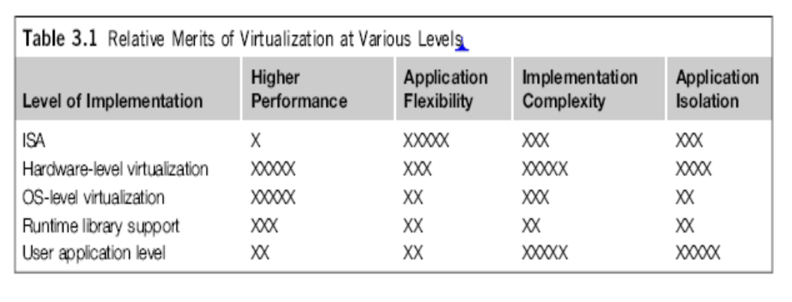

Slide 21
Full Virtualization vs. Para-Virtualization
Full virtualization does not need to modify guest OS, and critical instructions are emulated by software through the use of binary translation. On the other hand, para virtualization needs to modify guest OS, and non-virtualizable instructions are replaced by hypercalls that communicate directly with the hypervisor or VMM. As of full virtualization, the advantage is no need to modify OS. However, this approach of binary translation slows down the performance a lot.
Para virtualization reduces the overhead, but the cost of maintaining paravirtualized OS is high. The improvement depends on the workload. VMware Workstation applies full virtualization, which uses binary translation to automatically modify x86 software on-the-fly to replace critical instructions. The para virtualization is supported by Xen, Denali and VMware ESX.

Slide 22
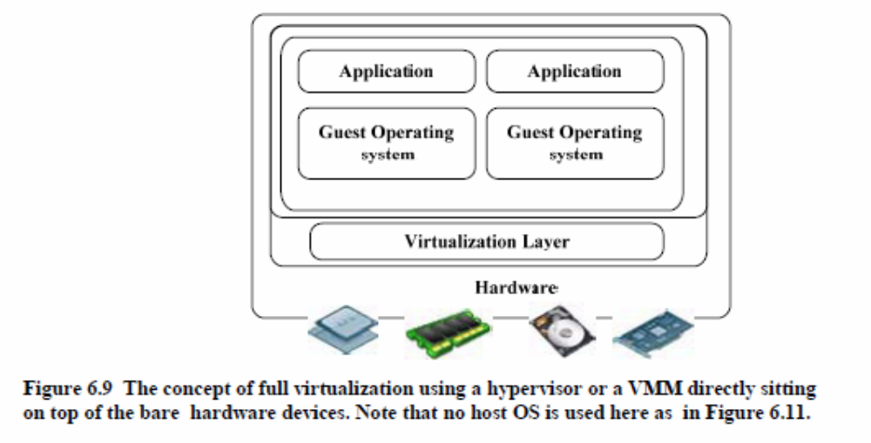
Full Virtualization

Slide 23
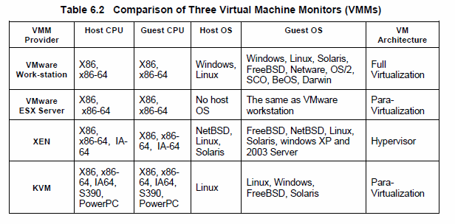
Major VMM and Hypervisor Providers

Slide 24
Hypervisor
A hypervisor is a hardware virtualization technique allowing multiple operating systems, called guests to run on a host machine. This is also called the Virtual Machine Monitor (VMM).
Type 1 hypervisor or the bare metal hypervisor sits on the bare metal computer hardware like the CPU, memory, etc. All the guest operating systems are a layer above the hypervisor. So the hypervisor is the first layer over the hardware. The original CP/CMS hypervisor developed by IBM was of this kind. Examples are Microsoft Hyper-V.
Type 2 or the hosted hypervisor do not run over the bare metal hardware but they run over a host operating system. The hypervisor is the second layer over the hardware. The guest operating systems run a layer over the hypervisor and so they form the third layer. Examples are FreeBSD. The operating system is usually unaware of the virtualization

Slide 25
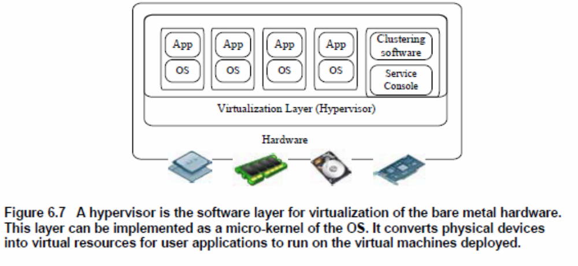
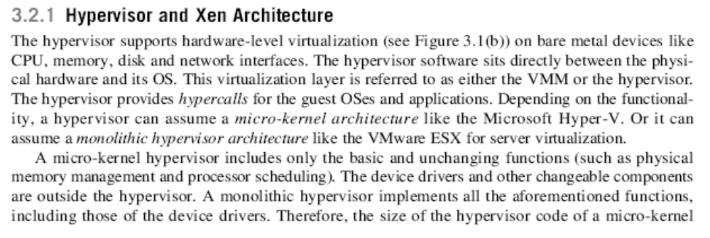
Hypervisor and the XEN Architecture

Slide 26
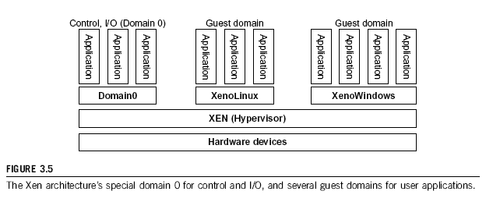
The XEN Architecture (1)

Slide 27
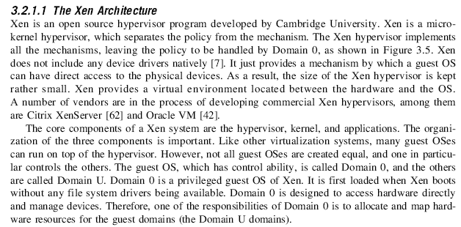
The XEN Architecture (2)

Slide 28
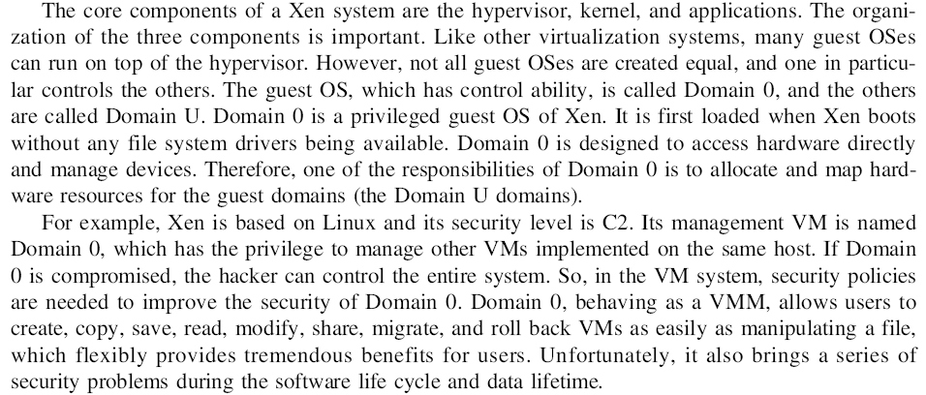
The XEN Architecture (3)

Slide 29
Para-Virtualization
In para-virtualization, the guest operating system has to be modified. Para-virtualization provides specially defined ‘hooks’ to do some tasks in the host and guest operating systems, which would otherwise have been done in a virtual environment, which is slower.
The VMM in a para-virtualized platform is simpler because the critical tasks are now performed in the operating system rater than by the VMM. Since the virtualization overhead decreases the performance increases.
Some of the disadvantages are the compatibility and the portability is reduces because of the modified operating system. Also the cost of maintenance is high because of the deep OS modifications.
Some examples of Para-virtualization are KVM and the XenWindowsGplPv project.

Slide 30
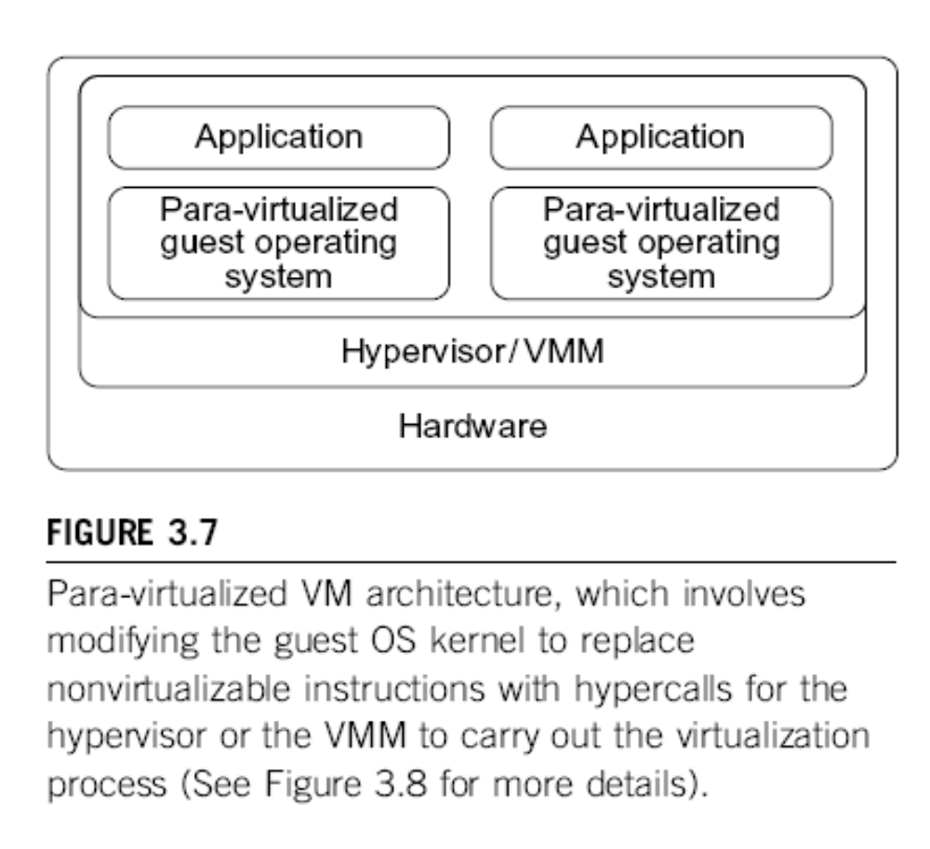
Para-
Virtualization with Compiler Support.
The KVM builds offers kernel-based VM on the Linux
platform, based on para-virtualization

Slide 31
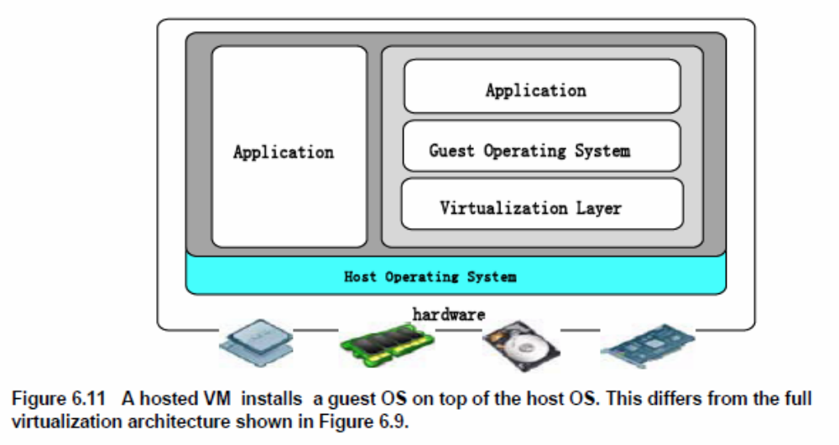
Host-based Virtualization

Slide 32
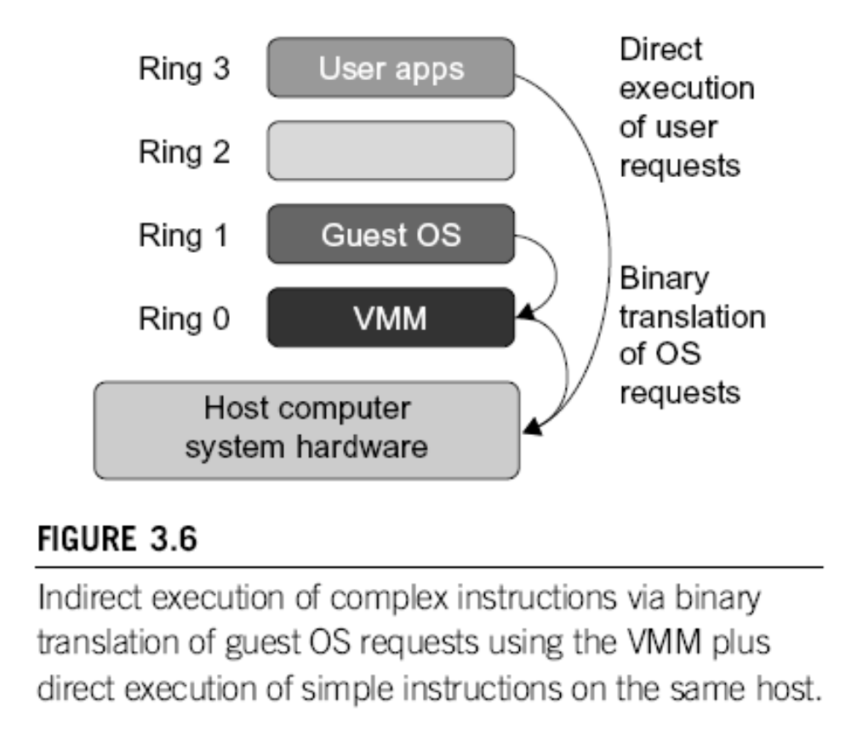
Binary Translation of Guest OS Requests using a VMM:

Slide 33
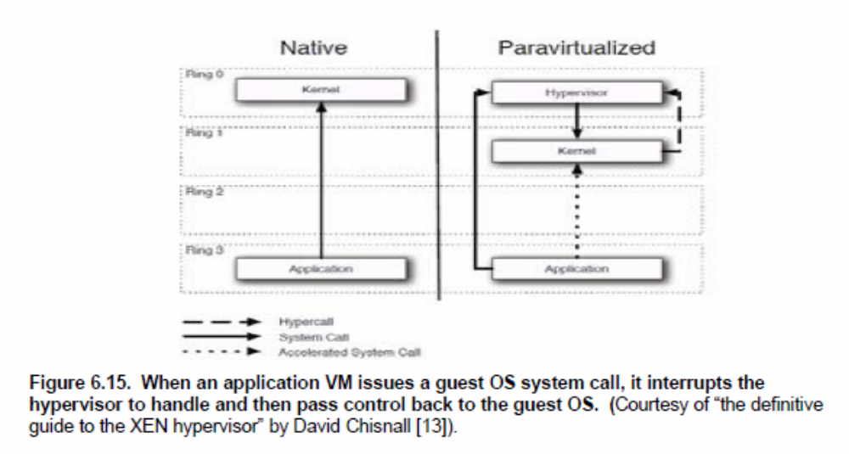
Hypercall Execution

Slide 34
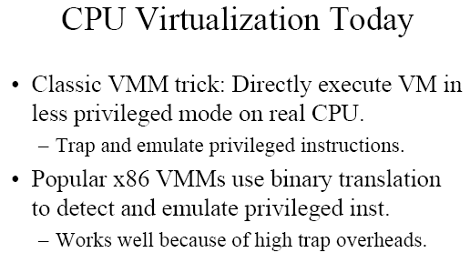
(Courtesy of Mendel Rosenblum, 2006)

Slide 35
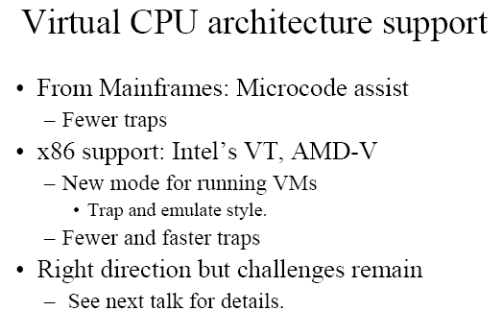
(Courtesy of Mendel Rosenblum, 2006)

Slide 36
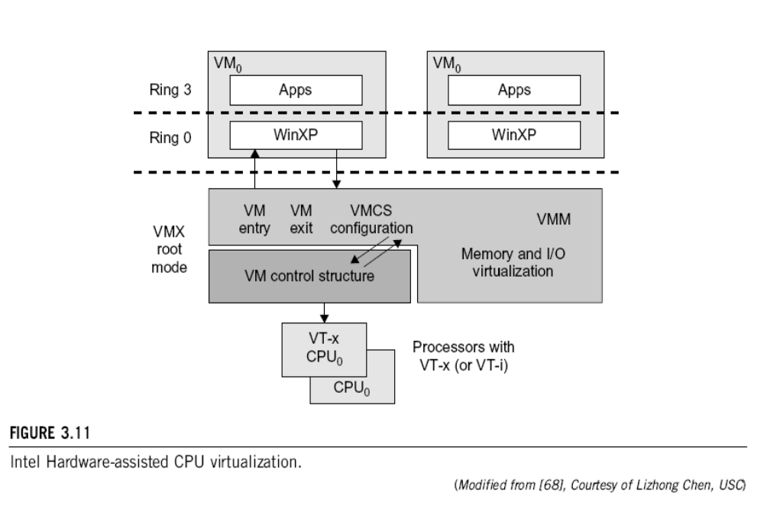

Slide 37
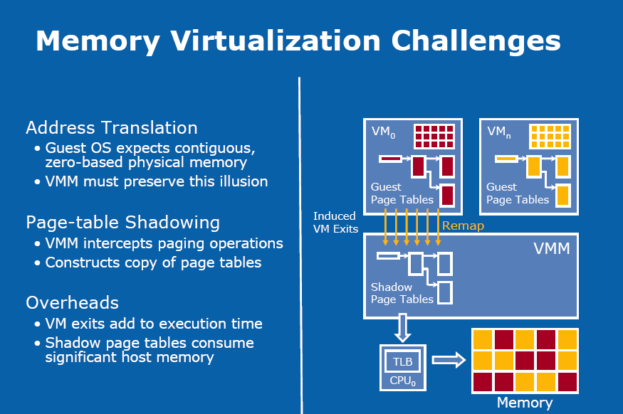

Slide 38
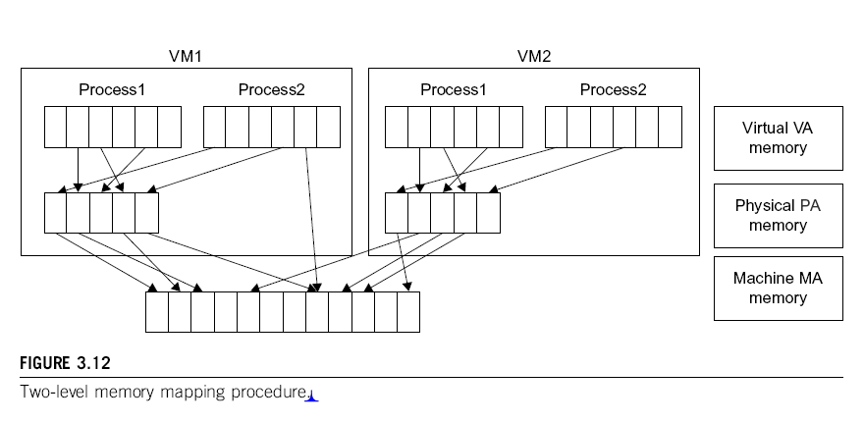

Slide 39
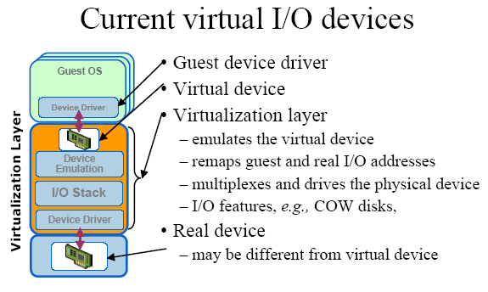

Slide 40
Conclusions on CPU, Memory
and I/O Virtualization :
CPU virtualization demands hardware-assisted traps of
sensitive instructions by the VMM
Memory virtualization demands special hardware support
(shadow page tables by VMWare or extended page table by
Intel) to help translate virtual address into physical address
and machine memory in two stages.
I/O virtualization is the most difficult one to realize due to
the complexity if I/O service routines and the emulation
needed between the guest OS and host OS.

Slide 41
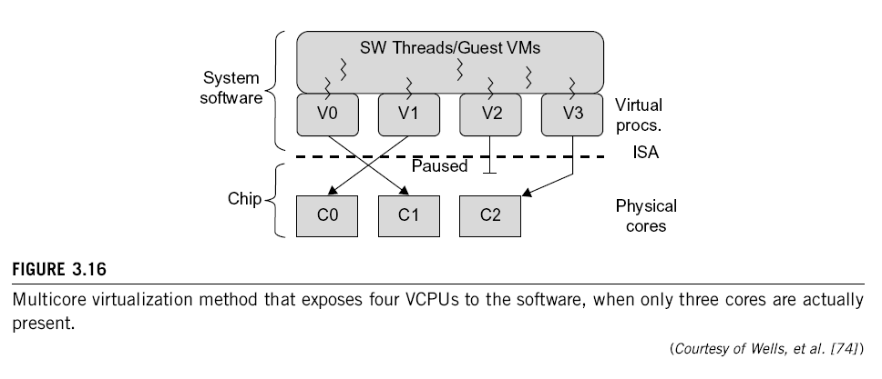
Multi-Core Virtualization:
VCPU vs. traditional CPU
Figure 3.16 Four VCPUs are exposed the software, only three cores are actually present. VCPUs V0, V1, and V3 have been transparently migrated, while VCPU V2 has been transparently suspended. (Courtesy of Wells, et al., “Dynamic Heterogeneity and the Need for Multicore Virtualization”, ACM SIGOPS Operating Systems Review, ACM Press, 2009 [68] )

Slide 42
Virtual Cluster Characteristics
The virtual cluster nodes can be either physical or virtual machines. Multiple VMs
running with different OSs can be deployed on the same physical node.
A VM runs with a guest OS, which is often different from the host OS, that manages the resources in the physical machine, where the VM is implemented.
The purpose of using VMs is to consolidate multiple functionalities on the same server. This will greatly enhance the server utilization and application flexibility.
VMs can be colonized (replicated) in multiple servers for the purpose of promoting distributed parallelism, fault tolerance, and disaster recovery.
The size (number of nodes) of a virtual cluster can grow or shrink dynamically, similarly to the way an overlay network varies in size in a P2P network.
The failure of any physical nodes may disable some VMs installed on the failing nodes. But the failure of VMs will not pull down the host system.

Slide 43
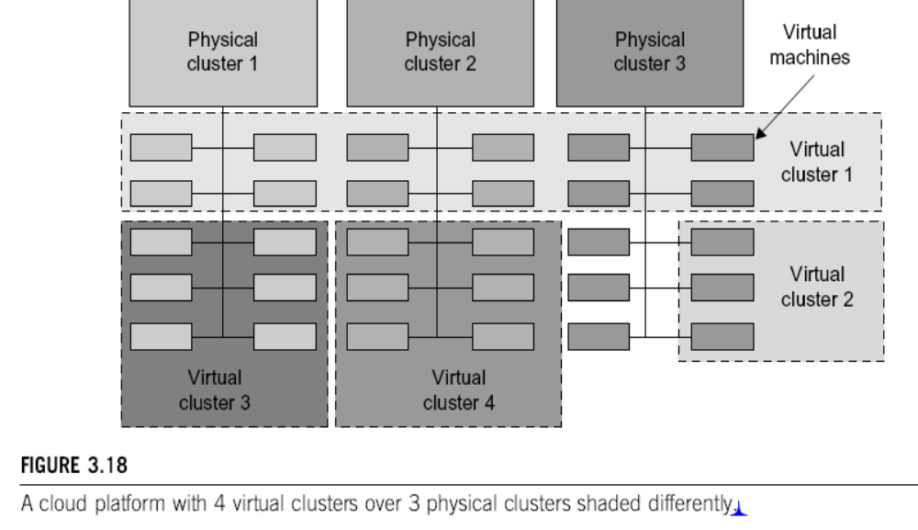
Virtual Clusters vs. Physical Clusters

Slide 44
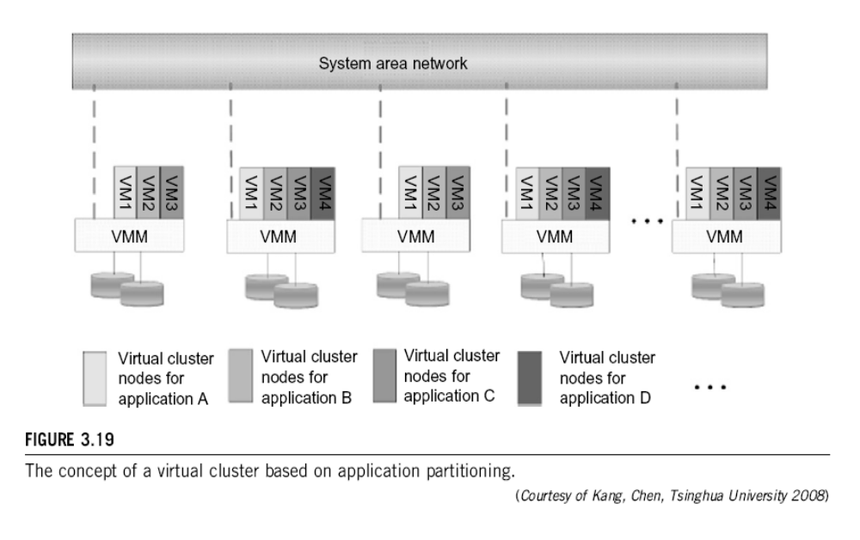

Slide 45
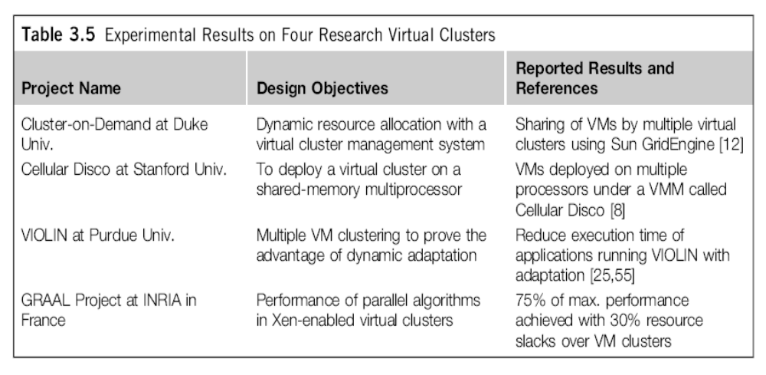
Virtual Cluster Projects

Slide 46
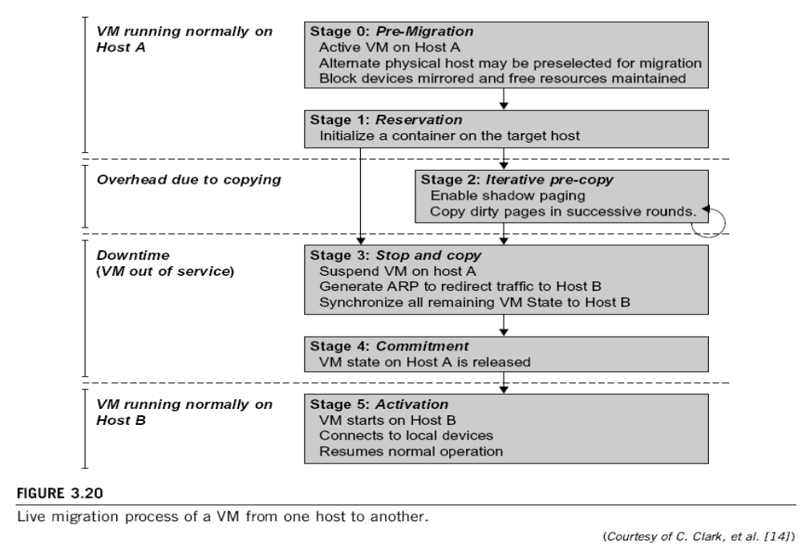
Live Migration of Virtual Machines

Slide 47
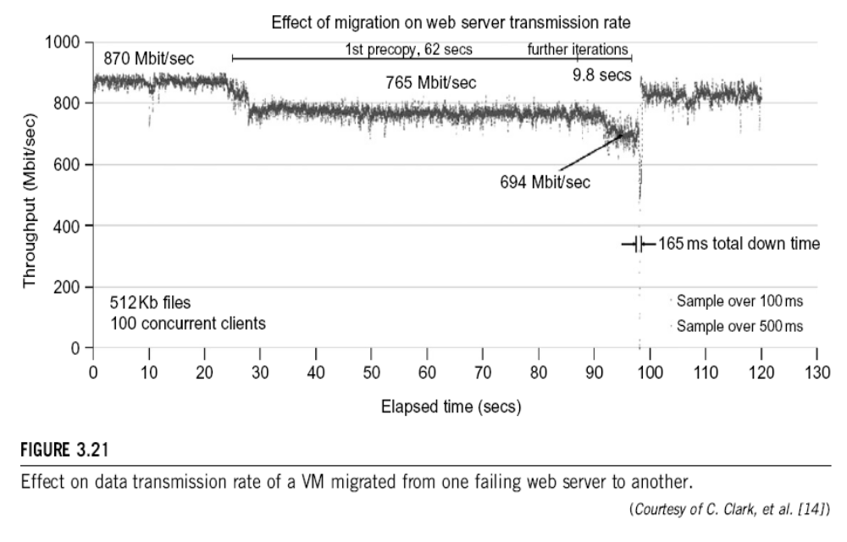

Slide 48
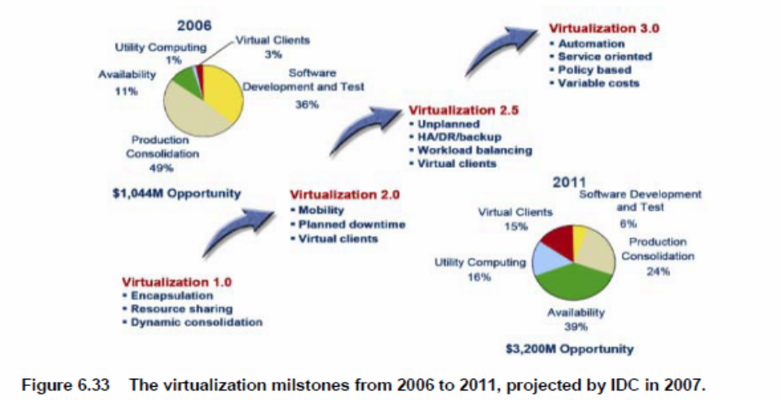
Projected Growth of Virtualization
Market from 2006 to 2011 by IDC

Slide 49
Reading Assignments :
K. Hwang, G. Fox and J. Dongarra, Distributed Systems and Cloud Computing, Chapter 3, 2011
M. Rosenblum and T. Garfinkel, “Virtual Machine Monitors: Current Technology and Future Trends”, IEEE Computer Magazine, May 2005, pp.39-47.
VM Ware, Inc., “Virtualization Overview “,
White paper, http://www.vmware.com , 2006.
Virtual Machines by James Smith and Ravi Nair, Morgan Kaufmann, an Elesevier imprint, 2005

