Slide 1

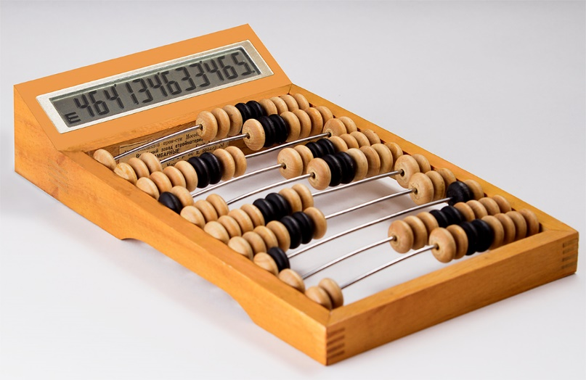
4 bit calculator
© 2016–2016 All rights reserved. Powered by Georgian Cha-cha and Armenian brandy™ ©

Slide 2

Special Thanks for our main sponsor:
JUST DO IT!!!
Power Of Will

Slide 3
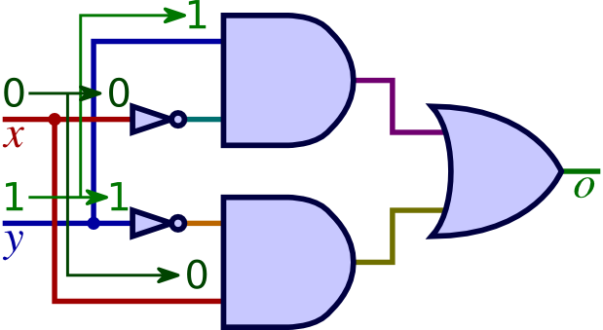
logic gates
A logic gate is an elementary building block of a digital circuit. Most logic gates have two inputs and one output. At any given moment, every terminal is in one of the two binary conditions low (0) or high (1), represented by different voltage levels.

Slide 4
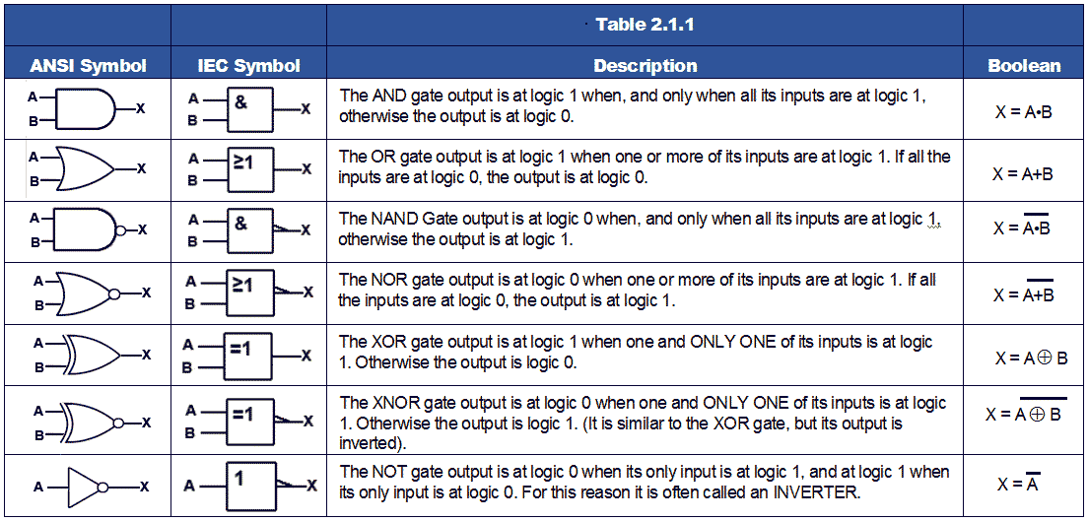

Slide 5
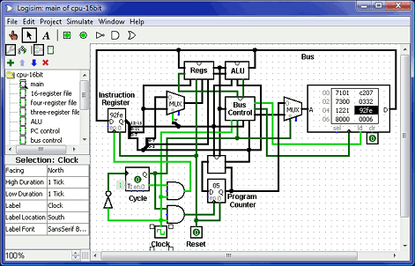
Logisim
Logisim is an educational tool for designing and simulating digital logic circuits, with the capacity to build larger circuits from smaller subcircuits, and to draw bundles of wires with a single mouse drag, Logisim can be used (and is used) to design and simulate entire CPUs for educational purposes.

Slide 6
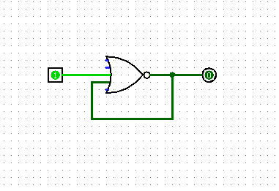
Nice way to DDoS yourself
➔ To 0
➔ To 1
1
NoR
1
1
1
And will change like that 2.7 billion times per second

Slide 7

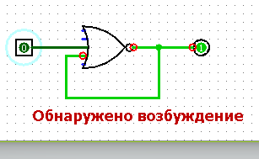

Slide 8
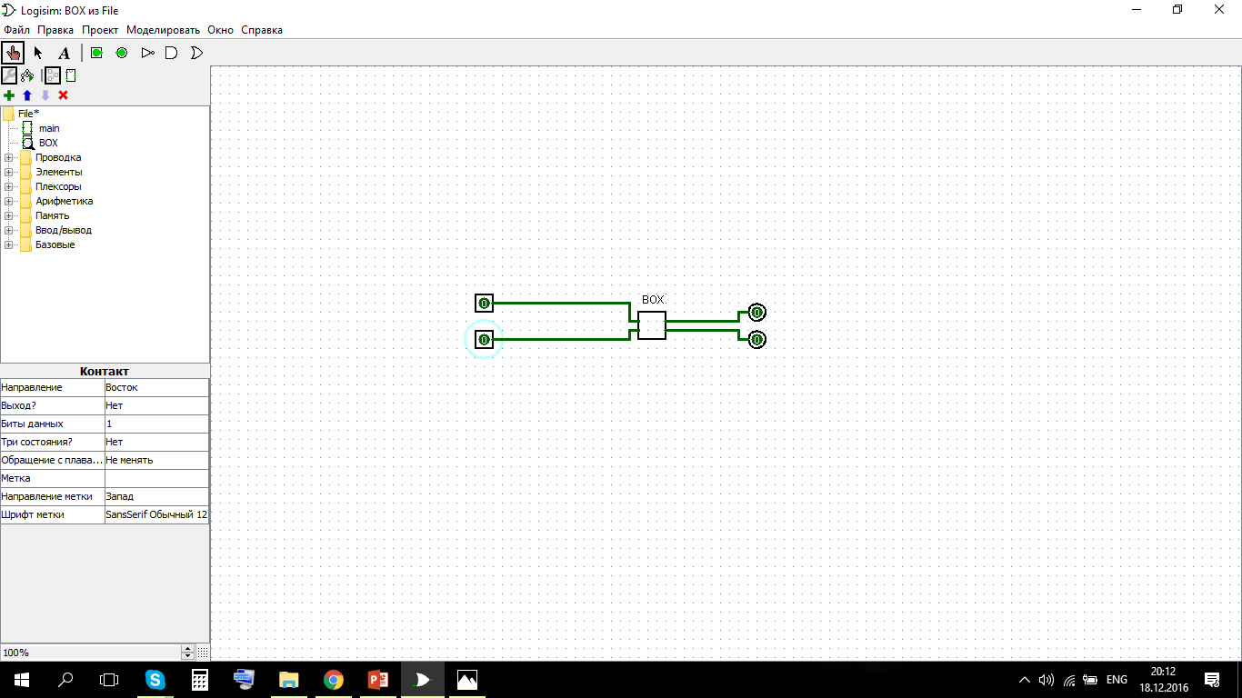
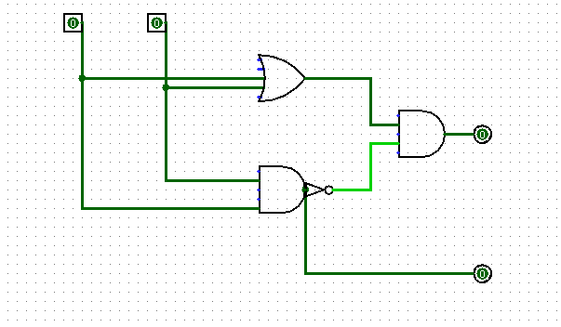

Slide 9
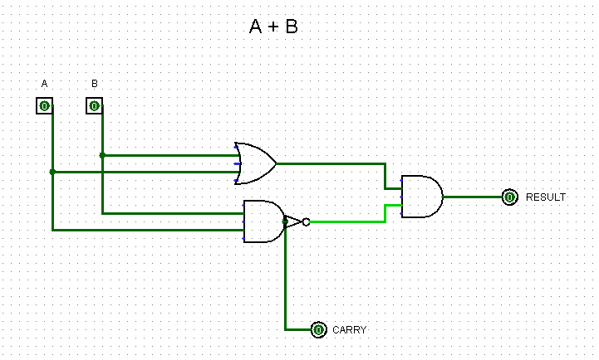
We used several “BOX”-es
H.A. – Half Adder

Slide 10
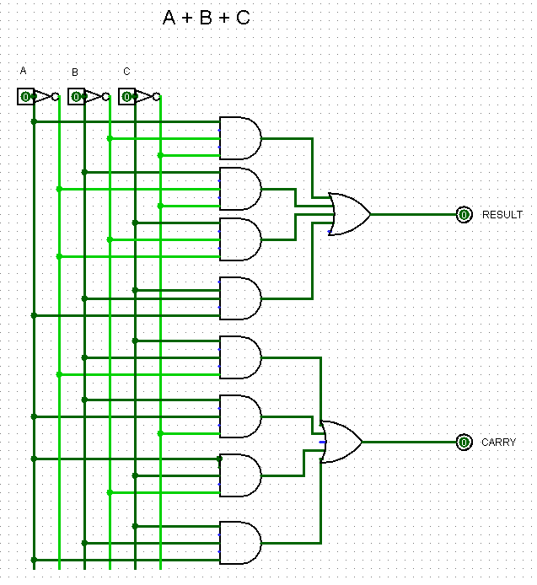
F.A. – Full Adder

Slide 11
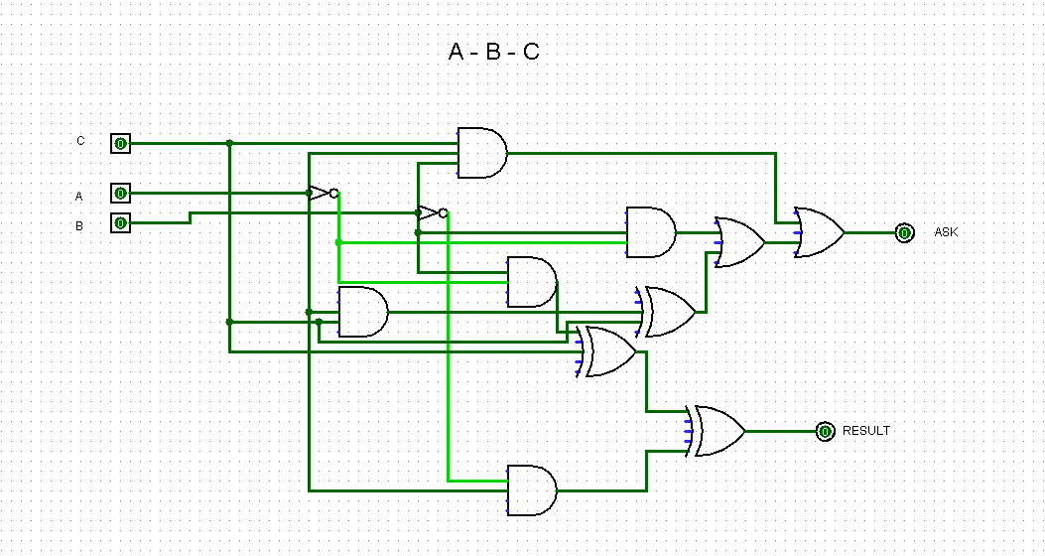
SUB - SUBTRACTOR

Slide 12
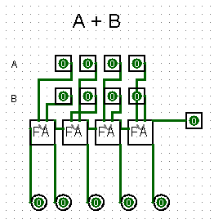
4 Bit ADDER

Slide 13
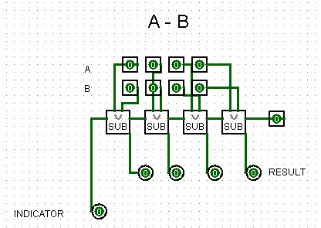
4 Bit SUBTRAСTOR

Slide 14


4 Bit MULTIPLIER

Slide 15
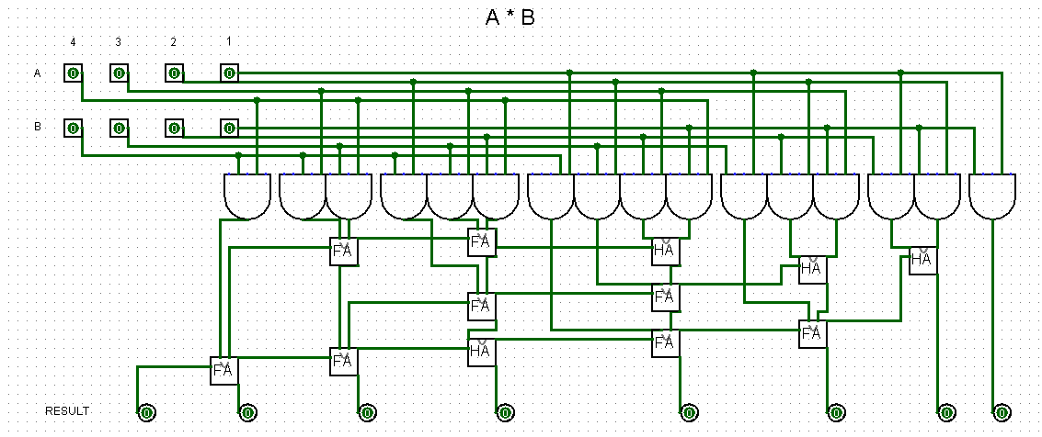
4 Bit MULTIPLIER

Slide 16
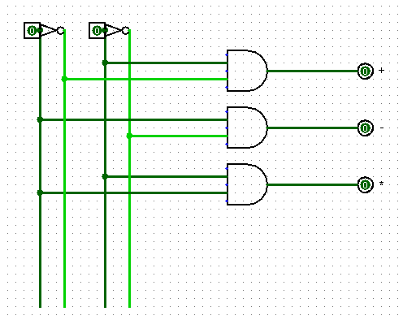
Controller

Slide 17

Why we don’t have division ?
Because there is enough division in our country

