Slide 1
Facial Expression Classification based on fer-2013
YUNZHE LI
GUANMING SHEN
ZHUJIAN MIAO

Slide 2
Outline
Define the problem
Model Introduction
Training process
Results and analysis
Learn and generalize

Slide 3
Define the problem

Slide 4

Facial Expression Classification

Slide 5
BACKGROUND
“Affection express = 7% language + 38% voice + 55% facial expression”
Facial emotion recognition algorithms are becoming increasingly powerful
Demands from marketing companies and social media Apps like Instagram
Human–computer interaction, production control, e-learning, fatigue driving detection, and emotional robot

Slide 6
General key steps
7 kinds of facial expression
Anger
Disgust
Fear
Happiness
Sadness
Surprise
Neural
Face detection
Face registration
Feature extraction
Feature classification

Slide 7

Challenges in Representation Learning:
Facial Expression Recognition Challenge from Kaggle.com
https://www.kaggle.com/c/challenges-in-representation-learning-facial-expression-recognition-challenge#description

Slide 8
FER-2013 dataset
based upon 48 by 48 pixel grayscale faces
7 different emotions
0=Angry, 1=Disgust, 2=Fear, 3=Happy, 4=Sad, 5=Surprise, 6=Neutral
Includes
28,709 Training examples
3,589 ”Public Test” examples
3,589 ”Private Test” data
Test Set
Training Set

Slide 9
Model Introduction

Slide 10
Things We’ve tried…
Some statistical learning algorithm | 2-Layers CNN architecture | 4-Layers CNN architecture
Currently working on… | 49% accuracy | 58% accuracy
 | Spend 2 hours to converge | Spend 8 hours to converge

Slide 11
Tools and Reference
Tools
Reference
Python
TensorFlow
Scikit-Learn
OpenCV
Shima Alizadeh and Azar Fazel, Convolutional Neural Networks for Facial Expression Recognition. arXiv:1704.06756v1 [cs.CV] 22 Apr 2017

Slide 12
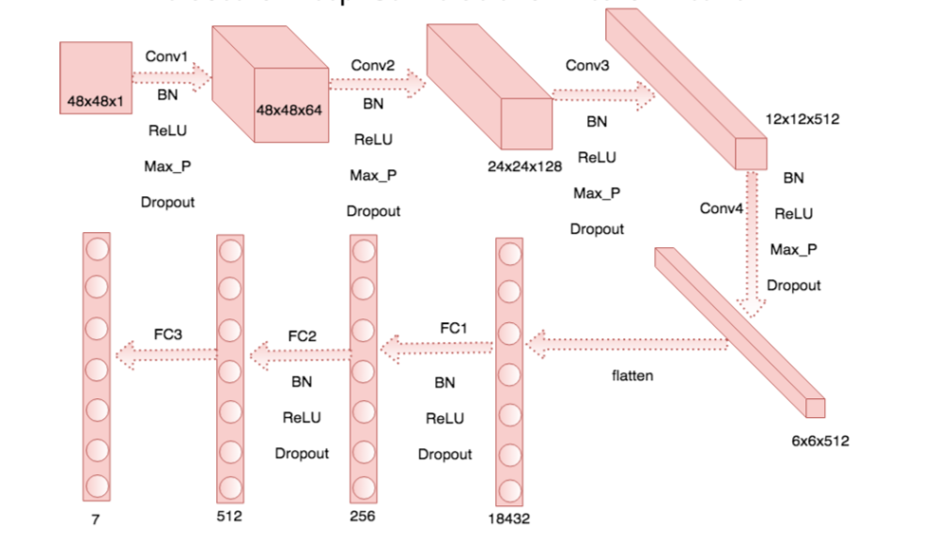
Architecture
Reference: arXiv:1704.06756v1 [cs.CV] 22 Apr 2017

Slide 13
Training process

Slide 14
Parameters
Loss function: softmax loss.
Optimizer: AdamOptimizer with learning rate = 0.001.
Run on the my laptop, dual core i5 CPU. Runtime: about 8 hours.
The batch size is 128. And the number of iteration is 7590. L2 regularization with lambda = 1e-7 for each layer.

Slide 15
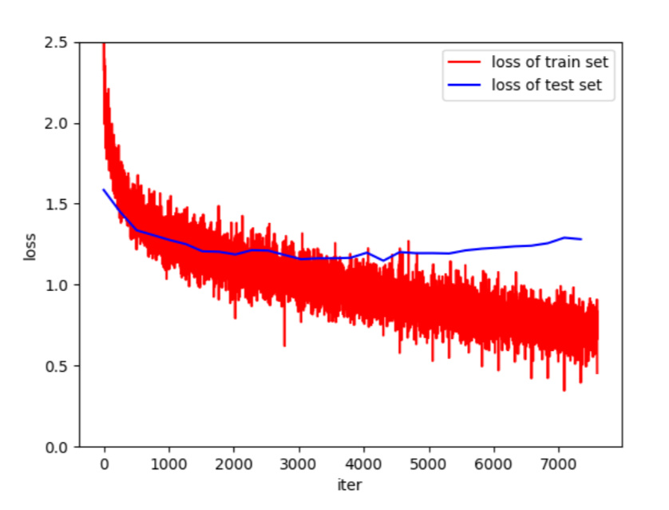
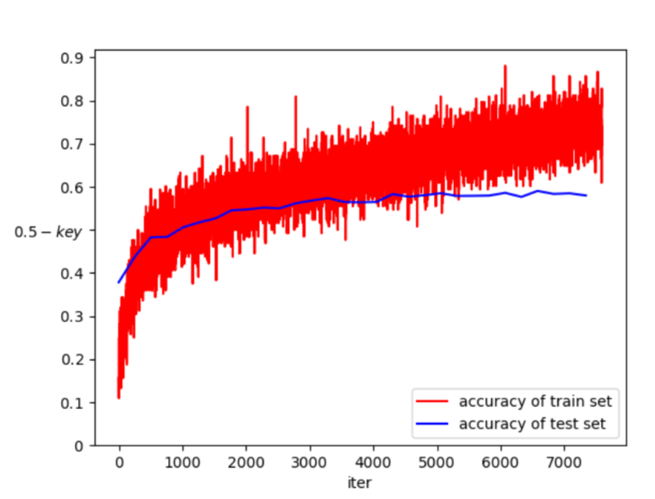
Loss
Accuracy

Slide 16
Results and analysis

Slide 17
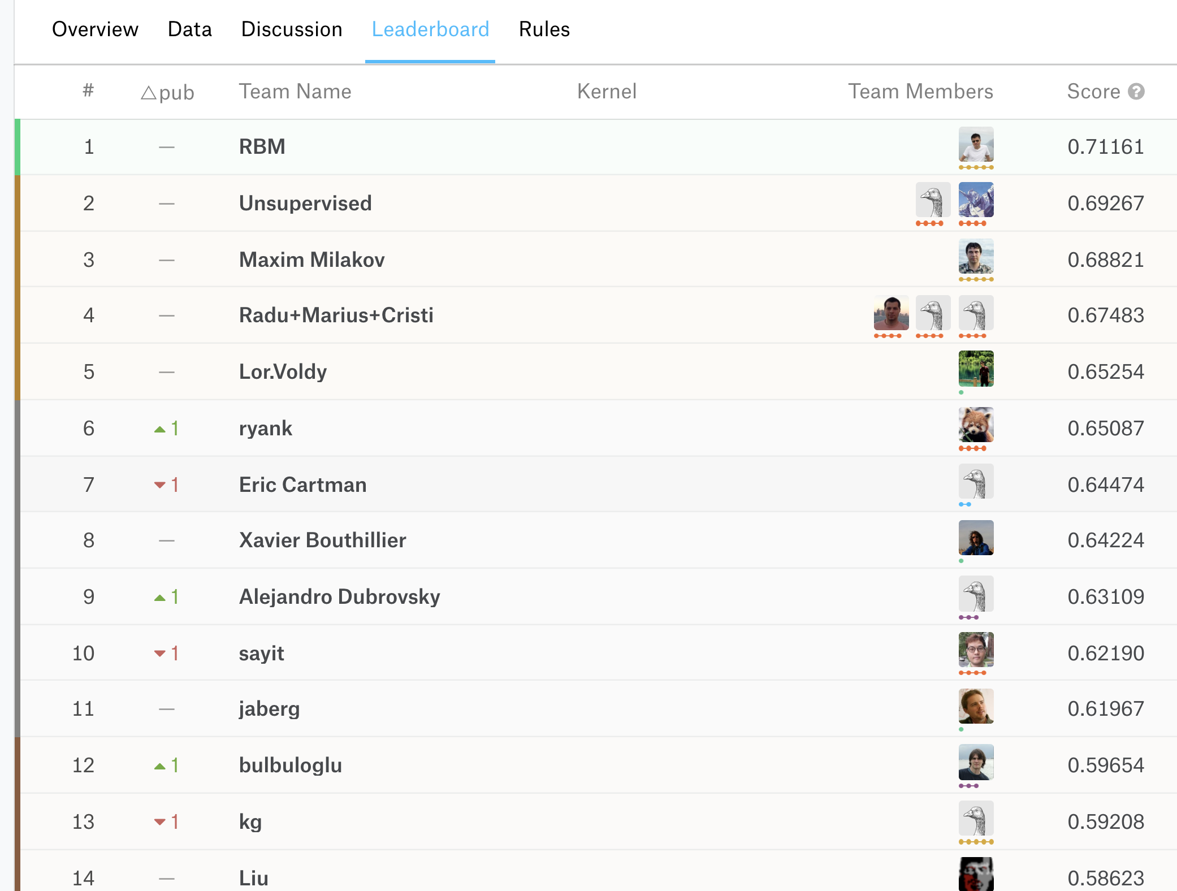
Test set accuracy
 | Accuracy | Number of face
Angry-0 | 0.48 | 491
Disgust-1 | 0.42 | 55
Fear-2 | 0.29 | 528
Happy-3 | 0.85 | 879
Sad-4 | 0.57 | 594
Surprise-5 | 0.68 | 416
Neutral-6 | 0.53 | 626
Total | 0.58 | 3589

Slide 18
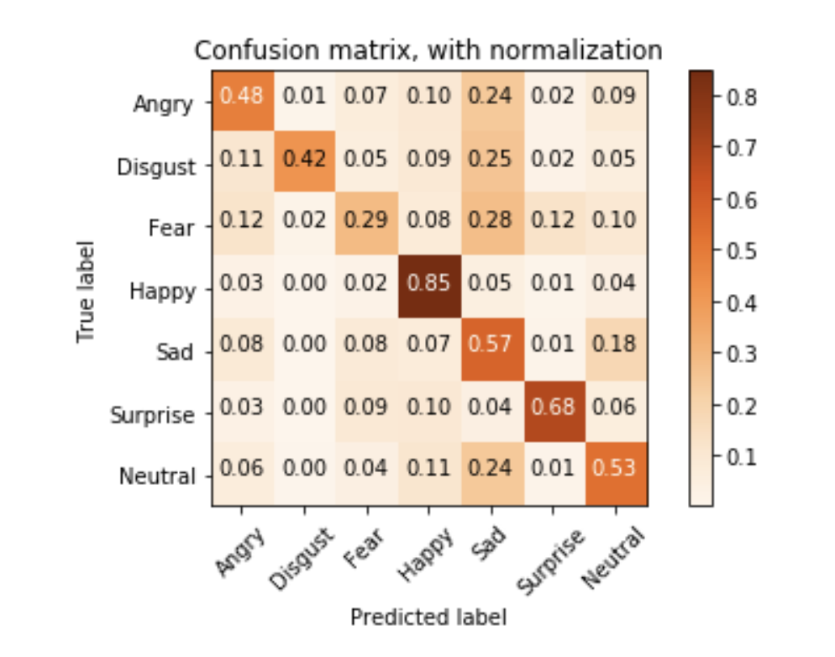
Confusion matrix

Slide 19
Learn and generalize

Slide 20
Face detection and cropping
Use the pre-built Haar Cascades algorithm model in OpenCV library
Set a minimum array for the detected bound to avoid wrong detection of faces
Return arrays of (x, y, w, h) and reshape the faces with them
Transfer arrays of faces to images and resize it to 48*48 pixels images

Slide 21
explanation of the detection model
Application of ‘Cascade of Classifiers’
Catch all features of an image and group them into different stages of classifiers and apply one by one
Check if a window is not a face region. If it is not, i.e. it fail the current stage, then discard it.
If it pass the current stage, then apply the next stage and process like this iteratively.
The window that passes all stages is a face region.

Slide 22
accuracy of the detection model
The classifier for face is already pre-trained in library
To avoid invalid detection of faces, we set a minimum array to filter patterns that are mistakenly detected as faces

Slide 23




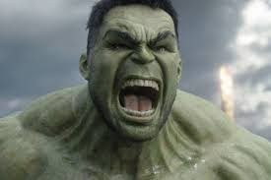









Test result
Happy
Angry
Happy
Neutral
Fear
Neutral
Sad
True
True
True
False
False
False
True

Slide 24
Thank you

