Slide 1
Big Data Federation
Coding Assignment
Guanming Shen
gshen3@ucsc.edu

Slide 2
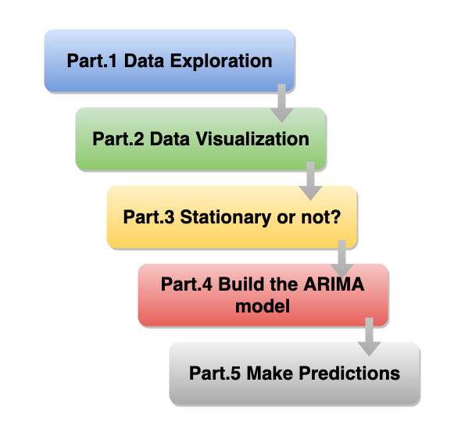

Slide 3
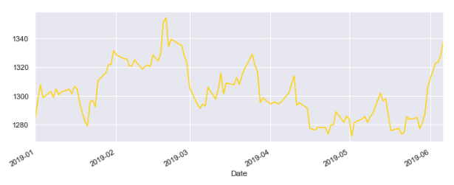
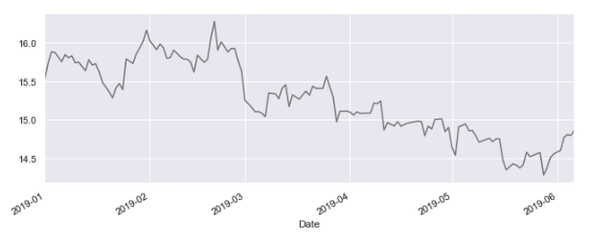
Property Summary
Price of both gold and silver data are NOT stationary.
Neither of them have obvious trend or obvious seasonality.
Both of them become stationary after first order differencing.

Slide 4
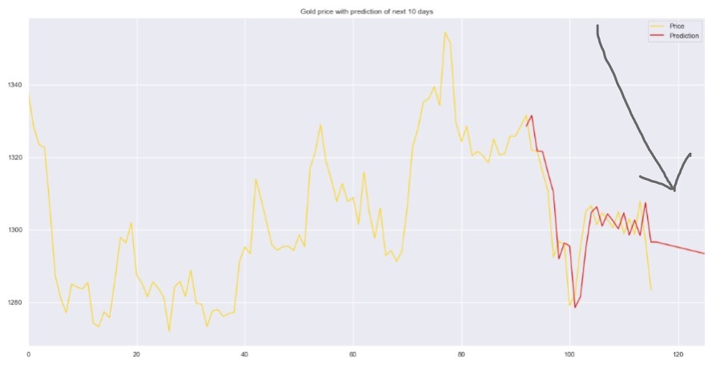
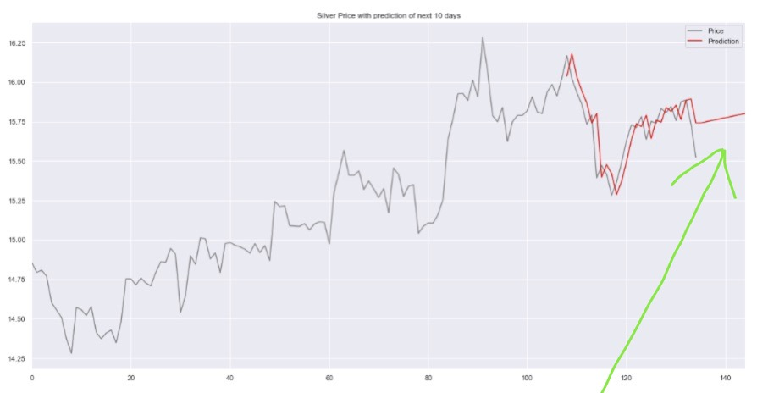
Conclusion
Firstly, given the fact that the data only covers the past 6 months, it’s almost impossible to analyze any seasonality or trend in a relatively longer period, since seasonality and trend are more usually analyzed in a dataset that has several years within it. In other words, the previous gold or silver prices are useful as predictors for their future prices, but not that kind of useful, let’s say, in a more quantitative way.
Secondly, past prices are useful in predicting the direction of changes (increase or decrease), but only for the prediction for a short period in the future.

Slide 5
Final Notes
The prediction result can always be further refined by constantly updating model parameters to get a better model or even applying other models like LSTM. However, the scope of the .ipynp file is to answer the questions of the assignment rather quantitatively. What’s more, the sole purpose of forecasting prices via ARIMA model is to help explain my answers in a much more specific and and visualized way.
Gold and silver prices can move in any direction which makes it very hard, if not impossible, to accurately predict them. Forecasted gold or silver prices are dependent on the assumptions imposed by ARIMA model which are based on auto regression, integrated and moving average concepts.
The simple example demonstrated in the jupyter notebook can be useful for forecasting movements of gold and silver prices in which past behaviour dictates present and values.

Slide 6
Please check the ipynb file for detailed analysis & explanation
Thank you

