Slide 1
NYC Taxi Data Project
Guanming Shen 1822018

Slide 2
Outline
Introduction
Data visualization
Data cleaning
Data extracting
Model training
Model testing
Result & conclusion

Slide 3
Introduction
The first goal of this project is to use the New York city yellow taxi dataset to explore the potential information leakage.
The second goal of this project is to build a prediction model based on the given dataset to predict trip duration within the rush hour time period (17:00:00 – 19:59:59).
The original dataset spans 8,713,831 taxi trips in June 2018. After being extracted, the data within the rush hours still has 1,547,759 taxi trip records.

Slide 4
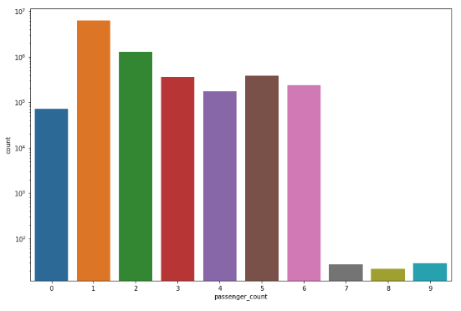
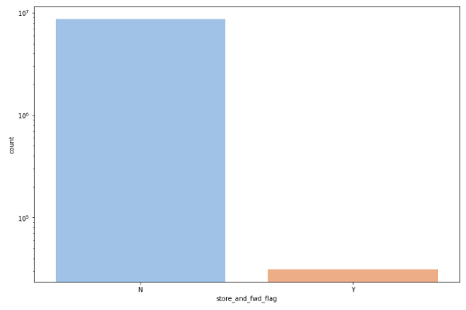
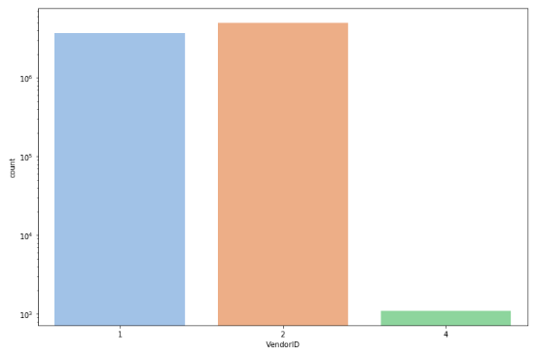
Data Visualization
We find:
There are some trip records with 0 or 7-9 passengers.
Most of the rides have only one single passengers while two passengers being the second most circumstances.
VeriFone (VendorID=2) has slightly more yellow taxi trip records than Creative Mobile Technologies (ID=1)
The vast majority of the trip records were immediately uploaded to the vendor while a very small amount of the records were stored and sent to the vendor afterwards.

Slide 5
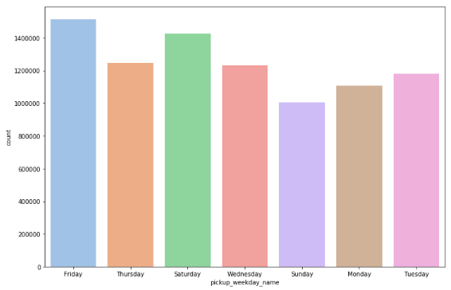
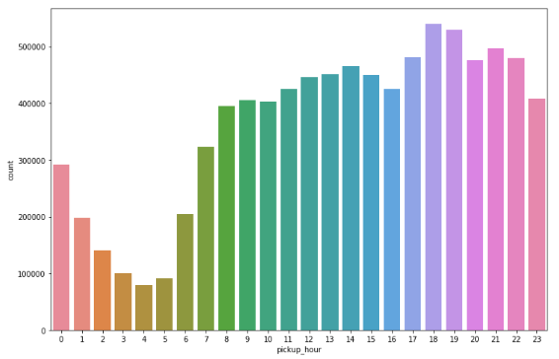
Data Visualization
We find:
The usage of the yellow cab reached its peak on Friday followed by Saturday in June 2018.
The picking up amount of the yellow cab reached its peak at 6 PM while the dropping off amount of the yellow cab reached its peak at 7 PM.

Slide 6
Data extraction & cleaning
Extract data within the rush hour period (from 17:00:00 to 19:59:59)
Extreme trip scenarios:
Trip duration > 22 hours
removed
Trip duration > 60 seconds, but trip distance = 0
removed
Trip duration = 0, but trip distance > 0
removed
Trip duration & trip distance both = 0
kept

Slide 7
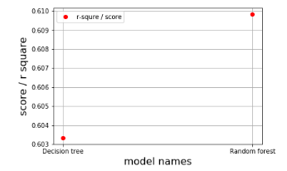
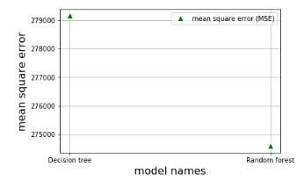
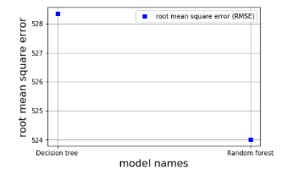
Model selection
Linear regression model
Score ranks 3rd
Decision tree model
Score ranks 2nd
Random forest model (final selection)
Score ranks 1st

Slide 8
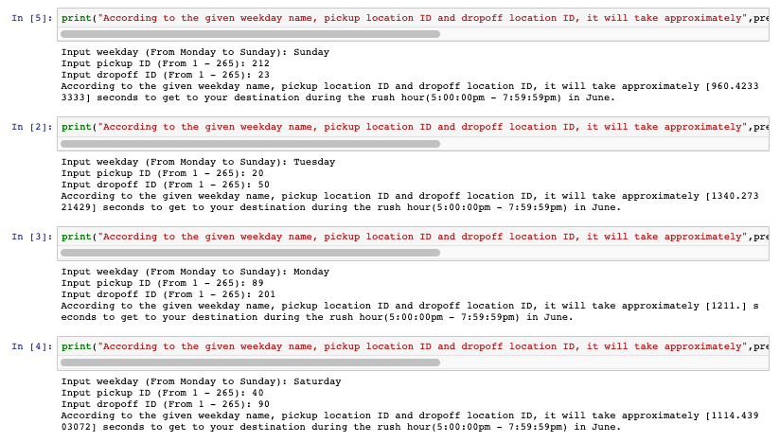
Model testing
Based on the prediction model that I built, now we can get the trip duration once given the weekday name, pick-up location ID and drop-off location ID.
The model achieves an accuracy of 66.47%.

Slide 9
Conclusion
Explored a very rich dataset of June 2018 constructed from TLC Trip Record Data (https://www1.nyc.gov/site/tlc/about/tlc-trip-record-data.page)
Found hidden information that lies within the large dataset
Built a rush hour trip duration prediction model based on the specific weekday, pickup location and destination
A heatmap of coordinates would be made if given longitude and latitude.
The prediction accuracy can be improved if given hardware with greater computing power.

