Slide 1
BIOMETRIC DOOR SECURITY SYSTEM

Slide 2
GUIDED BY: PRESENTED BY:
Prof. Pawan Kumar Gupta Anmol Sisodiya(0827IT151018)
Gursimran Sujlana(0827IT151038)
Mahak Verma(0827IT151058)

Slide 3
PROJECT PRESENTATION OUTLINE
Abstract
Introduction
Problem Statement
Survey of Existing Systems
Project Objectives
Use Case Diagram
Data Flow Diagram
Activity Diagram
Sequence Diagram
Conclusion
Limitations
Acknowledgement

Slide 4
ABSTRACT
A fingerprint unlock system uses fingerprint recognition system as a process of verifying the fingerprint image to open the electronic lock.
Verification is completed by comparing the data of authorized fingerprint image with incoming fingerprint image.
The incoming fingerprint image will first go through the extraction and filtering processes through which the information about it is obtained. Then the information of incoming fingerprint image will undergo the comparison process to compare it with authorized fingerprint image.
It will also open the lock via SMS which the lock will receive from mobile phones.

Slide 5
INTRODUCTION
Fingerprint-based identification is one of the most important biometric technologies which have drawn a substantial amount of attention recently.
Each human has unique owns fingerprint, even the twin have different fingerprint. So fingerprint recognition is useful in security law application.
The electronic lock using fingerprint recognition involves a process of verifying the user's identity by using fingerprint recognition as a key to the electronic lock.

Slide 6
PROBLEM STATEMENT
First step towards security was Lock and key system. Security protocol followed in this system was “Single key for a single lock”. Initially, this system was considered to provide utmost security but soon it proved by the fact that multiple keys of a single lock can easily made.
Another step towards security was security passwords that were used as an authenticating tool. In this a multiple set of numbers or alphabets is stored in the database for the purpose of authentication. This has a disadvantage that password can be hacked or acquired by unauthorized user by continuously trying all the possible combinations.

Slide 7
SURVEY OF EXISTING SYSTEM
i-Touchless Bio-Matric Fingerprint Door Lock
This fingerprint door lock can store upto 150 finger prints at a time and can add or delete users which is performed directly on the lock's pin pad.
But it is very costly and power cuts, battery discharge are common issues associated with these door locking systems.

Slide 8
PROJECT OBJECTIVES
The main objective of this project is to develop a secure locking system based on fingerprint scanning. In this project, microcontroller accompanied with an interface circuit has been used for opening and closing lock based on finger print which is stored in microcontroller itself so that only authorized person will access the security lock.

Slide 9
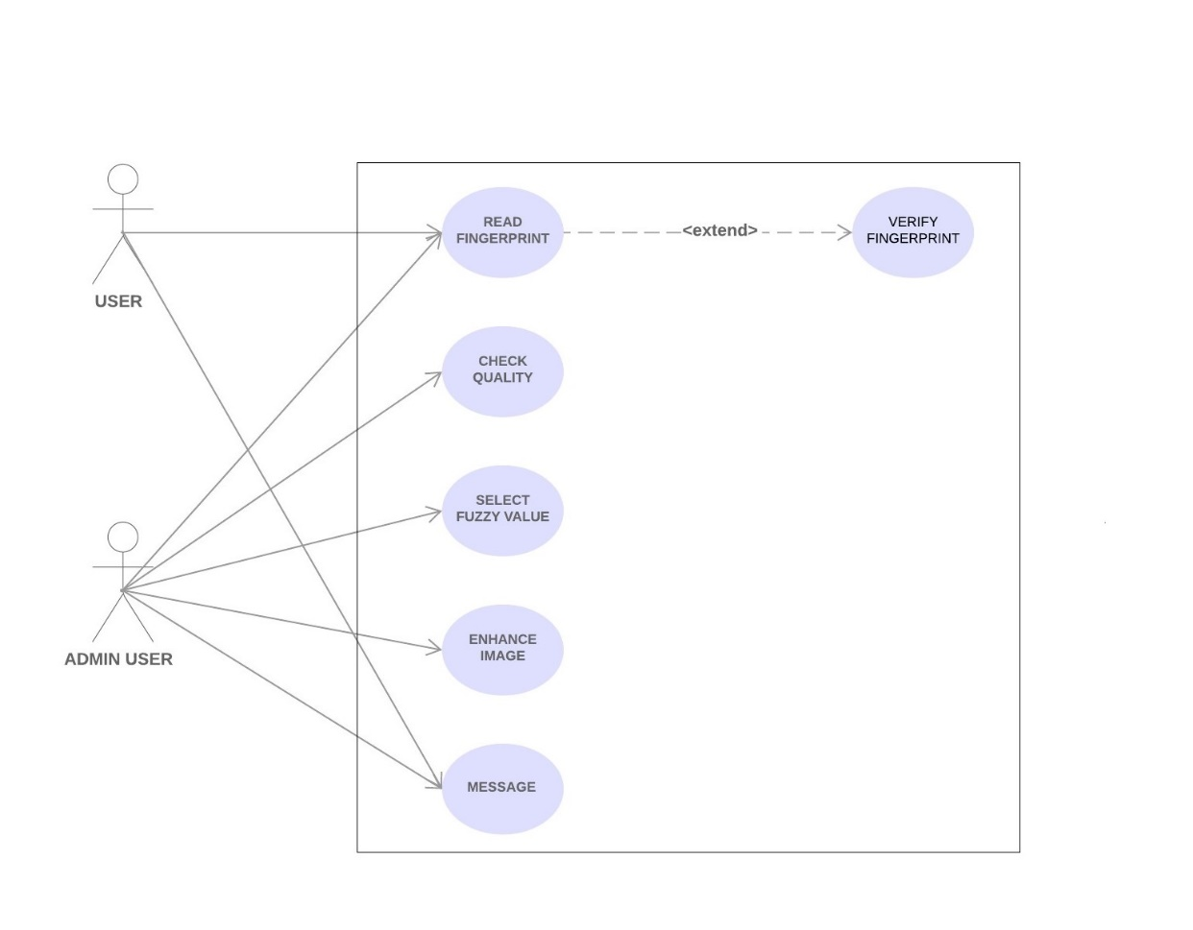
USE CASE DIAGRAM

Slide 10
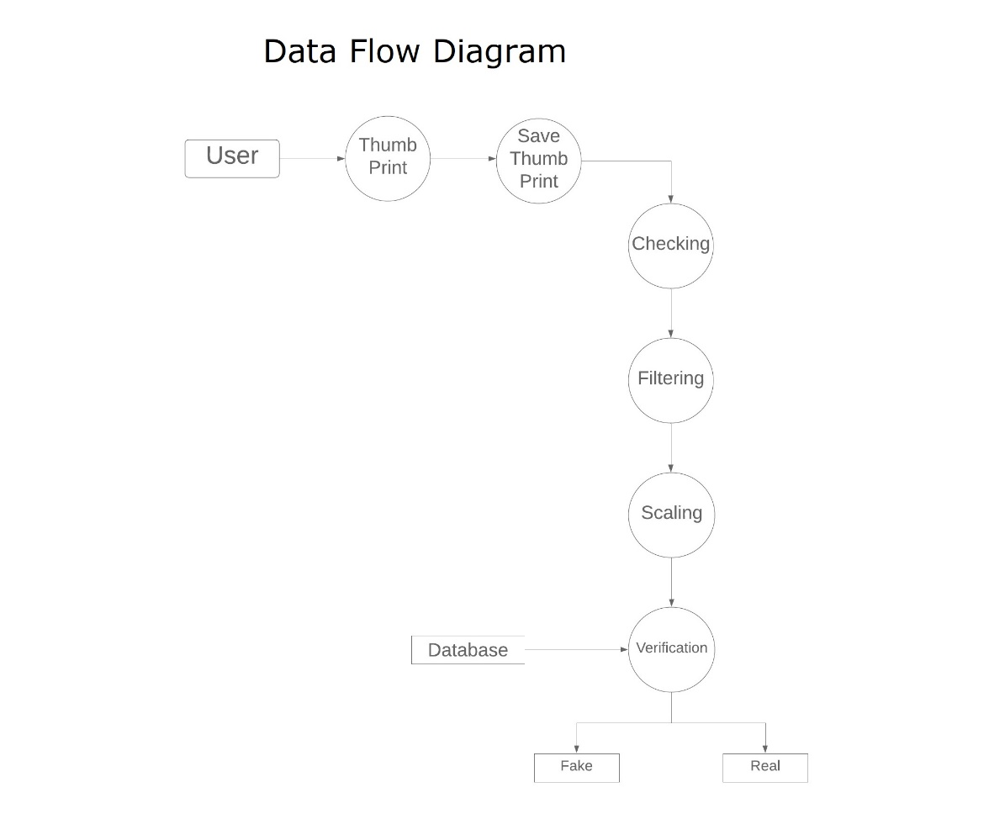
DATA FLOW DIAGRAM

Slide 11
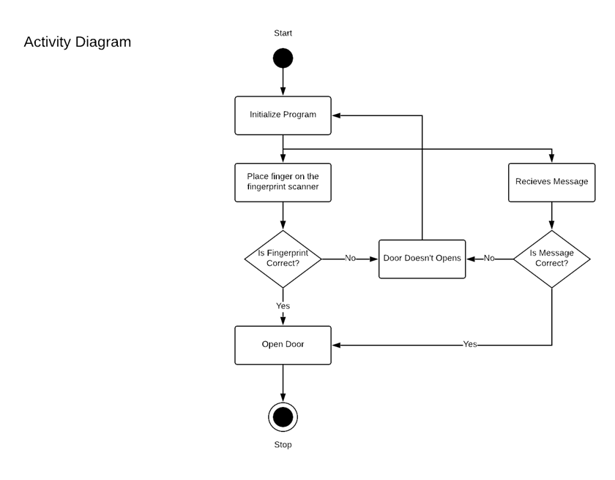

Slide 12
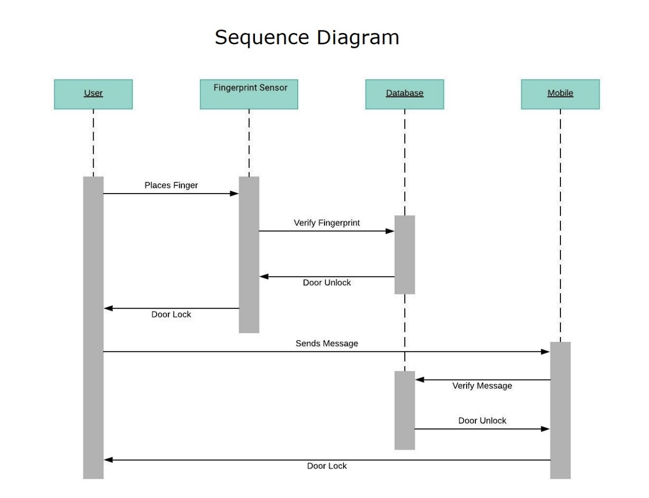
SEQUENCE DIAGRAM

Slide 13
CONCLUSION
Fingerprint identification enhances the security of a room and makes it possible only for some selected people to use the room.
Thus by implementing this relatively cheap and easily available system on a room, one can ensure much greater security and exclusivity than that offered by a conventional lock and key.
It can be deduced that the use of biometric security systems offers a much better and foolproof means of restricting the use of room by unauthorized users.

Slide 14
LIMITATIONS
Sometimes the scanner may refuse to recognize your finger in case of scarring or cuts or abrasions.
If someone does manage to create a copy/mold of your hand then the door can be opened.

Slide 15
ACKNOWLEDGEMENT
We like to thank our mentors for supporting us, guiding us and helping us in the completion of the project.

