Slide 1


Boot Camp
HTML Basics 2
23rd October, 2023
Prepared by:
Ass. Lecturer Patrick MUHOZA

Slide 2
Image Floating
Use the CSS float property to let the image float to the right or to the left of a text:
<!DOCTYPE html>
<html>
<body>
<p><strong>Float the image to the right:</strong></p>
<p>
<img src="smiley.gif" alt="Smiley face" style="float:right;width:42px;height:42px;">
A paragraph with a floating image. A paragraph with a floating image. A paragraph with a floating image.
</p>
<p><strong>Float the image to the left:</strong></p>
<p>
<img src="smiley.gif" alt="Smiley face" style="float:left;width:42px;height:42px;">
A paragraph with a floating image. A paragraph with a floating image. A paragraph with a floating image.
</p>
<p>Please use the CSS float property. The align attribute is deprecated in HTML 4, and not supported in HTML5.</p>
</body>
</html>

Slide 3
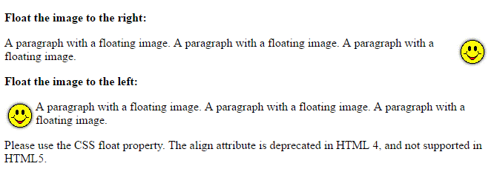
Output:

Slide 4
Image Maps
Use the <map> tag to define an image-map. An image-map is an image with clickable areas.
The name attribute of the <map> tag is associated with the <img>'s usemap attribute and creates a relationship between the image and the map.
The <map> tag contains a number of <area> tags, that defines the clickable areas in the image-map:

Slide 5
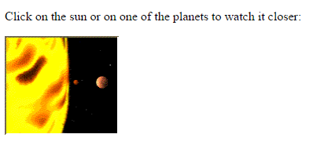
<!DOCTYPE html>
<html>
<body>
<p>Click on the sun or on one of the planets to watch it closer:</p>
<img src="planets.gif" alt="Planets" usemap="#planetmap" style="width:145px;height:126px;">
<map name="planetmap">
<area shape="rect" coords="0,0,82,126" alt="Sun" href="sun.htm">
<area shape="circle" coords="90,58,3" alt="Mercury" href="mercur.htm">
<area shape="circle" coords="124,58,8" alt="Venus" href="venus.htm">
</map>
</body>
</html>
Cont.
Output:

Slide 6
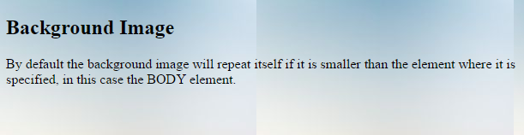
Background Image
To add a background image on an HTML element, use the CSS property background-image:
To add a background image on a web page, specify the background-image property on the BODY element:
<!DOCTYPE html>
<html>
<body style="background-image:url('skies.jpg')">
<h2>Background Image</h2>
<p>By default the background image will repeat itself if it is smaller than the element where it is specified, in this case the BODY element.</p>
</body>
</html>
Output:

Slide 7
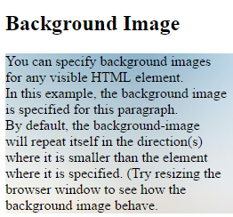
Cont.
To add a background image on a paragraph, specify the background-image property on the P element:
<!DOCTYPE html>
<html>
<body>
<h2>Background Image</h2>
<p style="background-image:url('skies.jpg')">
You can specify background images<br>
for any visible HTML element.<br>
In this example, the background image<br>
is specified for this paragraph.<br>
By default, the background-image<br>
will repeat itself in the direction(s)<br>
where it is smaller than the element<br>
where it is specified. (Try resizing the<br>
browser window to see how the<br>
background image behave.
</p>
</body>
</html>
Output:

Slide 8
The <picture> Element
HTML5 introduced the <picture> element to add more flexibility when specifying image resources.
The <picture> element contains a number of <source> elements, each referring to different image sources. This way the browser can choose the image that best fit the current view and/or device.
Each <source> element have attributes describing when their image is the most suitable.
The browser will use the first <source> element with matching attribute values, and ignore any following <source> elements.
Note: Always specify an <img> element as the last child element of the <picture> element. The <img> element is used by browsers that to not support the <picture> element, or if none of the <source> tags matched.

Slide 9
Cont.
<!DOCTYPE html>
<html>
<head>
<meta name="viewport" content="width=device-width, initial-scale=1.0">
</head>
<body>
<picture>
<source media="(min-width: 650px)" srcset="img_pink_flowers.jpg">
<source media="(min-width: 465px)" srcset="img_white_flower.jpg">
<img src="img_orange_flowers.jpg" alt="Flowers" style="width:auto;">
</picture>
<p>Resize the browser to see different versions of the picture loading at different viewport sizes.
The browser looks for the first source element where the media query matches the user's current viewport width,
and fetches the image specified in the srcset attribute.</p>
<p>The img element is required as the last child tag of the picture declaration block.
The img element is used to provide backward compatibility for browsers that do not support the picture element, or if none of the source tags matched.
</p>
<p><strong>Note:</strong> The picture element is not supported in IE12 and earlier or Safari 9.0 and earlier.</p>
</body>
</html>

Slide 10
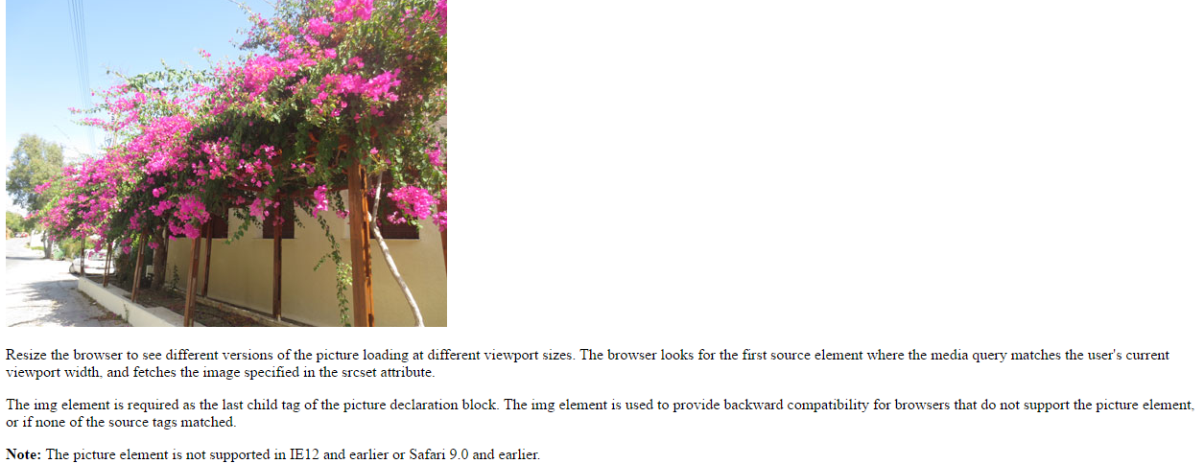
Output:

Slide 11
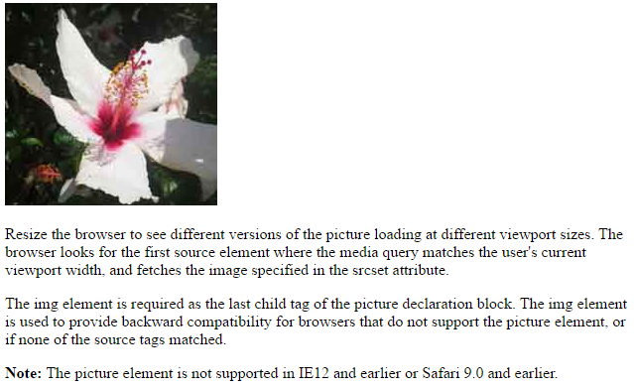
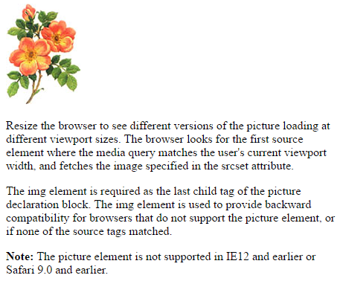
Cont.:

Slide 12
3. HTML Tables Defining an HTML Table
An HTML table is defined with the <table> tag.
Each table row is defined with the <tr> tag. A table header is defined with the <th> tag. By default, table headings are bold and centered. A table data/cell is defined with the <td> tag.
Note: The <td> elements are the data containers of the table. They can contain all sorts of HTML elements; text, images, lists, other tables, etc.

Slide 13
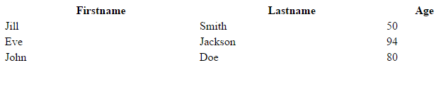
Cont.
<!DOCTYPE html>
<html>
<body>
<table style="width:100%">
<tr>
<th>Firstname</th>
<th>Lastname</th>
<th>Age</th>
</tr>
<tr>
<td>Jill</td>
<td>Smith</td>
<td>50</td>
</tr>
Output:

Slide 14
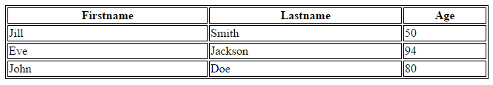
HTML Table - Adding a Border
Remember to define borders for both the table and the table cells.
<!DOCTYPE html>
<html>
<head>
<style>
table, th, td {
border: 1px solid black;
}
</style>
</head>
<body>
<table style="width:100%">
<tr>
<th>Firstname</th>
<th>Lastname</th>
<th>Age</th>
</tr>
<tr>
<td>Jill</td>
<td>Smith</td>
<td>50</td>
</tr>
<tr>
<td>Eve</td>
<td>Jackson</td>
<td>94</td>
</tr>
<tr>
<td>John</td>
<td>Doe</td>
<td>80</td>
</tr>
</table>
</body>
</html>
Output:

Slide 15
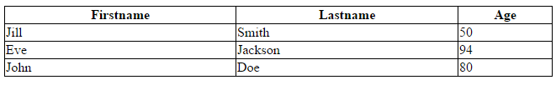
HTML Table - Collapsed Borders
If you want the borders to collapse into one border, add the CSS border-collapse property:
<!DOCTYPE html>
<html>
<head>
<style>
table, th, td {
border: 1px solid black;
border-collapse: collapse;
}
</style>
</head>
<body>
<table style="width:100%">
<tr>
<th>Firstname</th>
<th>Lastname</th>
<th>Age</th>
</tr>
<tr>
<td>Jill</td>
<td>Smith</td>
<td>50</td>
</tr>
<tr>
<td>Eve</td>
<td>Jackson</td>
<td>94</td>
</tr>
<tr>
<td>John</td>
<td>Doe</td>
<td>80</td>
</tr>
</table>
</body>
</html>
Output:

Slide 16
HTML Table - Adding Cell Padding
Cell padding specifies the space between the cell content and its borders.
If you do not specify a padding, the table cells will be displayed without padding.
To set the padding, use the CSS padding property:

Slide 17
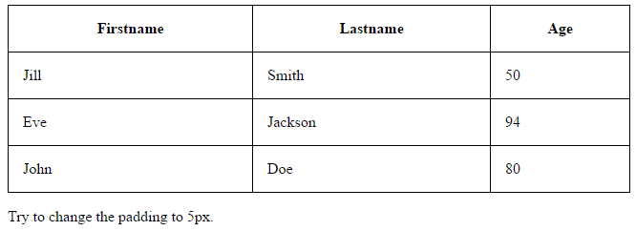
<!DOCTYPE html>
<html>
<head>
<style>
table, th, td {
border: 1px solid black;
border-collapse: collapse;
}
th, td {
padding: 15px;
}
</style>
</head>
<body>
<table style="width:100%">
<tr>
<th>Firstname</th>
<th>Lastname</th>
<th>Age</th>
</tr>
Cont.

Slide 18
HTML Table - Left-align Headings
By default, table headings are bold and centered.
To left-align the table headings, use the CSS text-align property:

Slide 19
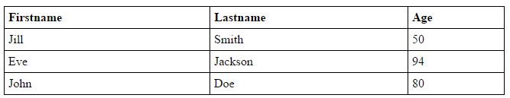
<body>
<table style="width:100%">
<tr>
<th>Firstname</th>
<th>Lastname</th>
<th>Age</th>
</tr>
<tr>
<td>Jill</td>
<td>Smith</td>
<td>50</td>
</tr>
<tr>
<td>Eve</td>
<td>Jackson</td>
<td>94</td>
</tr>
<tr>
<td>John</td>
<td>Doe</td>
<td>80</td>
</tr>
</table>
</body>
</html>
Cont.
<!DOCTYPE html>
<html>
<head>
<style>
table, th, td {
border: 1px solid black;
border-collapse: collapse;
}
th, td {
padding: 5px;
}
th {
text-align: left;
}
</style>
</head>
Output:

Slide 20
HTML Table - Adding Border Spacing
Border spacing specifies the space between the cells.
To set the border spacing for a table, use the CSS border-spacing property:
Note: If the table has collapsed borders, border-spacing has no effect.

Slide 21
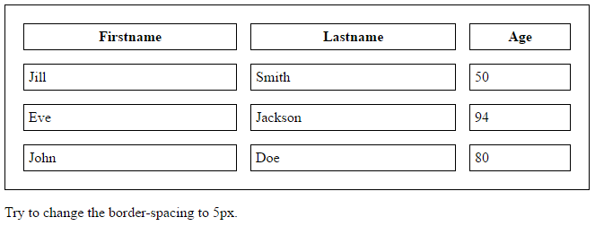
<tr>
<th>Firstname</th>
<th>Lastname</th>
<th>Age</th>
</tr>
<tr>
<td>Jill</td>
<td>Smith</td>
<td>50</td>
</tr>
<tr>
<td>Eve</td>
<td>Jackson</td>
<td>94</td>
</tr>
<tr>
<td>John</td>
<td>Doe</td>
<td>80</td>
</tr>
</table>
<p>Try to change the border-spacing to 5px.</p>
</body>
</html>
Cont.
<!DOCTYPE html>
<html>
<head>
<style>
table, th, td {
border: 1px solid black;
padding: 5px;
}
table {
border-spacing: 15px;
}
</style>
</head>
<body>
<table style="width:100%">
Output:

Slide 22
HTML Table - Cells that Span Many Columns
To make a cell span more than one column, use the colspan attribute:

Slide 23
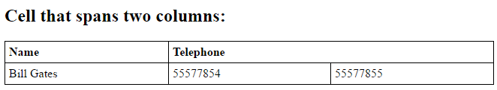
Cont.
<!DOCTYPE html>
<html>
<head>
<style>
table, th, td {
border: 1px solid black;
border-collapse: collapse;
}
th, td {
padding: 5px;
text-align: left;
}
</style>
</head>
<body>
<h2>Cell that spans two columns:</h2>
<table style="width:100%">
<tr>
<th>Name</th>
<th colspan="2">Telephone</th>
</tr>
<tr>
<td>Bill Gates</td>
<td>55577854</td>
<td>55577855</td>
</tr>
</table>
</body>
</html>
Output:

Slide 24
HTML Table - Cells that Span Many Rows
To make a cell span more than one row, use the rowspan attribute:

Slide 25
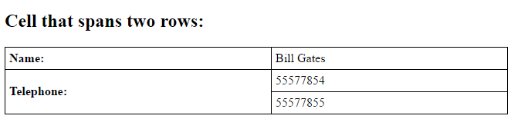
Cont.
<!DOCTYPE html>
<html>
<head>
<style>
table, th, td {
border: 1px solid black;
border-collapse: collapse;
}
th, td {
padding: 5px;
text-align: left;
}
</style>
</head>
<body>
<h2>Cell that spans two rows:</h2>
<table style="width:100%">
<tr>
<th>Name:</th>
<td>Bill Gates</td>
</tr>
<tr>
<th rowspan="2">Telephone:</th>
<td>55577854</td>
</tr>
<tr>
<td>55577855</td>
</tr>
</table>
</body>
</html>
Output:

Slide 26
HTML Table - Adding a Caption
To add a caption to a table, use the <caption> tag:
Note: The <caption> tag must be inserted immediately after the <table> tag.

Slide 27
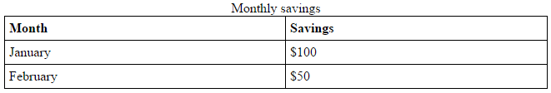
Cont.
<!DOCTYPE html>
<html>
<head>
<style>
table, th, td {
border: 1px solid black;
border-collapse: collapse;
}
th, td {
padding: 5px;
text-align: left;
}
</style>
</head>
<body>
<table style="width:100%">
<caption>Monthly savings</caption>
<tr>
<th>Month</th>
<th>Savings</th>
</tr>
<tr>
<td>January</td>
<td>$100</td>
</tr>
<tr>
<td>February</td>
<td>$50</td>
</tr>
</table>
</body>
</html>
Output:

Slide 28
A Special Style for One Table
To define a special style for a special table, add an id attribute to the table:
<table id="t01"> <tr> <th>Firstname</th> <th>Lastname</th> <th>Age</th> </tr> <tr> <td>Eve</td> <td>Jackson</td> <td>94</td> </tr> </table>

Slide 29
Cont.
<!DOCTYPE html>
<html>
<head>
<style>
table, th, td {
border: 1px solid black;
border-collapse: collapse;
}
th, td {
padding: 5px;
text-align: left;
}
table#t01 {
width: 100%;
background-color: #f1f1c1;
}
</style>
</head>
<body>
<table style="width:100%">
<tr>
<th>Firstname</th>
<th>Lastname</th>
<th>Age</th>
</tr>
<tr>
<td>Jill</td>
<td>Smith</td>
<td>50</td>
</tr>
<tr>
<td>Eve</td>
<td>Jackson</td>
<td>94</td>
</tr>
<tr>
<td>John</td>
<td>Doe</td>
<td>80</td>
</tr>
</table>
<br>
<table id="t01">
<tr>
<th>Firstname</th>
<th>Lastname</th>
<th>Age</th>
</tr>
<tr>
<td>Jill</td>
<td>Smith</td>
<td>50</td>
</tr>
<tr>
<td>Eve</td>
<td>Jackson</td>
<td>94</td>
</tr>
<tr>
<td>John</td>
<td>Doe</td>
<td>80</td>
</tr>
</table>
</body>
</html>

Slide 30
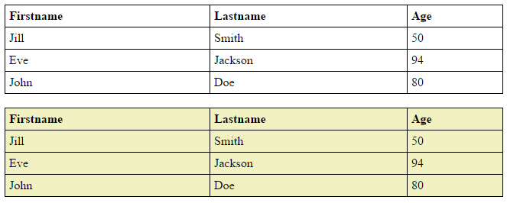
Output:

Slide 31
Add more styles:
<!DOCTYPE html>
<html>
<head>
<style>
table {
width:100%;
}
table, th, td {
border: 1px solid black;
border-collapse: collapse;
}
th, td {
padding: 5px;
text-align: left;
}
table#t01 tr:nth-child(even) {
background-color: #eee;
}
table#t01 tr:nth-child(odd) {
background-color:#fff;
}
table#t01 th {
background-color: black;
color: white;
}
</style>
</head>
<body>
<table>
<tr>
<th>Firstname</th>
<th>Lastname</th>
<th>Age</th>
</tr>
<tr>
<td>Jill</td>
<td>Smith</td>
<td>50</td>
</tr>
<tr>
<td>Eve</td>
<td>Jackson</td>
<td>94</td>
</tr>
<tr>
<td>John</td>
<td>Doe</td>
<td>80</td>
</tr>
</table>
<br>
<table id="t01">
<tr>
<th>Firstname</th>
<th>Lastname</th>
<th>Age</th>
</tr>
<tr>
<td>Jill</td>
<td>Smith</td>
<td>50</td>
</tr>
<tr>
<td>Eve</td>
<td>Jackson</td>
<td>94</td>
</tr>
<tr>
<td>John</td>
<td>Doe</td>
<td>80</td>
</tr>
</table>
</body>
</html>

Slide 32
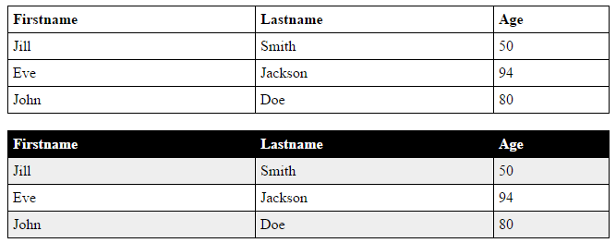
Output:

Slide 33
4. HTML Lists Unordered HTML List
An unordered list starts with the <ul> tag. Each list item starts with the <li> tag.
The list items will be marked with bullets (small black circles) by default:

Slide 34
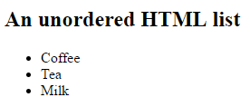
Cont.
<!DOCTYPE html>
<html>
<body>
<h2>An unordered HTML list</h2>
<ul>
<li>Coffee</li>
<li>Tea</li>
<li>Milk</li>
</ul>
</body>
</html>
Output:

Slide 35
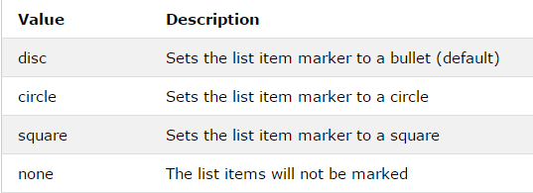
Unordered HTML List - Choose List Item Marker
he CSS list-style-type property is used to define the style of the list item marker:

Slide 36
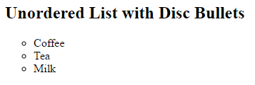
Cont.
<!DOCTYPE html>
<html>
<body>
<h2>Unordered List with circle</h2>
<ul style="list-style-type:circle">
<li>Coffee</li>
<li>Tea</li>
<li>Milk</li>
</ul>
</body>
</html>
Output:

Slide 37
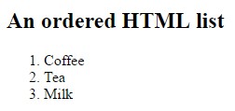
Ordered HTML List
Output:
An ordered list starts with the <ol> tag. Each list item starts with the <li> tag.
The list items will be marked with numbers by default:
<!DOCTYPE html>
<html>
<body>
<h2>An ordered HTML list</h2>
<ol>
<li>Coffee</li>
<li>Tea</li>
<li>Milk</li>
</ol>
</body>
</html>

Slide 38
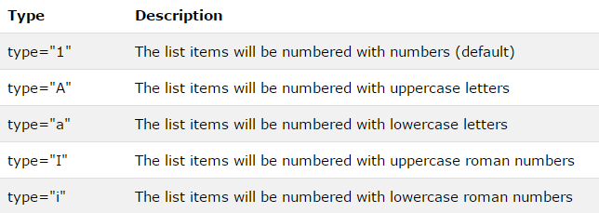
Ordered HTML List - The Type Attribute
The type attribute of the <ol> tag, defines the type of the list item marker:

Slide 39
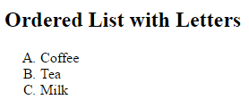
Cont.…
<!DOCTYPE html>
<html>
<body>
<h2>Ordered List with Letters</h2>
<ol type="A">
<li>Coffee</li>
<li>Tea</li>
<li>Milk</li>
</ol>
</body>
</html>
Output:

Slide 40
HTML Description Lists
HTML also supports description lists.
A description list is a list of terms, with a description of each term.
The <dl> tag defines the description list, the <dt> tag defines the term (name), and the <dd> tag describes each term:

Slide 41
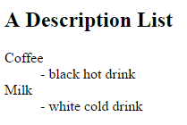
Cont.…
<!DOCTYPE html>
<html>
<body>
<h2>A Description List</h2>
<dl>
<dt>Coffee</dt>
<dd>- black hot drink</dd>
<dt>Milk</dt>
<dd>- white cold drink</dd>
</dl>
</body>
</html>
Output:

Slide 42
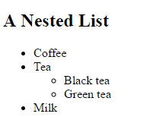
Nested HTML Lists
List can be nested (lists inside lists):
Note: List items can contain new list, and other HTML elements, like images and links, etc.
<!DOCTYPE html>
<html>
<body>
<h2>A Nested List</h2>
<ul>
<li>Coffee</li>
<li>Tea
<ul>
<li>Black tea</li>
<li>Green tea</li>
</ul>
</li>
<li>Milk</li>
</ul>
</body>
</html>
Output:

Slide 43

Horizontal Lists
HTML lists can be styled in many different ways with CSS.
One popular way is to style a list horizontally, to create a menu:
<!DOCTYPE html>
<html>
<head>
<style>
ul {
list-style-type: none;
margin: 0;
padding: 0;
overflow: hidden;
background-color: #333333;
}
li {
float: left;
}
li a {
display: block;
color: white;
text-align: center;
padding: 16px;
text-decoration: none;
}
li a:hover {
background-color: #111111;
}
</style>
</head>
<body>
<ul>
<li><a href="#home">Home</a></li>
<li><a href="#news">News</a></li>
<li><a href="#contact">Contact</a></li>
<li><a href="#about">About</a></li>
</ul>
</body>
</html>
Output:

Slide 44
End ^_^ ..

