Slide 1
Optimisation and Guess-then-Solver Attacks in Cryptanalysis
Guangyan Song
Oct 2015
Transfer viva

Slide 2
Problem Statement
Explore how (or develop own) software and tool can be used in the field of automated cryptanalysis
especially SAT solvers in algebraic attacks.
Study GOST, SIMON and Semaev cipher, discover properties which will lead to more efficient attacks
Study elliptic curves with special properties, work on attacks and implementation improvements
Recover private keys in bitcoin [18,000], improve on UCL competition outcomes and DEFCON.

Slide 3
Algebraic Cryptanalysis
“Breaking a good cipher should require as much work as solving a system of simultaneous equations in a large number of unknowns of a complex type”
-Claude Elwood Shannon, 1949
Modelling
Courtois-Bard-Jefferson method
Solving
XL, XSL, Gröbner basis algorithm
SAT solver, Elimlin, etc
Low data complexity
Normally works for small number of rounds

Slide 4
Targets to study
Neal Koblitz:
“The Uneasy Relationship Between Mathematics and Cryptography”, In Notices of the American Mathematical Society, September 2007, see www.ams.org
[...] in the real world if your cryptography fails, you lose a million dollars or your secret agent gets killed.
In academia, if you write about a cryptosystem and then a few months later find a way to break it, you’ve got two new papers to add to your résumé![...]

Slide 5
Targets to Study
Low diffusion
Low Multiplicative Complexity (MC)
Low I/O degree
Block cipher topology
(Potential) Government standards
We hope to contribute to future government crypto standards

Slide 6
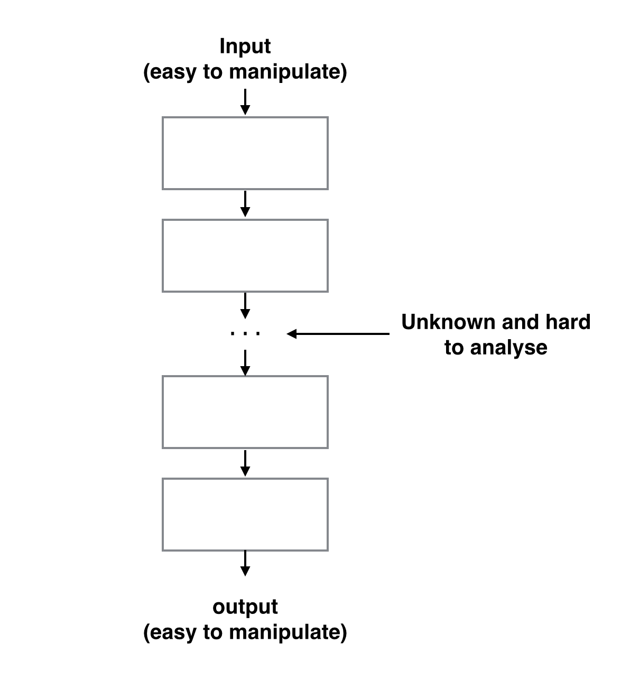
Block Cipher
Read & write access to inputs and outputs
Variables in the middle are unknown and hard to analyse
* oral side:Block cipher is difficult

Slide 7
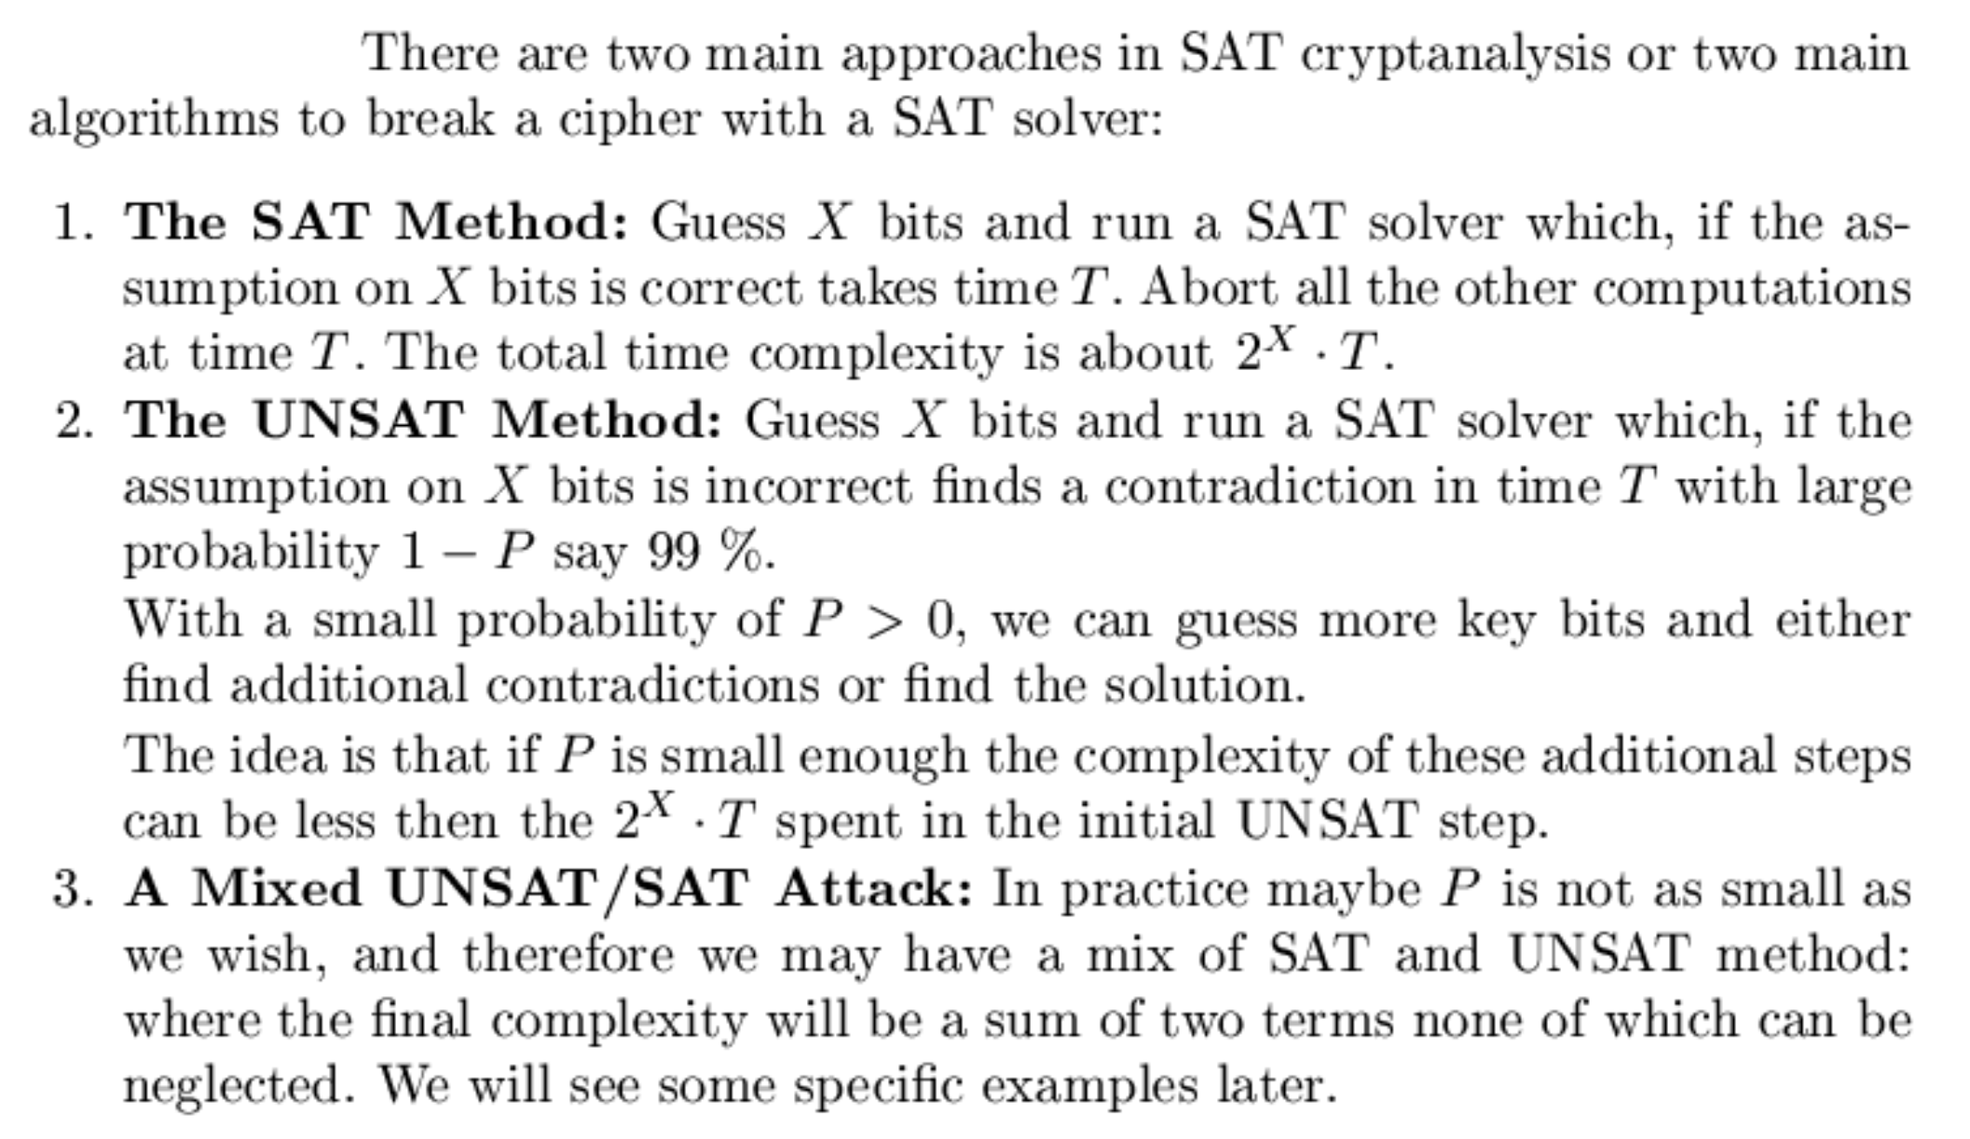
Contradiction Immunity

Slide 8
GOST
The Official Encryption Standard of Russian Federation.
Developed in the 1970s, or the 1980s,
First "Top Secret" algorithm.
Downgraded to "Secret" in 1990
Declassified in 1994
Submitted to ISO in 2010

Slide 9
Analysis of GOST
It was analysed by Schneier, Biham, Biryukov, Dunkelman, Wagner, Pieprzyk, Gabidulin,...
Nobody found an attack...
Nicolas Courtois, All about GOST slides
http://www.nicolascourtois.com/papers/GOST.pdf

Slide 10


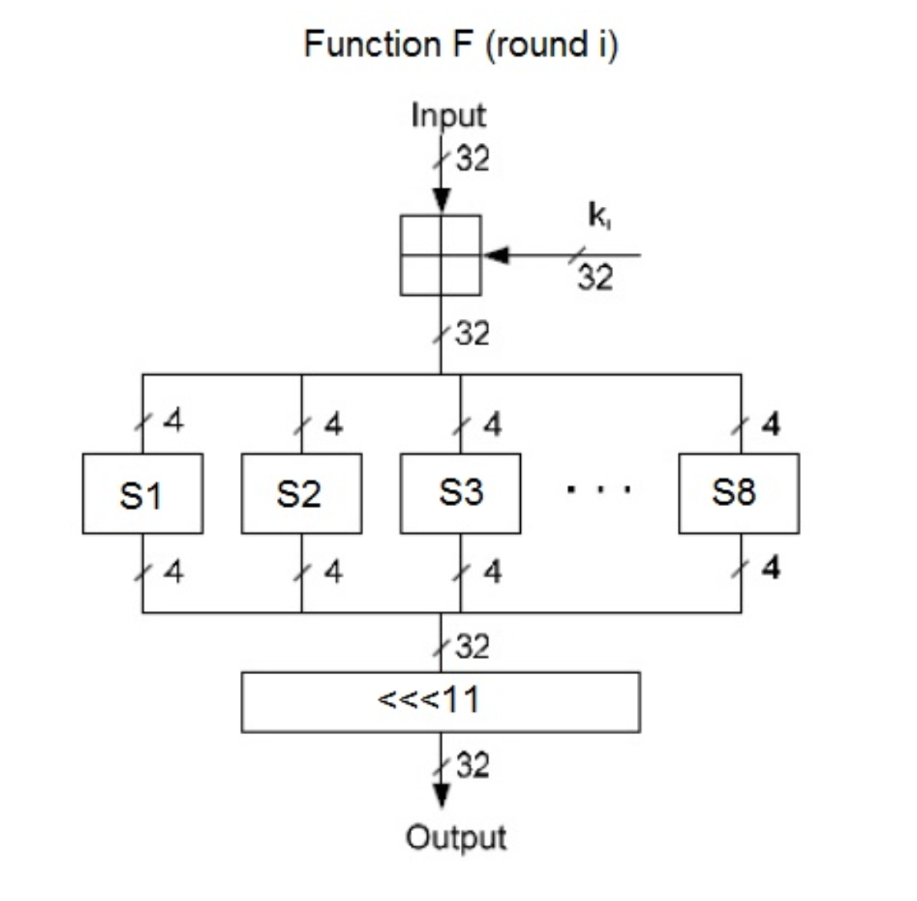
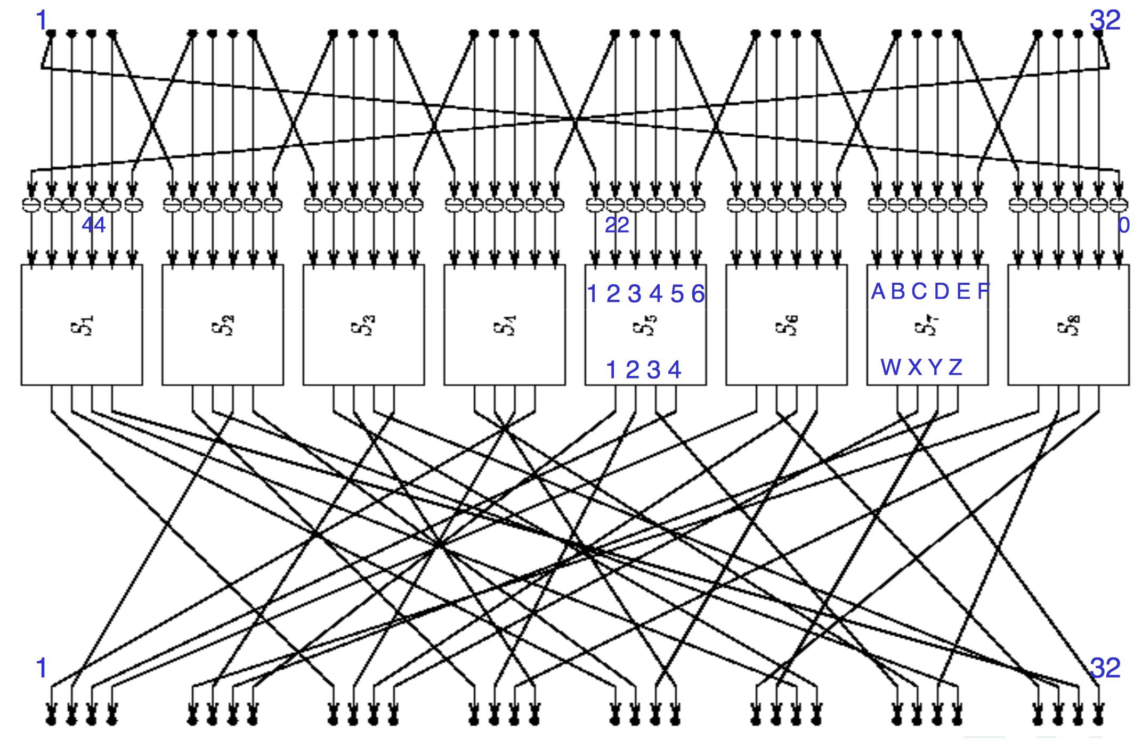
Low Diffusion
Diffusion: Each digit of the plaintext and each digit of the secret key should influence many digits of the ciphertext.

Slide 11
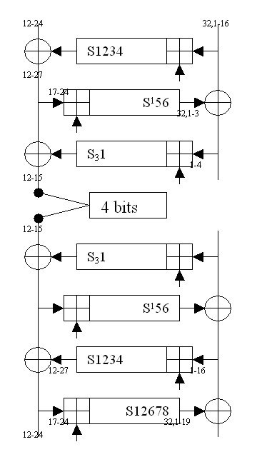
Our Attack on 8R GOST
Guess-then-determine attack
Which bits to guess?
UNSAT approach:
68 bits with probability 39%
78 bits with probability 50%
SAT approach
Guess 68 bits, solved all other bits in 400s on one laptop i7 CPU (with cryptominisat)
Leads to attacks on full 32R GOST
GOAL: automate this DISCOVERY process!

Slide 12
SIMON
Introduced by NSA in 2013
Lighted weighted cipher family designed for IoTs, mobile phone, etc
No security analysis in the spec
Our work focused on Simon 64/128 version

Slide 13
SIMON
“It's always fascinating to study NSA-designed ciphers .… And I enjoyed the discussion of requirements. Missing, of course, is any cryptanalytic analysis.
….Why was the work done, and why is it being made public? I'm curious.”
-Bruce Schneier, 1st July 2013
Then 2 papers published in FSE 2014 using differential cryptanalysis
After that many other researchers have studied the cipher…
Still safe until now
Submitted to ISO
Future NIST/NSA standard？

Slide 14
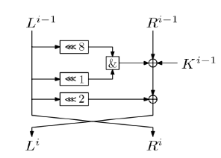
Structure of SIMON 64/128
128 bits key
44 rounds
1*32 multiplication
Low diffusion

Slide 15
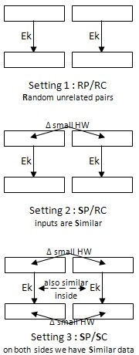
Our Approach
Combined algebraic and differential cryptanalysis
From known text attack to chosen text attack
Select P/C pairs which have low hamming distances

Slide 16
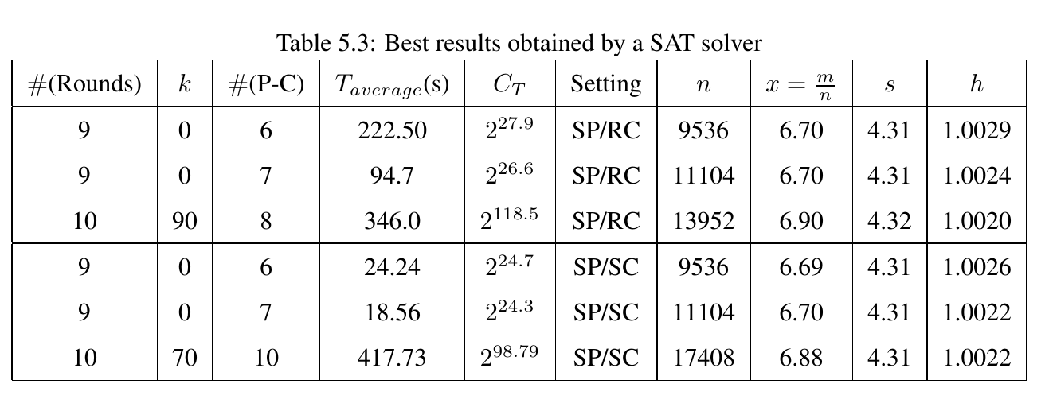
Results
Break 10/44 rounds
Break 9 rounds without guessing any key

Slide 17
Discussions
“SIMON and SPECK should not even be reviewed by anyone in the community, because it dignifies [the designs] and wastes the cycles – the brain cycles – of intelligent people, by going to look at a thing that is produced by a bad actor agency [(the NSA)].”
- Jacob Appelbaum, FSE 2015 invited talk
We stand the opposite: We believe it is important for the community to study
SIMON especially if it becomes a government standard in the future.
Our papers have been cited by new NSA paper and we also received emails
from NSA…

Slide 18
Elliptic Curve Cryptography
Public key cryptosystem
Widely used
Recommended by NIST, NSA suite B, ISO, and many others
Suite B recently not recommended any more?
Security relies on the hardness of solving ECDLP, well almost (OK for attacks, not OK for security proofs).

Slide 19
Summation Polynomials
Introduced by Semaev in 2004
new idea try to solve ECDLP
Studied by other researchers
Faug’ere et al (2014), Huang and Petit (2014), etc
New method published by Semaev in 2015
Solving the problem by introducing new variables
For binary elliptic curves
Main result claimed wrong by the community[UCL talk by Kosters]… but raised interesting questions!

Slide 20
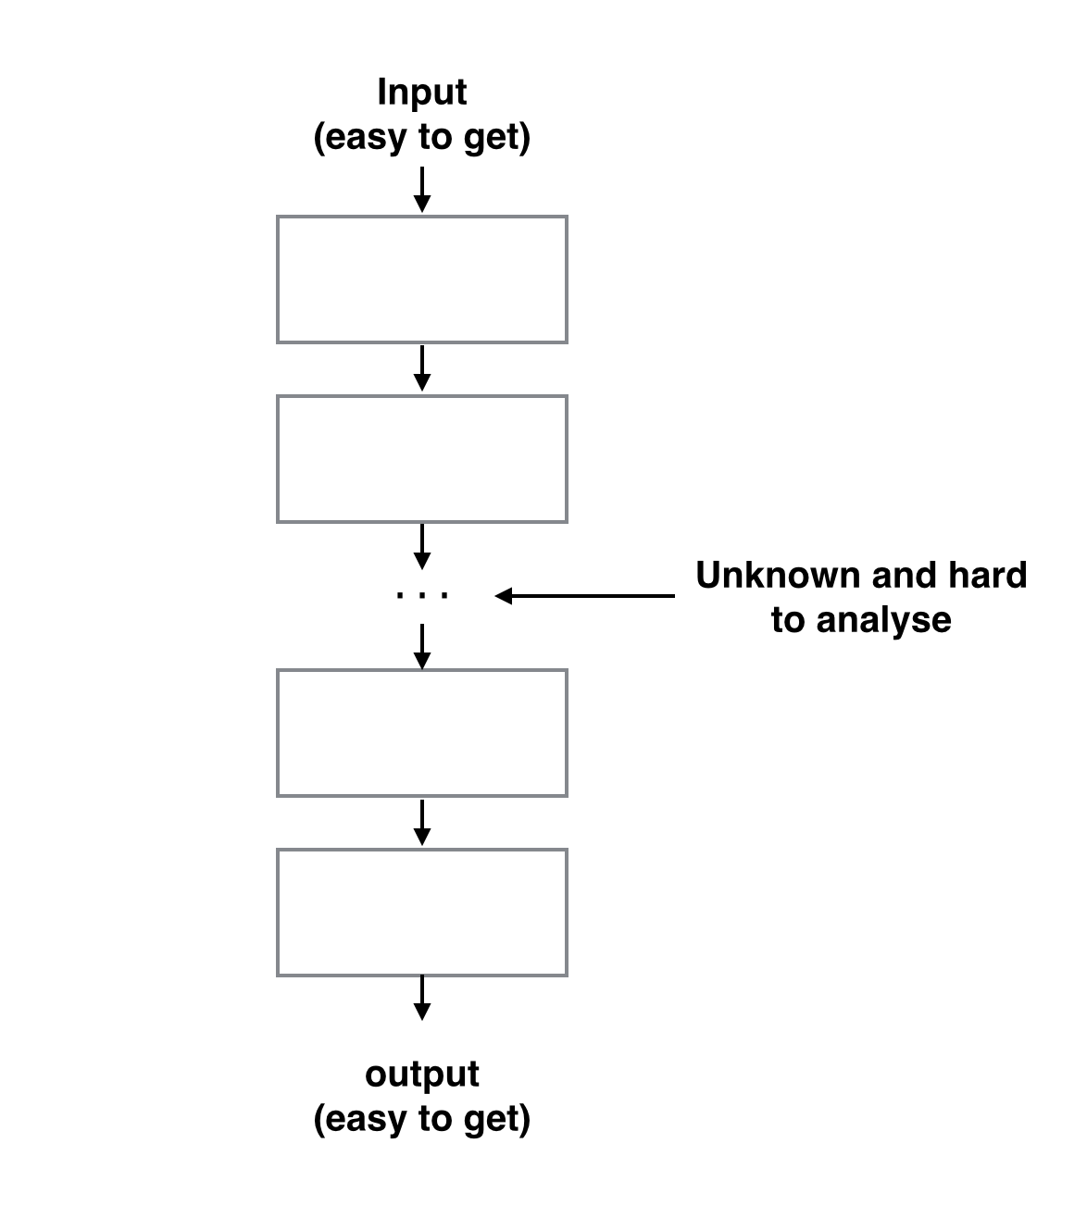
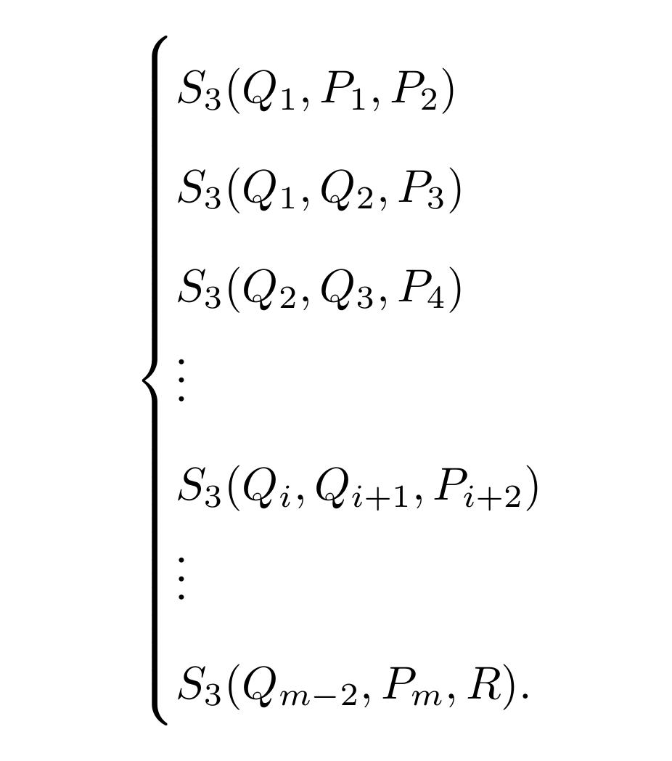
Semaev Block Cipher!! Solving By AC?

Slide 21

Bitcoin
Electronic money, secured with cryptography
Decentralised system based on p2p network
Transaction history is public and pseudonymous, signed with digital signature
Control of private key = control of the money!

Slide 22
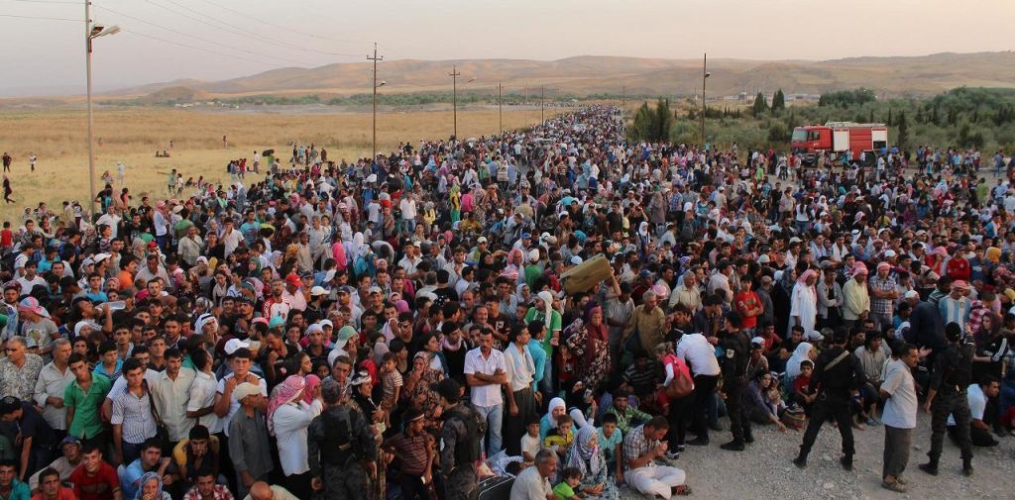

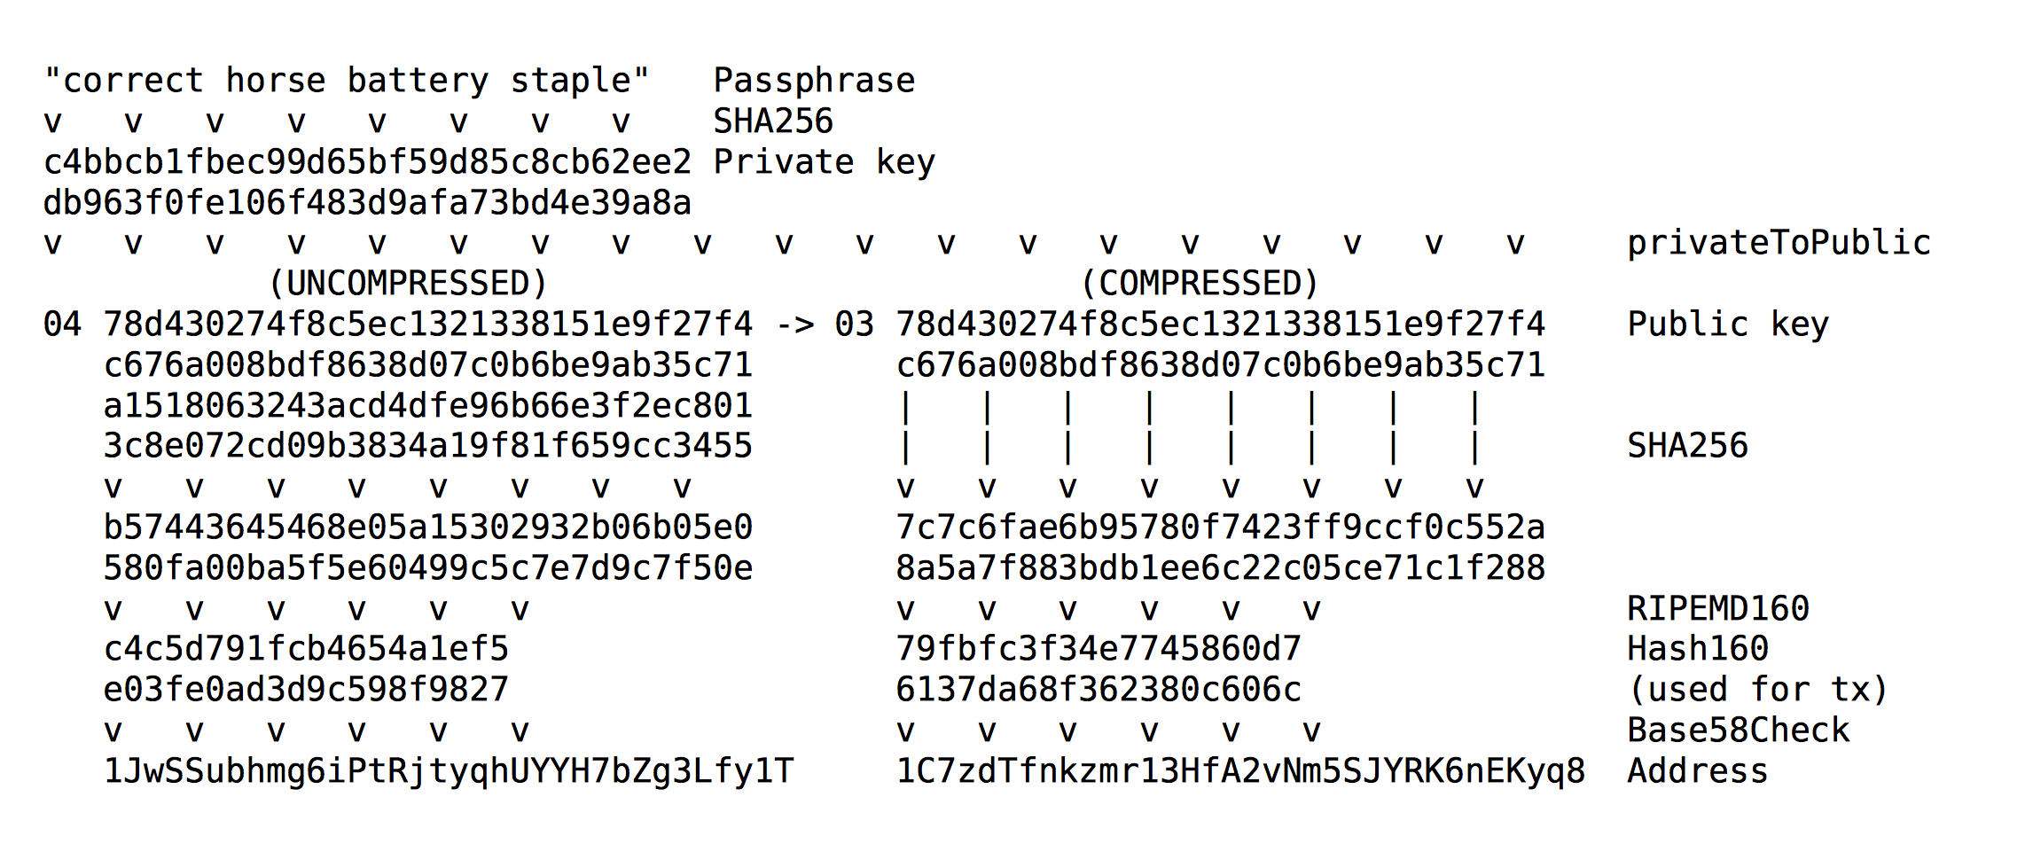
Brain Wallets

Slide 23
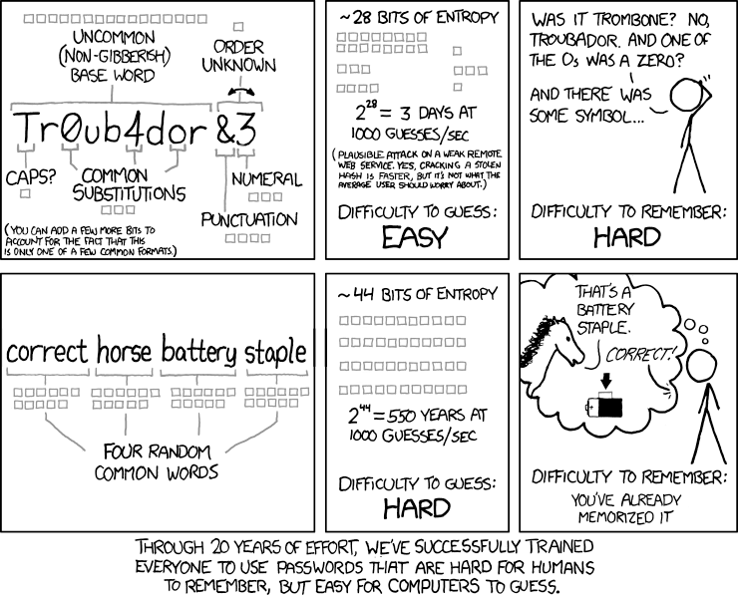

Slide 24
What is wrong here?
All transactions are public
Hash+a guess may give you the private key
Like a LinkedIn leaked password database??
Lots of users have simple passwords!
1000 guesses per seconds?
Defcon 2015, white hat hacker Ryan Castellucci shows his implementation: 130k per seconds
discovered by our students 9 months earlier.
We can do better (EC speed + guessing)!
Thieves in operation!

Slide 25
Speed Improvements
Key generation is based on elliptic curve point multiplication with a fixed point
Attacker needs to generate lots of keys and check against database
Defcon implementation: secp256k1 library
Developed by Bitcoin developers
Amazingly fast for special bitcoin prime, a lot faster than Openssl implementation!
Specific things needed to improve our attack…

Slide 26
Our Approach
Larger pre computation table
known in literature, normally will suggest small window size for real world implementation
As we are working on a specific attack => computation with a larger memory is acceptable
We implemented a flexible window size, attacker can choose based on their memory size

Slide 27
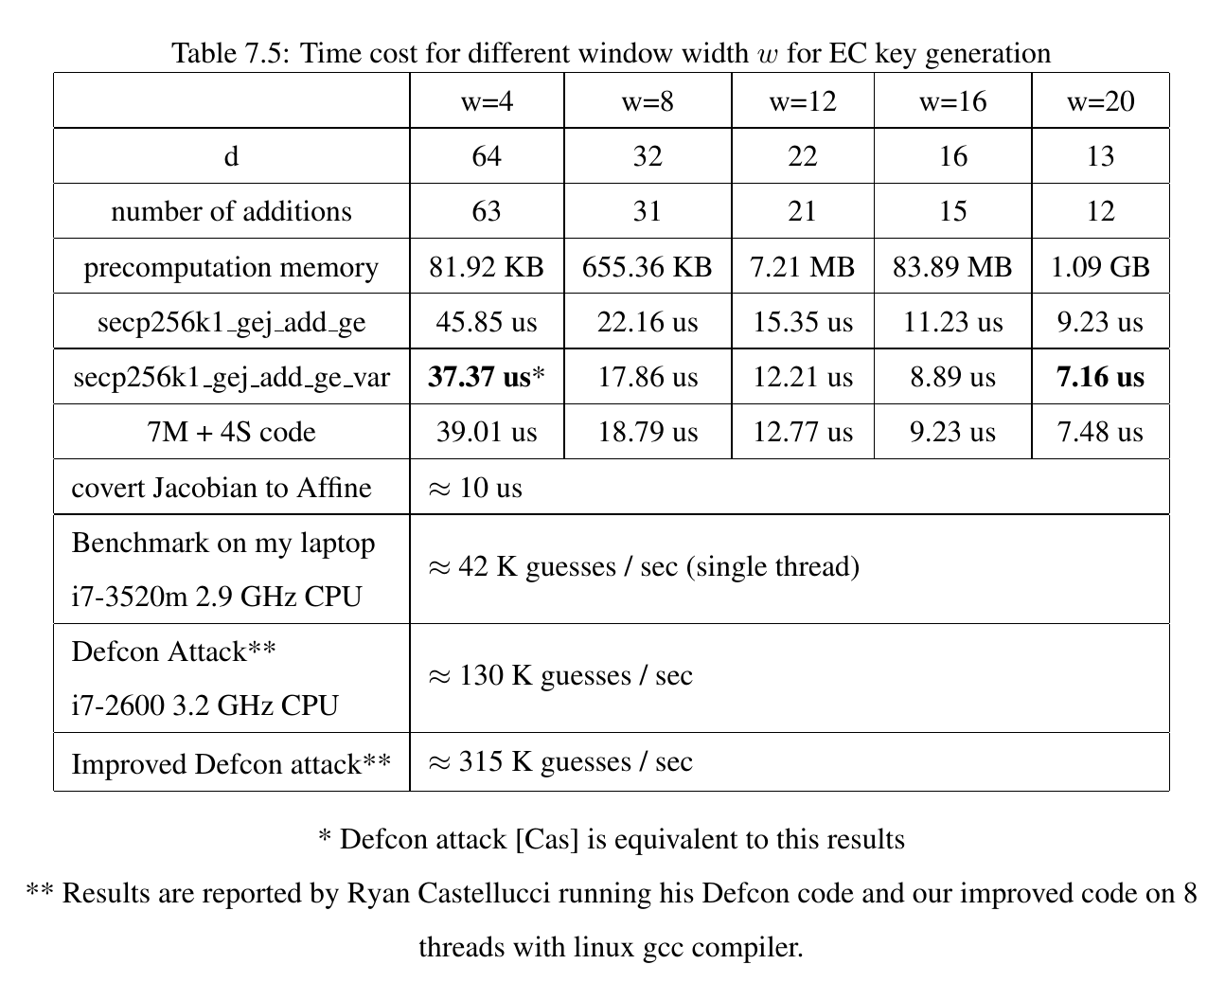

Slide 28
Some Latest Results
Testing on an m4.4xlarge (see https://aws.amazon.com/ec2/instance-types/)
Latest 2.4GHz intel Xeon E5-2676 v3 (Haswell)
brainflayer (reference), 16 processes, average of 5 runs: 219,460 passwords per second
brainflayer (win 20), 16 processes, average of 5 runs: 533,196 passwords per second
brainflayer (win 22), 16 processes, average of 5 runs: 542,884 passwords per second
brainflayer (win 24), 16 processes, average of 5 runs: 556,294 passwords per second
brainflayer (win 24 7M+4S), 16 processes, average of 5 runs: 558,449 passwords per second
19.2 billion passphrases per dollar, $52.02 to check a trillion passphrases.

Slide 29
Some Results
“andreas antonopoulos”
“mychemicalromance9”
“dajiahao”
“hankou”
“yohohoandabottleofrum”
“dudewheresmycar”
“youaremysunshinemyonlysunshine”
“tweetiecakesdiva4lyfe”
“THIS IS IT”
“nothing ventured nothing gained”
“Live as if you were to die tomorrow.
Learn as if you were to live forever.”
“Arnold Schwarzenegger"
“knights of cydonia”
“This is the way the world ends.”
“these aren't the droids you're
looking for”

Slide 30
Disclosure
Our code is currently available online
There is no money inside any address we found
some claimed already stolen
means that hackers run the attack in real time!
Disclosure of results are still under discussion
One possible way: address tag

Slide 31
Open Research Questions
Special multiplier for secp256k => further small speedups expected

Slide 32


Plaintext
Encryption round in the middle
Ciphertext
P1
C1
P2
C2
P3
C3
$$P_{i}$$
$$C_{i}$$
k_{092+095+064+032+065+120+033+100+001+024+002+058+004+049+104}+ ZR1_004_019+ ZR2_005_027+ZR3_005_027

Slide 33


P1
C1
P2
C2
P3
C3
$$P_{i}$$
$$C_{i}$$

Slide 34


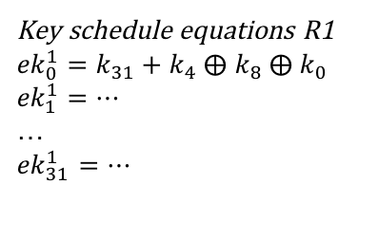
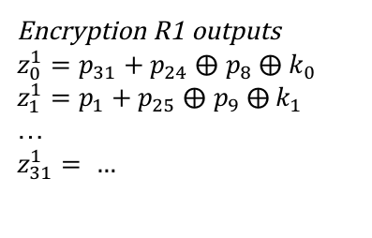
Encryption R1 outputs
$z_{0}^{1}=p_{31}+p_{24} ⨁$ $p_{8} ⨁{ k}_{0}$
$z_{1}^{1}=p_{1}+p_{25} ⨁$ $p_{9} ⨁{ k}_{1}$
…
$$z_{31}^{1}= …$$
Plaintext:
$p_{0},p_{1}$,…, $p_{31}$
Encryption Round 1
Encryption
Round 2
…
Key schedule equations R1
${ek}_{0}^{1}=k_{31}+k_{4} ⨁$ $k_{8} ⨁{ k}_{0}$
$${ek}_{1}^{1}=…$$
…
$${ek}_{31}^{1}=…$$
key:
$k_{0},k_{1}$,…, $k_{31}$
Key schedule
Round 1
Key schedule
Round 2

Slide 35
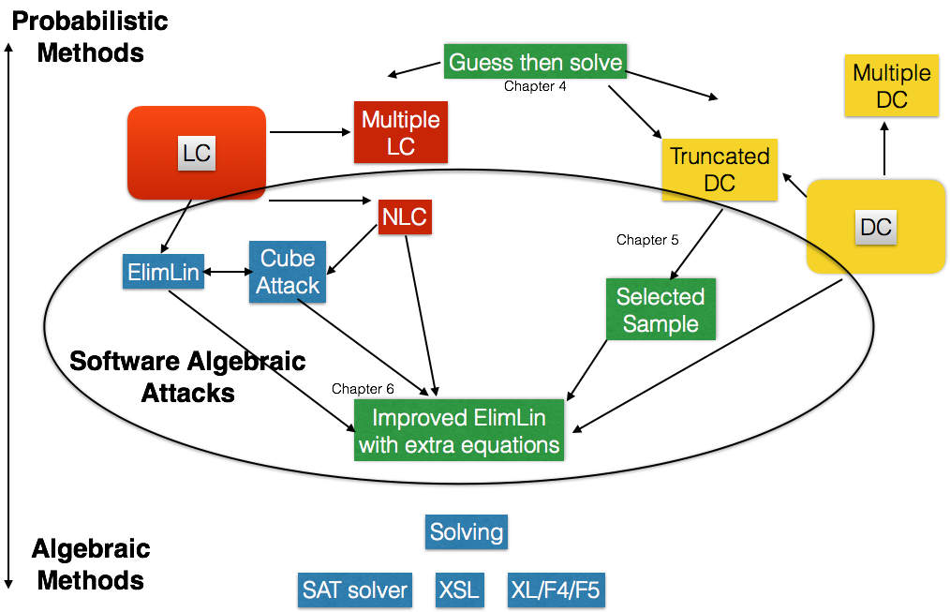

Slide 36
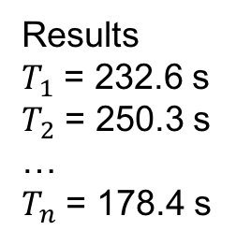
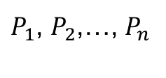
Guess different
set of bits
Results
$T_{1}$ = 232.6 s
$T_{2}$ = 250.3 s
…
$T_{n}$ = 178.4 s
Problem
P
SAT Solver
$P_{1}$, $P_{2}$,…, $P_{n}$

