Slide 1
Agentic Vision Pipeline for Net-Weight Extraction
Using Agentic AI to extract critical numeric data from warehouse label images.
Prepared by: Gayathri Sruthi Gannamaneni

Slide 2
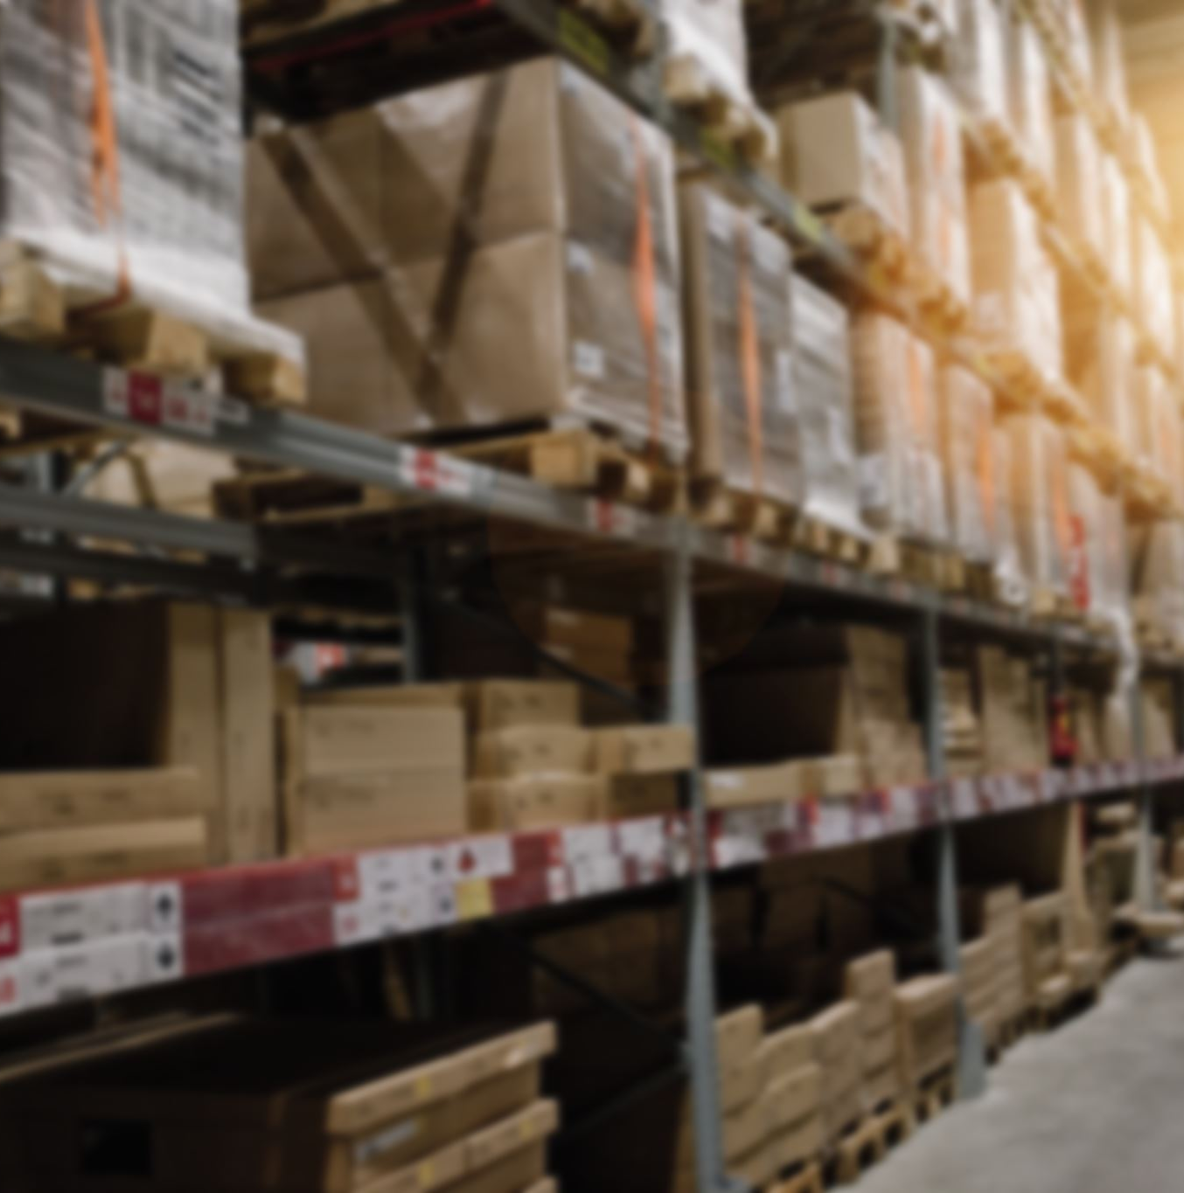
Problem Statement:
Warehouse box labels contain business-critical numeric information, especially net weight.
Image quality varies significantly due to cold-storage and operational conditions.
Traditional OCR struggles with accuracy and reliability in these scenarios.
Objective:
Build an agent-based vision system that:
  Extracts net weight reliably
  Provides confidence-based decisions
  Scales safely across real warehouse environments

Slide 3
What is ADK?
Agent Developer Kit (ADK) is a framework for building and orchestrating AI agents
Open-source agent framework from Google
Language-agnostic (Python, Java, etc.)
Model-agnostic (bring-your-own model)
Deployment-agnostic (local -> cloud)
Designed to build structured agent workflows
Easy to plug different models:
Gemini
Claude

Slide 4
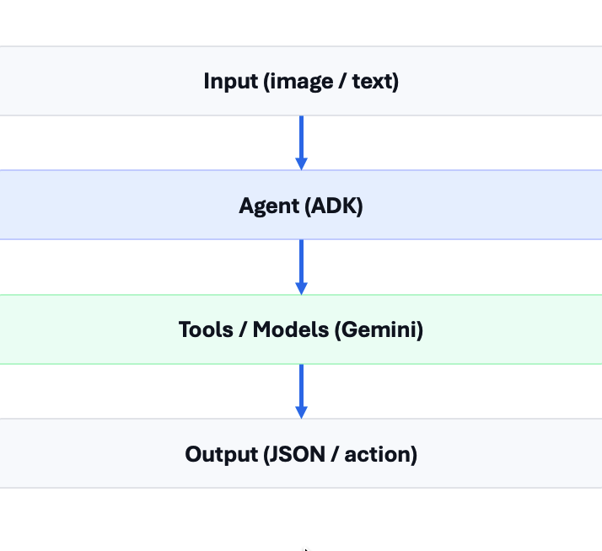
What is an Agent?
Agent = Decision + Action
Input: image
Decide: extract net weight
Act: return JSON / store data

Slide 5
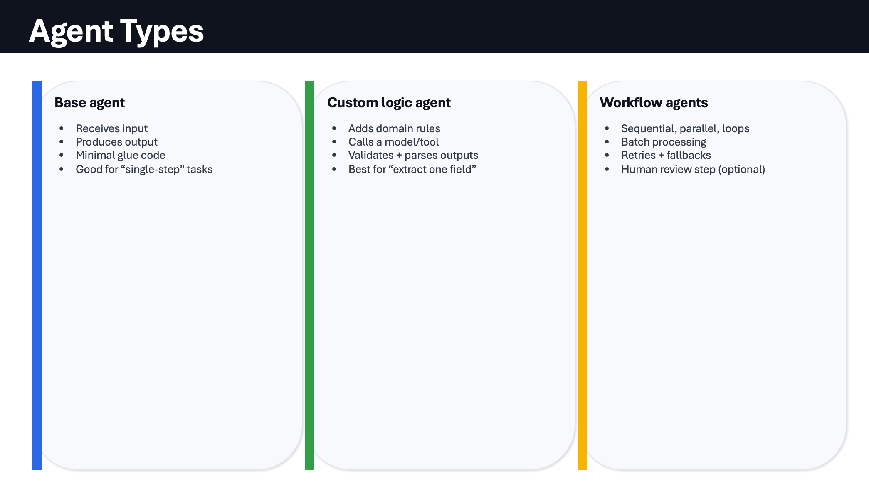

Slide 6
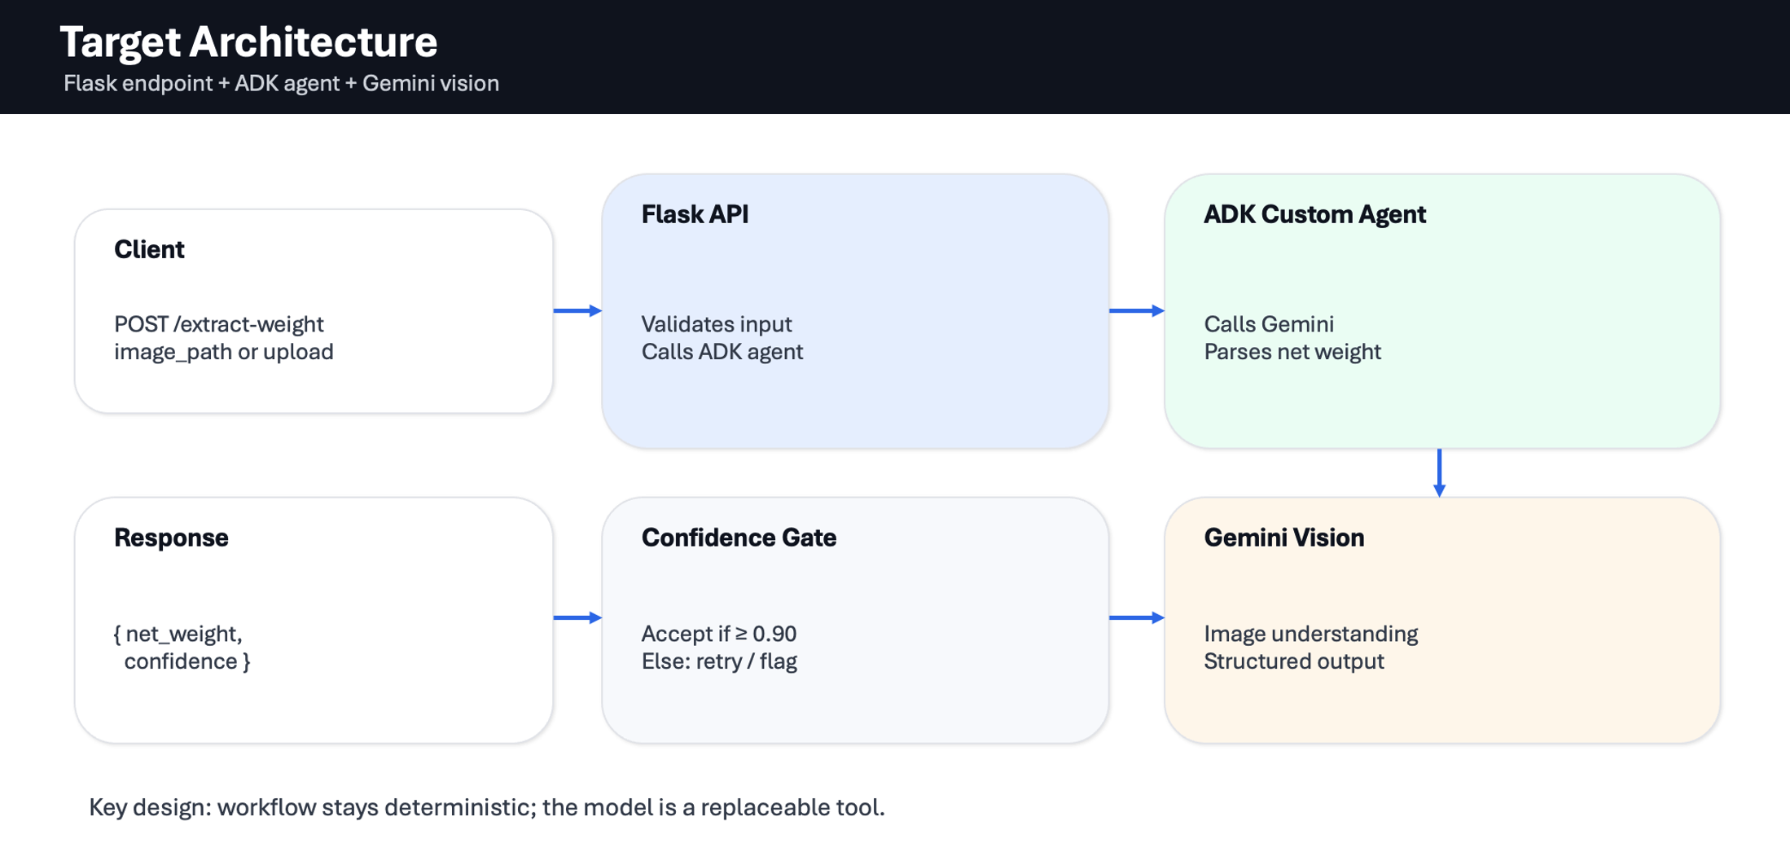

Slide 7
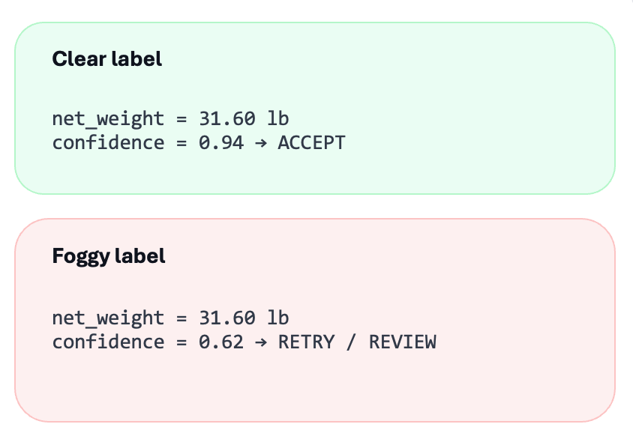
Confidence Threshold (≥ 90%):
Prevents wrong automation when images are foggy.
Decision Policy:
If confidence ≥ 0.90 → accept and return net_weight
If confidence < 0.90 → retry

