Slide 1
Visualize multivariate data
A radar chart approach

Slide 2
Benchmarking national labour market performances - Mosley, Hugh; Mayer, Antje
Usefulness of radar charts
Present multivariate data – Several performance measures
Visualization as performance indicator
Evaluating the performance of all EU member states

Slide 3
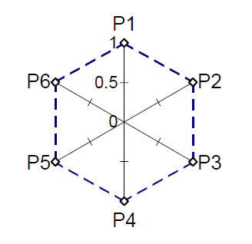
Radar charts
Assess performance on a organizational level (outputs, profitability, productivity)
Four or more axes integrated on a single radial figure
Name for likeness to radar screen – Also called measures matrix or net chart
Useful for visualizing multiple performance measures simultaneously
Possible to compare the same country at different time steps or several countries in the same graph

Slide 4
Radar charts - Data
Same scale for all measures
Standardize each measure to be between 1 and 0
Best performer = 1, worst performer = 0
Example: If the lowest unemployment rate is 5 %, the standardized value = 1. If the highest unemployment rate is 15 %, the standardized value = 0. An unemployment rate of 10 % then gets the value 0.5.
Selection of appropriate measures
Interpretation of the surface area
Affected by values and by sequence
Surface area of the polygon (SMOP) for different combinations

Slide 5
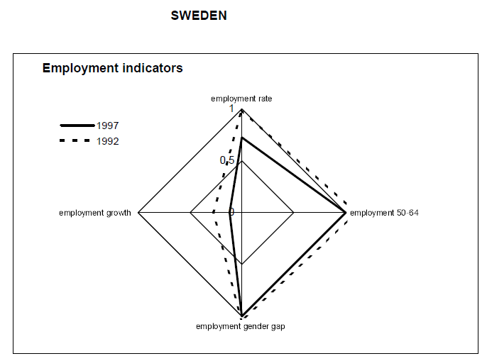
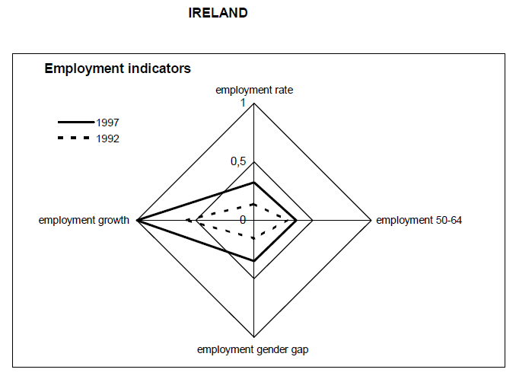
Results

Slide 6
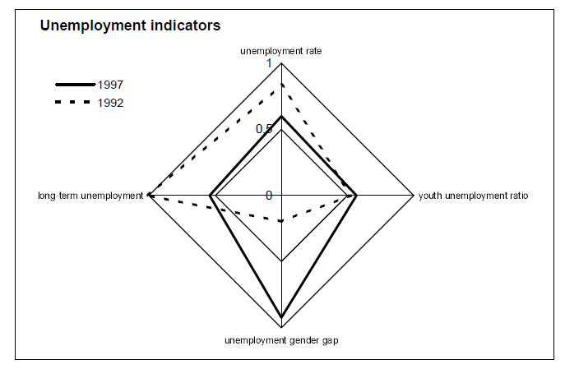
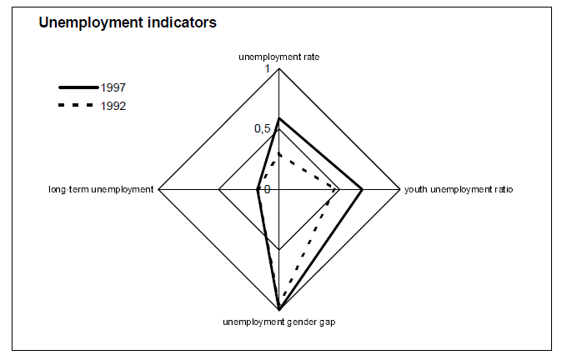
Sweden
Ireland

Slide 7
Are radar charts useful for benchmarking national labour market performance?
Intuitive overview of national performances
Performances on multiple measures and over time
Important to handle methodological issues well

