Slide 1
COLLEGE NAME: Ashoka Women’s Engineering College
DEPARTMENT: Electrical and Electrical Engineering
TITLE: Online Payments Fraud Detection Using Machine Learning
Submitted by: G. Supraja
Under the Guidance of: Mrs. Hari Priya
Academic Year:2025-2026

Slide 2


Slide 3
Introduction
Online payments are increasing rapidly worldwide.
Fraudulent transactions cause huge
financial losses.
Manual fraud detection is difficult and time-consuming.
Machine Learning helps in automatic fraud detection.

Slide 4
Problem Statement
Detect fraudulent transactions in online payment systems.
Classify transactions as:
Legitimate (0)
Fraudulent (1)
Improve security and reduce financial risks.

Slide 5
Project Objectives
Build a Machine Learning model for fraud detection.
Perform data preprocessing and feature scaling.
Train and test the model using transaction data.
Deploy the model using Flask web application.

Slide 6
Technologies Used
Python
Pandas
NumPy
Matplotlib / Seaborn
Scikit-learn
Flask
Bootstrap

Slide 7
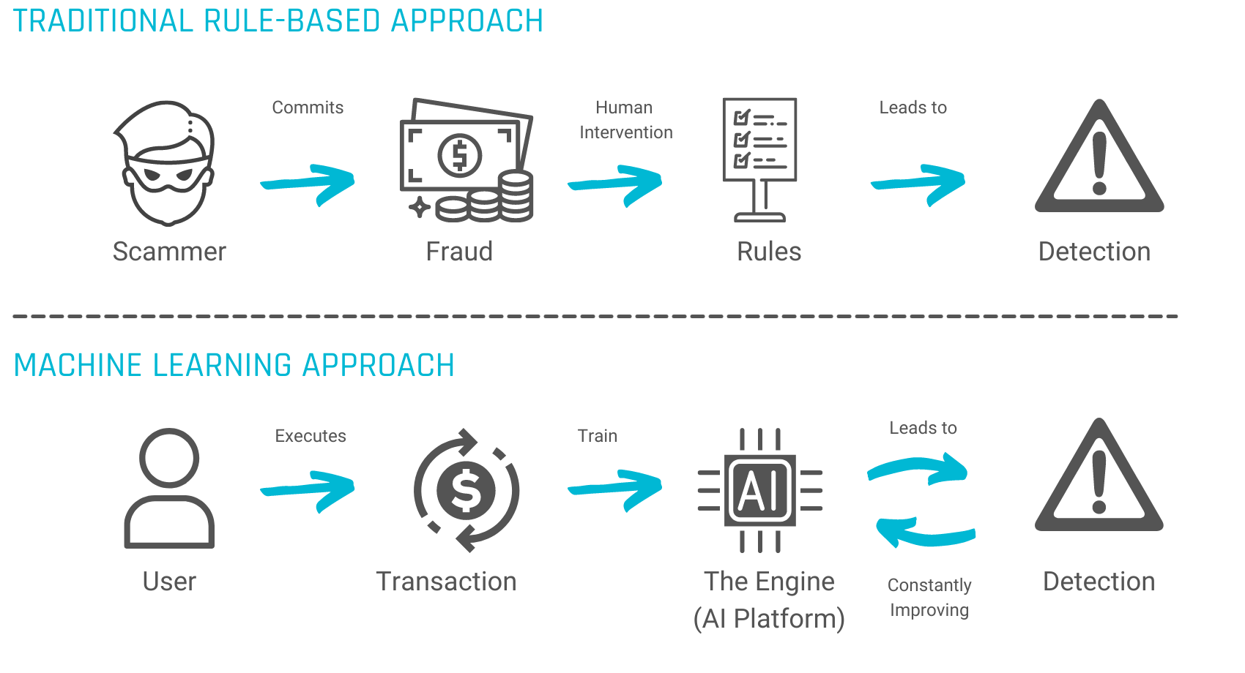

Slide 8
Dataset Information
Credit Card Transaction Dataset
Contains transaction details such as:
  Time
  Amount
  V1 to V28 features
Target Variable:
  Class = 0 (Normal)
  Class = 1 (Fraud)

Slide 9
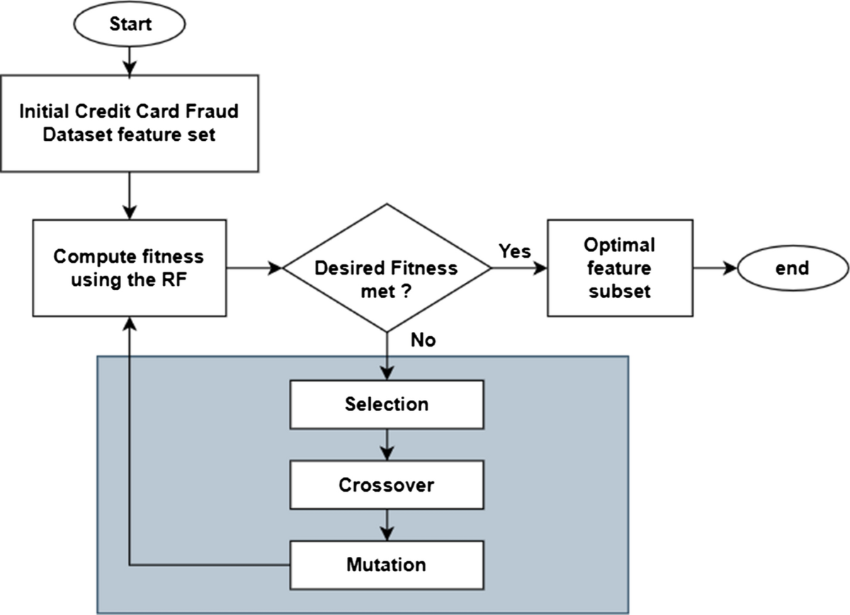

Slide 10
Data Preprocessing
Checked for missing values
Performed feature scaling using Standard Scaler
Split dataset into:
  80% Training Data
  20% Testing Data
Balanced dataset if required

Slide 11
Exploratory Data Analysis
Analyzed fraud vs normal transaction Distribution
Visualized transaction amount distribution
Observed fraud patterns in dataset
Model Building
Algorithm Used: Logistic Regression
Trained model using training data
Predicted results on test
data Saved model using Pickle

Slide 12
Model Evaluation
Accuracy Score
Confusion Matrix
Precision
Recall
F1-Score
These metrics help evaluate model performance.
System Architecture
1.User enters transaction details
2. Data sent to ML model
3. Model predicts fraud or legitimate
4. Result displayed on web application

Slide 13
Results
Model successfully detected fraudulent transactions
Improved security of online payments
Reduced financial losses

Slide 14
Future Enhancements
Implement Random Forest or XGBoost
Use Deep Learning models
Real-time fraud monitoring system
Deploy on cloud platforms

Slide 15
Conclusion
Machine Learning improves fraud detection accuracy.
Helps financial institutions prevent fraud.
Ensures secure and trustworthy online transactions.

