Slide 1
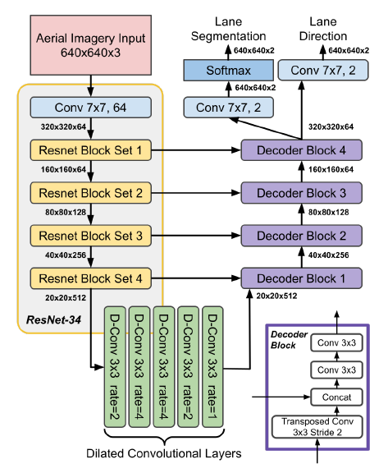

Slide 2
x, _, _ = common.create_conv_layer('enc_1', x, ch_in=3, (ch=64)*2, kx = 7, ky = 7, stride_x = 2, stride_y = 2, is_training = is_training = True, batchnorm = False)
def create_conv_layer(name, input_tensor, in_channels, out_channels, is_training = True, activation='relu', kx = 3, ky = 3, stride_x = 2, stride_y = 2, batchnorm=False, padding='VALID', add=None, deconv = False, dilation = 1, nopadding = False):

