Slide 1
Presentation title
Jon Herman

Slide 2
DWR estimates daily full natural flows (~unimpaired) for the basins along the Sacramento and San Joaquin rivers

Slide 3
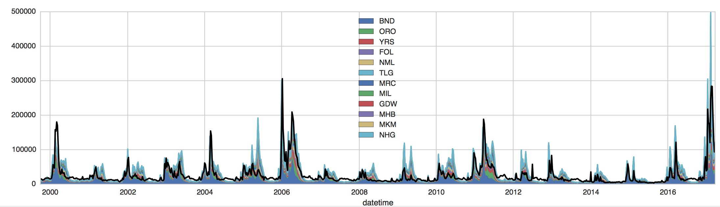
In winter months (flows too high to store), the sum of FNF lines up well with observed Delta inflow
(stations here: http://cdec.water.ca.gov/cgi-progs/staSearch?sta=&sensor_chk=on&sensor=8)

Slide 4
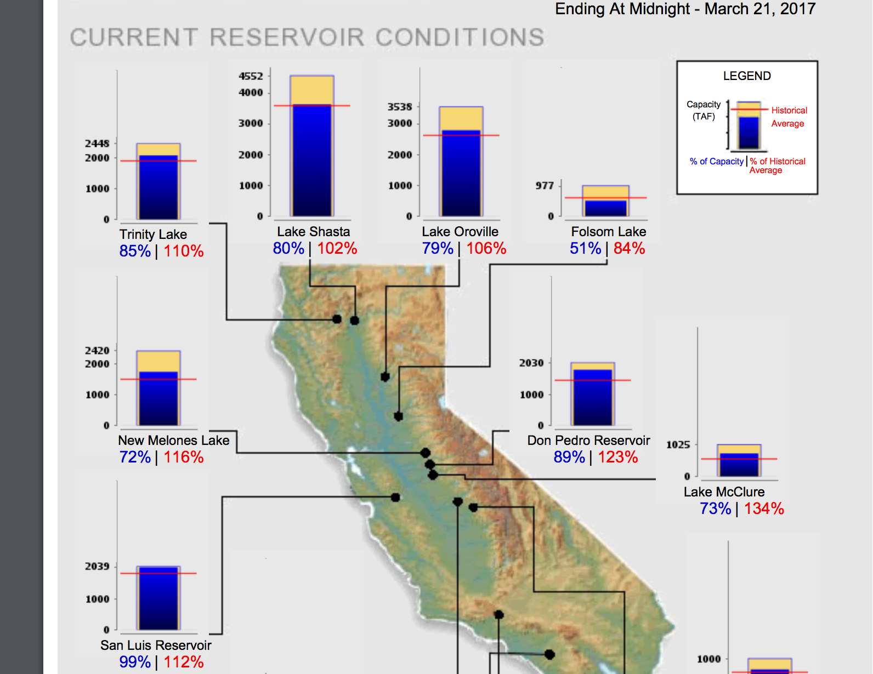
We’re focusing on Shasta, Oroville, Folsom reservoirs
Propose to use WRF streamflow from the other basins as “unimpaired flows” (additional gains into Delta)
Reason, we want to start from the inflows that Tamlin’s group develops without any other assumptions that only work in the historical scenario.
We can also use the FNF data to calculate water year type and 8RI

Slide 5
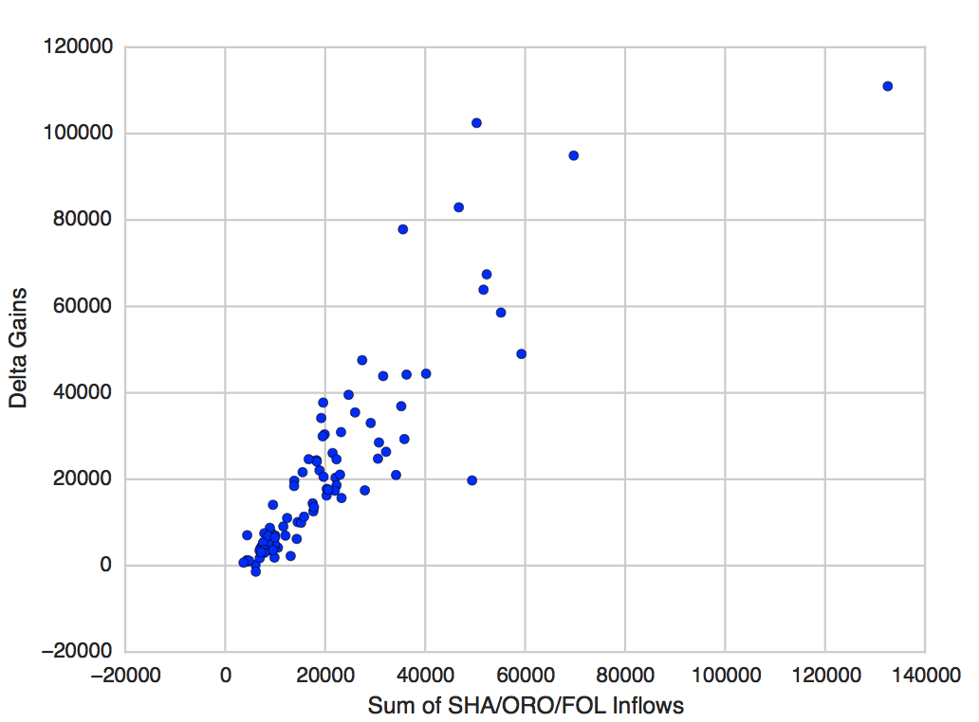
Or a simpler way using only the 3 inflows
All of the basins’ inflows are highly correlated, and so are their operations
In winter (Nov-Mar) assume gains into the Delta are equal to the sum of SHA/ORO/FOL inflows

Slide 6
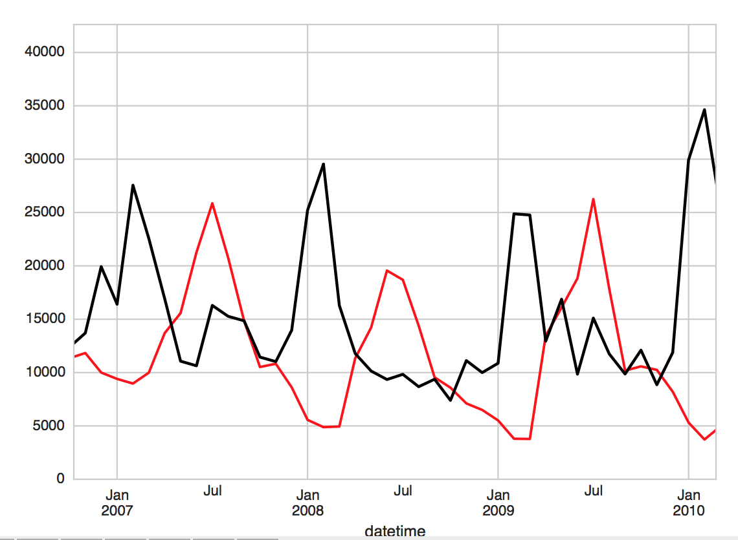
Diversions in summer
Some releases from SHA/ORO/FOL are consumed before reaching the Delta (Apr-Oct)
Assume this value is 0.5* the releases

Slide 7
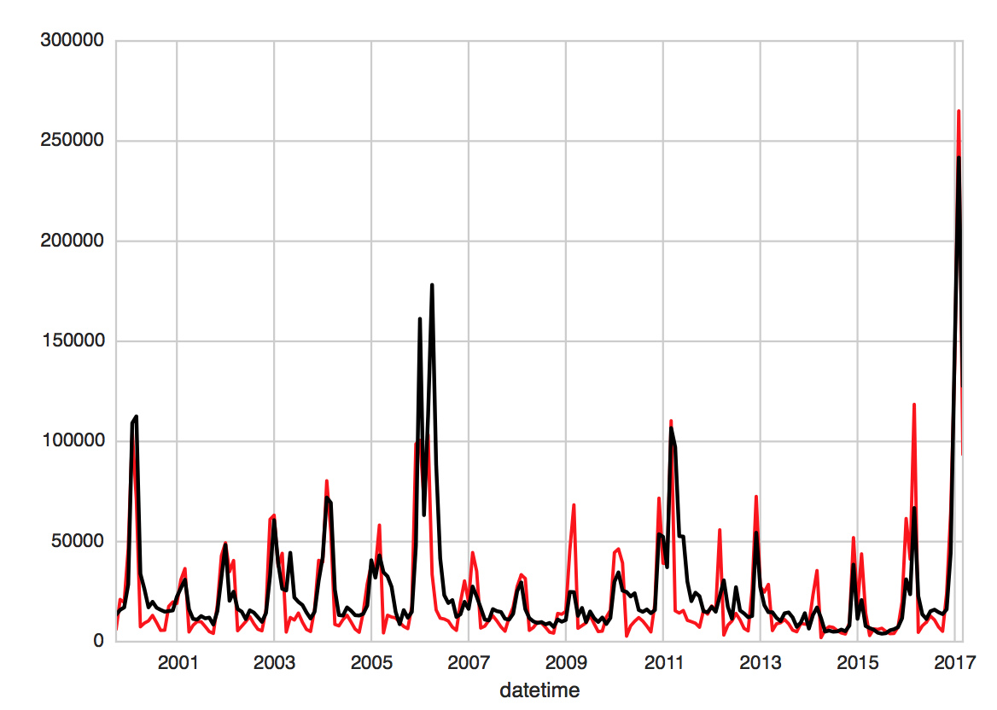
Does it work
Pretty well, with a few outliers. In terms of water supply it’s good enough.
(black = observed delta inflows; red = predicted)

