Slide 1
AirBnB Prices and The Prices Of Houses In The Various Cities

Slide 2
INSTRUCTIONS FOR USE
The Question
Does the Price of houses in a particular city have a direct correlation to the price of AirBnB ?

Slide 3
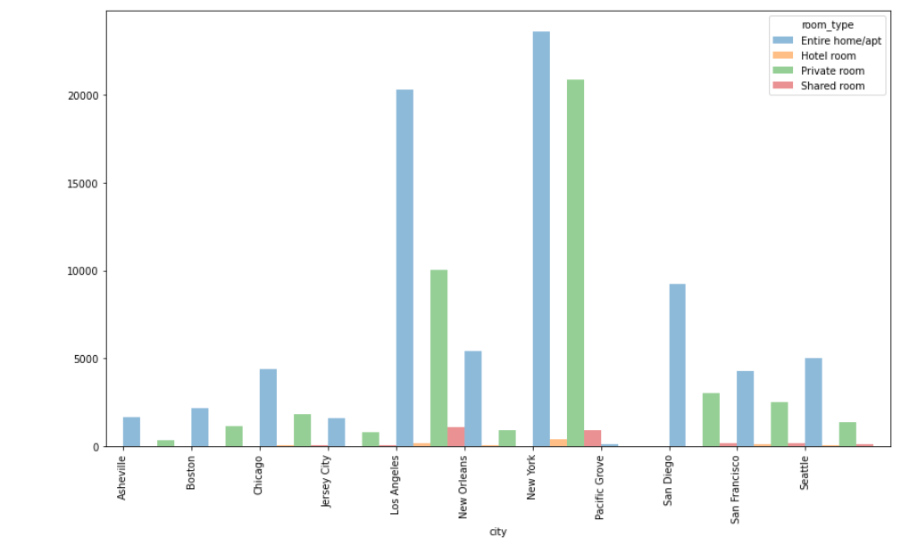
Airbnb Room Types
Notes:
Entire home/apt - Majority / shared room- least(LA & New York)

Slide 4
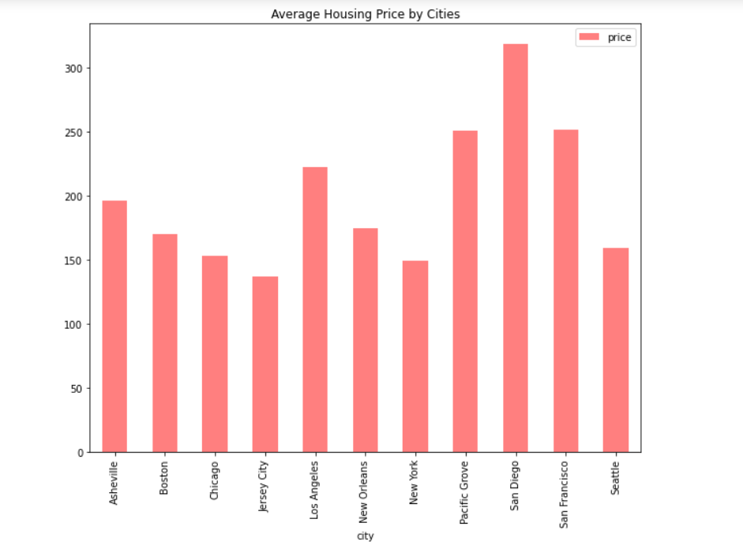
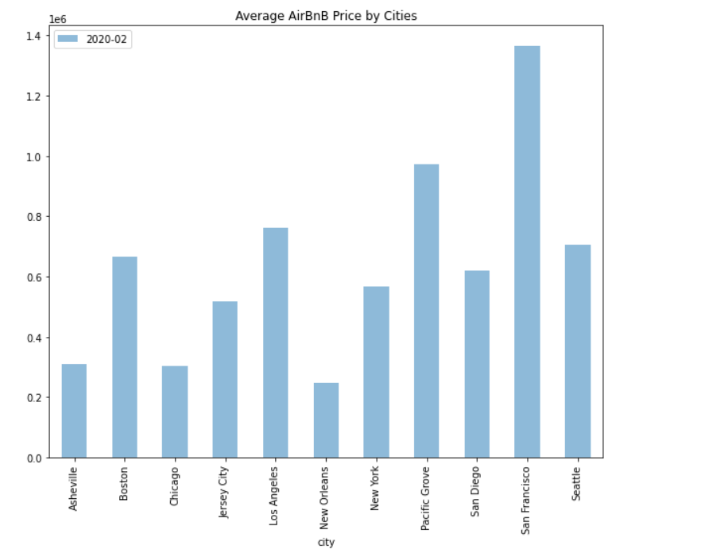

Slide 5
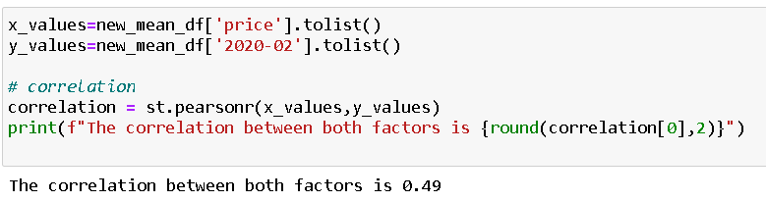
Do Housing Prices in Each City Correlate to the Prices of AirBnB
Notes:
Mid Correlation

Slide 6
THE END

