Slide 1
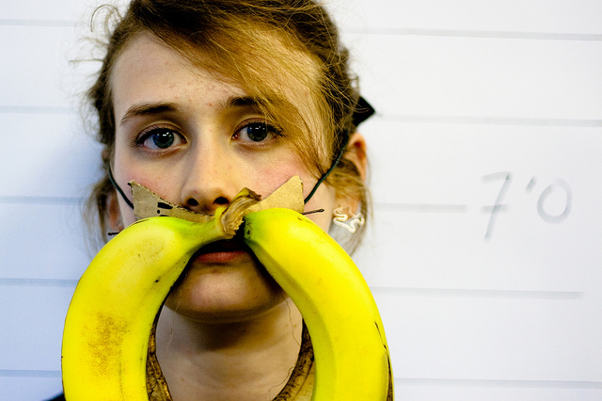
AI System
bananas
What is the mustache made of?

Slide 2

What is the mustache made of?
AI System
bananas

